Slide 1
Evan Baker
EAB_Project1
2 March 2014
% Evan Baker
% EAB_PROJECT1
% 2 April 2014
function TrussSolve
% This function will read in truss data files and do some simulations
clc
close all
figure(1)
hold on
multiplier = input('Displacement visualisation multiplier(recommend 10000):');
dataFiles = {'nodes';'elements';'lbc'}; % Make an array of the filenames we want to get
for i = 1:3
% Loop over the filename array
eval([dataFiles{i} ' = getData(dataFiles{i});']); % Prompt the user to grab the files we want
end
for i = 1:length(lbc(:,1));
% Do an error check on lbc.dat to make sure a later function will work
if lbc(i,1) ~= i; % Make sure the nodes in lbc.dat are in ascending order
error('Nodes are out of order in lbc.dat.')
return % Terminate if lbc isn't structured properly
end
end
plot(nodes(:,1),nodes(:,2),'bo'); % Plot the nodes
axis([min(nodes(:,1))-1, max(nodes(:,1))+1, min(nodes(:,2))-1, max(nodes(:,2))+1]); % Get a little room in the graph
labels = cellstr( num2str([1:length(nodes(:,1))]')); % Make a labels array for numbering the graph
text(nodes(:,1),nodes(:,2),labels,'VerticalAlignment','bottom','HorizontalAlignment','right'); % Put label text on graphs
for element = 1:length(elements(:,1)) % Do per element location/direction calculations
[x(element,:), y(element,:)] = getElementsXY(element,elements,nodes); % Store x, y coordinate vectors for the ends of the elements
plot(x(element,:),y(element,:)); % Plot the element vectors
end
labels2 = cellstr( num2str([1:length(elements(:,1))]')); % Make a labels array for numbering the elements
text(.5*(x(:,1)+x(:,2)),.5*(y(:,1)+y(:,2)),labels2,'VerticalAlignment','bottom','HorizontalAlignment','right'); %Put label text on graph
v = [x(:,2) - x(:,1),y(:,2) - y(:,1)]; % Get vector v, the element origin vectors
elementAngles = atan2(v(:,2),v(:,1)); % Get the angle of every element to the +x axis in radians
elementLengths = sqrt((v(:,1)).^2 + (v(:,2)).^2); % Calculate the element lengths from the endpoints
SSM = zeros(2*length(nodes(:,1))); % Prealloc an empty system stiffness matrix
for element = 1:length(elements(:,1)) % Do element and system stiffness calculations
% Make ESM#, the numbered element stiffness matrix.
eval(['ESM' num2str(element) ' = elementStiffnessMatrix(elements,elementLengths,element,elementAngles(element));']);
% Composite the ESMs into SSM, the system stiffness matrix
SSM = SSM + compositeSystem(elements,element,nodes,eval(['ESM' num2str(element)']));
end
constrainedState = zeros(1,2*length(nodes(:,1))); % Prealloc some vectors
forceApplied = zeros(2*length(nodes(:,1)),1);
displacementVarCount = 1:2*length(nodes(:,1));
for node = 1:length(nodes(:,1));
for i = 1:2
% Make a vector [x1 y1 x2 y2...] with 1 (true) if constrained, 0
% (false if not constrained per element per direction
constrainedState(2*node-2+i) = lbc(node,i+1);
% Put the loads in a similar vector to constraints above
forceApplied(2*node-2+i,1) = lbc(node,i+3);
end
end
for i = 2*length(nodes(:,1)):-1:1; % Remove rows and columns from the SSM and the force solution matrix
if constrainedState(i) == 1;
SSM(i,:) = []; % Remove rows/columns of constrained elements
SSM(:,i) = [];
forceApplied(i,:) = []; % Remove loads on constrained elements
displacementVarCount(i) = []; % Keep track of which elements' displacement we're solving for
end
end
displacement = (SSM\forceApplied); % FINALLY do the displacement calculation
nodesDisplaced = nodes'; % We want to count, and matlab linear indexes in the wrong direction so invert
for i = 1:length(displacementVarCount)
% Build a displaced node matrix
nodesDisplaced(displacementVarCount(i)) = nodesDisplaced(displacementVarCount(i)) + multiplier*displacement(i);
end
nodesMoved = nodesDisplaced'; % Flip the new node position matrix back into usable form
for element = 1:length(elements(:,1)) % Do per element location/direction calculations
[xMoved(element,:), yMoved(element,:)] = getElementsXY(element,elements,nodesMoved); % Store new x, y coordinate vectors for the ends of the elements
plot(xMoved(element,:),yMoved(element,:),'r'); % Plot deformed element vectors
end
plot(nodesMoved(:,1),nodesMoved(:,2),'ro'); % Plot moved nodes
nodes
displacement
displacementVarCount
nodesMoved
end
function [m] = getData(str)
% Prompt user to load a *.dat file of filename $str, return matr m with
% file contents.
[filename, pathname] = uigetfile({strcat(str,'*.dat'),'Truss Data'},'Select File');
absPath = strcat(pathname,filename); % Make an absolute path to make sure we grab the file properly
m = load(absPath); % Load the contents of the file into matrix m
end
function [x, y] = getElementsXY(element,elements,nodes)
% Take the elements matr, the element variable, and the nodes matr
% Return the vectors of the elements as x, y
x = [nodes(elements(element,1),1), nodes(elements(element,2),1)]; % x vector
y = [nodes(elements(element,1),2), nodes(elements(element,2),2)]; % y vector
end
function [esm] = elementStiffnessMatrix(elements,elementLengths,element,angle)
% Make the element stiffness esm matrix given elements matr, elementLength, the
% element we're interested in, and the angle of it to the horizontal.
esm = ((elements(element,3)*elements(element,4))/elementLengths(element)).*[...
cos(angle)^2,cos(angle)*sin(angle),-cos(angle)^2,-cos(angle)*sin(angle);...
cos(angle)*sin(angle),sin(angle)^2,-cos(angle)*sin(angle),-sin(angle)^2;...
-cos(angle)^2,-cos(angle)*sin(angle),cos(angle)^2,cos(angle)*sin(angle);...
-cos(angle)*sin(angle),-sin(angle)^2,cos(angle)*sin(angle),sin(angle)^2;...
];
end
function [ssm] = compositeSystem(elements,element,nodes,esm)
% Take an esm of size 4x4, make a dummy system stiffness matr, take elements matr,
% nodes matr, and the element of interest. Fill the dummy ssm appropriately
% and return it.
ssm = zeros(2*length(nodes(:,1)));
startNode = elements(element,1);
endNode = elements(element,2);
map = [2*startNode-1,2*startNode,2*endNode-1,2*endNode];
for i = 1:4
for j = 1:4
ssm(map(i),map(j)) = esm(i,j);
end
end
end
The purpose of this project is to code a truss solver that will take an input of three files – nodes, elements, and lbc – that contain the node locations, the element node connections, cross sectional areas, and young’s modulus, and the loads and boundary constraints.
The function will then simulate the loading of the struss and will solve for the node displacements and graph an unloaded and a deformed truss simultaneously. The deformations are extremely small so a deformation multiplier is used.

Slide 2
Instructions to run:
Run >>TrussSolve.m
Follow the prompts.
Files must be named nodes.dat, lbc.dat, elements.dat or some numbered variation of this.

Slide 3
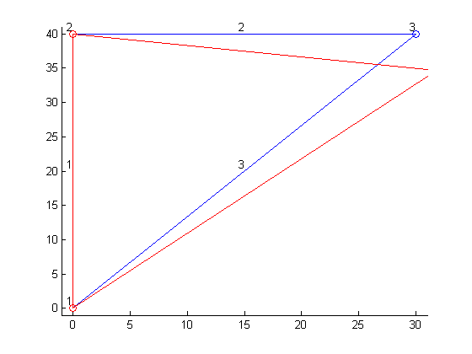
Problem 1:
% lbc.dat
% Loads and Boundary Conditions
% $node $xconstrained $yconstrained $loadinx $loadiny
% Positive is up, right, constrain states are true/false 1/0
1 1 1 0 0
2 1 0 0 0
3 0 0 0 -1000
% Nodes.dat
% Measured from bottom left corner
% In inches $xpos $ypos
0 0
0 40
30 40
% Elements.dat
% Identified by end nodes
% $end1 $end2 $area $modulus
1 2 .04 1e7
2 3 .03 1e7
1 3 .05 1e7
>>TrussSolve
Displacement visualisation multiplier(recommend 5 for 1, 100 for 2):5
nodes =
0 0
0 40
30 40
displacement =
0
0.0750
-0.2125
displacementVarCount =
4 5 6
nodesMoved =
0 0
0 40.0000
31.8750 34.6875

Slide 4
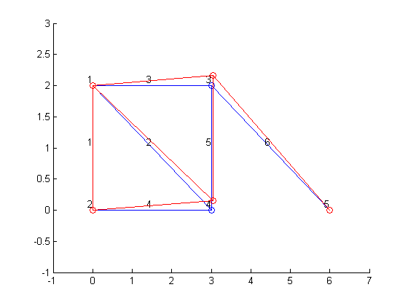
Problem 1:
% lbc.dat
% Loads and Boundary Conditions
% $node $xconstrained $yconstrained $loadinx $loadiny
% Positive is up, right, constrain states are true/false 1/0
1 1 1 0 0
2 1 1 0 0
3 0 0 0 450
4 0 0 0 0
5 1 1 0 0
6 0 0 0 0
% Nodes.dat
% Measured from bottom left corner
% In meters $xpos $ypos
0 2
0 0
3 2
3 0
6 0
% Elements.dat
% Identified by end nodes
% $end1 $end2 $area $modulus
1 2 1.29e-3 2e11
1 4 1.29e-3 2e11
1 3 1.29e-3 2e11
2 4 1.29e-3 2e11
4 3 1.29e-3 2e11
3 5 1.29e-3 2e11
>>TrussSolve
Displacement visualisation multiplier(recommend 5 for 1, 100 for 2):100
nodes =
0 2
0 0
3 2
3 0
6 0
displacement =
1.0e-04 *
0.0413
0.1693
0.0372
0.1528
displacementVarCount =
5 6 7 8
nodesMoved =
0 2.0000
0 0
3.0413 2.1693
3.0372 0.1528
6.0000 0

Slide 5
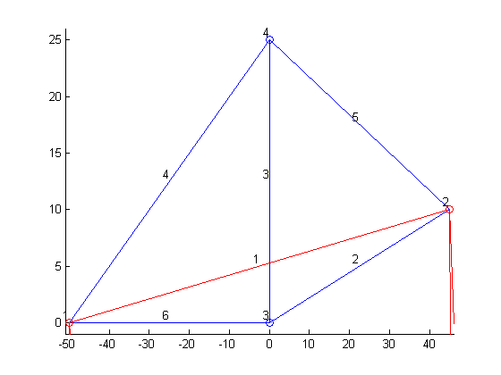
Problem 3:
% lbc.dat
% Loads and Boundary Conditions
% $node $xconstrained $yconstrained $loadinx $loadiny
% Positive is up, right, constrain states are true/false 1/0
1 1 1 0 0
2 1 1 0 0
3 0 0 0 -100
4 0 0 0 0
5 0 0 0 0
% Nodes.dat
% Measured from bottom left corner
% In meters $xpos $ypos
-50 0
45 10
0 0
0 25
% Elements.dat
% Identified by end nodes
% $end1 $end2 $area $modulus
1 2 0.1 10^7
2 3 0.1 10^7
3 4 0.1 10^7
1 4 0.1 10^7
2 4 0.1 10^7
1 3 0.1 10^7
>>Displacement visualisation multiplier(recommend 5 for 1, 100 for 2):1
nodes =
-50 0
45 10
0 0
0 25
displacement =
1.0e+04 *
0.2067
-1.8301
0.0400
-1.6030
displacementVarCount =
5 6 7 8
nodesMoved =
1.0e+04 *
-0.0050 0
0.0045 0.0010
0.2067 -1.8301
0.0400 -1.6005
>>
So, it looks like this truss failed. However, we have no failure check so it’s impossible to say really.

