Slide 1
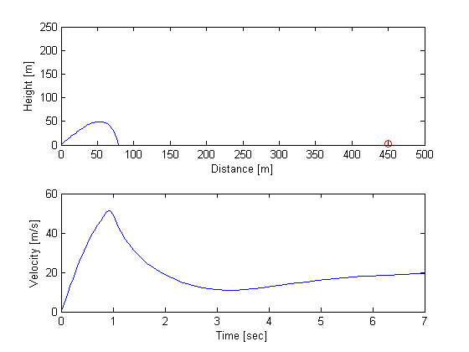
Evan Baker
EAB_Project2
30 April 2014
Test parameters:
Burn 0:1
Burnrate 0.1
Launch Angle 85
SimTime 7 (Coded as an option specifically for this example).
Results:
Final x = 79.6310
Final y = -3.2670
Time elapsed = 7
Fuel burned = 0.100
The object of this project was to build a rocket simulation to calculate the flight path of a rocket assisted basketball shot from Gavett to Georgen.
There is a coded basket check that will display success. This is calculated as:
y(basketleadingedge) >= basketheight + ballradius
&& y(baskettrailingedge-ballradius) <= basketheight
However, this fails if the angle of approach is too steep and the trajectory never reaches the back of basket check. For shallow enough angle through the basket, it works.
This code calculates the wet weight by the burn time and burn rate, and simulates by default for 10*burn time, so simTime is not an accurate measure of time-to-basket
An attempt was made to manually optimize according to fuel consumption.
An attempt was also made to write an optimizer, however the increment resolution required made it prohibitively slow, and the flaky basket success check did not record successful values and made the results unreliable.

Slide 2
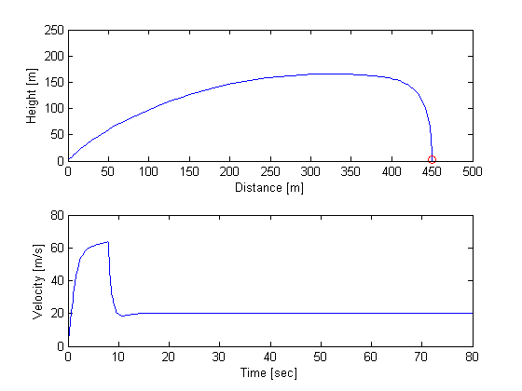
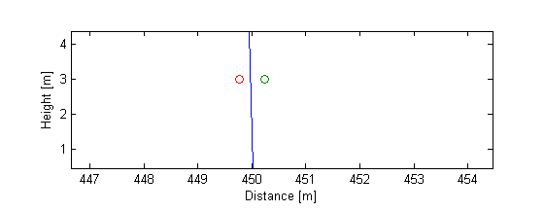
To remain extensible and avoid cluttering a single script (the idea was to write an optimizer) this code was written as several scripts which were called as necessary.
For successful execution, rocketdriver.m, buildObjects.m, controlpanel.m, launchrocket.m are required to be in the same dir. controlpanel.fig is required for the gui to render.
Optimized parameters found were:
Burn 0:8
Burnrate .1
Launch Angle 89.699
Which give a fuel load of .800
Basket confirmation had to be performed manually by zooming in on the plot where the trajectory and basket bounds are both plotted.
The terminal velocity of the basketball
appears to be 20 m/s.
Basket Check:

