Slide 1


CSA1717-ARTIFICIAL INTELLIGENCE
CAPSTONE PROJECT PRESENTATION
On
AI-Based Intelligent Maze Navigation and Optimal Path Planning System
GUIDE BY
Dr.M.ANOOP
DONE BY
ATHIN SIVA S (192524237)
M.VIDYADHAR(192511467)
KUSHAL KUMAR(192524068)
1

Slide 2

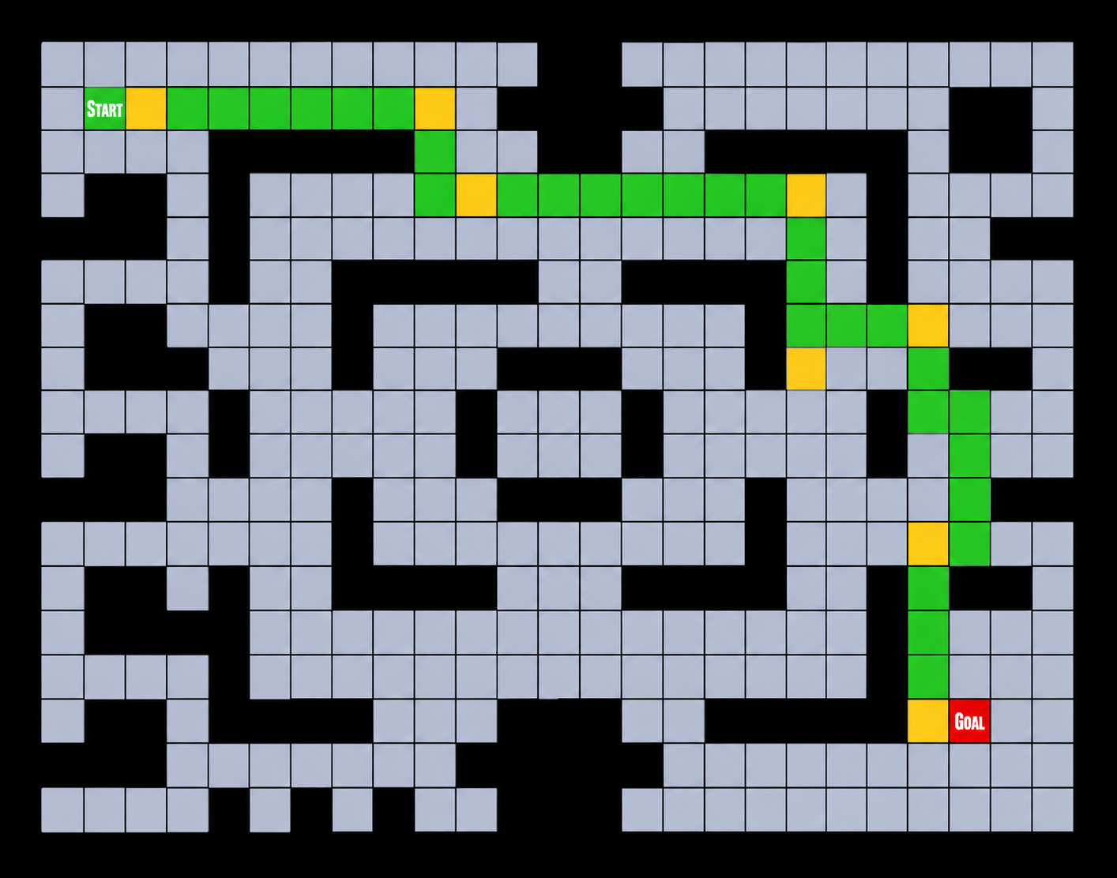
Abstract
The AI-Based Intelligent Maze Navigation and Optimal Path Planning System is an Artificial Intelligence-based solution designed to navigate through maze environments efficiently and identify the shortest and safest path from a starting point to the destination. The system generates maze environments, maps them into a searchable grid, detects obstacles, and uses the A* search algorithm to calculate an optimal route. By combining intelligent pathfinding with obstacle detection and visualization, the system provides faster and more accurate navigation compared with traditional brute-force methods. The proposed system is implemented using Python, with libraries such as NumPy, Matplotlib, and Pygame, and can be applied to autonomous robots, warehouse automation, self-driving vehicles, drones, search-and-rescue systems, and smart logistics.

Slide 3





Introduction
Maze navigation is a core problem studied in Artificial Intelligence.
AI enables autonomous agents to move through space intelligently.
The system computes the shortest and safest route through the maze.
AI Agent
navigating a dynamic maze
using intelligent search
Intelligent search algorithms drive real-time decision-making.
Real-world use spans robotics, automation, and self-driving vehicles.
2

Slide 4


Problem Statement
Traditional maze-solving methods are computationally inefficient.
Traditional Method
• Slow, brute-force search
Complex mazes sharply increase processing time.
• No adaptability
• High computation cost
Dynamic obstacles make real-time navigation difficult.
Manual path planning lacks adaptability to change.
AI-Based Navigation
• Fast, informed search (A*)
AI-based navigation provides an optimal, adaptive solution.
• Adapts to obstacles
• Optimized computation
3

Slide 5




Objectives
Design an intelligent maze navigation system
Generate maze environments programmatically
Find the shortest path using A* search
Detect and avoid obstacles in real time
Improve overall navigation efficiency
Visualize navigation results clearly
4

Slide 6
System Architecture
User Input
Pipeline Overview
Maze Generation
User provides maze size and settings as input.
Environment Mapping
System generates a valid maze environment.
AI Pathfinding Engine
Environment is mapped into a searchable grid.
Obstacle Detection
The AI Pathfinding Engine computes an optimal route using A* search.
Optimal Path Planning
Obstacles are detected and the path is updated dynamically.
The optimal path is finalized and rendered visually.
Visualization
Performance metrics such as time and path length are analyzed.
Performance Analysis
5

Slide 7
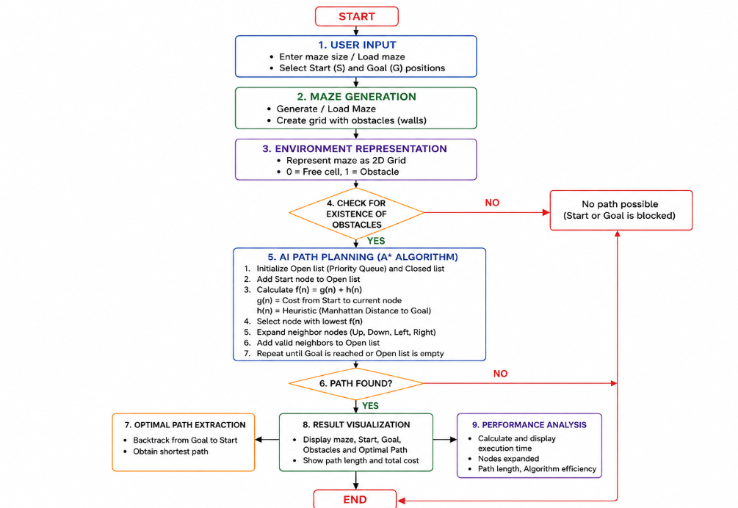
System Architecture

Slide 8
Modules
Maze Generation
AI Pathfinding
Obstacle Detection
Visualization
Create maze
A* Search
Detect blocked cells
Display maze
Validate maze
Path Optimization
Update navigation
Show shortest path
Performance metrics
6

Slide 9
A* Search Algorithm
f(n) = g(n) + h(n)
Algorithm Flow
g(n) = Distance from start
Start: Add start node to open list
h(n) = Estimated distance to goal
Pick node with lowest f(n)
Working Steps
1
Initialize open list
Node = Goal?
2
Select lowest f(n)
3
Expand neighbors
Expand neighbor nodes
4
Update costs
Update g, h, f costs
5
Repeat until goal
6
Display shortest path
Shortest path found
7

Slide 10



Applications
Autonomous Robots
Warehouse Automation
Self-driving Vehicles
Drone Navigation
Search and Rescue
Smart Logistics
Industrial Automation
AI-based Games
9

Slide 11
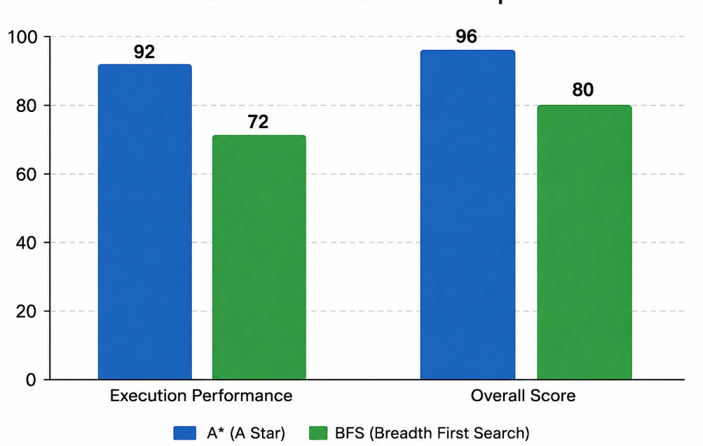
Program and Execution
10

Slide 12
Advantages
Finds optimal path
Faster navigation
Obstacle avoidance
High accuracy
Low computational cost
Easy implementation
Real-time performance
Scalable solution
11

Slide 13
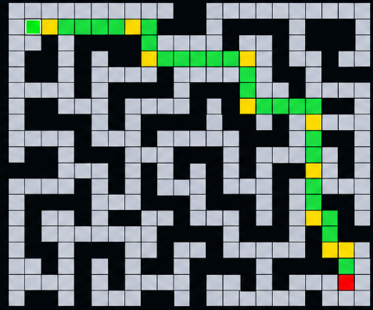
Results
Results
Maze generated successfully
Optimal path identified
Reduced navigation time
Improved path accuracy
Performance analyzed
12

Slide 14
Conclusion
AI improves maze navigation efficiency.
The A* algorithm finds the shortest possible path.
The system reduces travel time and computational effort.
Suitable for robotics, autonomous vehicles, and smart automation.
Future enhancements will enable intelligent real-time navigation.
13

Slide 15

Future Scope
Future Scope
1
Deep Reinforcement Learning
2
Dynamic obstacle handling
3
Multi-robot navigation
4
IoT integration
5
3D maze navigation
14

Slide 16
REFERENCES
• [1] M. Mohamad, “A Systematic Literature Review of A* Pathfinding,” Procedia Computer Science, vol. 179, pp. 507–514, 2021.
• [2] R. Yonetani, T. Taniai, M. Barekatain, M. Nishimura, and A. Kanezaki, “Path Planning using Neural A* Search,” Proceedings of the 38th International Conference on Machine Learning, vol. 139, pp. 12029–12039, 2021.
• [3] K. Mayilvaganam, A. Shrivastava, and P. Rajagopal, “An A* Based Path Planning Approach for Autonomous Vehicles,” AIR 2021: Advances in Robotics, 2021.
• [4] Y. Sun, Q. Yuan, Q. Gao, and L. Xu, “A Multiple Environment Available Path Planning Based on an Improved A* Algorithm,” International Journal of Computational Intelligence Systems, vol. 17, Article 172, 2024.
• [5] B. Elkari Eidia, L. Ourabah, H. Sekkat, A. Hsaine, C. Essaiouad, Y. Bouargane, and K. El Moutaouakil, “Exploring Maze Navigation: A Comparative Study of DFS, BFS, and A* Search Algorithms,” Statistics, Optimization and Information Computing, vol. 12, no. 3, pp. 761–781, 2024.
• [6] Y. He, T. Hou, and M. Wang, “A New Method for Unmanned Aerial Vehicle Path Planning in Complex Environments,” Scientific Reports, vol. 14, Article 9257, 2024.
• [7] H. Min, X. Xiong, P. Wang, and Y. Yu, “Autonomous Driving Path Planning Algorithm Based on Improved A* Algorithm in Unstructured Environment,” Proceedings of the Institution of Mechanical Engineers, Part D: Journal of Automobile Engineering, vol. 235, no. 2–3, pp. 513–526, 2021.
15

Slide 17
THANK YOU

