Slide 1
IBM DATA SCIENCE CAPSTONE PROJECT
Athira Govindan Kutty

Slide 2
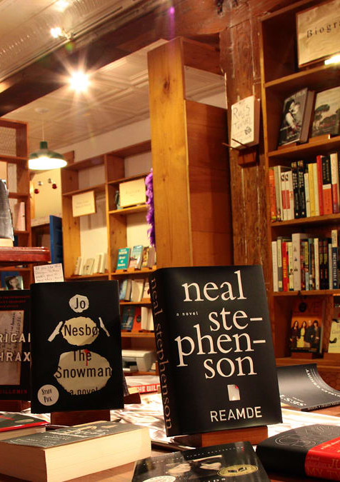
BEST LOCATIONS TO START A BOOKSTORE
A project to find best locations to start an enterprise of a bookstore in Warwickshire by using Foursquare API.

Slide 3
INTRODUCTION
This project is aimed to find best locations to start a small enterprise of a bookstore in Warwickshire.
It is done with the help of Foursquare API and a number of libraries in python.
The unsupervised machine learning technique of k-means clustering is also used.

Slide 4
DATA
DATA NEEDED
Towns in Warwickshire county
Location coordinates of these towns
Accessibility of bookstores or libraries within a commutable distance
For towns without any bookstores or libraries, does the town have a big enough population to start a venture. Also, the presence of schools or colleges in the vicinity so that the store could be useful for students and teachers
DATA EXTRACTION
Data was extracted using beautiful soup library from the following websites:
List of towns: https://worldpostalcode.com/united-kingdom/england/Warwickshire
Population data: https://www.ebayinuk.co.uk/warwickshire-towns-villages-population/
Location coordinates of the towns were obtained using OpenCage API.
Foursquare API was used to collect details of bookstores, libraries and schools in these towns.

Slide 5
FLOWCHART

Slide 6
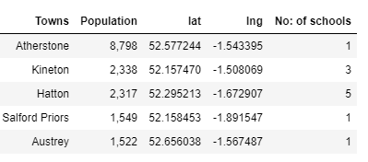
METHODOLOGY
List of 285 towns in Warwickshire was scrapped from the website and converted into a data frame.
Location coordinates were extracted using Open Cage API.
Bookstores and libraries within 5km radius of these towns were found using Foursquare API.
Out of 285 towns 169 towns have either a bookstore or a library while the rest of 116 towns do not have libraries or bookstores.
Towns without bookstores or libraries are taken for further analysis and population and vicinity to schools is checked.
For this, population data was scrapped using beautiful soup and merged with data frame of towns and its location data
Using Foursquare, a data frame of schools nearby is obtained.
285 Towns
169 towns with BS/Lib
116 towns without BS/Lib
Data frame of towns with population data and number of schools nearby

Slide 7
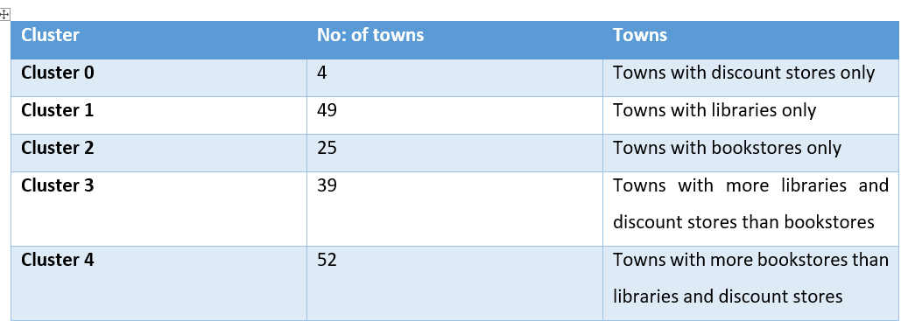
METHODOLOGY
Population and School data was then plotted using the seaborn library for further analysis.
Towns that already had bookstores/libraries were then clustered.
One-hot encoding was done to get how many bookstores and libraries are there in a town.
This data was then clustered to get 5 different clusters.
Among these cluster the cluster with towns that only have libraries was then considered as these will also be a good option to start a bookstore.
As done before the population and schools data were taken for further analysis.
Clusters obtained after k-means clustering

Slide 8
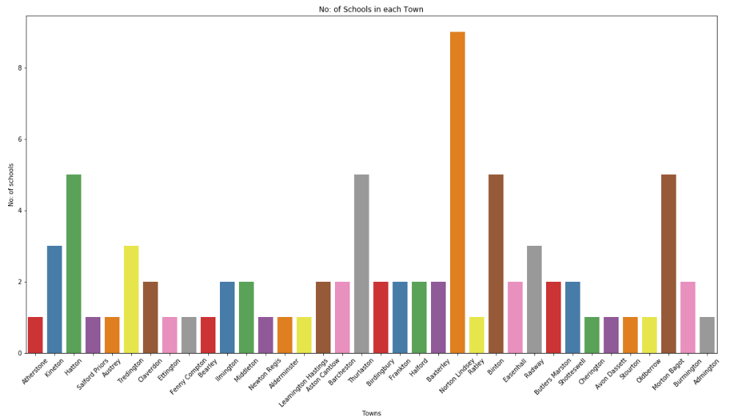
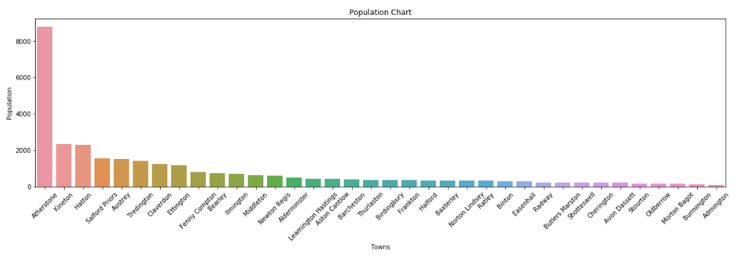
RESULTS
By analysing the data set of towns with no libraries or bookstores, 3 towns that are best suited for the purpose was obtained.
From the visualisations, Atherstone was the town with highest population.
While Kineton and Hatton have appreciable population and they also have schools nearby.
Hence Atherstone, Hatton and Kineton are the best options in this set of towns.

Slide 9
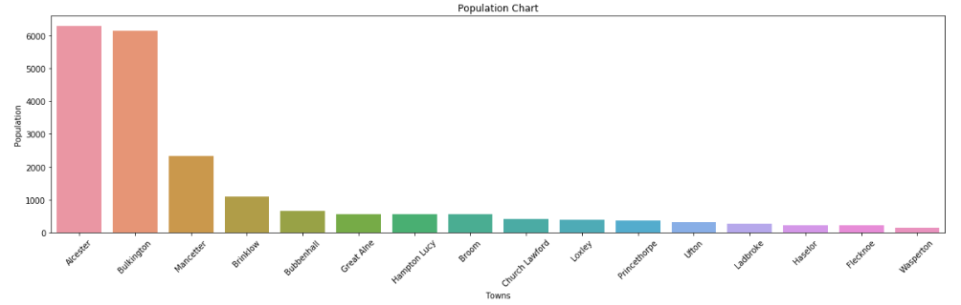
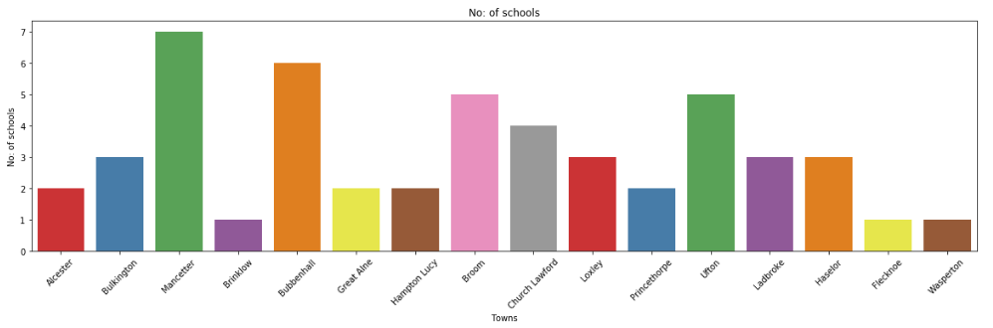
RESULTS
While taking the towns that already has bookstores and libraries, similar analysis shows that the towns of Alcester, Bulkington and Mancetter are the best options.
Hence, from 285 towns 6 towns that are best suited for opening a bookstore was obtained.

Slide 10
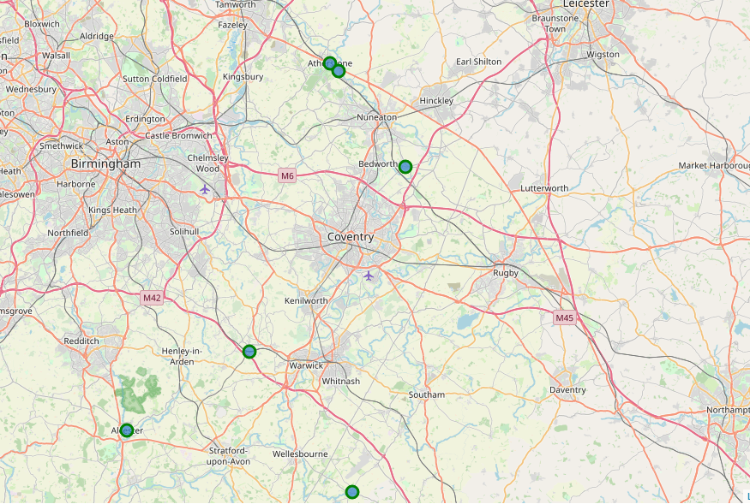
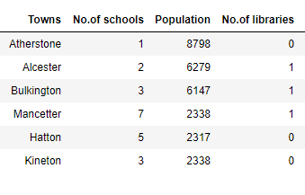
CONCLUSION
By using Foursquare API, K-means clustering technique and a number of libraries in python, 6 towns that are best suited to start a bookstore was obtained. They are:
Atherstone
Hatton
Kineton
Alcester
Bulkington
Mancetter
Dataset and map of the shortlisted towns

Slide 11
DISCUSSION
Population and vicinity to schools are the only factors considered for this project other than these various other data such as vicinity to malls, railway stations, supermarkets, rent for commercial buildings and many more can also be considered.
Population data of all towns was not available.
Bookstores helps the purpose of sharpening a man’s mind with different books and they will always have a brighter future. Even now there are many towns that do not have any source of books like a library or a bookstore. These towns can be found using this method with a few improvements and new ventures can be started here.

Slide 12
REFERENCES
The Futures is bright for Print books: https://www.twosides.info/UK/print-book-sales-rise
Printed books have a positive future: https://www.storaenso.com/en/newsroom/news/2018/5/printed-books- have-a-positive-future-a-new-survey-indicates

