Slide 1
PES UNIVERSITY, Bangalore
(Established under Karnataka Act No.16 of 2013)
UE17CS203- INTRODUCTION TO DATA SCIENCE

Slide 2
EXPLORATORY ANALYSIS ON JAPAN HOSTEL DATASET
DATASET LINK: https://www.kaggle.com/koki25ando/hostel-world-dataset/kernels

Slide 3
TEAM MEMBERS
1.Name:Athira.A.D.
SRN:PES1201701633
2.Name:Gagana.R.
SRN:PES1201701618
3.Name:Niveditha.C.U.
SRN:PES1201701640.
From SECTION C

Slide 4
Dataset:Japan Hostel Dataset Introduction
Japan hostel service is for young and independent travellers seeking a social travel experience. The group focuses on hostels, maintains a leading hostel database with over 16,000 hostels and approximately 20,000 other forms of budget accommodation available globally unlike the other travel agents. Since 2005, it has also been managing customer-generated review database consisting of more than 10 million post-stay reviews.

Slide 5
Analysis
In the exploratory analysis, the parameters such as summary.score, rating.band ,cleanliness etc are related to be each other. Here, parameter treatment is taken as the prior and compared with the other parameters.
Graphs are drawn by taking different parametres, to visualize the relation between parameters.

Slide 6
Information about the Data Set
Contents:
hostel.name
City (City name where hostel is located in)
price.from (Minimum Price for 1 night stay)
Distance (Distance from city center (km))
summary.score (Summary score of ratings)
rating.band (Rating band)
Atmosphere (Rating score of atmosphere)

Slide 7
Cleanliness (Rating score of cleanliness)
Facilities (Rating score of falicities)
location.y (Rating score of location)
Security (Rating score of security)
Staff (Rating score of staff)
Valueformoney (Rating score of value for money)
Lon (Longitude)
Lat (Latitude)

Slide 8
This dataset contains 342 rows and 16 Columns. This dataset is collected from the Website https://www.kaggle.com
Link for the dataset https://www.kaggle.com/koki25ando/hostel-world-dataset/kernels

Slide 9
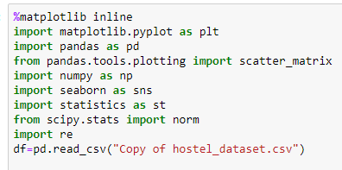
Modules being used

Slide 10
Processing (Data Cleaning)
Steps we followed to clean the dataset:
Some of the rows in our dataset have complete missing values,which are not useful in analysis. So those rows are completely removed.
NAN’s for numeric columns like lon(longitute) and lat(latitude) are replaced with average of the column.
NAN’s for categorical columns like rating.band are replaced with its previous row values.

Slide 11
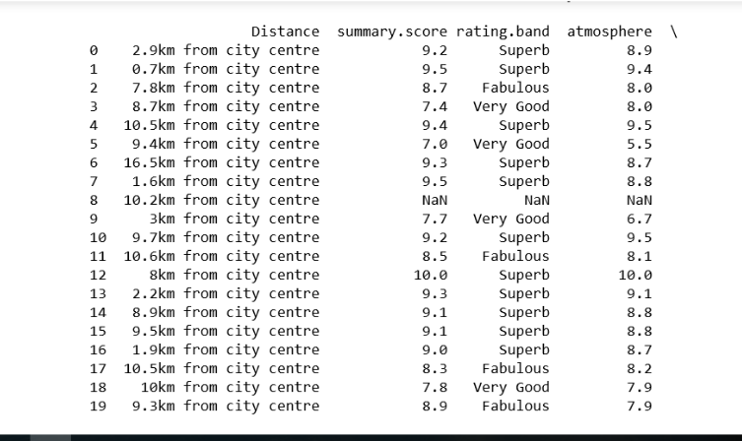
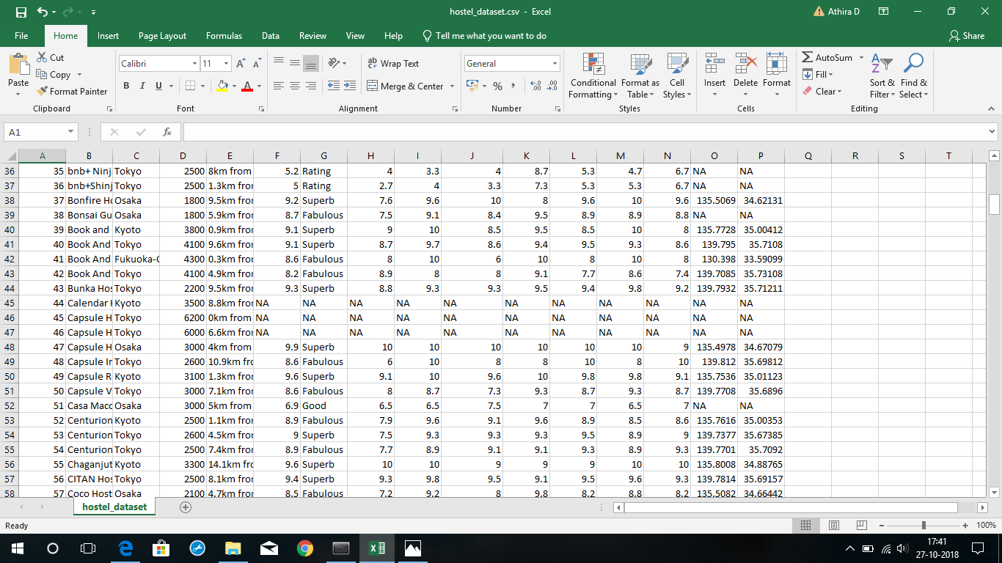
Dataset before cleaning

Slide 12
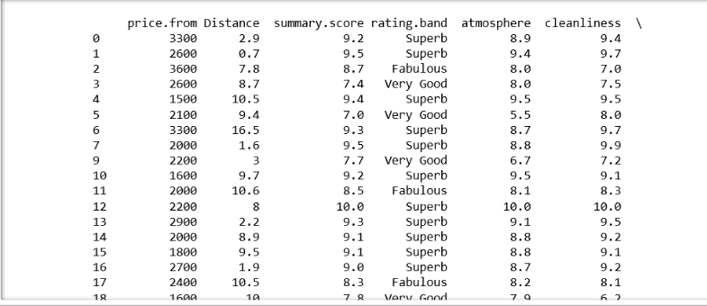
Dataset after cleaning

Slide 13
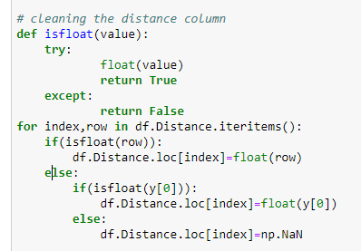
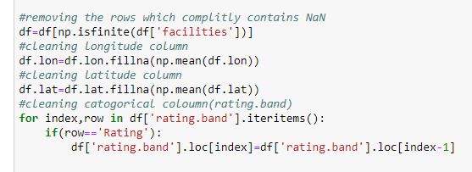
Data cleaning

Slide 14
Visualizing dataset and concluding insights

Slide 15
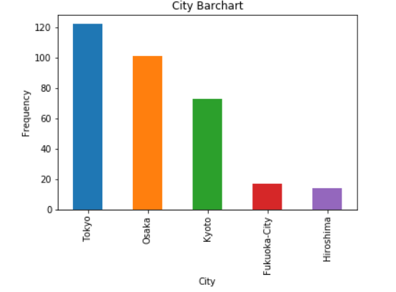
Above bargraph shows hostels in main five cities in japan listed on HostelWorld.com
This datset only covers these five cities at the moment.mainly these cities are famous destinations for tourists from foreign countries.

Slide 16
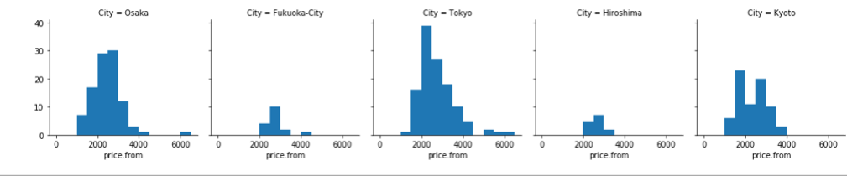
These graphs are showing distributions of minimum prices for 1 night stay in main 5 cities in Japan.
Hotels in Japan usually costs 2.5-5K JPY for each night stay. However,these histograms show that it only costs around 2-2.5K JPY for 1 night stay at hostels. So it concludes that you can minimize your expenses for stay almost 50% when you stay in hostels.

Slide 17
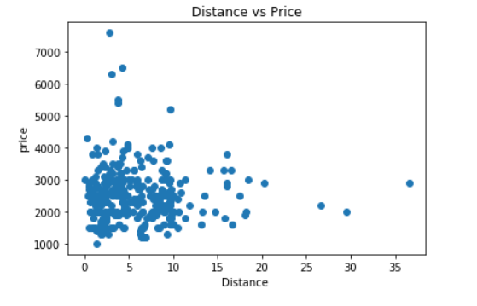
It was expected that superb hostels are mainly closer to the city center and location of each hostel is playing a huge role to their rating result.
However this visulization shows that location is not too important.

Slide 18
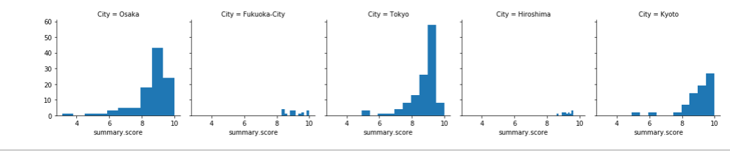
From this graph we can analyse that Fukuoka and Hiroshima have only hostels which have higher ratings. Although the number of hostels in these cities are relatively little, they are giving high quality services to tourists. The other thing we can tell from these histograms is that biggest three cities (Kyoto,Osaka,Tokyo) ratings are between 8 and 9. on the other hand, other 2 cities(Hiroshima and Fukuoka) average ratings are higher.

Slide 19
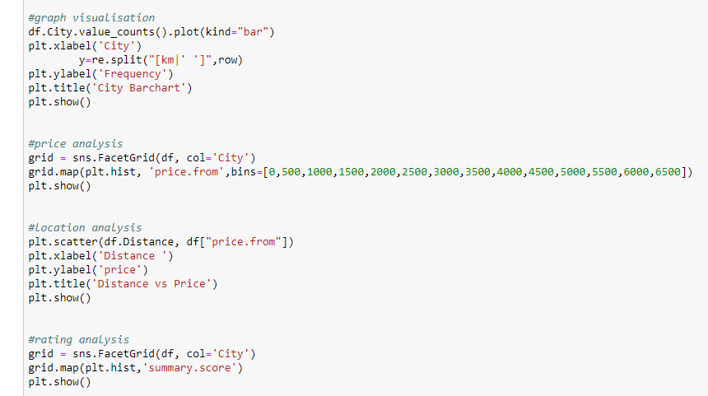
Data visualization

Slide 20
Hypothesis Testing

Slide 21
In this analysis we did hypothesis testing for price column. We would like to determine if price for one night stay in hostel have a mean greater than 2600 taking significance level as 0.05.
We took null hypothesis as
H0:mue<=2600
Alternate hypothesis as
H1:mue>2600
After performing hypothesis test, we got observed significance level as 0.49 which is greater than alpha.
SO WE FAILED TO REJECT NULL HYPOTHESIS.
So we concluded that it is plausible that the price for one night stay in hostel have a mean value less than 2600.

Slide 22
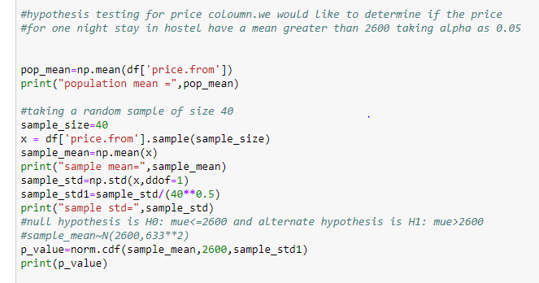

Hypothesis testing
Result

Slide 23
Conclusion
In this analysis we have found that tourists can minimize their expences up to 50% when they stay in hostel.
Hostels with great locations are not always score higher rating score. There are multiple factors that satisfy their customers.

