Slide 1
MACHINE LEARNING PROJECT
COURSE CODE - UE17CS303
ATHIRA A D - PES1201701633
NIVEDITHA C U - PES1201701640
MANEESHA S - PES1201700024

Slide 2
PROBLEM STATEMENT: EXOPLANET CLASSIFICATION
DATA SOURCE: UNIVERSITY OF PUERTO RICO’S PLANETARY HABITABILITY LABORATORY’S EXOPLANETS.
ABOUT DATASET
Dataset consists of 68 features in total, where 13 are categorical and remaining 55 are continuous.
There are a total of 3876 rows where each row represents a particular exoplanet.
The ground truth is habitability of each class.
The catalog includes important features like Atmospheric type, Mass, Radius, Surface Temperature, Escape Velocity, Earth Similarity Index, Flux, Orbital Velocity etc.
This is a dataset where overwhelming majority are non-habitable samples.
non-habitable 3820
mesoplanet 31
psychroplanet 18
hyposychroplanet 3
thermoplanet 3
6. Since number of samples in hyposychroplanet and thermoplanet is very less compared to total number of samples in dataset, it is suitable for classification task and therefore these two classes are not considered for prediction.

Slide 3
PRE PROCESSING
DIMENSIONALITY REDUCTION
Based on the missing value ratio (if missing value ration is greater than 90% then drop the column).
Based on variance of each column (an attribute with low variance not really separating data points in any way, so that has been removed).
Unnecessary columns are removed.
example: Name of the host star, year of discovery etc.
CATEGORICAL ENCODING
Our dataset contains categorical columns like P. Mass Class, P.Atmospheric Class, P. Habitable Class, we applied label encoding to convert categorical columns into numerical since ML Model will not take string values.
REPLACING MISSING VALUES
Replaced non-categorical columns with class-wise mean.
Categorical columns are replaced with mode.

Slide 4
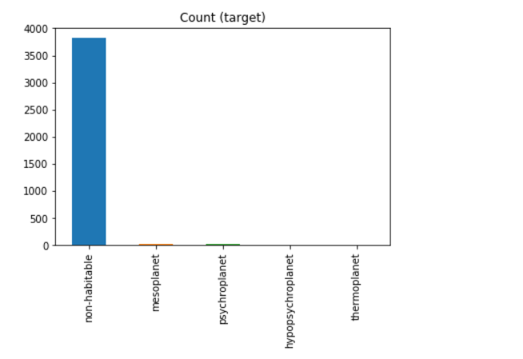
CLASSIFICATION
Applied KNN(k-nearest neighbor) with k=3.
2. Since the dataset is highly imbalanced we applied KNN separately for under sampled and over sampled dataset.
3. For undersampling we removed rows containing “gas “ as composition class since all the planets with gas composition is non habitable.
4. For oversampling we just duplicated random records from minority class.
5. It has already being known that Surface Temperature (ST) can distinguish habitable planets from non habitable ones with a large degree of precision. So it is necessary to verify whether our classifier works properly even without this feature.
6. Hence we tried KNN with and without Temperature attribute.

Slide 5
RESULTS
KNN FOR UNDER SAMPLED DATA WITH TEMPERATURE | ACCURACY=98.186
KNN FOR UNDER SAMPLED DATA WITHOUT TEMPERATURE | ACCURACY=96.158
KNN FOR OVER SAMPLED DATA WITH TEMPERATURE | ACCURACY=98.135
KNN FOR OVER SAMPLED DATA WITHOUT TEMPERATURE | ACCURACY=96.957

