Slide 1

Designing an Inclusive, Insight-Driven Dashboard & Chat System
Empowering Teams through Visual Analytics and Accessible Communication
Athira George
22011102010

Slide 2
Design Objectives
Objective:
Create a web app that improves productivity, communication, and decision-making using intuitive design and rich data visuals.
Key Goals:
- Visualize workload trends and task priorities
- Enable efficient team communication
- Ensure accessibility and responsiveness across devices
- Support dark mode and font scaling

Slide 3
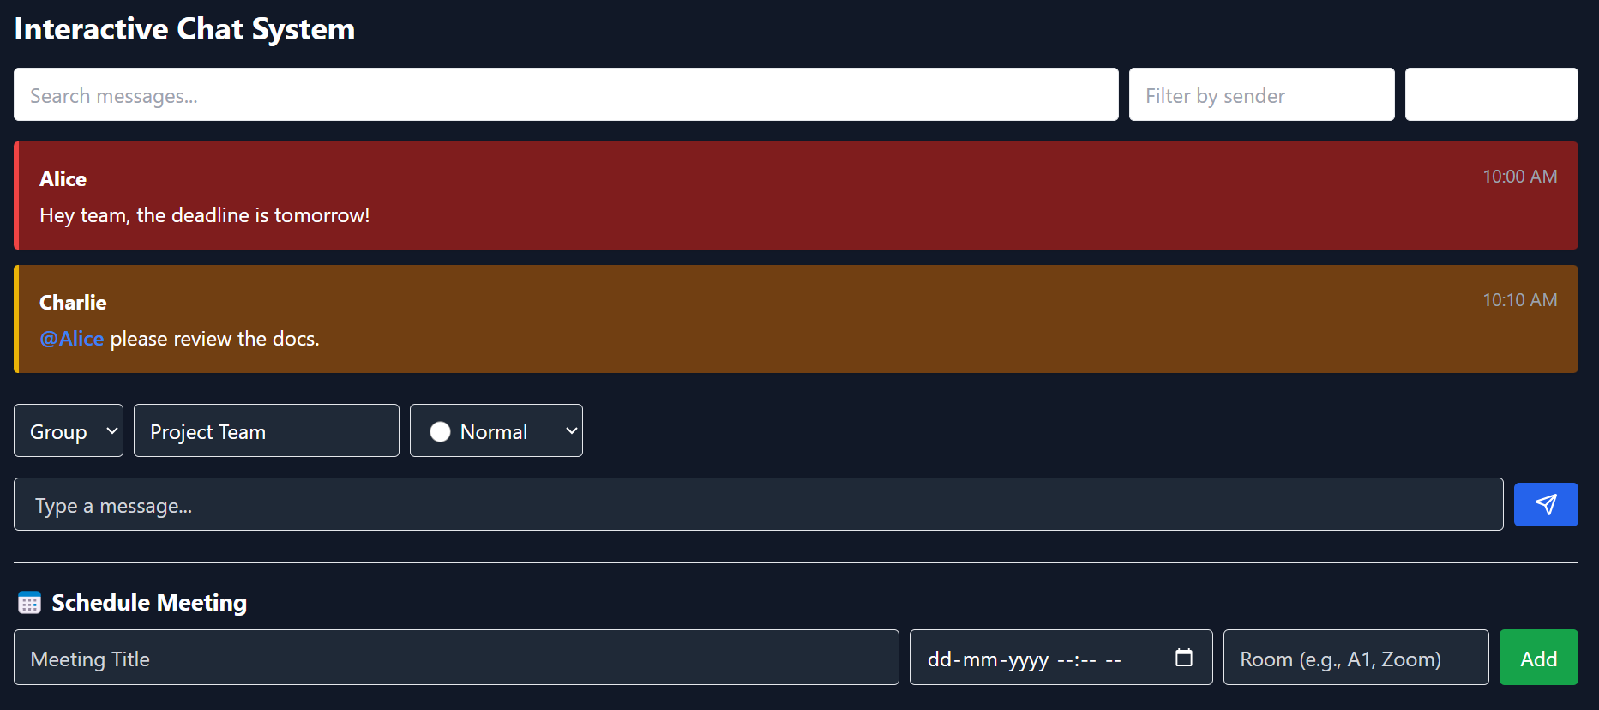
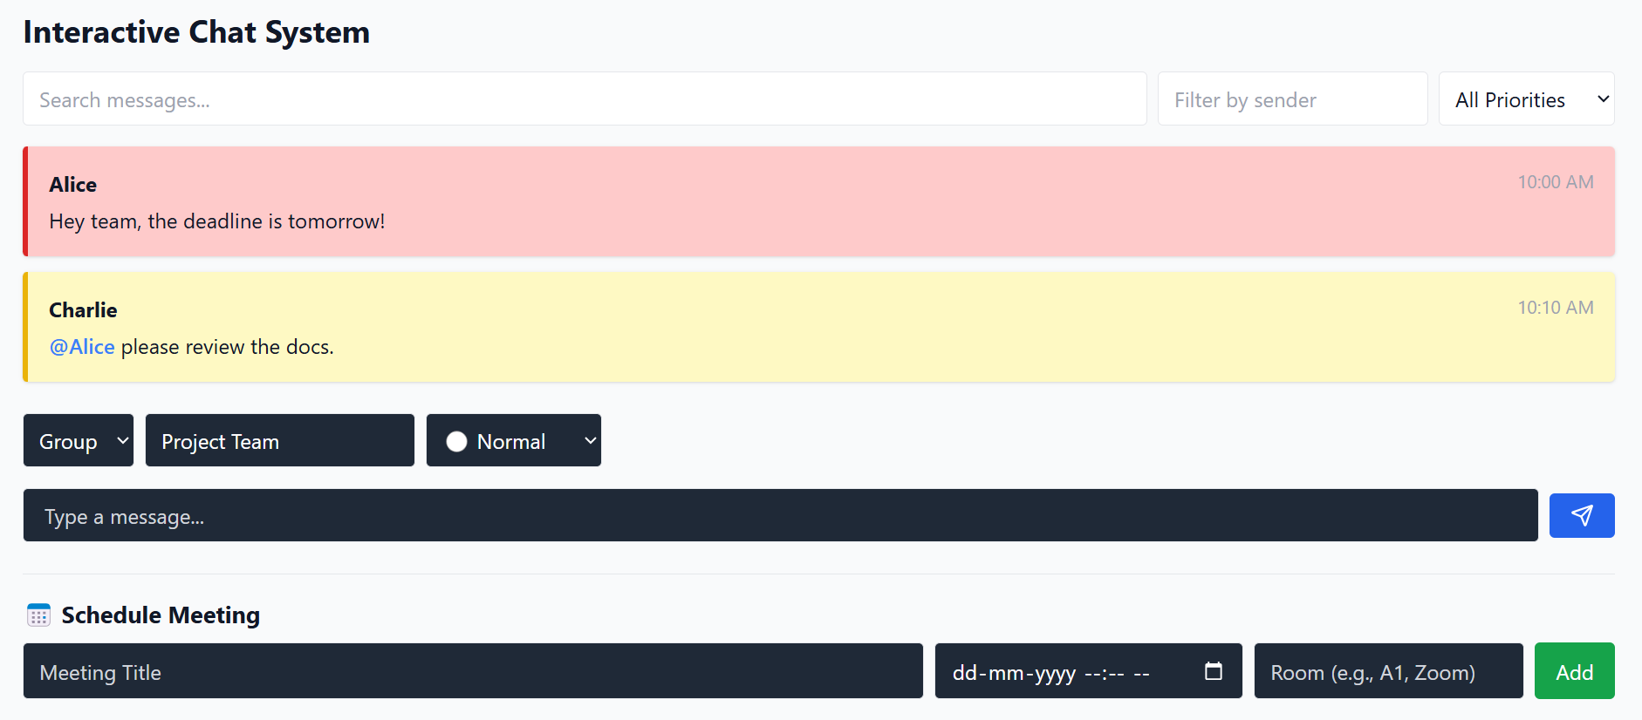
UI/UX Design Features
Dark Mode + Persistent Settings:
Reduces eye strain and improves comfort in low light
Remembers user preference via localStorage
Font Size Adjustment:
Improves readability for low-vision users
Offers quick toggle for inclusive access
Responsive Layout:
Adapts cleanly to all devices using TailwindCSS grid/flex utilities
Keyboard & Screen Reader Support:
keyboard shortcuts (e.g., Ctrl + Enter)
Navigable for assistive technology users

Slide 4
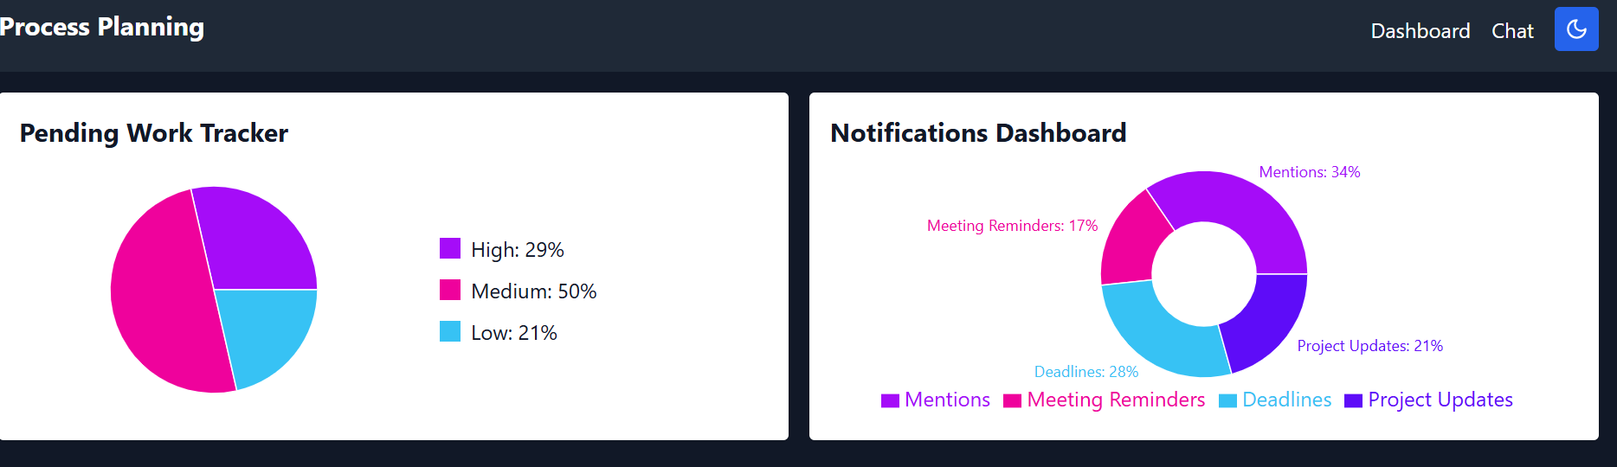
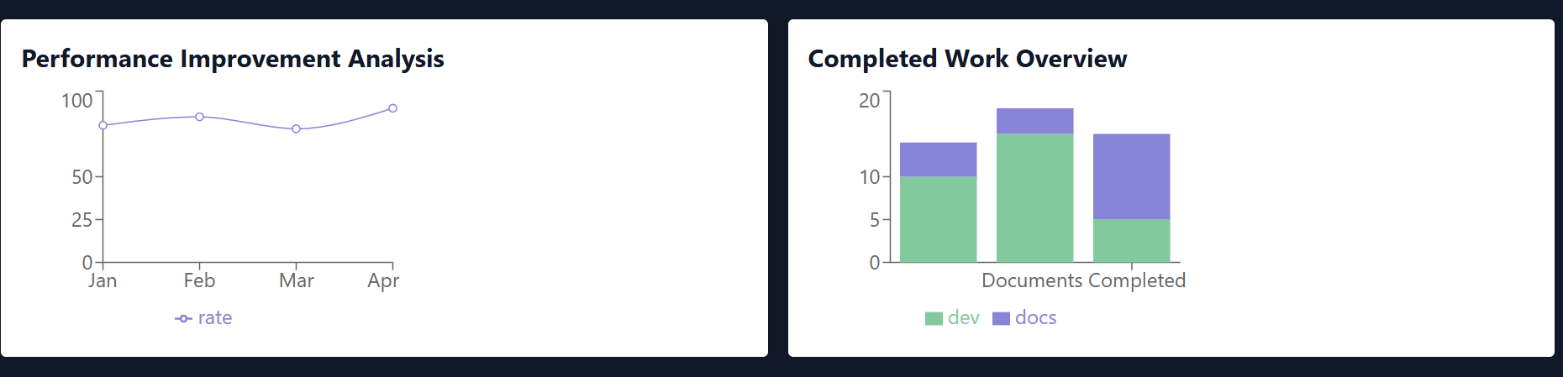
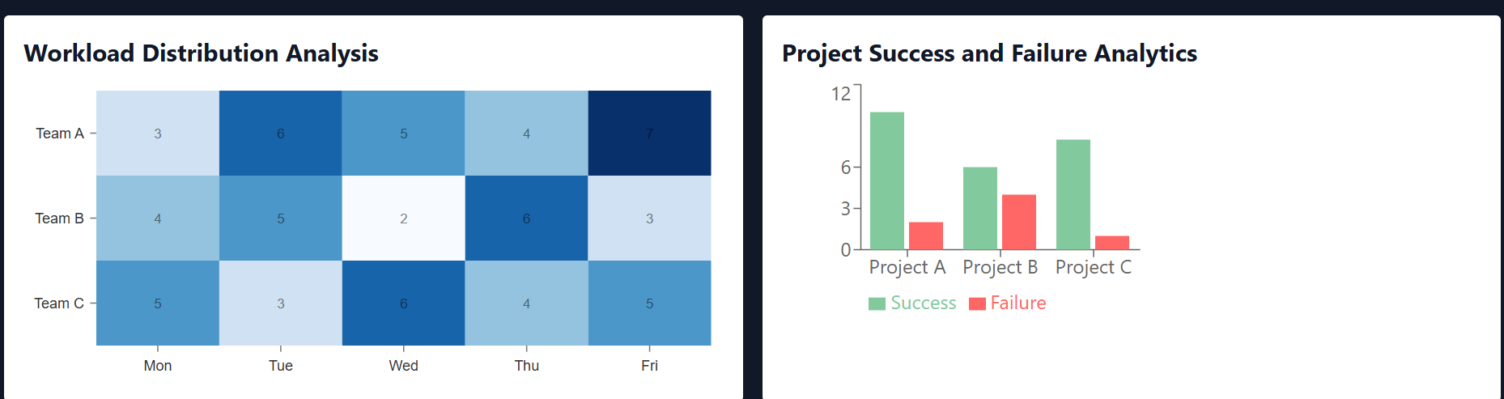
Data Visualizations
Charts Implemented:
Pie Chart: Task urgency overview (High/Medium/Low)
Donut Chart: Alert categories (Mentions, Reminders, etc.)
Line Chart: Performance trend analysis
Stacked Bar Chart: Work distribution by task type
Heatmap: Team workload across weekdays
Grouped Bar Chart: Project success vs failure comparison
Benefits:
Data-driven task prioritization
Performance tracking
Efficient resource allocation
Immediate visual feedback for decision-making

Slide 5
Final Takeaways
What Makes This Design Work:
Clear separation of data and communication
Built-in accessibility features
Visual simplicity paired with powerful insights
Scalable for real team use

