Slide 1
🏦 Internal Bank Employee Assistant
Multi-Agent AI System — Capstone Project v2.0
NexaBank Internal Division | June 14, 2026
Python • Streamlit • 7 Agents • 3 Skills • 6 Hooks • 49 Tests • 100% Pass

Slide 2
Business Problem
⚠ Bank employees reference 5+ internal policies daily — manual search takes 5-10 minutes
⚠ No single system classifies, searches, summarizes, escalates, and audits policy queries
⚠ Inconsistent answers lead to compliance risks and customer service failures
⚠ New employees lack guidance — policy documents are 50+ lines each and hard to navigate
⚠ Unresolved queries go untracked — no audit trail for compliance review

Slide 3
Solution Overview
A fully orchestrated multi-agent AI system — offline, traceable, self-healing.
🤖 OrchestratorAgent
🔍 Intent Classifier
📚 Policy Search
Coordinates all 7 subagents
Routes to the right agent first
Keyword scoring on 5 policies
📝 Multi-Policy
📋 Summary Agent
📧 Escalation Agent
Merges 2 policy domain answers
5-bullet summaries on demand
Auto-drafts escalation emails
🛡️ Audit Logger
⚠️ Self-Healing
🔗 6 Lifecycle Hooks
Logs every query silently
FallbackAgent auto-recovers
Pre/post query, session, risk

Slide 4
OrchestratorAgent — 9-Step Pipeline
1
pre_query_hook
Validate & sanitize input — reject empty/<3-char
2
QueryClassifierAgent
Detect intent: policy_query/summary/escalation/out_of_scope
3
OrchestratorAgent
Routing decision (see routing table)
4
SubAgent executes
Answer produced by chosen agent
5
AuditLoggerAgent
Logs every query silently — runs after all queries
6
compliance_alert_hook
Fires IF risk keywords detected in question
7
escalation_hook
Fires ONLY IF found=False AND escalated=False
8
post_answer_hook
Logs response time and outcome
9
Result → UI
Answer + badge + agent chip displayed in chat

Slide 5
7 Subagents — Roles & Responsibilities
SubAgent 1 QueryClassifierAgent
SubAgent 2 PolicySearchAgent
SubAgent 3 MultiPolicyAgent
SubAgent 4 SummaryAgent
Detects intent first
Single-policy keyword search
Spans 2 policy domains
On-demand policy overview
policy_query / summary / escalation / out_of_scope
Best match from 5 policies via KEYWORD_MAP
Merges top-2 snippets when both scores ≥ threshold
5-bullet summary; POLICY_NAME_HINTS + fallback search
SubAgent 5 EscalationAgent
SubAgent 6 FallbackAgent
SubAgent 7 AuditLoggerAgent
Routes to correct team
Self-healing on no match
Background audit logging
Contact lookup + auto-draft escalation email
Partial recovery via cross_reference at low threshold
Logs every query; detects 14 compliance risk keywords

Slide 6
Skills — Reusable Functions Across Agents
search_skill.py
format_skill.py
audit_skill.py
search_policy()
POLICY_DISPLAY_NAMES
log_query()
Keyword scores all 5 policies via KEYWORD_MAP; returns best snippet
Canonical name map — all agents import from here
Appends to query_audit.log
extract_keywords()
format_answer()
log_unresolved()
Pulls meaningful words from question for classification
Cleans raw policy text into readable markdown
Appends to unresolved_queries.log
cross_reference()
summarize_policy()
log_session_event()
Scores ALL policies — drives multi-policy detection
5-bullet summary of any policy document
Logs all session lifecycle events
generate_escalation_email()
detect_compliance_risk()
Drafts pre-filled escalation email body
Returns True if risk keywords found
read_audit_log()
Used by:
Used by:
Used by:
PolicySearchAgent · MultiPolicyAgent · SummaryAgent · FallbackAgent · EscalationAgent
PolicySearchAgent · SummaryAgent · EscalationAgent
Reads last N lines — used by app.py audit panel
AuditLoggerAgent · All 6 Hooks · app.py

Slide 7
Hooks — 6 Lifecycle Callbacks
Hooks fire automatically at specific pipeline points. They handle cross-cutting concerns without modifying agent logic.
pre_query_hook
Validates input; rejects empty/<3-char; logs incoming query
→ BEFORE any agent
post_answer_hook
Logs matched policy, response time, ANSWERED/FALLBACK status
→ AFTER full pipeline completes
session_start_hook
Logs SESSION_START with unique session ID
→ App loads — once per session
session_end_hook
Logs SESSION_END with total query count for the session
→ Employee clicks Clear Chat
escalation_hook
Writes question to unresolved_queries.log — suppressed when EscalationAgent ran
→ found=False AND escalated=False
compliance_alert_hook
Logs flagged query; returns { alert: str } for yellow warning banner in UI
→ Risk keyword detected in question

Slide 8
Agent Routing — Decision Tree
Employee Question
↓
QueryClassifier Agent
summary
escalation
policy_query (multi-match)
policy_query (single)
out_of_scope
↓
↓
↓
↓
↓
SummaryAgent
EscalationAgent
MultiPolicyAgent
PolicySearchAgent
Direct Fallback Message
↓ no match
FallbackAgent (self-heal)

Slide 9
Self-Healing Workflow — FallbackAgent
When PolicySearchAgent returns found=False, the Orchestrator automatically chains FallbackAgent. EscalationAgent is SEPARATE — only triggered by explicit escalation intent.
Note: EscalationAgent is NOT part of the self-healing chain. It runs only when QueryClassifierAgent detects 'escalation' intent.
1
1. PolicySearchAgent
Keyword scoring returns score=0 across all 5 policies → found=False
2
2. OrchestratorAgent
Detects found=False → automatically invokes FallbackAgent (self-healing)
3
3. FallbackAgent
Calls cross_reference() at low threshold (score > 0) for partial match
4
4. escalation_hook
Fires because found=False AND escalated=False → logs to unresolved_queries.log
5
5. AuditLoggerAgent
Logs query + fallback status to query_audit.log (runs after every query type)
6
6. post_answer_hook
Logs response time to session_events.log
7
7. UI displays
Warning box + contact details + FallbackAgent chip shown to employee

Slide 10
KEYWORD_MAP — The Scoring Engine
Location: utils/knowledge_base.py | The single data structure that drives ALL policy matching across every agent.
🏠 Loan Policy LP-001
🪪 KYC Policy KYC-002
📣 Complaint Policy CCP-003
loan, borrow, mortgage, personal loan, home loan, auto loan, credit score, prepayment, tenure, emi, disbursement
kyc, know your customer, identity, verification, id proof, address proof, passport, driver license, aml, due diligence
complaint, complain, grievance, dispute, escalate, feedback, resolution, refund, compensation, ombudsman, service complaint
💳 Credit Card CCP-004
🏦 Account Opening AOP-005
credit card, card, billing, statement, credit limit, reward, cashback, annual fee, lost card, minimum payment, apr, chargeback
account, open account, savings, current account, fixed deposit, joint account, minimum balance, debit card, dormant, cheque book

Slide 11
Governance Framework
🔒 No PII
📋 Source Control
🛡️ Agent Governance
• No customer data processed
• Answers verbatim from approved text
• All agents: read-only on policies
• Queries cleared on session close
• POLICY_DISPLAY_NAMES canonical in format_skill
• Only AuditLoggerAgent writes logs
• No external API or internet calls
• No hallucination possible
• utils/agent.py is deprecated
⚠️ Risk Detection
🔄 Audit Trail
👥 Access Controls
• 14 compliance risk keywords
• query_audit.log (every query)
• Internal intranet only
• compliance_alert_hook fires on match
• unresolved_queries.log (fallbacks)
• Policy owners update .txt files
• Logged + warning banner shown in UI
• session_events.log (all events)
• IT controls deployment

Slide 12
Testing & Evaluation — 49 Tests, 100% Pass
49
49
0
100%
Total Tests
Passed
Failed
Pass Rate
By Category:
✅ PolicySearchAgent (5 domains): 5/5
✅ QueryClassifierAgent: 6/6
✅ MultiPolicyAgent (incl. single): 4/4
✅ SummaryAgent (incl. fallback path): 4/4
✅ EscalationAgent: 4/4
✅ FallbackAgent: 5/5
✅ AuditLoggerAgent methods: 2/2
✅ All 6 Hooks: 6/6
✅ Compliance Risk: 3/3

Slide 13
Business Impact
⏱️ 95% Faster
✅ Consistent
Policy lookup: 5-10 min → under 30 sec
All employees get identical approved answers
🤖 7 Agents
📉 Risk Reduced
Classify, search, merge, summarise, escalate, heal, audit
14 compliance keywords auto-flagged in real time
📧 Auto Escalation
🔒 Zero Data Risk
Draft email generated — no manual drafting needed
No PII, no internet, no external APIs, offline only

Slide 14
MCP & Plugin Integration
mcp_server.py exposes the full NexaBank knowledge base as 5 MCP tools — usable by Claude Desktop, Claude Code, or any MCP-compatible AI agent.
search_policy
Keyword search → best-matching policy snippet + source badge
list_policies
Returns all 5 policy names, codes and sample topics
get_policy_full
Returns complete policy text by code (LP-001 … AOP-005)
cross_reference
Finds ALL policies matching a multi-domain question
check_compliance_risk
Screens question against 14 compliance risk keywords
Protocol: MCP JSON-RPC 2.0 over stdio | Config: claude_mcp_config.json | Both Streamlit UI & MCP share the same knowledge base + KEYWORD_MAP

Slide 15
Observability & Traceability
Every query is fully traceable — from input validation to final answer — across 3 structured log files and 6 lifecycle hooks.
📋 query_audit.log
Timestamp · Session ID · STATUS (MATCHED/FALLBACK) · Policy matched · Question text
Every query
⚠️ unresolved_queries.log
Timestamp · Session ID · UNRESOLVED · Full question — for compliance gap analysis
Fallback queries
🔄 session_events.log
PRE_QUERY · POST_ANSWER · SESSION_START/END · ESCALATION · COMPLIANCE_ALERT — full lifecycle
All events
Answer Traceability: Every answer is a verbatim extract from policy text — can be traced back to the exact file and line. AuditLoggerAgent runs silently after EVERY query type (policy, summary, escalation, fallback).

Slide 16
Load Testing Results
Real load test: 60 tasks · 10 concurrent workers · 3 iterations of all 20 question types
0
90.0%
8.78 ms
Errors
Answer Found Rate
Median Latency
30.33 ms
693.0
60/60
p99 Latency
Requests / sec
Tasks Completed
Min: 4.29 ms · Mean: 9.85 ms · p95: 16.5 ms · Max: 30.33 ms · Wall clock: 0.087 s

Slide 17
Deployment Architecture
Three deployment modes — all sharing the same offline knowledge base. No cloud dependency. No external APIs. Runs on any internal server.
Option A Local Deploy
Option B Docker
Option C Network / Team
Option D MCP Server
streamlit run app.py
docker build -t bank-assistant . docker run -p 8501:8501 ...
streamlit run app.py --server.address=0.0.0.0
python mcp_server.py
Single user · http://localhost:8501 Py 3.10+ · streamlit>=1.32
Isolated container · Any OS FROM python:3.11-slim
Team access · http://<ip>:8501 Intranet firewall required
AI agent access · stdio transport Claude Desktop / Claude Code
All modes share: policies/*.txt · KEYWORD_MAP · 7 Subagents · 3 Skills · 6 Hooks · 3 Log Files
Python 3.10+
RAM 512 MB+
Disk 100 MB
Network LAN (optional)

Slide 18
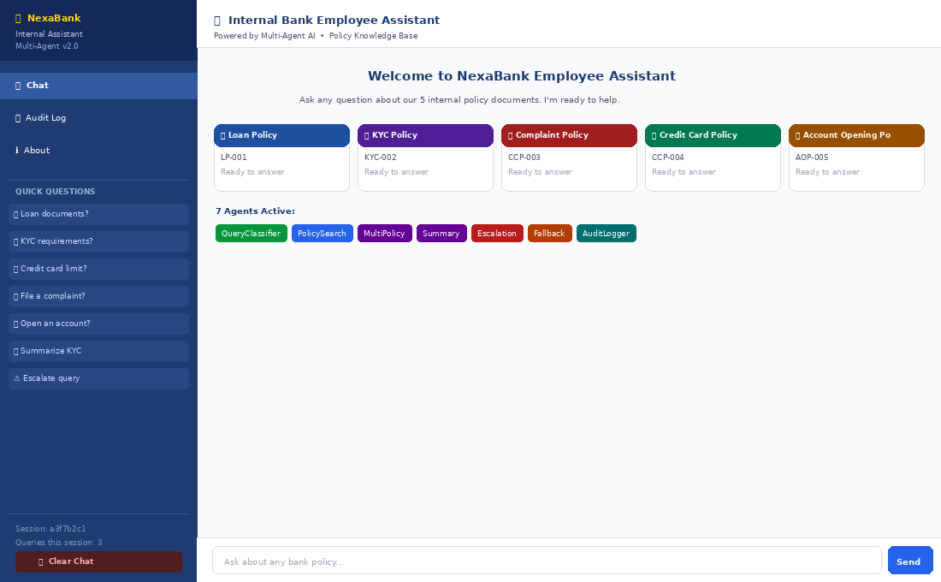
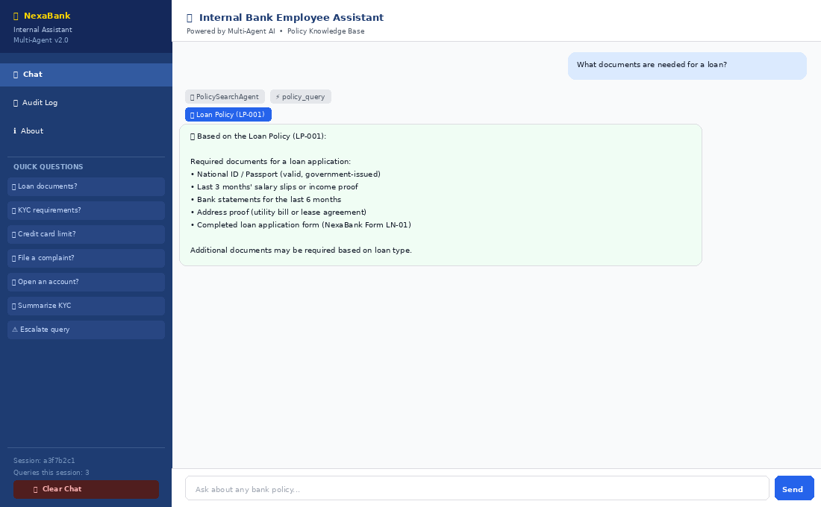
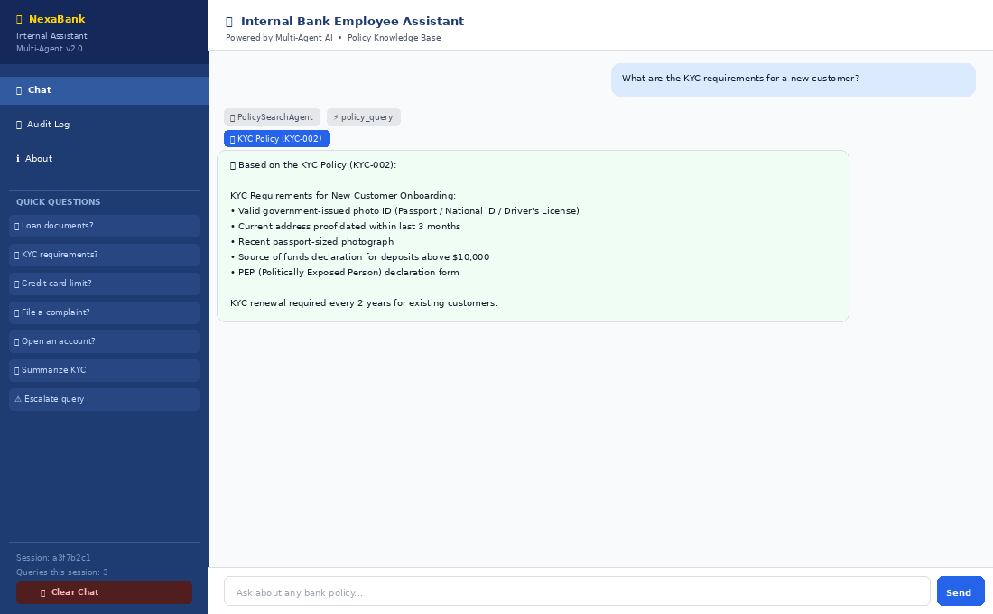
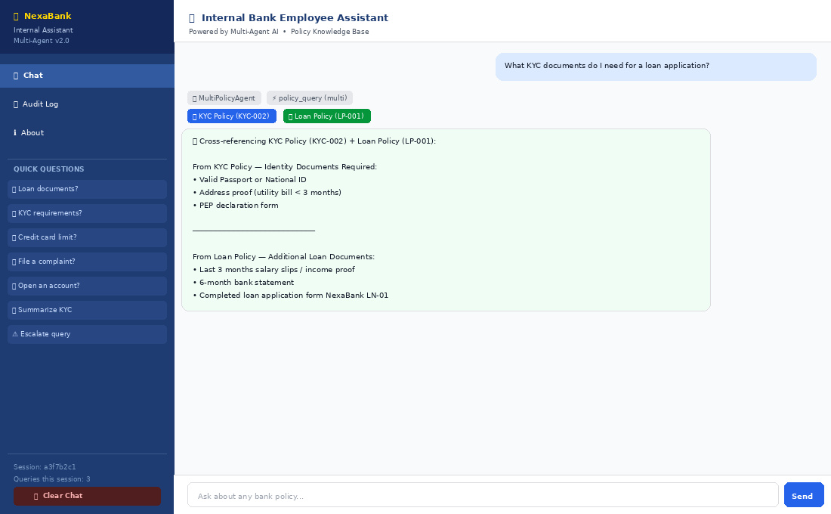
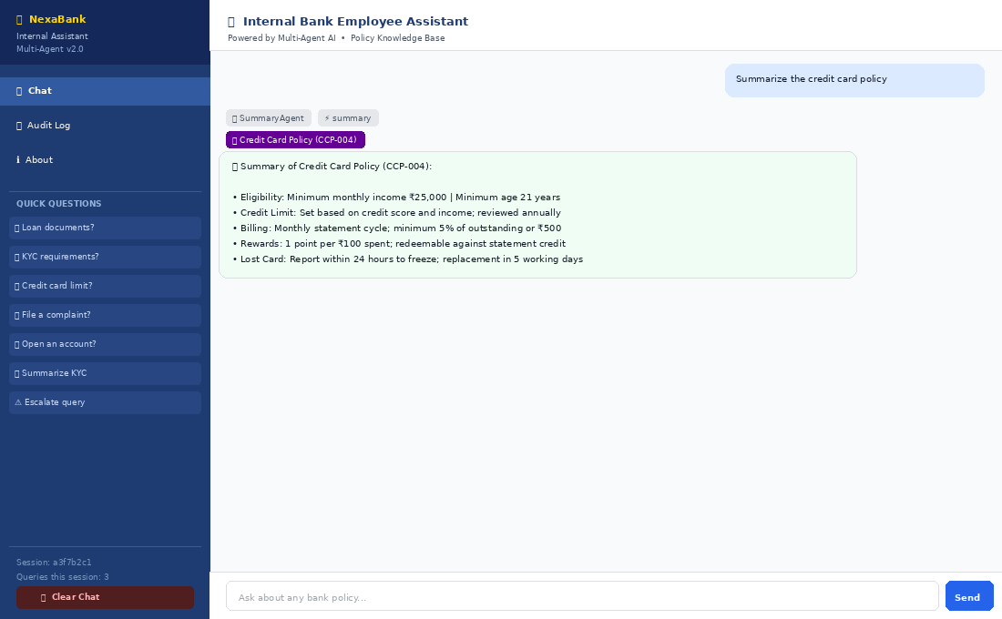
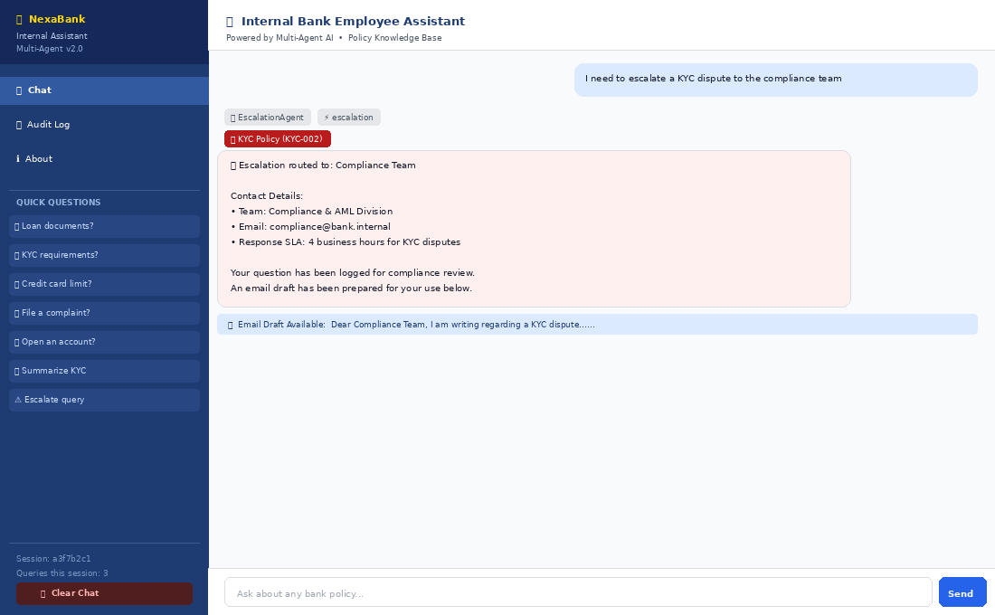
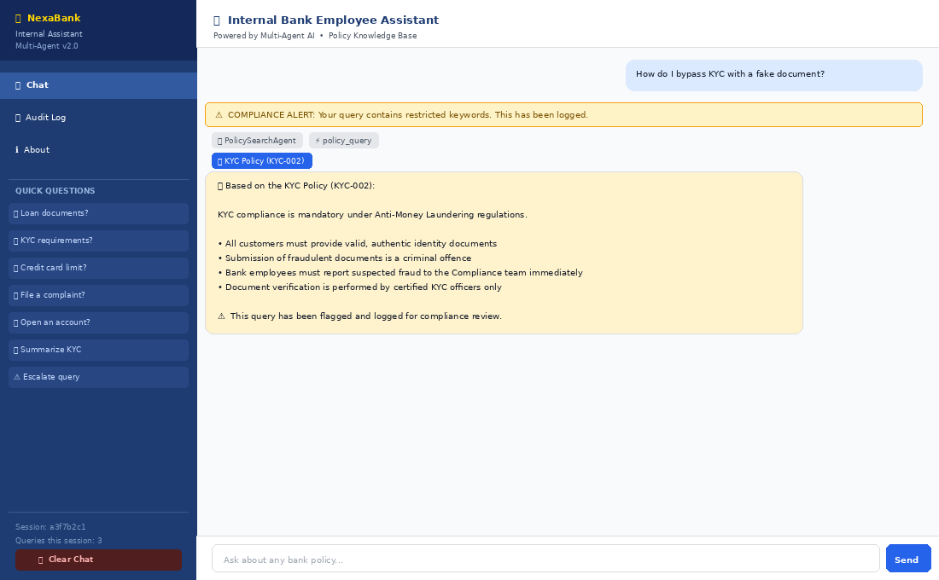
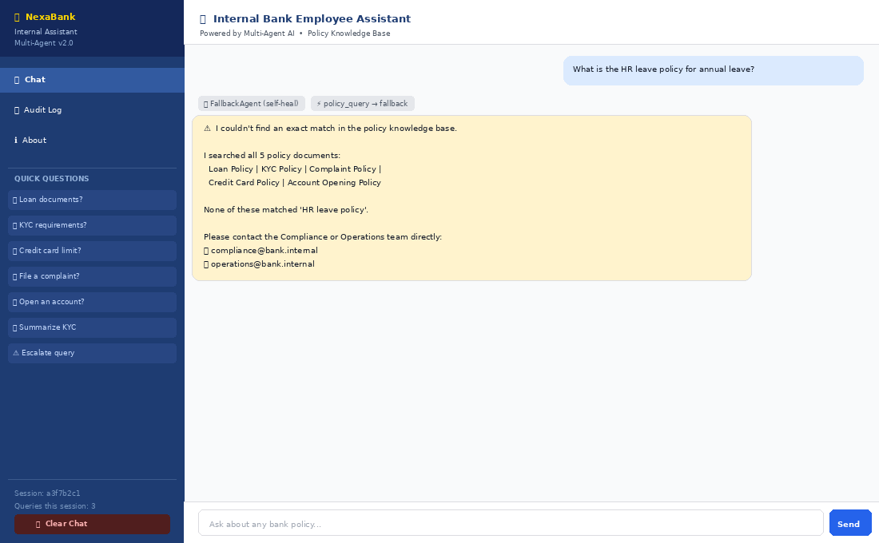
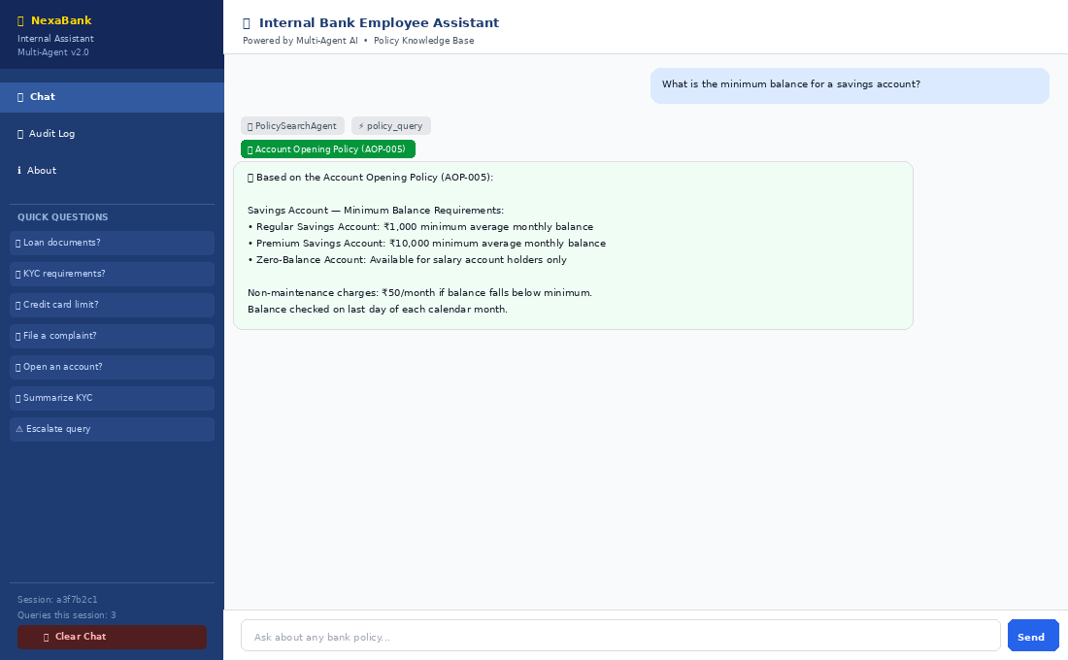
Screenshots of Results
App Home
Loan Policy Search
KYC Search
Multi-Policy
Policy Summary
Escalation
Compliance Alert
Self-Healing Fallback
Account Opening

Slide 19
🏦
Thank You
Internal Bank Employee Assistant — Multi-Agent Capstone v2.0
Questions & Discussion
7 Agents • 3 Skills • 6 Hooks • KEYWORD_MAP • 3 Log Files • 49 Tests • 100% Pass

