Slide 1
BMW Case Study ATHIRA PULICKAKUDY SALIN

Slide 2
Outlier
FLOW
Threshold
Imbalance data
K-Fold,best
Paramenters
Missing Values
Understanding
Problem
Sampling
Feature Engineering
Results and Interpetations
Model
Understanding
and Cleaning Data
Feature
Generation/Extraction
Task
Metrics
Solution
Correlation
Accuracy interpretations
Optimal Features

Slide 3
Understanding Problem
Problem :- Perform a binary classification of the "Type" column.
Goal : - Based on the data, find an elegant way to perform binary classification on ‘Type’.

Slide 4
Solution
Find an elegant way to perform a binary classification of the column ‘Type’
The dataset contain both numerical and categorical features.
Generate one-hot-encoding of the categorical features.
Study the importance of different features, consider the informative Features and remove the less important features
Train on several models for binary classification and consider the best model
Understand importance of Variables based on the learning and existing bias in our model.
Speak to the Data

Slide 5
Understanding Data
Missing Values
Skewness
Imbalance Data
Outliers

Slide 6
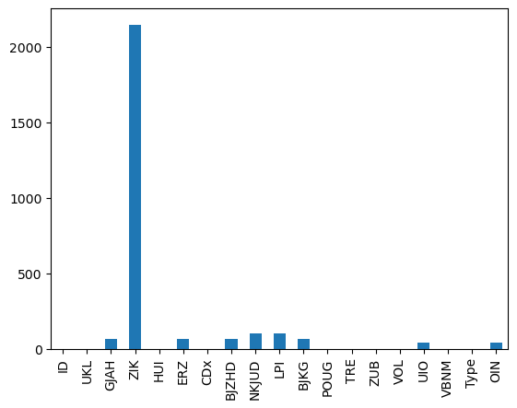
Missing Values
‘ZIK’ has mostly missing values
May lose information
Numerical features imputed with mean
Categirical features imputed with mode
Random forest can be trained on the observed values of a data matrix to predict the missing values.
Lets Understand the distributions

Slide 7
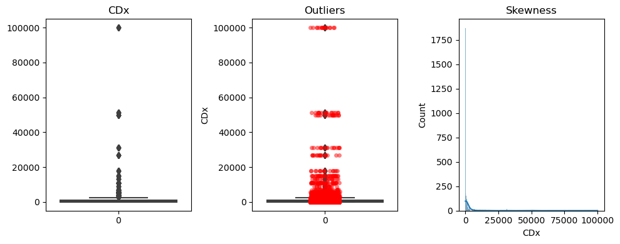
Outliers
Cdx Very skewed, but Outliers exist

Slide 8
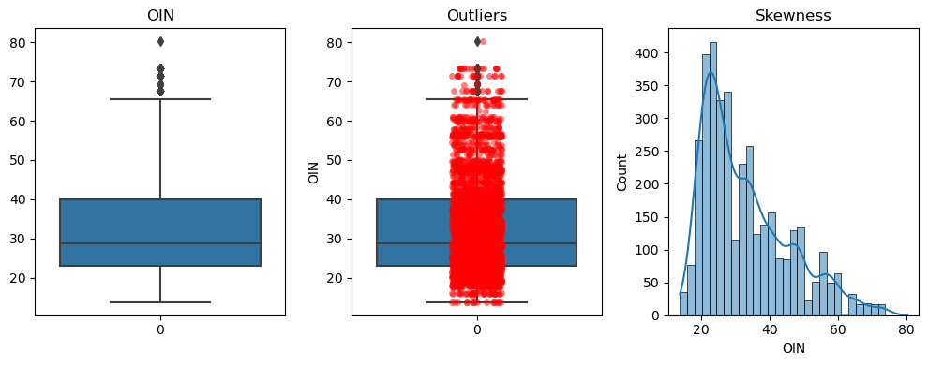
Outliers
OIN Normally distributed, not Outliers exist

Slide 9
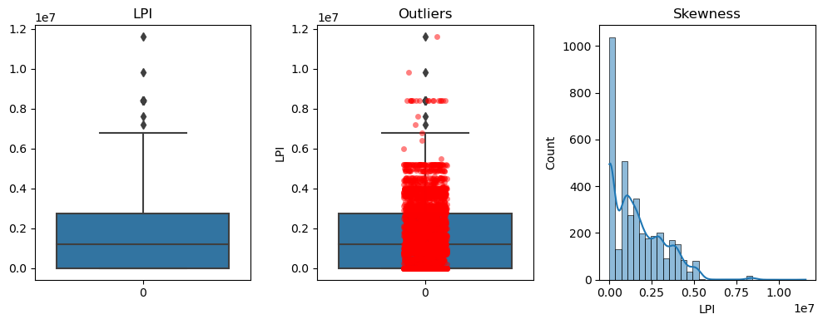
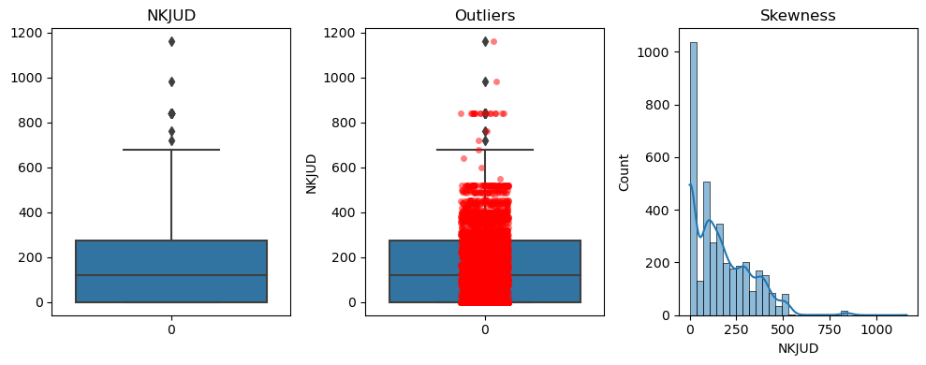
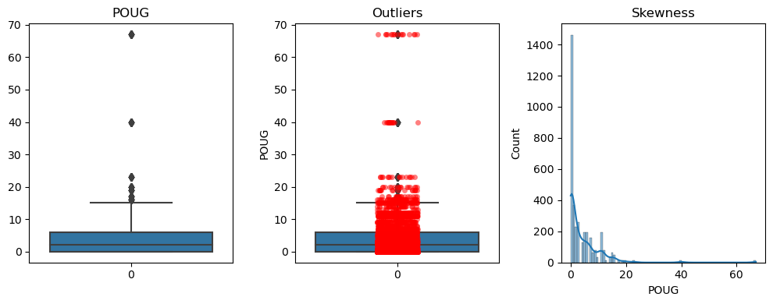
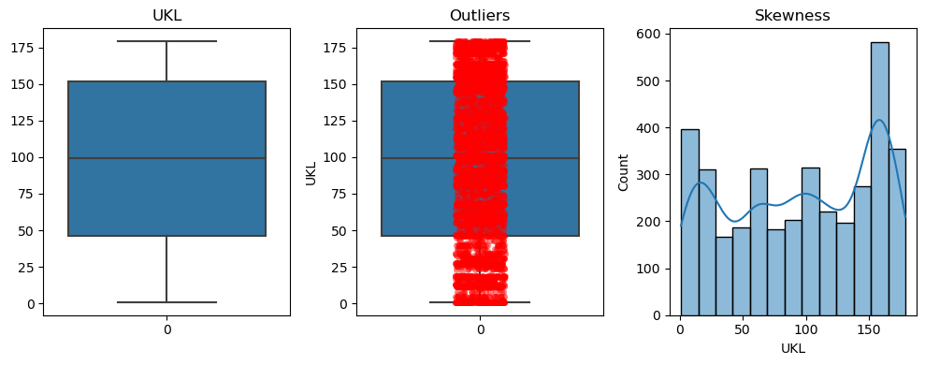
LPI
Skewed, few outliers
NKJUD
Skewed, few outliers
POUG
Very skewed, exist outliers
Slightly skewed, no outliers
UKL

Slide 10
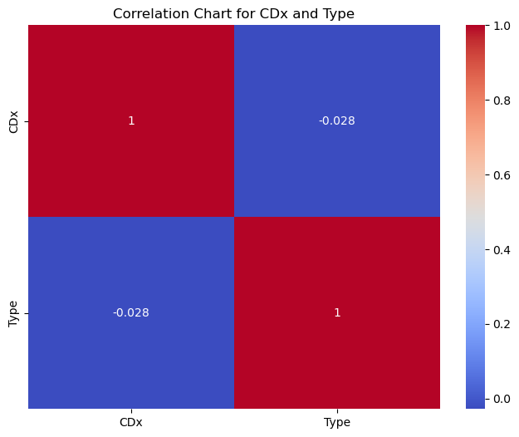
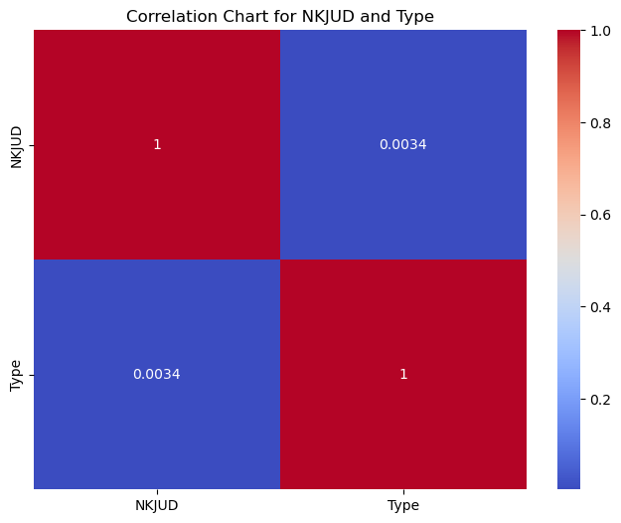
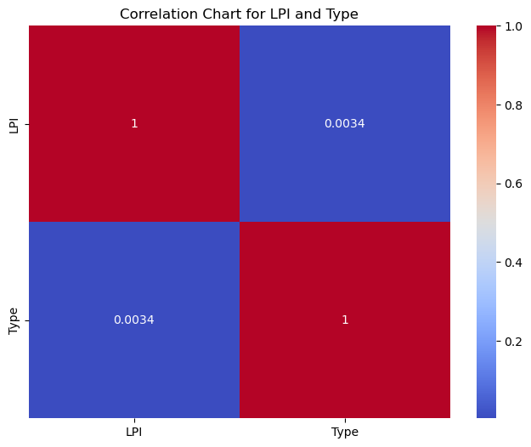
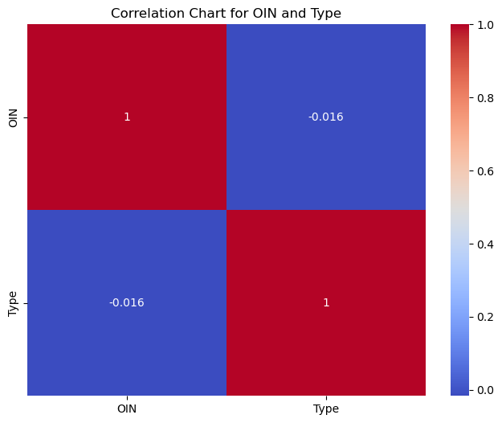
Correlation between target and numerical features
Correlation analysis helps identify the most relevant features.
Cdx - negatively correlated
LPI - is positively correlated
NKJUD -positively correlated
OIN – negatively correlated

Slide 11
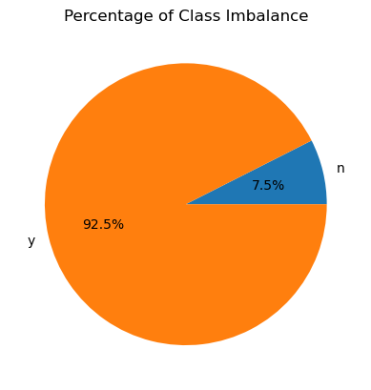
Imbalance Data
Accuracy Paradox
Oversampling, Not Under-sampling !!
Too less data to go for under-sampling of modelling data

Slide 12
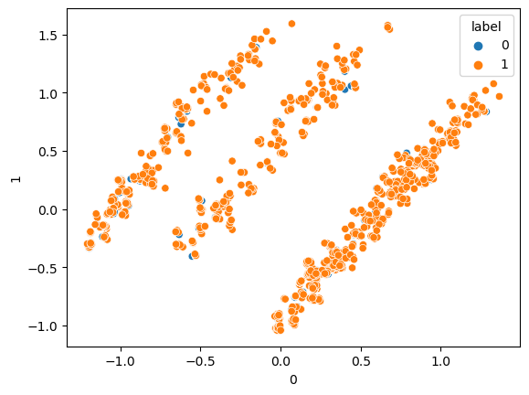
Outliers
Applied TNSE on the data to remove outliers using one class SVM.
Principle component analysis can be done.
Found Few Outliers

Slide 13
Feature Engineering
Feature Extraction
Correlation
Feature Selection

Slide 14
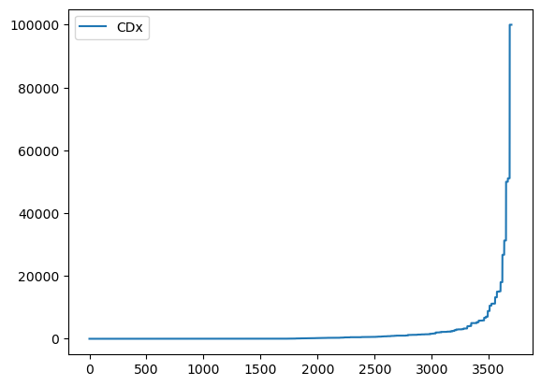
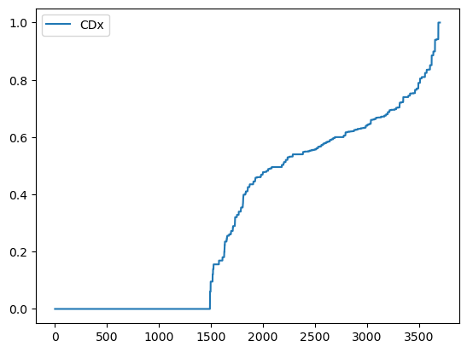
Feature Engineering
Total 43 are there.
Skewness correction
The numerical features considered and checked the skewness.
'Cdx','POUG','TRE' are log-transformed to account for skewness
All the numerical features are then scaled.
CDx
Log transformed CDx

Slide 15
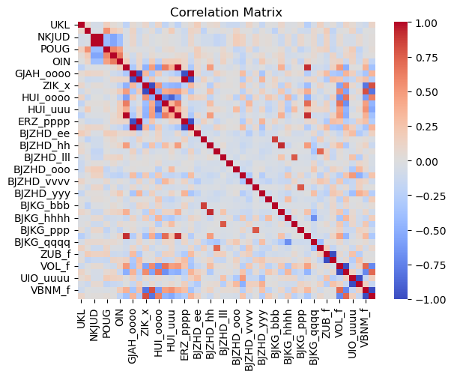
Correlation
The correlations between categorical data features can captured by chi-squared test.
The correlations between continuous numerical data features can be captured by one-Class anova and T-test.

Slide 16
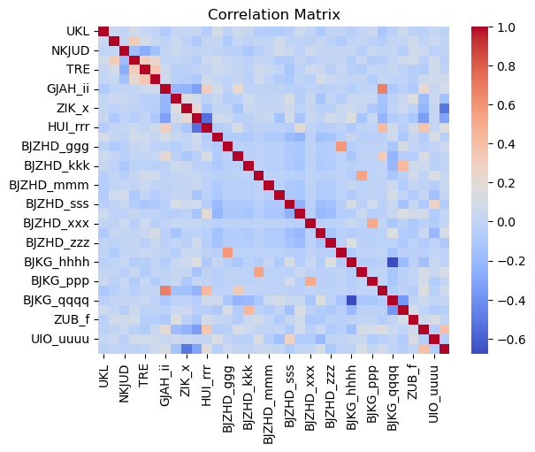
Correlation
One hot encoded the categorical features and then removed highly correlated features
Correlation matrix before and after removing highly correlated features

Slide 17
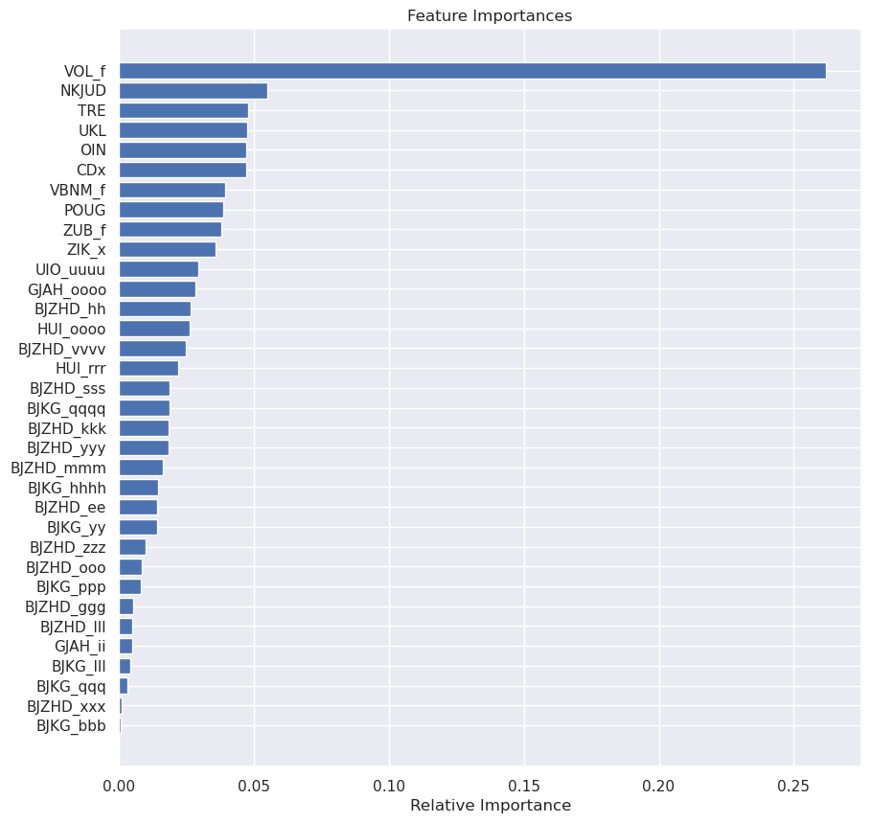
Feature Selection
Generate plots from drop_feature_impotance
Including all these 38 features will either over-fit or introduce variance to our model
More features also increase the flexibility of the model, which might end up with bad results on validating data set.
10 features are dropped based on the feature importance’s and correlation (both categorical and continuous)
Reduce training time
Improved Accuracies

Slide 18
Model
Sampling
K-Fold
Evaluation
Threshold

Slide 19
Sampling
Modelling dataset contains highly imbalance classes
ML algorithms struggle with accuracy because of the unequal distribution in dependent variable.
This causes the performance of existing classifiers to get biased towards majority class.
Tried oversampling but best results comes with class weights
Avoid discarding useful information

Slide 20
K-Fold Evaluation
Logistic Regression, Random Forest and SVM
Random Forest is chosen
5-Kfold model is ran to optimize the learning process.
Average AUC Is optimized in iteration
Best Parameters are chosen based on the K-Fold CV

Slide 21
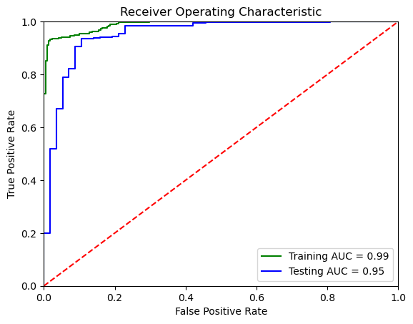
Threshold
Precision vs Recall
Threshold from ROC Curve is taken as reference
5-Fold CV is ran to optimize threshold

Slide 22
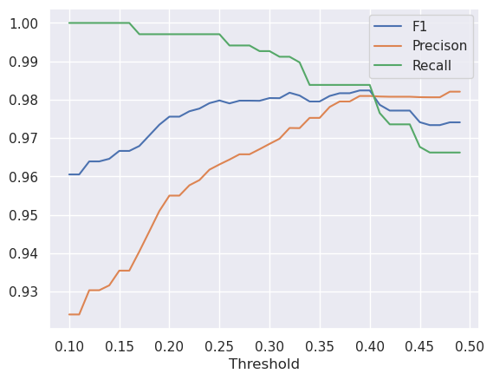
Threshold
Precision, F1 and recall performs when threshold is 0.4

Slide 23
Results and Interpretation
Metrics Choosen
Interpretations

Slide 24
Metrics Chosen
ROC curve: It can be used to select a threshold for a classifier which maximises the true positives, while minimising the false positives.
AUC: It can be used to compare the performance of two or more classifiers.
Confusion matrix: It can be used to understand the TP,TN,FP,FN and it can be used to understand the model performance.
Recall : TP / (TP+FP)
Precision : TP / (TP+FN)
F-Score : (2*Recall*Precision) / (Recall +Precision)

Slide 25
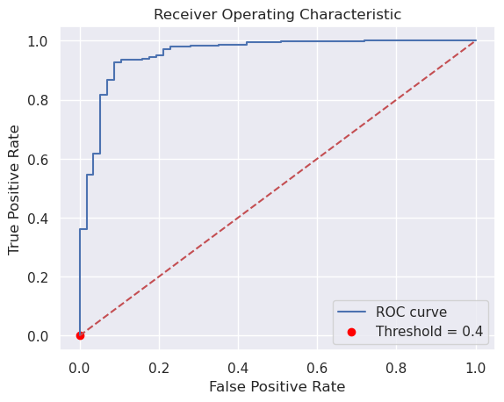
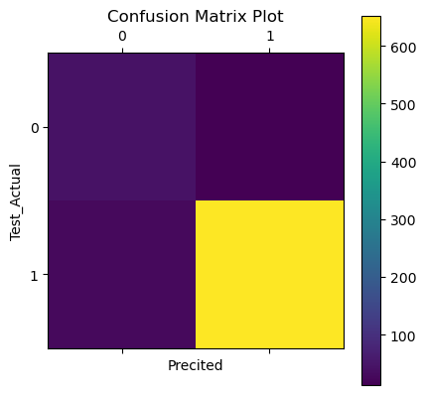
Accuracies & Interpretation
The Accuracies are presented for 5-Fold cross validation
Recall = 0.977974
Precision = 0.979412
Accuracy = 0.960705
F-Score = 0.978692

Slide 26
QUESTIONS ?

