Slide 1
Support Vector Machine

Slide 2
Contents
SVM Concept
Hyperplane
Types of SVM
Tuning SVM Classifier
Kernel
Regularization
Gamma
Margin
Advantages and Disadvantages

Slide 3
Support Vector Machine
Support vector machines (SVMs) are a set of supervised learning methods used for classification, regression and outliers detection.
SVM is a non-probabilistic linear classifier which directly says to which group the datapoint belongs to without using any probability calculation.
The objective of the support vector machine algorithm is to find a hyperplane in an N-dimensional space(N — the number of features) that distinctly classifies the data points.

Slide 4
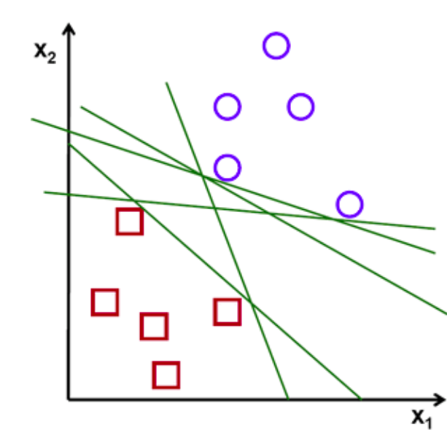
Cont..

Slide 5
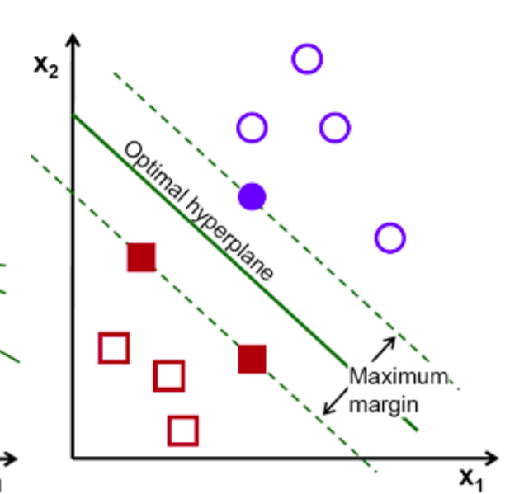
Cont..

Slide 6
Cont..
The best decision boundary is called a hyperplane.
SVM chooses the extreme points/vectors that help in creating the hyperplane. These extreme cases are called as support vectors, and hence algorithm is termed as Support Vector Machine.
Support Vectors − Datapoints that are closest to the hyperplane is called support vectors. Separating line will be defined with the help of these data points.
The distance between the vectors and the hyperplane is called as margin. The goal of SVM is to maximize this margin.

Slide 7
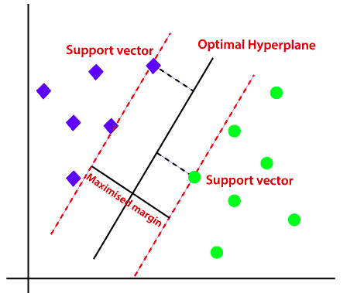

Slide 8
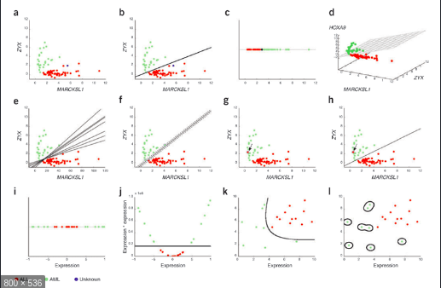
Hyperplane
There can be multiple lines/decision boundaries to segregate the classes in n-dimensional space, but we need to find out the best decision boundary that helps to classify the data points. This best boundary is known as the hyperplane of SVM.

Slide 9
Cont..
The dimensions of the hyperplane depend on the features present in the dataset, which means if there are 2 features, then hyperplane will be a straight line. And if there are 3 features, then hyperplane will be a 2-dimension plane.
A Hyperplane is an n-1 dimensional plane which optimally divides the data of n dimensions.

Slide 10
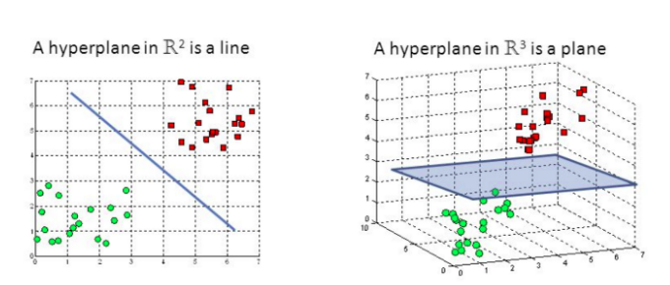
Cont..

Slide 11
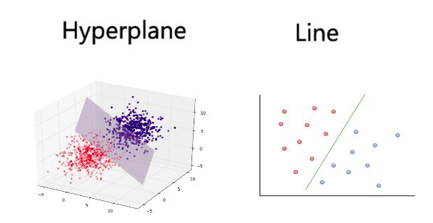
Cont..

Slide 12
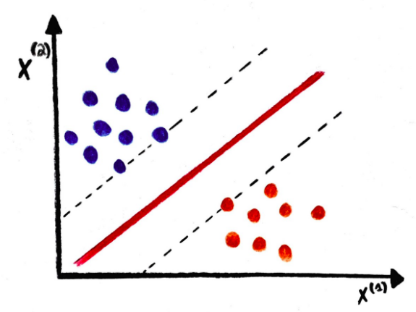
Types of SVM
Linear SVM: Linear SVM is used for linearly separable data, which means if a dataset can be classified into two classes by using a single straight line, then such data is termed as linearly separable data, and classifier is used called as Linear SVM classifier.

Slide 13
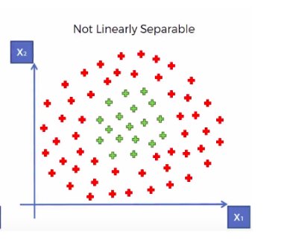
Non-linear SVM
If a dataset cannot be classified by using a straight line, then such data is termed as non-linear data and classifier used is called as Non-linear SVM classifier.

Slide 14
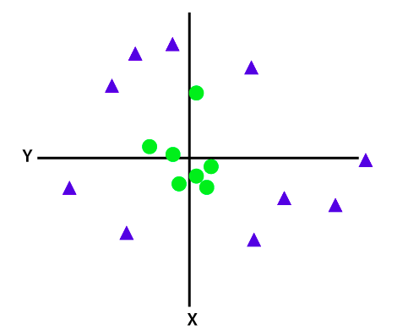
Cont..
If data is linearly arranged, then we can separate it by using a straight line, but for non-linear data, we cannot draw a single straight line.

Slide 15
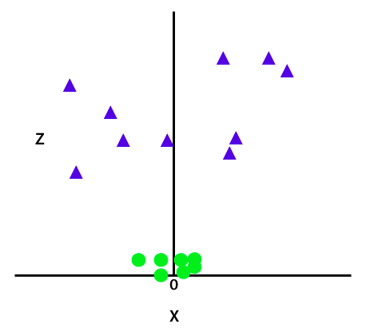
So to separate these data points, we need to add one more dimension. For linear data, we have used two dimensions x and y, so for non-linear data, we will add a third dimension z.

Slide 16
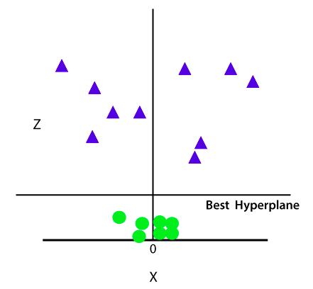
SVM will divide the datasets into classes in the following way.

Slide 17
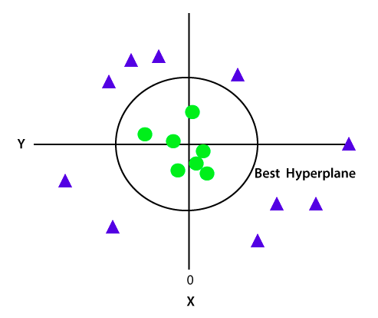
Cont..
Since the datapoints are in a 3-d Space, it is looks like a plane parallel to the x-axis.
There is no line that can separate the two classes in this x-y plane.
If we convert it in 2d space with z=1 then it will become as:

Slide 18
Cont...
We apply transformation and add one more dimension as we call it z-axis.
Lets assume value of points on z plane, z = x² + y². In this case we can manipulate it as distance of point from z-origin. Now if we plot in z-axis, a clear separation is visible and a line can be drawn .
When we transform back this line to original plane, it maps to circular boundary as shown in image. These transformations are called kernels.

Slide 19
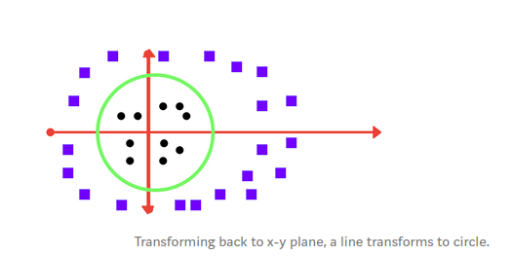
Cont..
you don’t have to guess/ derive the transformation every time for your data set. The sklearn library's SVM implementation provides it inbuilt.

Slide 20
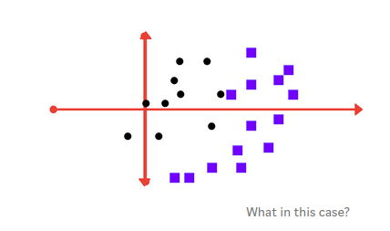
How can we classify?

Slide 21
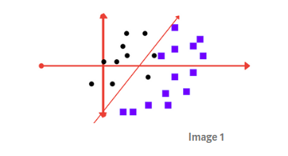
Cont..
It tolerates some outlier points.

Slide 22
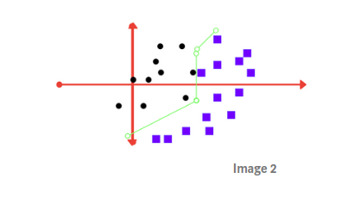
Cont..
Trying to achieve 0 tolerance with perfect partition.

Slide 23
Tuning SVM Classifier
Regularization parameter and gamma are the tuning paramenters in SVM classifier.
Varying those we can achive considerable non linear classification line with more accuracy in reasonable amount of time.
One more parameter is kernel.

Slide 24
Kernel
SVM algorithm is implemented with kernel that transforms an input data space into the required form.
SVM uses a technique called the kernel trick in which kernel takes a low dimensional input space and transforms it into a higher dimensional space.
In simple words, kernel converts non-separable problems into separable problems by adding more dimensions to it.
It makes SVM more powerful, flexible and accurate

Slide 25
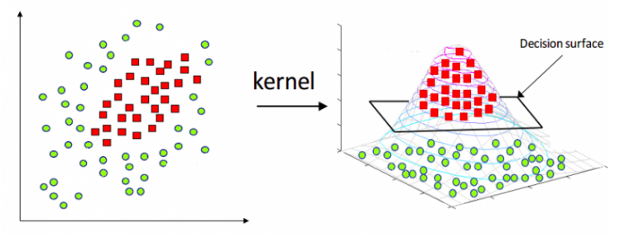
Cont..

Slide 26
Common Kernels used with SVM
Linear Kernel
Polynomial kernel
Gaussian Kernal
RBF - Gaussian Radial Basic Fuction (Default)
Sigmoid Kernel
Laplace RBF Kernel
ANOVA Radial Basic Kernel

Slide 27
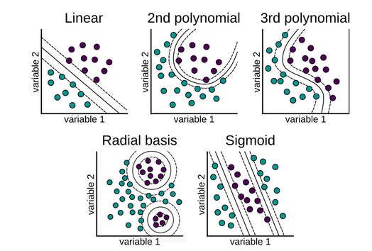
Cont..

Slide 28
Linear Kernel
The learning of the hyperplane in linear SVM is done by transforming the problem using some linear algebra.
For linear kernel the equation for prediction for a new input using the dot product between the input (x) and each support vector (xi) is calculated as follows:
f(x) = B(0) + sum(ai * (x,xi))
This is an equation that involves calculating the inner products of a new input vector (x) with all support vectors in training data.
The coefficients B0 and ai (for each input) must be estimated from the training data by the learning algorithm.

Slide 29
Polynomial Kernel
It is more generalized form of linear kernel and distinguish curved or nonlinear input space.
The formula for polynomial kernel is - k(X,Xi)=1+sum(X∗Xi)^d
Here, d is the degree of polynomial, which we need to specify manually in the learning algorithm.

Slide 30
Radial Basis Function (RBF) Kernel
RBF kernel, mostly used in SVM classification, maps input space in indefinite dimensional space.
The formula explains it mathematically −
K(x,xi) = exp(−gamma∗sum(x−xi^2))
Here, gamma ranges from 0 to 1. We need to manually specify it in the learning algorithm.

Slide 31
Regularization
The Regularization parameter ( C parameter in python’s sklearn library) tells the SVM optimization how much you want to avoid misclassifying each training example.
C is a hypermeter in SVM to control error.
For large values of C, the optimization will choose a smaller-margin hyperplane if that hyperplane does a better job of getting all the training points classified correctly.
Conversely, a very small value of C will cause the optimizer to look for a larger-margin separating hyperplane, even if that hyperplane misclassifies more points.

Slide 32
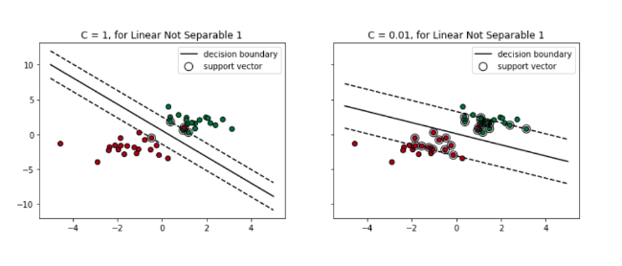

Slide 33
Cont..
Misclassification due to lower regularization value

Slide 34
Cont..
High regularization value

Slide 35
Gamma
It is used when we use Gaussian RBF kernel. If we use linear or polynomail kernel there is no need of gamma , only C hypermeter is used.
The gamma parameter defines how far the influence of a single training example reaches, with low values meaning ‘far’ and high values meaning ‘close’.
In other words, with low gamma, points far away from plausible seperation line are considered in calculation for the seperation line. Where as high gamma means the points close to plausible line are considered in calculation.
Gamma higher means more curvature and vice versa.

Slide 36
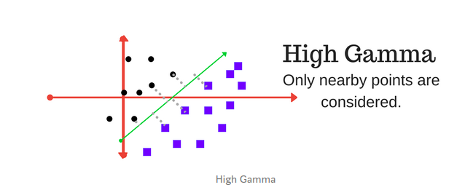
Cont..

Slide 37
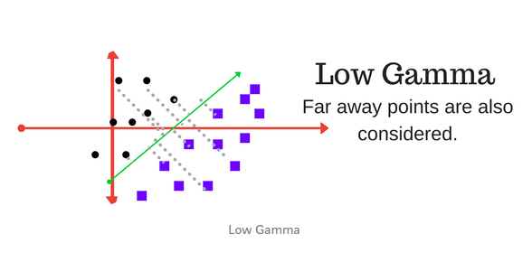

Slide 38
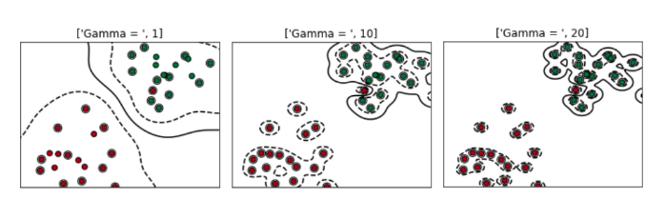
Cont..

Slide 39
Margin
Margin is a very importrant characteristic of SVM classifier.
SVM always tries to achieve a good margin.
A margin is a separation of line to the closest class points.
A good margin is one where this separation is larger for both the classes.
A good margin allows the points to be in their respective classes without crossing to other class.

Slide 40
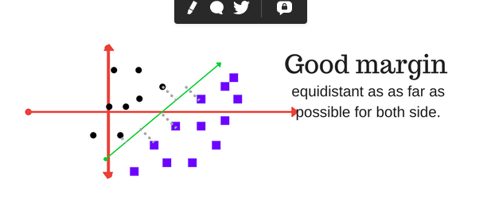
Cont..

Slide 41
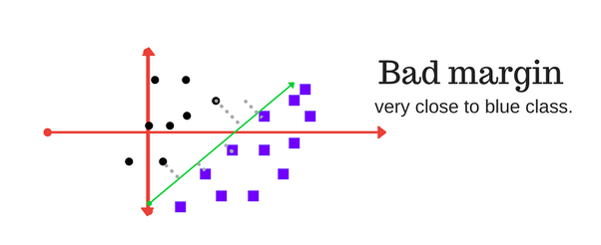
Cont..

Slide 42
Advantages of SVM classifier
SVMs are effective when the number of features is quite large.
It works effectively even if the number of features is greater than the number of samples.
Non-Linear data can also be classified using customized hyperplanes built by using kernel trick.
It is a robust model to solve prediction problems since it maximizes margin.

Slide 43
Disadvantages of SVM classifier
The biggest limitation of the Support Vector Machine is the choice of the kernel. The wrong choice of the kernel can lead to an increase in error percentage.
With a greater number of samples, it starts giving poor performances.
SVMs have high algorithmic complexity and extensive memory requirements due to the use of quadratic programming.

