Slide 1





BOOKBREEZE-EMPORIUM
Team Members: Team Guide:
Abarna R Mrs. R.Umamaheshwari
Athirshdalakshmi S
Sathyapriya K
Vinisha B
Disclaimer: The content is curated for educational purposes only.

Slide 2
-BOOKBREEZE-EMPORIUM
OUTLINE
Abstract
Problem Statement
Aims, Objective & Proposed System/Solution
System Design/Architecture
System Development Approach (Technology Used)
Algorithm & Deployment
Conclusion
Future Scope
References
Video of the Project
Notes:
These are the list of chapters that we are going to cover in these foundation codes. Those are chapter one what are AI and ML? chapter 2 applied Python programming in AI, and chapter 3 is exploratory data analysis for ML.

Slide 3
Abstract This project introduces the technologies used in the building of an online bookshop website and describes the functional structure of the system using a function diagram. The front-end system handles user login and registration, commodity display, shopping cart management, and other module operations. The backend manages users, keeps track of book sales history, adds and manages books, handles orders, and performs other module activities. Through application of the Online-bookstores website, users can buy books online, which solves the problem that users are busy and have no time to shop in physical bookstores.
-BOOKBREEZE-EMPORIUM

Slide 4
Problem Statement Customer complaints about delayed delivery, incorrect book recommendations, and improper order processing are on the rise at the online bookshop, which is having a negative impact on customer satisfaction and retention rates.
-BOOKBREEZE-EMPORIUM

Slide 5
Aim The aim of the online Book Store project is to create a user-friendly and efficient platform that provides a seamless experience for customers to browse, search, and purchase a wide range of books online. Objective The goal of this online bookstore project is to create a platform that is user-centric and transforms the way people interact with books. The main goal is to create a shopping and browsing experience that is easy to use and accessible on a variety of devices.
-BOOKBREEZE-EMPORIUM

Slide 6
Proposed Solution Our website design is user friendly interface and easy to access .Both buyers and bookstore managers can achieve their own needs . By using html,css,java servlets pages,mysql db and eclipse ide , the Website provides user login and registration, commodity display, shopping cart, library management, order management, information management and other modules functions.
-BOOKBREEZE-EMPORIUM

Slide 7
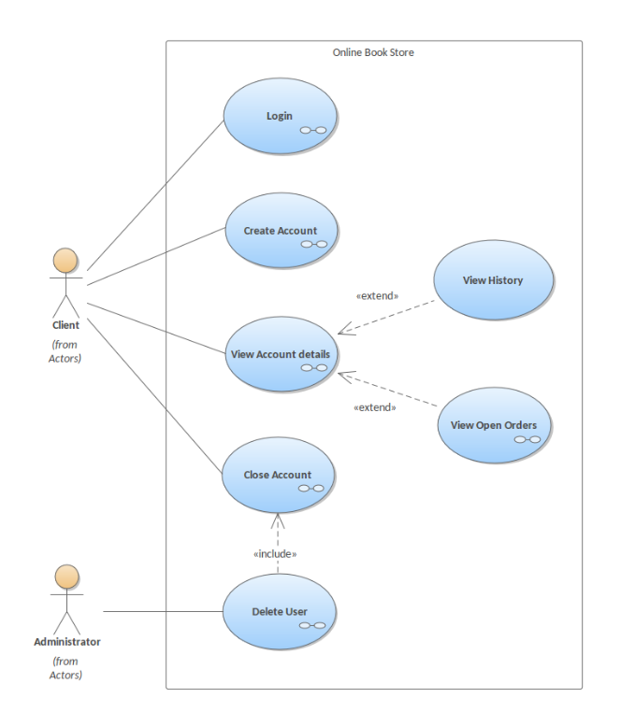
System Architecture
-BOOKBREEZE-EMPORIUM

Slide 8

Overview:
-BOOKBREEZE-EMPORIUM

Slide 9
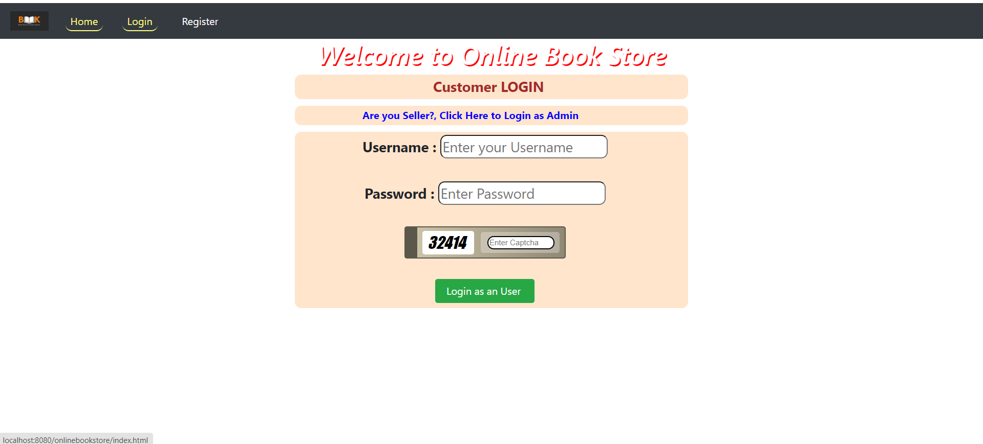
Overview:
-BOOKBREEZE-EMPORIUM

Slide 10
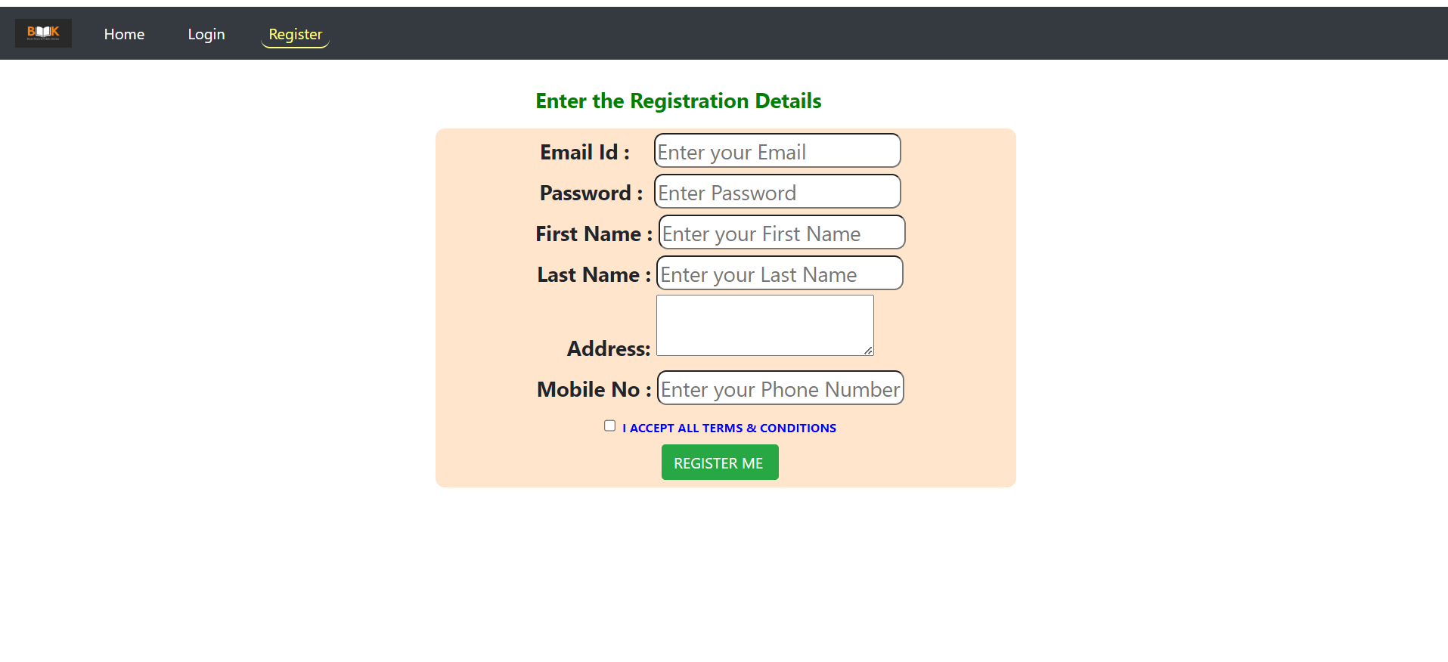
Overview:
-BOOKBREEZE-EMPORIUM

Slide 11
System Development Approach ●Front-End Development: HTML CSS JavaScript ●Back-End Development: Java ●Database: MySql
-BOOKBREEZE-EMPORIUM

Slide 12
Algorithm: Collaborative Filtering: Analyze user behavior (purchases, views) to suggest books based on similar user preferences.
-BOOKBREEZE-EMPORIUM

Slide 13
Conclusion: The online bookstore project success relies heavily on meeting customer expectations and satisfaction. However, recent challenges with delayed deliveries, inaccurate recommendations, and order processing errors have negatively impacted user experiences, leading to increased complaints and lowered retention rates. To counter these issues, immediate attention to enhancing delivery efficiency, refining recommendation algorithms, and optimizing order processing is crucial. Implementing solutions for timely deliveries, upgrading recommendation systems for personalized and accurate suggestions, and streamlining backend processes are pivotal steps. By prioritizing these aspects, the bookstore can rectify current shortcomings, boost customer satisfaction, and foster loyalty in a competitive online market.
-BOOKBREEZE-EMPORIUM

Slide 14
Future Scope 1.The future scope for an online Book Store project can involve several enhancements and expansions to meet evolving customer needs and technological advancements. 2.Implementing blockchain technology can enhance security by ensuring secure transactions and protecting user data. 3.Integrating AI-powered chatbots can significantly improve customer support. 4.These chatbots can assist users in finding books, provide real-time order updates, and offer personalized recommendations.
-BOOKBREEZE-EMPORIUM

Slide 15
-BOOKBREEZE-EMPORIUM
Reference
Kun Qian. "Online Bookstore Management System Based on JSP." Science & Technology Vision, 2015, vol. 18, pp.126-127.
Notes:
Reference
These are the references for this session.
15

Slide 16
-BOOKBREEZE-EMPORIUM
Thank you!
Notes:
thank you very much for joining this PPT, keep learning.
16

