Slide 1
proximity sensor

Slide 2
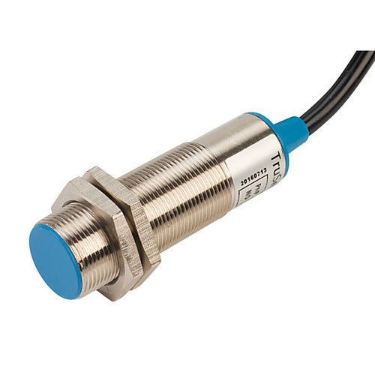

Slide 3
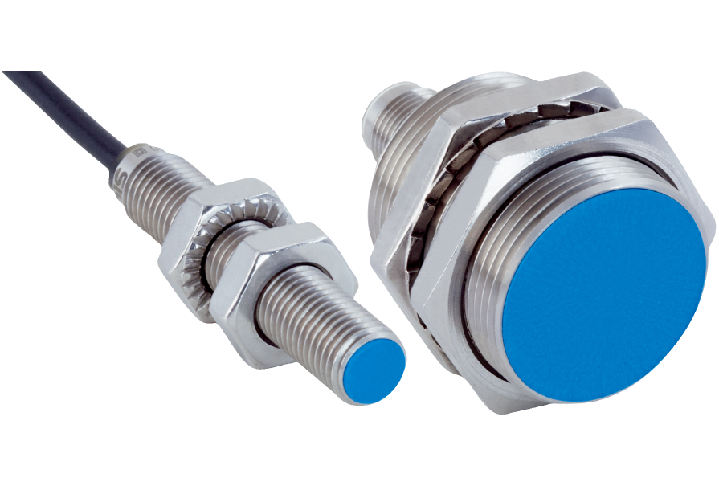
proximity sensor
Proximity Sensors are sensors that detect movement or presence of an objects without making physical with the object and converts that information captured into an electrical signal.
Proximity sensors detect the presence of an object,
Without touching it.
As these sensors are non contact sensors they do
Not cause any damage to the object.

Slide 4
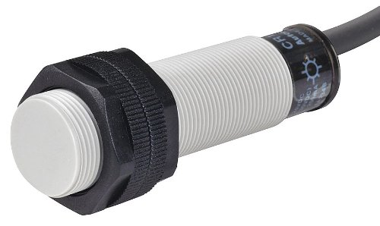
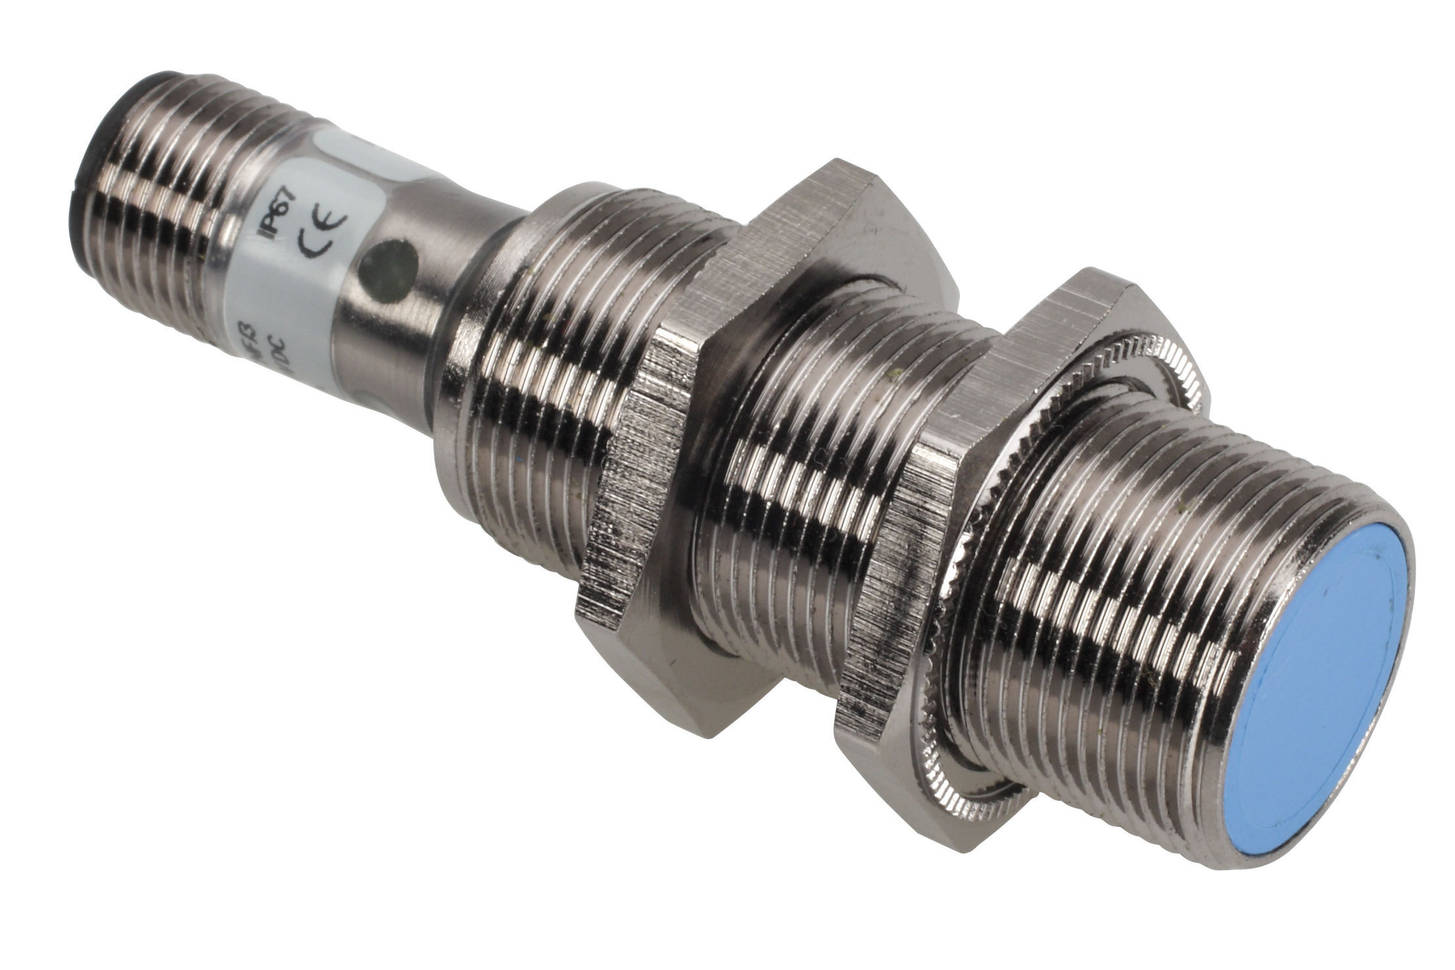
The most commonly used proximity sensors are :
Capacitive proximity sensor
2. Inductive proximity sensor

Slide 5
Capacitive proximity sensor
Working principle of capacitive proximity sensors :
capacitive proximity sensor is based on the principle of parallel plate capacitor. It consist of two parallel plates that are separated by a dielectric material which is a poor conductor of electricity which is a poor conductor of electricity such as plastic,glass or porcelain.The two parallel plates are conductive and they are usually made of Aluminum,Tantalum or other metals.
The ability of a capacitor to store electric charge when a voltage is applied is called capacitace.
Quantity measuring the ability of a dielectric material to store charge is called Dielectric constant.

Slide 6
Capacitance of a capacitor
The capacitance of a capacitor is directly proportional to the dielectric contant between the two plate and inversely proportional to the distance between the two plates.
C = ε0εr(A/d)
Where,
A = Area of the parallel plate.
d = Distance between the plates.
ε0 = The permittivity of free space
εr = The relative permittivity of the medium

Slide 7
Types of capacitive proximity sensors :
1. Dielectric type :
Dielectric type of capacitive sensor can detect any target that has a dielectric constant greater than air. It has two parallel plates inside the sensing head which operates like an open capacitor .
Here air acts as the dielectric.When no target is present,the capacitance between the plate will be very less.These plates are linked to an oscillator and a detector circuit. As the target which has dielectric constant more than air comes near to the sensor the capacitance between the plate increases.Increasing capacitance increases the amplitude of the oscillation of the oscillator.When the oscillation exeeds a specific value, the detector turns on the output of the sensor.When the target object moves away from the sensor the oscillation amplitude decreases and when it falls below a threshold value the sensor returns to the initial state.This type of sensor sence both metallic and non metallic objects.

Slide 8
2. Conductive type :
In this type of sensor is only one capacitor plate inside the sensor, the target itself becomes the other plate of the parallel plate capacitor.
The plate of a parallel plate capacitor should be conductive, so this type of sensor is used if the target is electrically conductivr material.The air gap between the sensor and the target functions as the dielectric .The plate inside the sensor is connected to an oscillator circuit that is used to generate an electrostatic field . As the conductive target approaches the sensor,the distance between the two plates decreases ,due to which the capacitance increases and results in increases of oscillation amplitude.Once the oscillations exceeds a predetermind value ,output signal from the sensor is generated which indicates that the target has reached near the sensor.

Slide 9
Inductive proximity sensor
Inductive proximity sensor are used to detect metal objects.
An inductive proximity sensors has four main components.
1 . Coil :
The coil generate necessary electromagnetic field a cup shaped magnetic core holds the coil.This core is necessary to concentrate the coil’s magnetic filed on the front area of the sensor.
2 . Oscillator :
The oscillator is generally an LC oscillator.It produces radio frequency which help to generate an electromagnetic field.
3 . Trigger circuit :
The trigger circuit senses the change in amplitude of oscillation and gives the signal to the output circuit.
4 . Output circuit :
The out put circuit has a transistor after receiving the signal the transistor switches on and gives an output.

Slide 10
Working principle of inductive proximity sensor
Inductive proximity sensors operte on the basic of faraday’s law of inductance.
According to faradays law of inductance when an electrically conducting object is placed in a magnetic field then an Electric current called eddy current will be generated in the object.
According to the lenz’s law the eddy current creates a magenetic field in a conductor and this eddy current mangenetic field opposes the magnetic field which created it.

Slide 11
Working of inductive proximity sensor
The proximit sensor is installed in athe area where we need to sense the presence of an electrically conductive target object. When the sensing coil in the oscillation circuit is supplied with an alternating current , a changing magnetic field is created around the coil.
When the target object entres this electromagnetic field some of the electromagnetic energy is transferred.According to the faradays law of induction an electric current called eddy current will be generated in the object.This eddy current produces another magnetic field called eddy current magnetic field and it opposes the magnetic field which created it.As the eddy current magnetic field opposes the magnetic field of the coil, the intensity of the magnetic field of the coil reduces.
As the target comes very close to the sensor the eddy current increases, decreasing the amplitude of the electromagnetic field.
When amplitude of electromagnetic field increases above a predetermined level of the output state of the sensor switches back to its normal condition.

