Slide 1
Most popular components
Athiswaran.v

Slide 2
DataGrid charts Listview scheduler Diagram PDF Viewer Excel Library

Slide 3
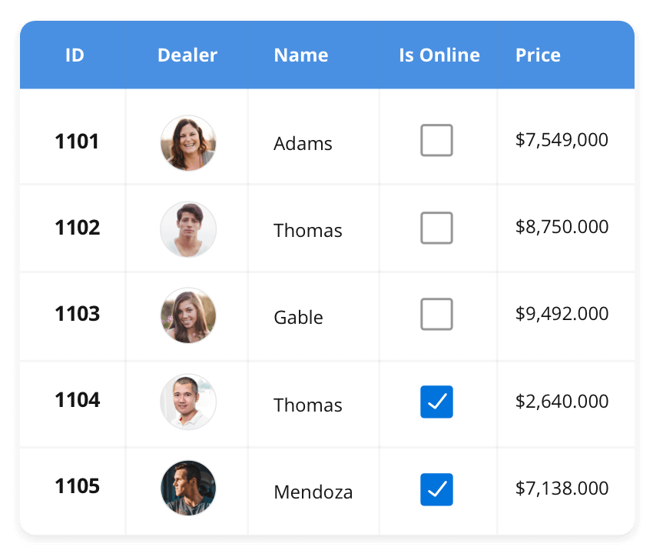



The DataGrid control is a high-performance grid component That helpsdisplay and manipulate large amounts of data in a tabular format.Its rrich feature sets includes functionalities like data binding, sorting, grouping, editing, filtering, swipping, dragging, resizing, loading more items, pull-to-refresh, andexporting to EXCEL and PDF formats.
SUPPORTED PLATFORMS
JavaScript | Angular | React | Vue | Blazor
Flutter | jQuery | ASP.NET MVC | ASP.NET Core
ASP.NET Web Forms
WinForms | WPF | WinUI | Flutter | Xamarin | UWP
Xamarin | Flutter | UWP

Slide 4
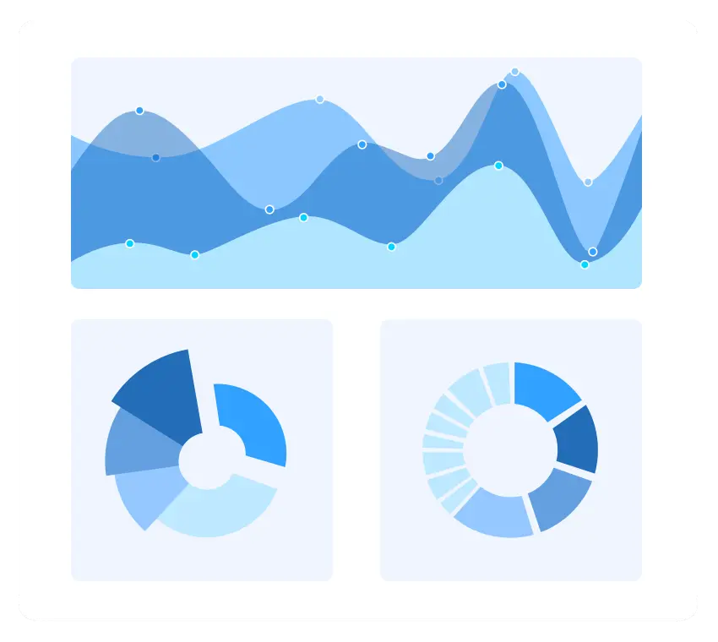
Charts
The Charts control can plot a wide range of chart types, ranging from line charts to specialized financial charts. Its rich feature set includes functionalities like data binding, multiple axes, legends, animation, data labels, annotations, trackballs, tooltips, and zooming.
SUPPORTED PLATFORMS
JavaScript | Angular | React | Vue | Blazor
Flutter | jQuery | ASP.NET MVC | ASP.NET Core
ASP.NET Web Forms
WinForms | WPF | WinUI | Flutter | Xamarin | UWP
Xamarin | Flutter | UWP

Slide 5
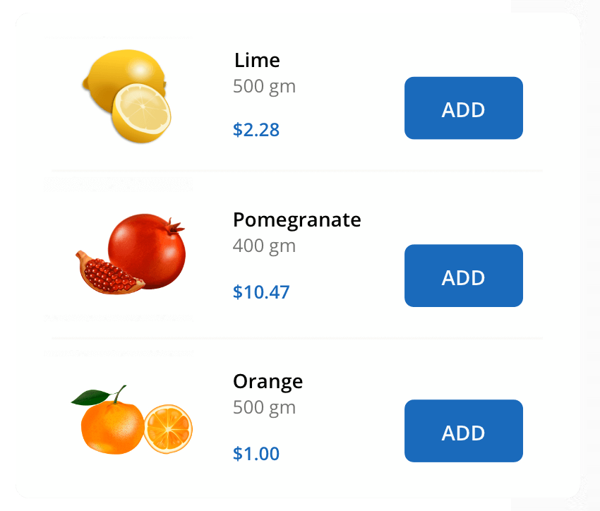

ListView
The ListView renders a set of data items with UI views or custom templates. It has many features like grouping, sorting, filtering, paging, swiping, multiple selection, drag and drop, and different layout types. The ListView control has been optimized to work with large amounts of data.
SUPPORTED PLATFORMS
JavaScript | Angular | React | Vue | Blazor
Flutter | jQuery | ASP.NET MVC | ASP.NET Core
ASP.NET Web Forms
WinForms | WPF | WinUI | Flutter | Xamarin | UWP
Xamarin | Flutter | UWP

Slide 6
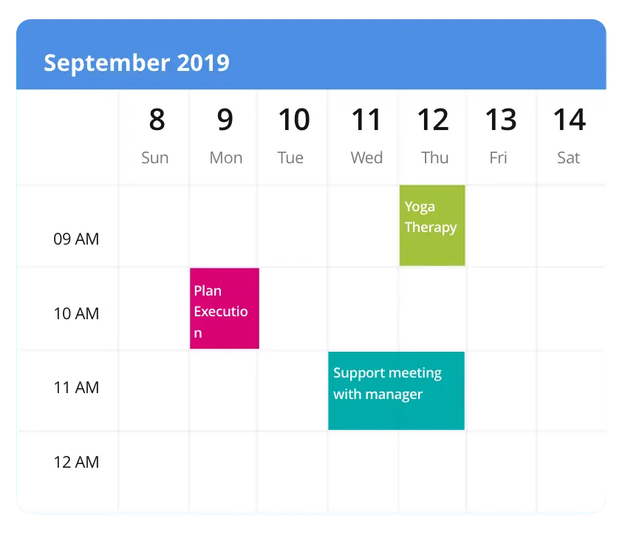
Scheduler
The Scheduler is a fully featured calendar component that allows you to manage your time efficiently. It facilitates easy resource scheduling, appointment rescheduling, drag and drop, resizing actions, and more.
SUPPORTED PLATFORMS
JavaScript | Angular | React | Vue | Blazor
Flutter | jQuery | ASP.NET MVC | ASP.NET Core
ASP.NET Web Forms
WinForms | WPF | WinUI | Flutter | Xamarin | UWP
Xamarin | Flutter | UWP

