Slide 1
Cast Iron
Ferrous alloys with > 2.1 wt% C
more commonly 3 - 4.5 wt%C
low melting (also brittle) so easiest to cast
Cementite decomposes to ferrite + graphite
Fe₃C → 3 Fe (α) + C (graphite)
generally a slow process
Notes:
So phase diagram for this system is different (Fig 12.4)

Slide 2
Fe-C True Equilibrium Diagram
T(°C)
1600
Graphite formation promoted by
Si > 1 wt%
slow cooling
1400
L
Liquid +
Graphite
γ
+L
1200
γ
1153°C
Austenite
4.2 wt% C
1000
α + γ
γ + Graphite
800
740°C
600
0.65
α + Graphite
From Fig. 9.2
Callister’s Materials Science and Engineering, Adapted Version.
(Fig. 9.2 adapted from Binary Alloy Phase Diagrams, 2nd ed.,
Vol. 1, T.B. Massalski (Ed.-in-Chief), ASM International, Materials Park, OH, 1990.)
400
0
1
2
3
4
90
100
(Fe)
C_{o} , wt% C
Notes:
Cast irons have graphite

Slide 3
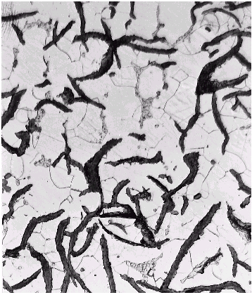
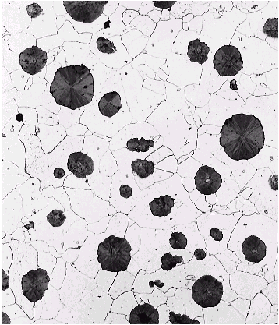
Types of Cast Iron
Gray iron
graphite flakes
weak & brittle under tension
stronger under compression
excellent vibrational dampening
wear resistant
Ductile iron
add Mg or Ce
graphite in nodules not flakes
matrix often pearlite - better ductility
From Fig. 9.3(a) & (b), Callister’s MSE, Adapted Version.

Slide 4
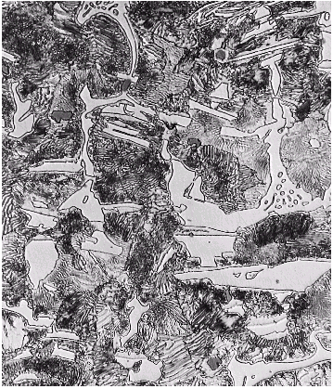
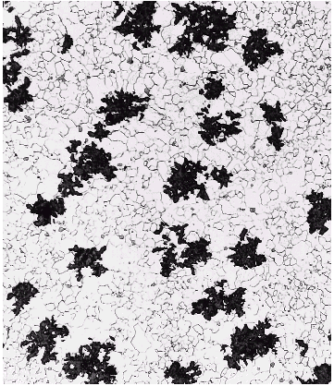
Types of Cast Iron
White iron
<1wt% Si so harder but brittle
more cementite
Malleable iron
heat treat at 800-900ºC
graphite in rosettes
more ductile
From Fig. 9.3(c) & (d), Callister’s MSE, Adapted Version.

