Slide 1
Corrosion

Slide 2
Factors affecting choice of an engineering material
Corrosion resistance
Availability
Cost
Materials
Strength
Appearance
Fabricability

Slide 3
Corrosion
Corrosion is an irreversible interfacial reaction of a
material with its environment which results in
consumption of the material or in dissolution into the
material of a component of the environment
Corrosion is the destructive result of electrochemical
reaction between a metal or alloy and its environment

Slide 4
Costs of Corrosion
Economic
Direct
Indirect
Human life & safety

Slide 5
Costs of Corrosion: Economy aspect
The annual cost of corrosion worldwide is over 3% of the world’s GDP
UTILITIES:
Drinking Water & Sewerage
Gas distribution
Electrical utilities etc.
TRANSPORTATION:
Ships & Aircrafts
Railroad & vehicles
INFRASTRUCTURE:
Gas & liquid transmission
Airports, Waterways
PRODUCTION & MANUFACTURING:
Chemical, Petrochemical, Pharmaceutical, food, paper, metal, oil& gas Exploration etc.
GOVERNMENT:
Defense
Nuclear etc.

Slide 6
Electrochemical Reactions
Zn + 2HCl Zncl₂ + H₂
Zn + 2H⁺ Zn²⁺ + H₂
Zn Zn²⁺ + 2e
. . . . . . .Oxidation (anodic reaction)
2H⁺ + 2e H₂
. . . . . . Reduction (cathodic reaction)
During metallic corrosion, the rate of oxidation equals the rate
of reduction (in terms of electron production and consumption)

Slide 7
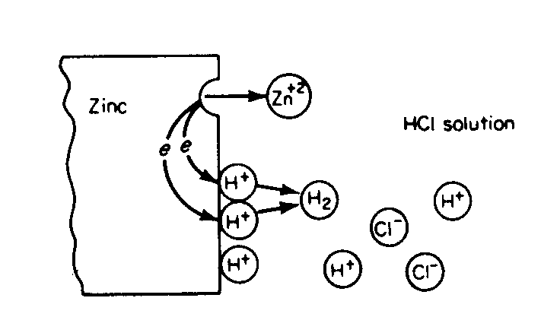
Electrochemical Reactions
Electrochemical reactions occurring during corrosion of Zn
in air-free HCl acid

Slide 8
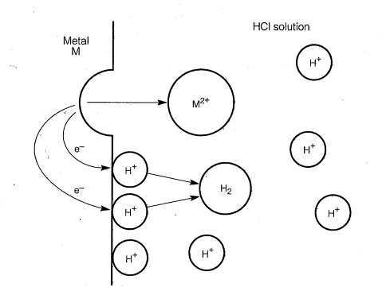
Electrochemical Reactions
Electrochemical reactions occurring during corrosion of a
metal (M) in air-free HCl acid

Slide 9
Anodic Reactions
M M^{n+} + ne
Fe Fe²⁺ + 2e
Ni Ni²⁺ + 2e
Al Al³⁺ + 3e

Slide 10
Cathodic Reactions
2H⁺ + 2e H₂
Fe³⁺ + e Fe²⁺
Redox reaction
Sn⁴⁺ + 2e Sn²⁺

Slide 11
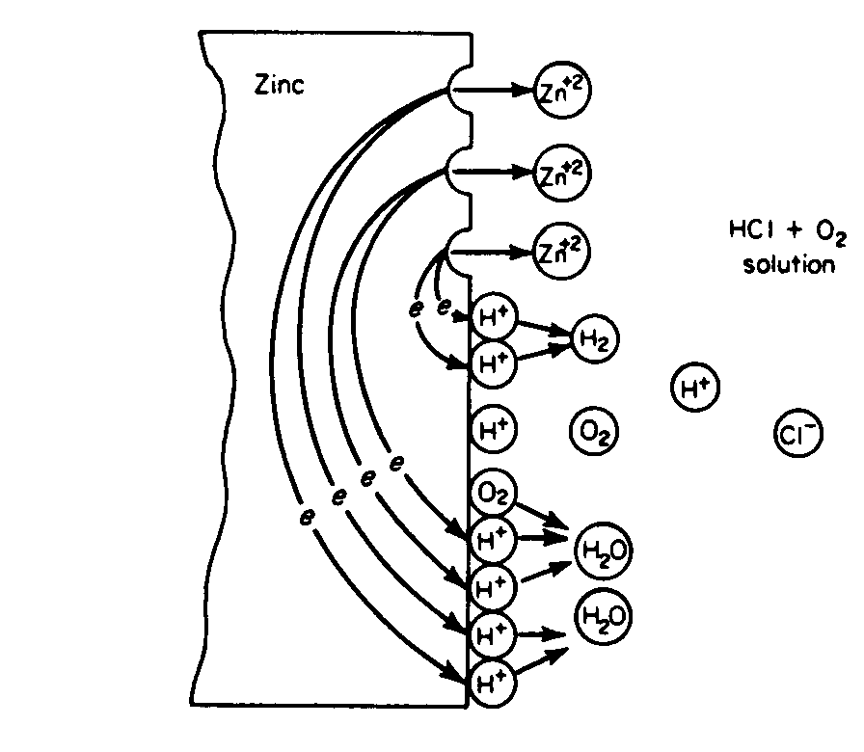
Electrochemical Reactions in aerated solution
Electrochemical reactions occurring during corrosion of Zn
in aerated HCl acid

Slide 12
Cathodic Reactions
O₂ + 4H⁺ + 4e– 2H₂O
. . . . . . .Acid solution
O₂ + 2H₂O + 4e– 4OH –
. . . . . Neutral solution
In the absence of all other reduction reaction, water
will be reduced by
2H₂O + 2e– H₂ + 2OH –

Slide 13
Formation of rust due to corrosion
Fe Fe²⁺ + 2e
O₂ + 2H₂O + 4e– 4OH –
2Fe + O₂ + 2H₂O 2Fe²⁺ + 4OH –
2Fe(OH)₂
2Fe(OH)₃

Slide 14
Summary: What’s need for corrosion to happen
  An anode: This is where the damage occurs. Oxidation takes place.
  A cathode: Here’s where the reduction reaction takes place.
  An electrolyte: (Almost any moisture will do.)
  Current Path: A current path between the cathode and anode.

Slide 15
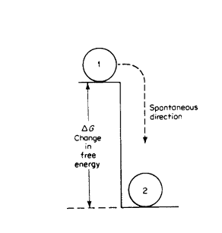
Free Energy
Mechanical analogy of free-energy change

Slide 16
Free Energy and Electrode Potential
Zn + 2HCl Zncl₂ + H₂
Zn + 2H⁺ Zn²⁺ + H₂
Zn Zn²⁺ + 2e
. . . . . . .Oxidation (anodic reaction)
2H⁺ + 2e H₂
. . . . . . Reduction (cathodic reaction)
ΔG = -nFE
E = E_{a} + E_{c}

Slide 17
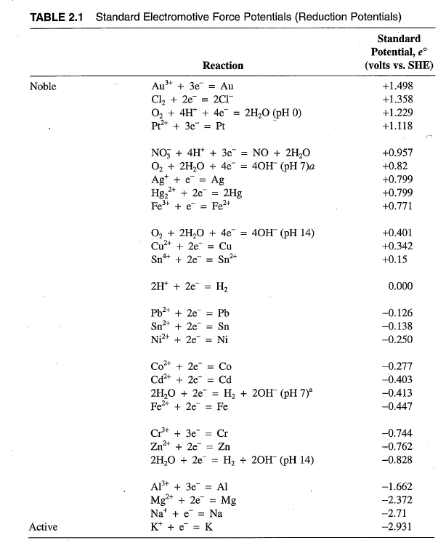
Electromotive force or emf series
Standard half-cell electrode potential

Slide 18
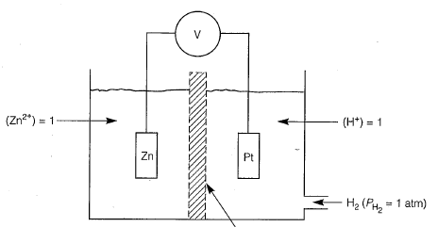
Cell potential

Slide 19
Cell potential
E = E_{a} + E_{c}
ΔG = -nFE
A positive E corresponding to a negative ΔG indicates that the reaction is spontaneous in the written direction
Zn Zn²⁺ + 2e
2H⁺ + 2e H₂
E = +0.762 + 0= +0.762

Slide 20
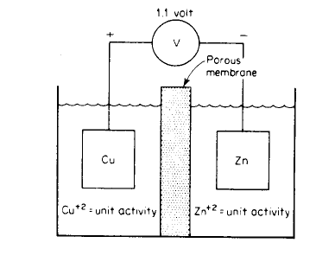
Cell potential

Slide 21
Cell potential
3Pb + 2Al³⁺ 3Pb²⁺ + 2Al
Pb Pb²⁺ + 2e
Al³⁺ + 3e Al
E = − 1.662 + 0.126 = −1.532
Reaction will occur in reverse
direction

Slide 22
Prediction of corrosion behaviour
Cu + H₂SO₄ No reaction
2Cu + 2H₂SO₄ + O₂ 2CuSO₄ + 2H₂O
Cu/Cu²⁺ more +ve than H₂/H⁺
O₂/H₂O more +ve than Cu/Cu²⁺

Slide 23
Take home thoughts!!!!!
As the redox potential of metal become more positive
    Tendency to corrode decreases
    Tendency decreases even in presence of oxidizers
The metals at the uppermost part of the redox series is
extremely inert (e.g. Pt and Gold)
Redox potential can be used to state a criterion for
corrosion
    Corrosion will not occur until the spontaneous
    direction of the reaction is metal oxidation
Major use of thermodynamic as far as corrosion is
concerned
    It tells unambiguously that corrosion will not occur
    It does not tell about the rate of corrosion
23

Slide 24
Eight Forms of Corrosion
Uniform or General attack
Galvanic or Two-metal corrosion
Crevice Corrosion
Apart from uniform corrosion, all other seven forms of corrosion are localized corrosion
Pitting
Intergranular corrosion
Selective leaching or parting
Erosion corrosion
Stress corrosion

Slide 25
Why localized corrosion is more dangerous than uniform corrosion
In uniform corrosion, the anodic and cathodic area is almost equal – so anodic current density (i.e. current/ anodic area) is not very high. Further, it is easy to predict or measure uniform corrosion rate.
However, in localized corrosion, due to smaller anodic area, anodic current density is very high. As a result, the corrosion rate is also very high. Furthermore, it is difficult to predict or measure localized corrosion rate.

Slide 26
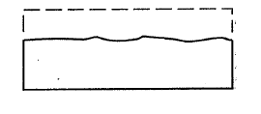
Uniform or General attack
Schematic illustration of uniform attack
Uniform corrosion accounts for the greatest tonnage
of metal consumed
Yet this form of corrosion is not difficult to predict
and control!

Slide 27
Uniform or General attack
For uniform corrosion to happen, the corrosive
environment must have the same access to all parts
of the metal surface
Metal must be metallurgically and compositionally
uniform
Uniform corrosion is preferred from technical
viewpoint as it is predictable and thus acceptable
for design

Slide 28
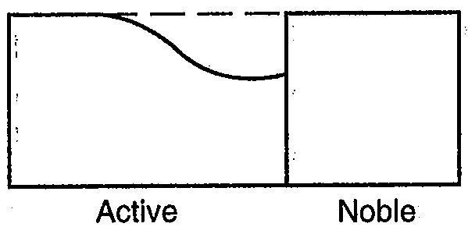
Galvanic or Two-metal corrosion
The less resistant metal becomes anodic
The more resistant metal becomes cathodic
The driving force for current and corrosion is
the potential developed between the two metal

Slide 29
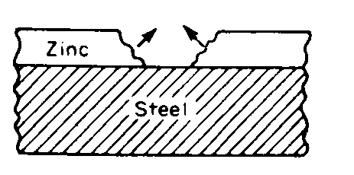
Beneficial Application of Galvanic Corrosion
Galvanized steel
Zn is anodic to steel and preferentially corroded to protect steel

Slide 30
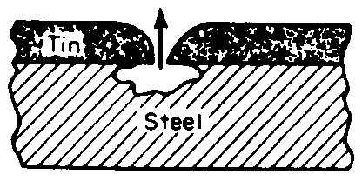
Tin plating is not preferred
The tin, which is more corrosion resistant than Zn is
not desirable
– Sn is cathodic to steel
At perforations in the Sn coating, the corrosion of the
steel is accelerated due to galvanic action
Tin plating

Slide 31
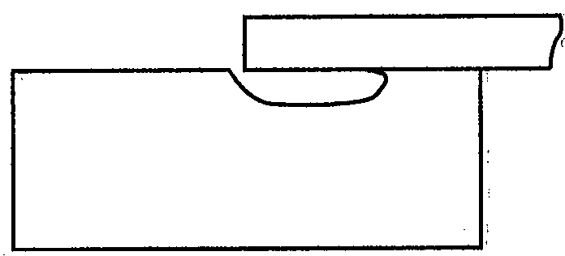
Crevice Corrosion
Intensive localized corrosion frequently occurs within the
crevices and other shielded areas on metal surface exposed
to corrosives
This type of attack usually associated with small volumes of
stagnant solution caused by holes, gasket surfaces, lap joints,
surface deposits, crevices under bolt and river heads
– As a result, this form of corrosion is called crevice
corrosion

Slide 32

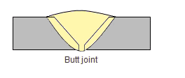
Crevice Corrosion……How to Combat
Use welded butt joints instead of riveted or bolted joints in
new equipment
Close crevices in existing lap joints by continuous welding or
soldering
Design vessels for complete drainage; avoid sharp corners
and stagnant areas
Butt Joint
Riveted Joint

Slide 33
Pitting Corrosion
Pitting is one of the most destructive and insidious form of
corrosion
It is often difficult to detect pits because of there small size
and because pits are often covered with corrosion product
Pitting is particularly vicious because it is a localized and
intense form of corrosion, and failure often occurs with
extreme suddenness

Slide 34
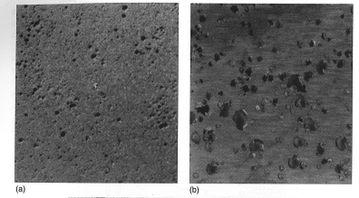
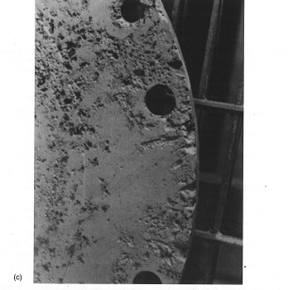
Pit morphology
Shallow
Deep
Deep & closely spaced

Slide 35
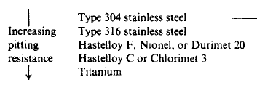
Prevention of pitting corrosion
Addition of 2% Mo to 18:8 SS (type 304) to produce type 316
results in very large increase in pitting resistance

Slide 36
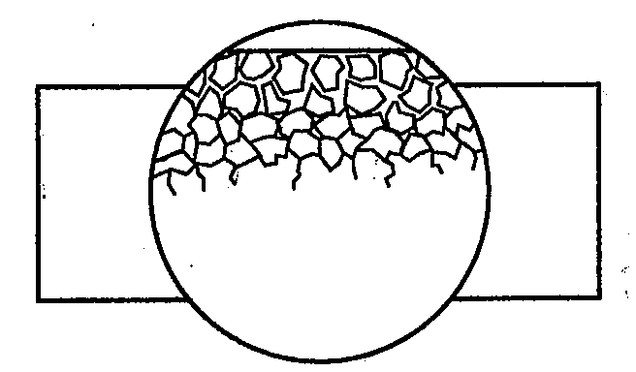
Intergranular Corrosion
Schematic illustration of intergranular corrosion
Localized attack at and adjacent to grain boundaries
With relatively littlie corrosion of the grains

Slide 37
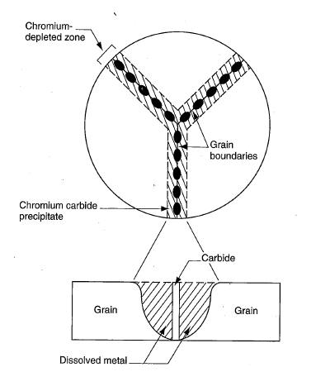
Sensitization in 18:8 stainless steel
Selective precipitation of chromium carbide at grain boundaries is known as sensitization
It happens due to exposing the 18:8 stainless steel
at 500 - 800°C for longer time or cooling from higher temperature through this temp zone very slowly (happened during welding of thicker section)
The Cr content near the grain boundaries decreases significantly due to sensitization and as a result the
near grain boundaries area become prone to inter granular corrosion
18:8 austenitic stainless steel consists of 18%Cr and 8%Ni
Schematic representation of inter granular corrosion in 18:8 austenitic stainless steel

Slide 38
How to control sensitization in stainless steel
Employing high temperature annealing followed by fast
quenching
Adding elements that are strong carbide former (like Ti
or Nb).
Lowering the C content below 0.03 wt%

Slide 39
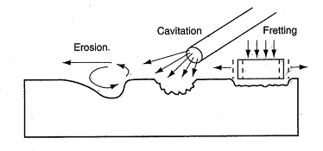
Erosion Corrosion
Schematic illustration of erosion corrosion

Slide 40
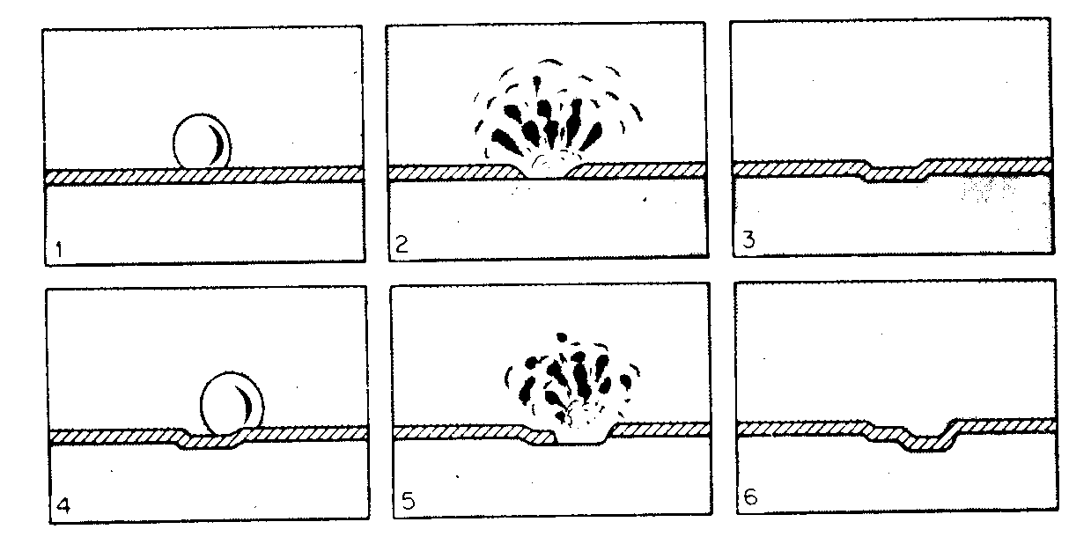
Cavitation Damage
A special form of erosion corrosion – caused by the
formation and collapse of vapor bubbles in a liquid near
metal surface
Schematic representation of steps in cavitations

Slide 41
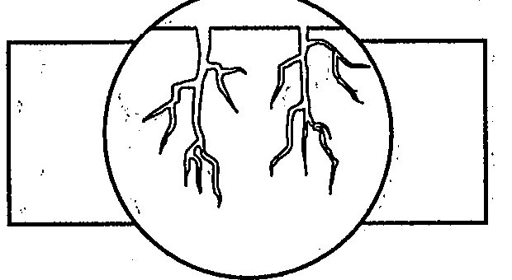
Stress corrosion cracking
Schematic illustration of stress corrosion cracking
Stress Corrosion Cracking (SCC)
Corrosion Fatigue

Slide 42
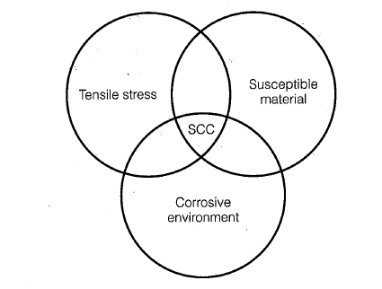
Stress corrosion cracking
Simultaneous tensile stress, susceptible metallurgical
condition and corrosive solution required for SCC

Slide 43
Corrosion Rate expression (from weight loss)
Mils per year (mpy)
Where W = weight loss (mg)
D = density of specimen (g/cm³)
A = area of specimen, (sq. in)
T = Exposure time, (hour)
Relative corrosion resistance | mpy
Outstanding | <1
Excellent | 1-5
Good | 5-20
Fair | 20-50
poor | 50-200
Unacceptable | >200

Slide 44
Problem
A zinc test specimen of dimensions 3-inch (L) × 2-inch (W) × 0.125-inch (T) with a 0.25 inch diameter circular hole for suspending in solution is exposed (its all surfaces) for 120 hours in acid solution and loses 150 milligrams. calculate the corrosion rate in mpy. Given, density of zinc = 7.14 g/cm³.
Solution
D=7.14 g/cm3
T=120 hours
W= 150 mg
A={2× [l×w + l×h + w×h]}-{2× [∏×r²]}+{2×∏×r×h}

Slide 45
={2× [2×3+3×0.125+0.125×2]}-{2×∏× (0.25/2)²}+
{2×∏× (0.25/2) ×0.125}
=13.25 in²
Corrosion rate = 534×W/DAT
=534×150/7.14×13.25×120
=7.0556 mpy
Note : Here hole has been no effect on exposed area,
because {2× [∏×r²]} = {2×∏×r×h}

