Slide 1
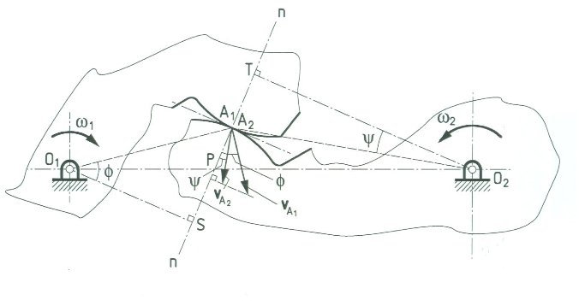
Gears – Angular Velocity Ratio
Source: Kinematic analysis and synthesis of mechanisms by Mallik, Ghosh and Dittrich

Slide 2
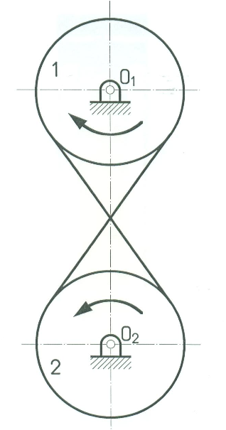
Constant Angular Velocity Ratio
Can be achieved using a belt pulley system:
Angular velocity ratio is same as the inverse ratio of the diameters
Source: Kinematic analysis and synthesis of mechanisms by Mallik, Ghosh and Dittrich

Slide 3
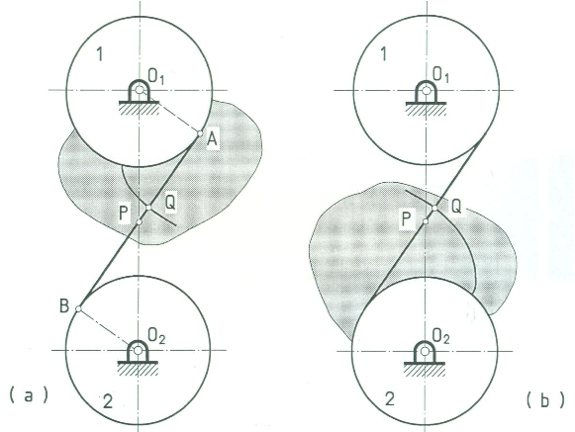
Involute Profile
The curves on the shaded area are the involute profiles.
Obtained by tracing the point Q on the shaded flanges attached to pulleys 1 and 2.
Source: Kinematic analysis and synthesis of mechanisms by Mallik, Ghosh and Dittrich

Slide 4
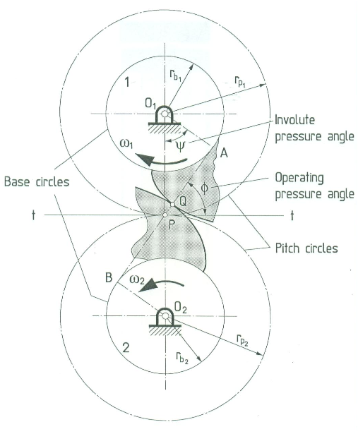
Involute Profile
Path of contact is always the line AB.
Thus the situation is same as the crossed belt and pulley system
Constant angular velocity ratio is maintained.
Source: Kinematic analysis and synthesis of mechanisms by Mallik, Ghosh and Dittrich

Slide 5
Gear Mesh Design – Spur and Helical
Useful quantities:

Slide 6
Gear Mesh Design – Spur and Helical
Criteria:
Load, speed, reliability, life (N), overload (K_{o}), design factor (n_{d})
Apriori Decisions:
Pressure angle (φ), Helix angle (ψ)
Addendum (a), Deddendum (d), root fillet radius (r_{F})
Gear Ratio (m_{G}), Numer of teeth (N_{p}, N_{G})
Quality Number (Q_{v})
Design Decisions:
Module (m), Face width (b)
Pinion Material, core hardness, case hardness
Gear Material core hardness, case hardness

Slide 7
Design Steps
Choose a module:
Check for Pinion bending and wear (pitting)
Choose material and a core hardness
Calculate face width to satisfy safety factor and standardize (ensure 3π m ≤ b ≤ 5π m)
Compute AGMA factors of safety S_{F} and S_{H}
If not satisfactory modify module and repeat until the design is satisfactory
Check for Gear bending and wear (pitting)
Choose material and a core hardness
Compute AGMA factors of safety S_{F} and S_{H}
If not satisfactory modify module and repeat until the design is satisfactory

Slide 8
Gear Force Analysis

Slide 9
AGMA Equations for Bending (SI Units)
AGMA Stress Equation for Bending:
Condition of support | Face width
 | Up to 50 mm | Up to 150 mm | Up to 225 mm | Up to 400 mm
Accurate mounting, low bearing clearances, minimum elastic deflection, precision gears | 1.3 | 1.4 | 1.5 | 1.8
Less rigid mounting, less accurate gears, contact across full face | 1.6 | 1.7 | 1.8 | 2.0
Accuracy and mounting such that less than full-face contact exists | Over 2.0

Slide 10
AGMA Equations for Bending (SI Units)
AGMA Strength Equation for Bending:

Slide 11
AGMA Equations for Pitting (SI Units)
AGMA Stress Equation for Contact (pitting):

Slide 12
AGMA Equations for Pitting (SI Units)
AGMA Strength Equation for Pitting:

