Slide 1
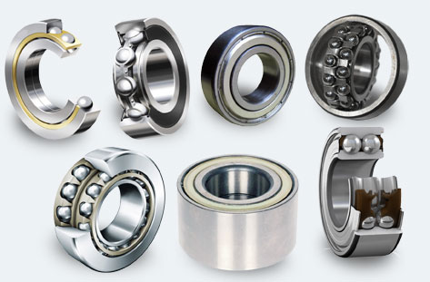
Rolling Contact Bearings
Rolling contact bearings: Load is transferred through elements in rolling contact.
Also called anti-friction bearing due to its low friction characteristics.
Advantage: Lower price, low maintenance, ease of operation
Application: Extensively used
Ball bearings
Source: RAS Bearings and Industrial Components

Slide 2
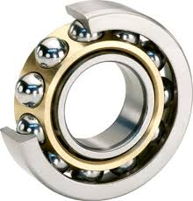
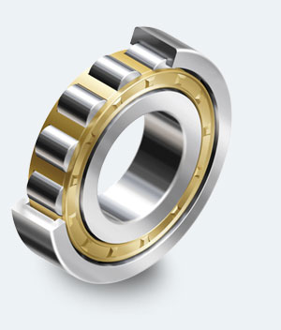
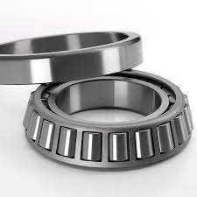
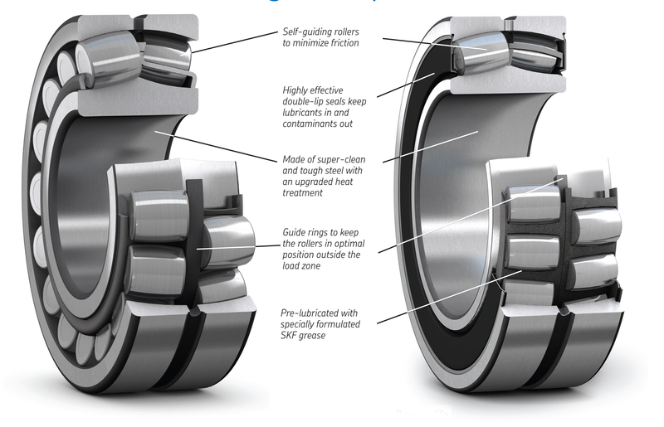
Types of Rolling Contact Bearings
Rolling bearings Types:
Ball Bearings: Rolling elements are spherical balls
Roller Bearings: Rolling elements are rollers (cylindrical or straight, tapered, spherical)
Ball bearing
Source: indiantradebird.com
Straight roller
globalcpec.com
Tapered roller bearing
Source: globalcpec.com
Spherical roller bearing
Source: SKF
Ball Bearings: Can take radial and axial thrust load
Straight Roller Bearings: Larger load capacity than ball bearings
Zero misalignment required
Can not take axial thrust

Slide 3
Types of Rolling Contact Bearings
Ball bearing
indiantradebird.com
Straight roller
globalcpec.com
Tapered roller bearing
Source: globalcpec.com
Spherical roller bearing
Source: SKF
Ball Bearings: Lower load capacity, Can take radial and axial thrust load
Straight Roller Bearings: Larger load capacity than ball bearings, Zero misalignment required
Can not take axial thrust
Tapered Roller Bearings: High load capacity, Some misalignment permitted,
Load: Radial, axial thrust and combined radial and thrust
Tapered Roller Bearings: Heavy load capacity, Large misalignment permitted,
Increases contact area with increased load

Slide 4
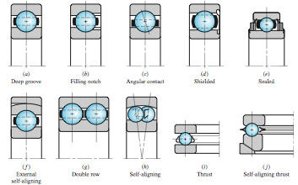
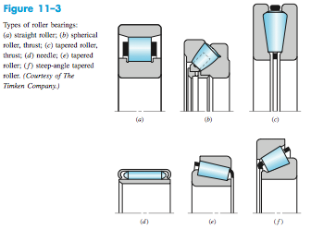
Types of Rolling Contact Bearings
Types of Ball Bearings:
Types of Roller Bearings

Slide 5
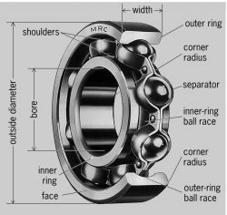
Bearing Components
Ball bearing
Source: encyclopedia2.thefreedictionary.com

Slide 6
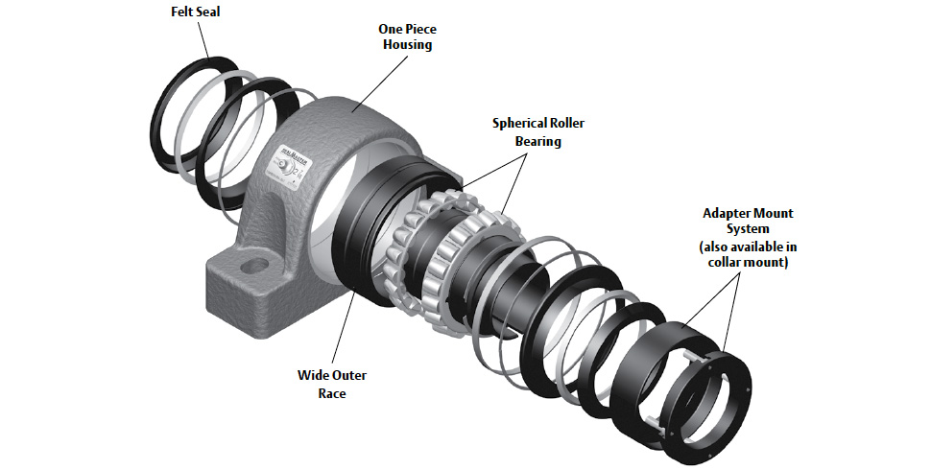
Bearing Assembly
Bearing Assembly
Source: Aggregates and Mining Today

Slide 7
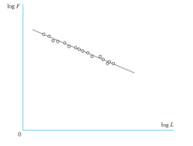
Bearing Life
Load on Bearings: Fluctuation contact stress (on ball or roller, and the races)
Failure Scenario: Fatigue (for proper lubrication, mounting, sealing, temperature and
Dust control)
Measure of Life: (1) Number of revolutions of inner ring with outer fixed before fatigue.
(2) Hours of operation at constant angular speed before fatigue
Fatigue Criterion: Pitting or spalling of an area 0.01 square inch (6.5 sq. mm)
This is for constant reliability R

Slide 8
Bearing Selection
Rated Load and Life: Provided in Manufacturer’s Catalog.
Compare with desired load and life
From Catalog select a bearing with rating F_{R} or higher.
This is for constant reliability R
For 90 % reliability (R=0.9): (F_{R,} , L_{R} ) are called (C_{10,} , L_{1o} )

