Slide 1
Chapter 17: Electrical Properties
ISSUES TO ADDRESS...
• How are electrical conductance and resistance
characterized?
• What are the physical phenomena that distinguish
conductors, semiconductors, and insulators?
• For metals, how is conductivity affected by
imperfections, T, and deformation?
• For semiconductors, how is conductivity affected
by impurities (doping) and T?

Slide 2
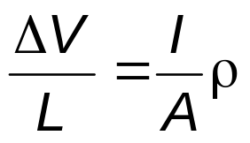
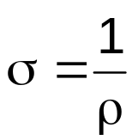
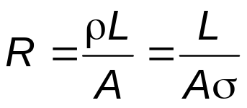
Electrical Conduction
• Ohm's Law:
ΔV = I R
voltage drop (volts = J/C)
C = Coulomb
resistance (Ohms)
current (amps = C/s)
A
(cross
e
-
I
sect.
ΔV
area)
L
• Resistivity, ρ and Conductivity, σ:
-- geometry-independent forms of Ohm's Law
-- Resistivity is a material property & is independent of sample
resistivity
(Ohm-m)
ε : electric
field
intensity
J: current density
• Resistance:
conductivity

Slide 3
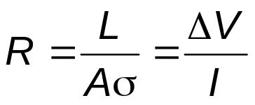
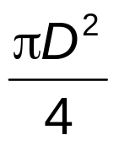
Example: Conductivity Problem
What is the minimum diameter (D) of the wire so that ΔV < 1.5 V?
100m
-
e
-
I = 2.5A
+
Cu wire
ΔV
100m
< 1.5V
2.5A
7
-1
6.07 x 10 (Ohm-m)
Solve to get D > 1.87 mm

Slide 4
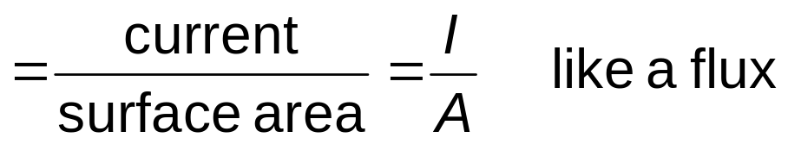
Definitions
Further definitions
  J = σ ε <= another way to state Ohm’s law
  J ≡ current density
  ε ≡ electric field potential = V/ or (ΔV/Δ  )
J = σ (ΔV/Δ )
Electron flux conductivity voltage gradient
Current carriers
  electrons in most solids
  ions can also carry (particularly in liquid solutions)

Slide 5
Conductivity: Comparison
-1
-1
• Room T values (Ohm-m)
    = (Ω - m)
METALS
conductors
CERAMICS
Silver
6.8 x 10
7
Soda-lime glass 10
-10
-10
-11
Copper
6.0 x 10
7
Concrete 10
-9
Iron
1.0 x 10
7
Aluminum oxide <10
-13
SEMICONDUCTORS
POLYMERS
-4
Polystyrene <10
-14
Silicon
4 x 10
Germanium
2 x 10
0
Polyethylene 10
-15
-10
-17
GaAs
10
-6
semiconductors
insulators
Selected values from Tables 17.1, 17.3, and 17.4
Callister’s Materials Science and Engineering, Adapted Version.
.

Slide 6
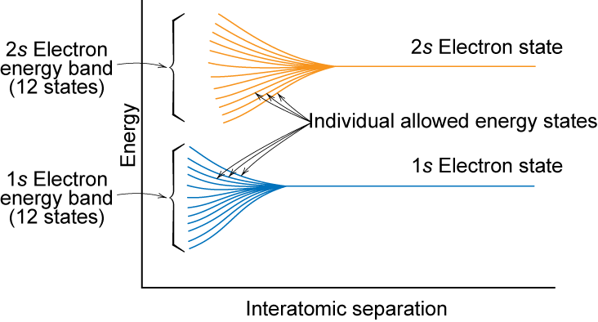
Electronic Band Structures
From Fig. 17.2
Callister’s Materials Science and Engineering, Adapted Version.
Notes:
So the individual atomic energy levels interact to form molecular energy levels

Slide 7
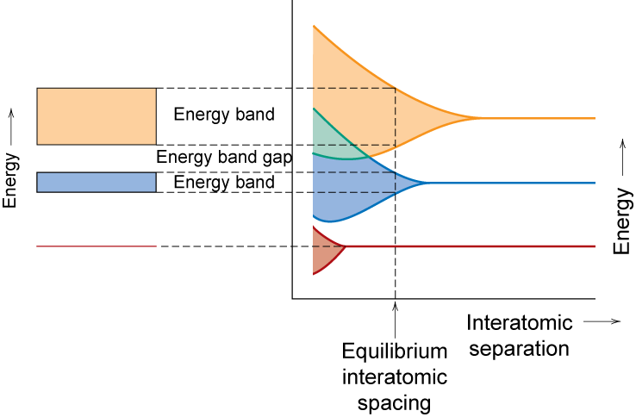
Band Structure
Valence band – filled – highest occupied energy levels
Conduction band – empty – lowest unoccupied energy levels
Conduction
band
valence band
from Fig. 17.3
Callister’s Materials Science and Engineering, Adapted Version.
Notes:
contains valence electrons from the atoms

Slide 8
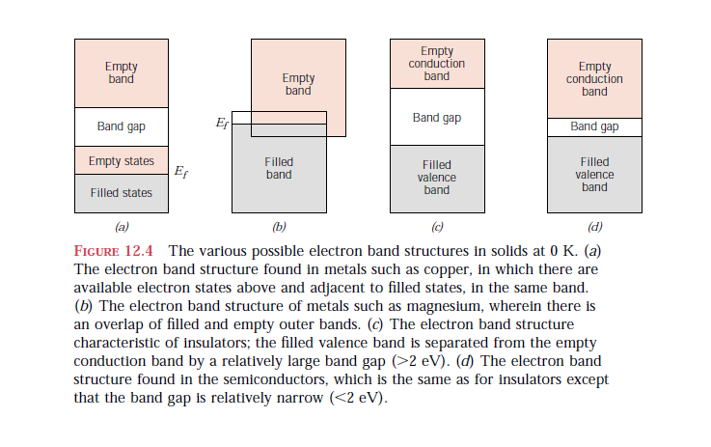
Summary of electron band structures
in conductor, Semiconductors & insulators
  The energy corresponding to the highest filled state at 0K is called Fermy Energy (E_{f})

Slide 9
Conduction & Electron Transport
• Metals (Conductors):
-- Thermal energy puts
many electrons into
a higher energy state.
-
+
-
• Energy States:
-- for metals nearby
energy states
are accessible
by thermal
fluctuations.
Energy
Energy
empty
band
GAP
empty
partly
band
filled
filled
valence
valence
band
band
filled states
filled states
filled
filled
band
band

Slide 10
Energy States: Insulators & Semiconductors
• Insulators:
-- Higher energy states not
accessible due to gap (> 2 eV).
• Semiconductors:
-- Higher energy states separated
by smaller gap (< 2 eV).
Energy
Energy
empty
band
empty
?
band
GAP
GAP
filled
filled
valence
valence
band
band
filled states
filled states
filled
filled
band
band

Slide 11
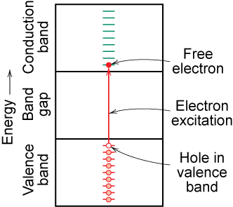
Charge Carriers
Adapted from Fig. 18.6 (b), Callister 7e.
Two charge carrying mechanisms
  Electron – negative charge
  Hole – equal & opposite
  positive charge
Move at different speeds - drift velocity
Higher temp. promotes more electrons into the conduction band
∴ σ↑ as T↑
Electrons scattered by impurities, grain boundaries, etc.

Slide 12
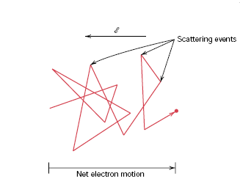

Electron Mobility
  Drift velocity (V_{d})= average electron velocity

Slide 13
Metals: Resistivity vs T, Impurities
• Imperfections increase resistivity
-- grain boundaries
-- dislocations
-- impurity atoms
-- vacancies
These act to scatter
electrons so that they
take a less direct path.
6
ρ
Cu + 3.32 at%Ni
• Resistivity
increases with:
-- temperature
-- wt% impurity
-- %CW
5
Ohm-m)
Cu + 2.16 at%Ni
4
Resistivity,
deformed Cu + 1.12 at%Ni
3
-8
(10
2
Cu + 1.12 at%Ni
1
“Pure” Cu
ρ = ρ_{thermal}
+ ρ_{impurity}
+ ρ_{deformation}
0
-200
-100
0
T (°C)
from Fig. 17.8, Callister’s Materials Science and Engineering, Adapted Version.
(Fig. 17.8 adapted from J.O. Linde, Ann. Physik 5, p. 219 (1932); and C.A. Wert and R.M. Thomson, Physics of Solids, 2nd ed., McGraw-Hill Book Company, New York, 1970.)

Slide 14
Question: If a metallic material is cooled through its melting temperature at an extremely rapid rate, it will form a noncrystalline solid (i.e., a metallic glass). Will the electrical conductivity of the noncrystalline metal be greater or less than its crystalline counterpart? Why?
Answer: The electrical conductivity for a metallic glass will be less than for its crystalline counterpart. The glass will have virtually no periodic atomic structure, and, as a result, electrons that are involved in the conduction process will experience frequent and repeated scattering. (There is no electron scattering in a perfect crystal lattice of atoms)

Slide 15

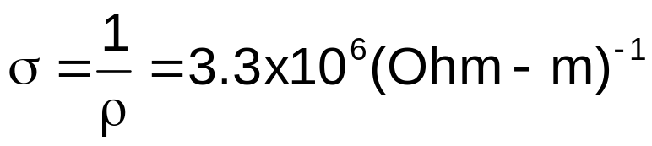
Estimating Conductivity
• Question:
-- Estimate the electrical conductivity σ of a Cu-Ni alloy
that has a yield strength of 125 MPa.
From Fig. 17.9, Callister‘ MSE Ad. Vr
180
ρ
50
160
Ohm-m)
140
40
125
30
120
Resistivity,
30
Yield strength (MPa)
-8
100
20
21 wt%Ni
(10
80
10
60
0
0
10
20
30
40
50
0
10
20
30
40
50
wt. %Ni, (Concentration C)
wt. %Ni, (Concentration C)
From Fig. 10.16(b), Callister’s MSE Adapted Version.
From step 1:
C_{Ni} = 21 wt%Ni

Slide 16
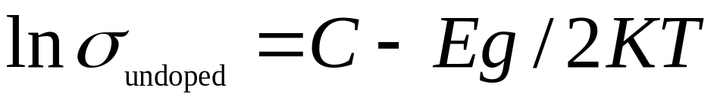
Pure Semiconductors:
Conductivity vs T
• Data for Pure Silicon:
-- σ increases with T
-- opposite to metals
Energy
electrical conductivity,
σ
empty
(Ohm-m)
-1
?
band
10
4
GAP
electrons
can cross
gap at
higher T
10
3
filled
2
valence
10
band
1
filled states
10
0
filled
10
pure
band
-1
(undoped)
10
material
Si
Ge
GaP
CdS
band gap (eV)
1.11
0.67
2.25
2.40
10
-2
50
10
0
1
000
T(K)
From Fig. 19.15, Callister 5e. (Fig. 19.15 adapted from G.L. Pearson and J. Bardeen, Phys. Rev. 75, p. 865, 1949.)
Selected values from Table 17.3, Callister’s MSE Adapted Version.

Slide 17
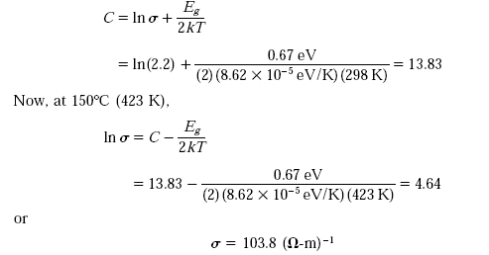
Problem
Given, E_{g} for Germanium is 0.67 eV
Solution

Slide 18
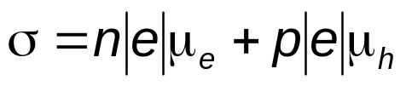
Conduction in Terms of Electron and Hole Migration
• Concept of electrons and holes:
valence
electron
hole
electron
hole
electron
Si atom
pair creation
pair migration
-
+
-
+
no applied
applied
applied
electric field
electric field
electric field
• Electrical Conductivity given by:
From Fig. 17.11
Callister’s Materials Science and Engineering, Adapted Version.
# holes/m
3
hole mobility
3
electron mobility
# electrons/m

Slide 19
Intrinsic Semiconductors
Pure material semiconductors: e.g., silicon & germanium
  Group IVA materials
Compound semiconductors
  III-V compounds
    Ex: GaAs & InSb
  II-VI compounds
    Ex: CdS & ZnTe
  The wider the electronegativity difference between
  the elements the wider the energy gap.

Slide 20
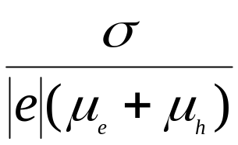
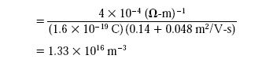
Problem: For intrinsic silicon, the room-temperature electrical conductivity is 4×10⁻⁴ (Ω-m)⁻¹; the electron and hole mobilities are, respectively, 0.14 and 0.048 m²/V-s. Compute the electron and hole concentrations at room temperature.
S OLUTION
Since the material is intrinsic, electron and hole concentrations will be the same, and therefore,
n= p=

Slide 21
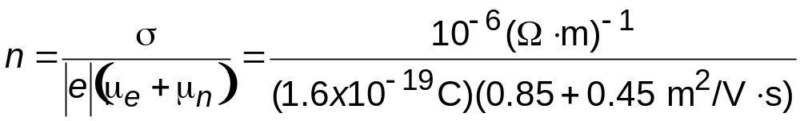
Number of Charge Carriers
Intrinsic Conductivity
  σ = n|e|μ_{e} + p|e|μ_{e}
for intrinsic semiconductor n = p
∴ σ = n|e|(μ_{e} + μ_{n})
Ex: GaAs
For GaAs n = 4.8 x 10²⁴ m⁻³
For Si n = 1.3 x 10¹⁶ m⁻³

Slide 22
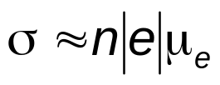
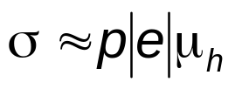
Intrinsic vs Extrinsic Conduction
• Intrinsic:
# electrons = # holes (n = p)
--case for pure Si
• Extrinsic:
--n ≠ p
--occurs when impurities are added with a different
valence electrons than the host (e.g., Si atoms)
• n-type Extrinsic: (n >> p)
• p-type Extrinsic: (p >> n)
Phosphorus atom
Boron atom
hole
4
+
4
+
4
+
4
+
conduction
4
+
4
+
4
+
4
+
electron
4
+
5+
4
+
4
+
4
+
3
+
4
+
4
+
valence
4
+
4
+
4
+
4
+
electron
4
+
4
+
4
+
4
+
From Figs. 17.12(a) & 17.14(a), Callister’s Materials Science and Engineering, Adapted Version.
no applied
Si atom
no applied
electric field
electric field

Slide 23
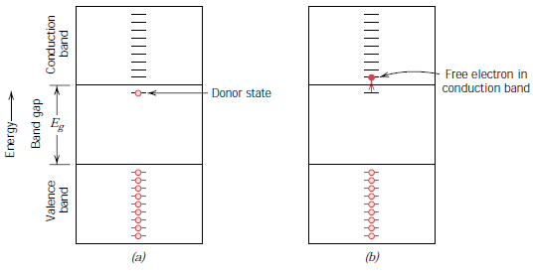
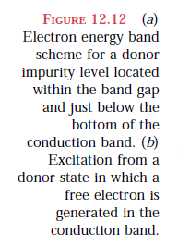
n-type Extrinsic Semiconduction

Slide 24
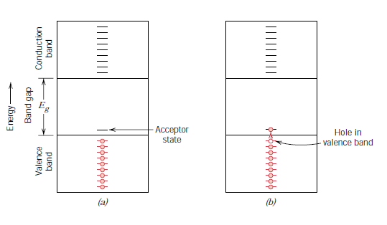
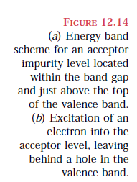
p-type Extrinsic Semiconduction

Slide 25
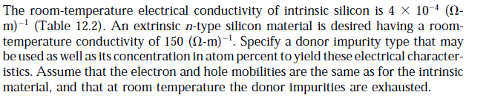
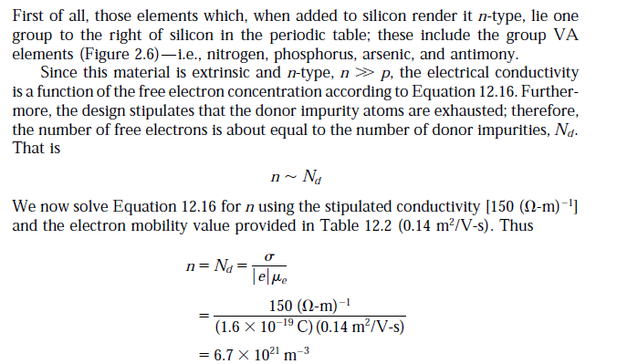
Problem
Solution

Slide 26
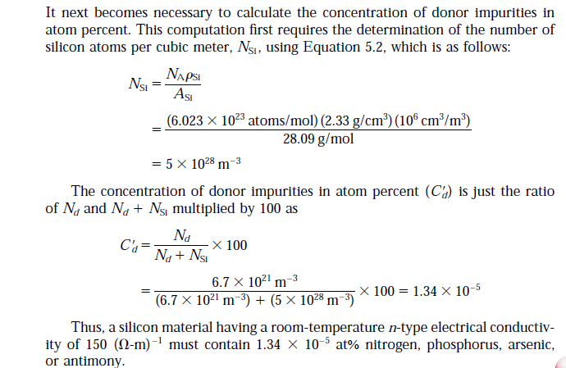

Slide 27
Doped Semiconductor: Conductivity vs. T
• Data for Doped Silicon:
-- σ increases doping
-- reason: imperfection sites
lower the activation energy to
produce mobile electrons.
• Comparison: intrinsic vs
extrinsic conduction...
-- extrinsic doping level:
10²¹/m³ of a n-type donor
impurity (such as P).
-- for T < 100 K: "freeze-out“,
thermal energy insufficient to
excite electrons.
-- for 150 K < T < 450 K: "extrinsic"
-- for T >> 450 K: "intrinsic"
10
4
σ
0.0052at%B
10
3
-1
10
2
doped
0.0013at%B
10
1
(Ohm-m)
electrical conductivity,
doped
10
0
pure
undoped
From Fig. 17.17, Callister’s MSE Adapted Version
(Fig. 17.17 from S.M. Sze, Semiconductor Devices, Physics, and Technology, Bell Telephone Laboratories, Inc., 1985.)
-1
(undoped)
3
10
2
extrinsic
10
-2
freeze-out
intrinsic
concentration (10²¹/m³)
50
10
0
1
000
conduction electron
T(K)
1
From Fig. 19.15, Callister 5e. (Fig. 19.15 adapted from G.L. Pearson and J. Bardeen, Phys. Rev. 75, p. 865, 1949.)
0
0
200
400
600
T
(K)

Slide 28
p-n Rectifying Junction
• Allows flow of electrons in one direction only (e.g., useful
to convert alternating current to direct current.
• Processing: diffuse P into one side of a B-doped crystal.
• Results:
From Fig. 17.21, Callister’s MSE Adapted Version.
+
p-type
n-type
+
+
-
-
--No applied potential:
no net current flow.
+
+
-
-
-
--Forward bias: carrier
flow through p-type and
n-type regions; holes and
electrons recombine at
p-n junction; current flows.
p-type
+
-
n-type
+
+
+
-
+
-
-
-
+
-
--Reverse bias: carrier
flow away from p-n junction;
carrier conc. greatly reduced
at junction; little current flow.
p-type
n-type
-
+
+
-
+
-
-
+
+
+
-
-

Slide 29
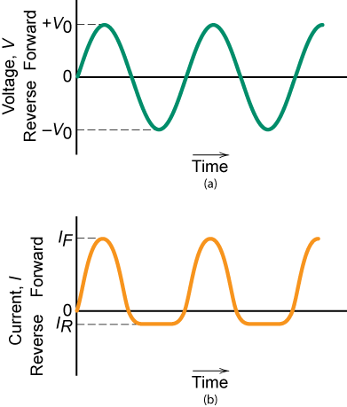
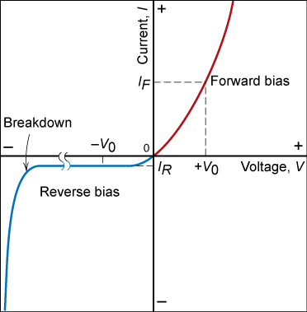
Properties of Rectifying Junction
Fig. 17.22, Callister’s MSE Adapted Version
Fig. 17.23, Callister’s MSE Adapted Version.

Slide 30
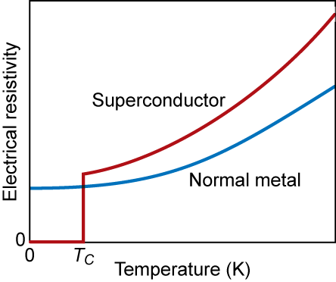
Superconductivity
Hg
Copper (normal)
From Fig. 18.26
Callister’s Materials Science and Engineering, Adapted Version.
4.2 K
T_{c} = temperature below which material is superconductive
= critical temperature

Slide 31
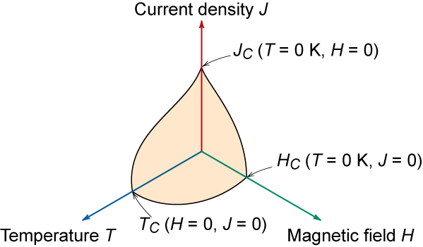
Limits of Superconductivity
26 metals + 100’s of alloys & compounds
Unfortunately, not this simple:
  J_{c} = critical current density if J > J_{c} not superconducting
  H_{c} = critical magnetic field if H > H_{c} not superconducting
  H_{c}= H_{o} (1- (T/T_{c})²)
From Fig. 18.27
Callister’s Materials Science and Engineering, Adapted Version.

Slide 32
Advances in Superconductivity
This research area was stagnant for many years.
  Everyone assumed T_{c,max} was about 23 K
  Many theories said you couldn’t go higher
1987- new results published for T_{c} > 30 K
  ceramics of form Ba_{1-x} K_{x} BiO_{3-y}
  Started enormous race.
    Y Ba₂Cu₃O_{7-x} T_{c} = 90 K
    Tl₂Ba₂Ca₂Cu₃O_{x} T_{c} = 122 K
    tricky to make since oxidation state is quite important
Values now stabilized at ca. 120 K
HgBa₂Ca₂Cu₂O₈ T_{c} = 153 K
Notes:
Suddenly everyone was doing superconductivity. Everyone was doing similar work, making discoveries, & rushing to publish so they could claim to have done it first. Practically, daily new high temp. records were set.

Slide 33
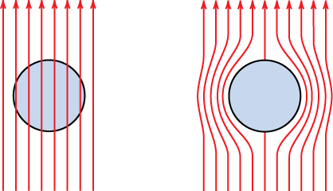
Meissner Effect
Superconductors expel magnetic fields
This is why a superconductor will float above a magnet
normal
superconductor
From Fig. 18.28
Callister’s Materials Science and Engineering, Adapted Version.

Slide 34
Current Flow in Superconductors
Type I current only in outer skin
      - so amount of current limited
Type II current flows within wire
Type I
M
Type II
H_{C1}
H_{C}
H_{C2}
H
complete diamagnetism
mixed state
normal

Slide 35
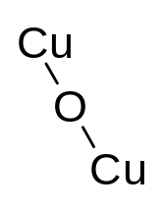
Superconducting Materials
CuO₂ planes
X
linear chains
X
X
X
Ba
Y
Ba
X
X
X
(001) planes
X
YBa₂Cu₃O₇
Vacancies (X) provide electron coupling between CuO₂ planes.

Slide 36
Summary
• Electrical conductivity and resistivity are:
-- material parameters.
-- geometry independent.
• Electrical resistance is:
-- a geometry and material dependent parameter.
• Conductors, semiconductors, and insulators...
-- differ in accessibility of energy states for
conductance electrons.
• For metals, conductivity is increased by
-- reducing deformation
-- reducing imperfections
-- decreasing temperature.
• For pure semiconductors, conductivity is increased by
-- increasing temperature
-- doping (e.g., adding B to Si (p-type) or P to Si (n-type).

