Slide 1
Fatigue
• Fatigue = failure under cyclic stress.
specimen
compression on top
Adapted from Fig. 11.18, Callister’s Materials Science and Engineering, Adapted Version.
(Fig. 11.18 is from Materials Science in Engineering, 4/E by Carl. A. Keyser, Pearson Education, Inc., Upper Saddle River, NJ.)
bearing
bearing
motor
counter
flex coupling
tension on bottom
• Stress varies with time.
-- key parameters are S, σ_{m}, and frequency
σ
σ
max
σ
S
m
σ
min
time
• Key points: Fatigue...
--can cause part failure, even though σ_{max} < σ_{c}.
--causes ~ 90% of mechanical engineering failures.

Slide 2
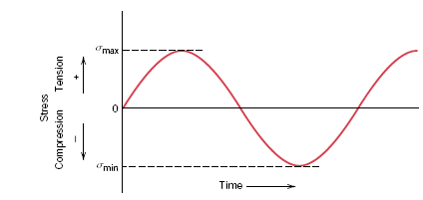
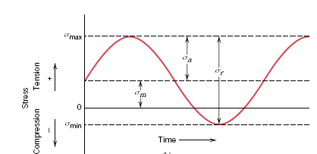



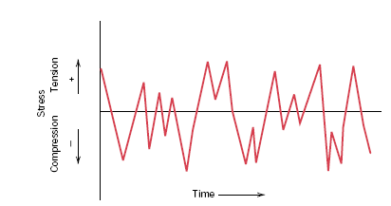
Cyclic stress
Reversed stress cycle
Repeated stress cycle
Random stress cycle

Slide 3
Fatigue Design Parameters
• Fatigue limit, S_{fat}:
--no fatigue if S < S_{fat}
S = stress amplitude
case for
unsafe
steel
(typ.)
S_{fat}
safe
From Fig. 11.19(a), Callister’s MSE Adapted Version.
10
3
10
5
10
7
10
9
N = Cycles to failure
• Sometimes, there is
no fatigue limit!
S = stress amplitude
case for
unsafe
Al
(typ.)
safe
From Fig. 11.19(b), Callister’s MSE
Adapted Version.
10
3
10
5
10
7
10
9
N = Cycles to failure

Slide 4
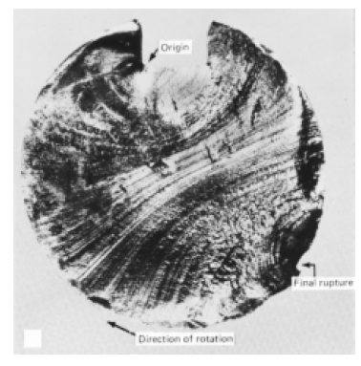
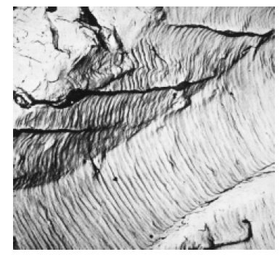
Fatigue crack initiation and propagation
• Fatigue failure is characterized by three distinct step
-- Crack initiation
-- Crack propagation
-- Final failure (occurs very rapidly)
Crack propagation step is characterized by beachmarks and striations
Beachmark
ridges in
steel
Fatigue striations
in Al

Slide 5
Fatigue Mechanism
• Crack grows incrementally
typically 1 to 6
increase in crack length per loading cycle
--crack grows faster as
• Δσ increases
• crack gets longer
• loading freq. increases.

Slide 6
Thermal shock/Thermal Fatigue
• Occurs due to: uneven heating/cooling.
• Ex: Assume top thin layer is rapidly cooled from T₁ to T₂:
rapid quench
σ
T₂
Tension develops at surface
tries to contract during cooling
resists contraction
T₁
Temperature difference that
can be produced by cooling:
Critical temperature difference
for fracture (set σ = σf)
set equal
• Result:
• Large thermal fatigue resistance when is large.

Slide 7
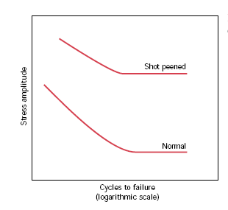

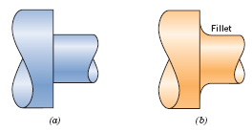
Improving Fatigue Life
1. Impose a compressive
surface stress
(to suppress surface
cracks from growing)
--Method 1: shot peening
shot
--Method 2: carburizing
put
C-rich gas
surface
into
compression
2. Remove stress
concentrators.
bad
better
From Fig. 11.25, Callister’s Materials Science and Engineering, Adapted Version.
bad
better

Slide 8
SUMMARY
• Engineering materials don't reach theoretical strength.
• Flaws produce stress concentrations that cause
premature failure.
• Sharp corners produce large stress concentrations
and premature failure.
• Failure type depends on T and stress:
- for noncyclic σ and T < 0.4T_{m}, failure stress decreases with:
- increased maximum flaw size,
- decreased T,
- increased rate of loading.
- for cyclic σ:
- cycles to fail decreases as Δσ increases.
- for higher T (T > 0.4T_{m}):
- time to fail decreases as σ or T increases.

