Slide 1
Mechanical Failure
ISSUES TO ADDRESS...
• How do flaws in a material initiate failure?
• How is fracture resistance quantified; how do different
material classes compare?
• How do we estimate the stress to fracture?
• How do loading rate, loading history, and temperature
affect the failure stress?
Ship-cyclic loading
from waves.
Computer chip-cyclic
thermal loading.
Hip implant-cyclic
loading from walking.
From chapter-opening photograph, Chapter 11, Callister’s Materials Science and Engineering, Adapted Version.
(by Neil Boenzi, The New York Times.)
From Fig. 21.30(b), Callister’s Materials Science and Engineering, Adapted Version.
(Fig. 21.30(b) is courtesy of National Semiconductor Corporation.)
From Fig. 21.26(b), Callister’s MSE, Adapted Version.

Slide 2
Fracture mechanisms
Ductile fracture
Occurs with plastic deformation
Brittle fracture
Little or no plastic deformation
Catastrophic

Slide 3
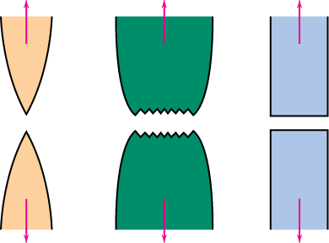
Ductile vs Brittle Failure
• Classification:
Fracture
Very
Moderately
Brittle
behavior:
Ductile
Ductile
Adapted from Fig. 8.1, Callister 7e.
%RA or %EL
Large
Moderate
Small
• Ductile
fracture is usually
desirable!
Ductile:
warning before fracture
Brittle: No warning

Slide 4
Example: Failure of a Pipe
• Ductile failure:
--one piece
--large deformation
• Brittle failure:
--many pieces
--small deformation
Figures from V.J. Colangelo and F.A. Heiser, Analysis of Metallurgical Failures (2nd ed.), Fig. 4.1(a) and (b), p. 66 John Wiley and Sons, Inc., 1987. Used with permission.

Slide 5
Moderately Ductile Failure
• Evolution to failure:
void
void growth
shearing
necking
and linkage
at surface
fracture
nucleation
σ
50 mm
• Resulting
fracture
surfaces
(steel)
50 mm
100 mm
particles
serve as void
nucleation
sites.
From V.J. Colangelo and F.A. Heiser, Analysis of Metallurgical Failures (2nd ed.), Fig. 11.28, p. 294, John Wiley and Sons, Inc., 1987. (Orig. source: P. Thornton, J. Mater. Sci., Vol. 6, 1971, pp. 347-56.)
Fracture surface of tire cord wire loaded in tension. Courtesy of F. Roehrig, CC Technologies, Dublin, OH. Used with permission.

Slide 6
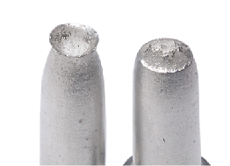
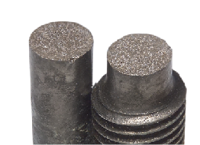
Ductile vs. Brittle Failure
cup-and-cone fracture
brittle fracture
From Fig. 11.3,
Callister’s Materials Science and Engineering,
Adapted Version.

Slide 7
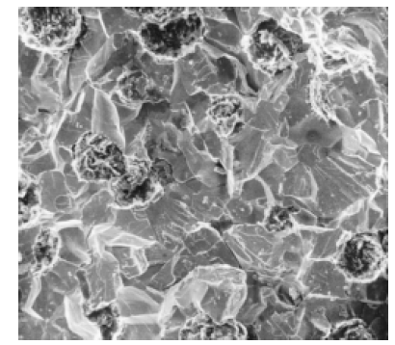
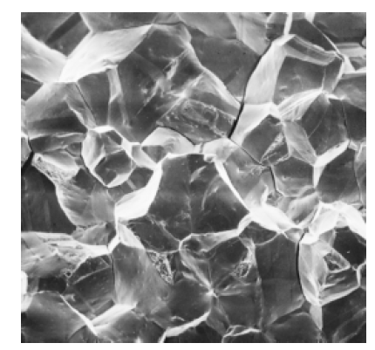
Fracture Surfaces
• Intergranular
(between grains)
• Intragranular
(within grains)
304 S. Steel (metal)
Reprinted w/permission from "Metals Handbook", 9th ed, Fig. 633, p. 650. Copyright 1985, ASM International, Materials Park, OH. (Micrograph by J.R. Keiser and A.R. Olsen, Oak Ridge National Lab.)
316 S. Steel (metal)
Reprinted w/ permission from "Metals Handbook", 9th ed, Fig. 650, p. 357. Copyright 1985, ASM International, Materials Park, OH. (Micrograph by D.R. Diercks, Argonne National Lab.)
160 mm
4 mm
Ductile Cast Iron
Scanning Electron factograph showing a transgranular fracture
Scanning Electron factograph showing a intergranular fracture

Slide 8
Ideal vs Real Materials
• Stress-strain behavior (Room T):
σ
perfect mat’l-no flaws
TS << TS
E/10
engineering
materials
perfect
materials
carefully produced glass fiber
E/100
typical ceramic
typical strengthened metal
typical polymer
ε
0.1
• DaVinci (500 yrs ago!) observed...
-- the longer the wire, the
smaller the load for failure.
• Reasons:
-- flaws cause premature failure.
-- Larger samples contain more flaws!
Reprinted w/ permission from R.W. Hertzberg, "Deformation and Fracture Mechanics of Engineering Materials", (4th ed.) Fig. 7.4. John Wiley and Sons, Inc., 1996.

Slide 9
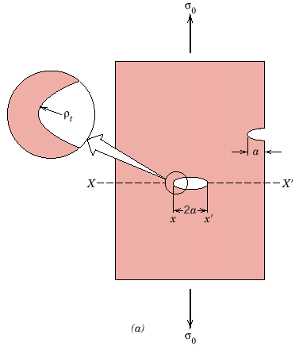
Flaws are Stress Concentrators!
Results from crack propagation
Griffith Crack
where ρ_{t} = radius of curvature
σ_{o} = applied stress
σ_{m} = stress at crack tip
K_{t} = stress concentration factor
ρ_{t}
From Fig. 11.8(a)
Callister’s Materials Science and Engineering,
Adapted Version.
Notes:
Stress concentrated at crack tip

Slide 10
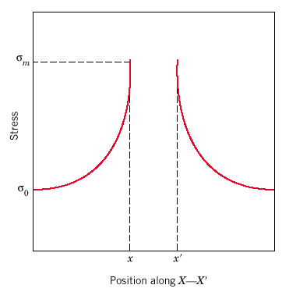
Concentration of Stress at Crack Tip
The magnitude of the localized
stress diminishes with distance
away from the crack tip.
At positions far removed, the
stress is just the nominal stress
σ₀, or the load divided by the
specimen cross- sectional area
(perpendicular to this load).

Slide 11
Crack Propagation
Cracks propagate due to sharpness of crack tip
A plastic material deforms at the tip, “blunting” the crack.
deformed region
brittle
Energy balance on the crack
Elastic strain energy-
energy stored in material as it is elastically deformed
this energy is released when the crack propagates
creation of new surfaces requires energy
plastic

Slide 12
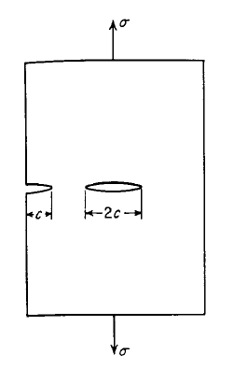


When Does a Crack Propagate?
• Griffith theory of brittle fracture:
-- A crack will propagate when the decrease in elastic strain energy is at least equal to energy required to create the new crack surface
elastic strain energy per unit of plate thickness is equal to
The surface energy due to the presence of the crack is

Slide 13





When Does a Crack Propagate?
Orowan suggested that the Griffith equation would be made more compatible with brittle fracture in metals by the inclusion of a term γ_{p} expressing the plastic work required to extend the crack wall

Slide 14
When Does a Crack Propagate?
Crack propagates if above critical stress
where
E = modulus of elasticity
γ_{s} = specific surface energy
c = one half length of internal crack
For ductile => replace γ_{s} by γ_{s} + γ_{p}
where γ_{p} is plastic deformation energy
i.e., σ_{m} > σ_{c}

Slide 15
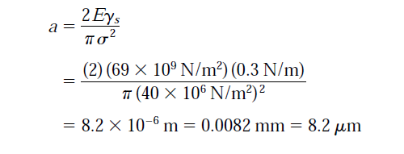
Solve this problem
A relatively large plate of a glass is subjected to a tensile stress of 40 MPa. If the specific surface energy and modulus of elasticity for this glass are 0.3 J/m² and 69 GPa, respectively, determine the maximum length of a internal flaw that is possible without fracture.

Slide 16
Fracture Toughness
An expression has been developed that relates this critical stress for crack propagation (σ_{c}) to crack length (c) as
K_{c} =
In this expression Kc is the fracture toughness, a property that is a measure of material’s resistance to brittle fracture when a crack is present. Worth noting is that Kc has the unusual units of MPa.m^{1/2}

Slide 17
Design Against Crack Growth
• Crack growth condition:
K ≥ K_{c} =
• Largest, most stressed cracks grow first!
--Result 1: Max. flaw size
dictates design stress.
--Result 2: Design stress
dictates max. flaw size.
σ
c_{max}
fracture
fracture
no
no
fracture
a_{max}
fracture
σ

Slide 18
Design Example: Aircraft Wing
• Material has K_{c} = 26 MPa-m^{0.5}
• Two designs to consider...
Design A
--largest flaw is 9 mm
--failure stress = 112 MPa
Design B
--use same material
--largest flaw is 4 mm
--failure stress = ?
• Use...
• Key point: Y and K_{c} are the same in both designs.
--Result:
112 MPa
9 mm
4 mm
Answer:
• Reducing flaw size pays off!

Slide 19
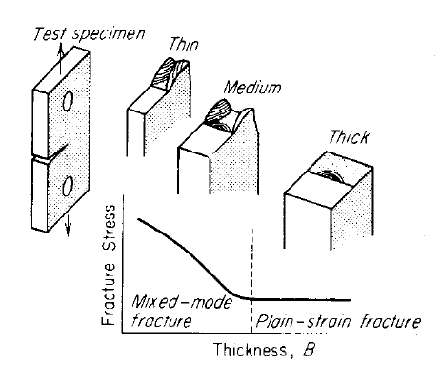
Plane Strain Fracture Toughness
• For relatively thin specimens,
K_{c} will depend on its thickness
However, when the specimen
thickness is greater than the
crack dimension, K_{c} becomes
independent of thickness
Effect of specimen thickness on stress and mode of fracture

Slide 20
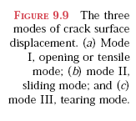
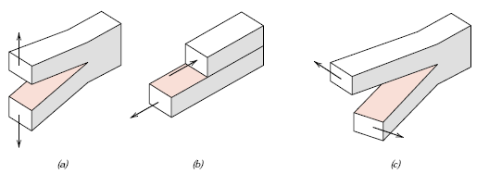
Plane Strain Fracture Toughness
Mode I
Mode II
Mode III
K_{c} for thick specimen in mode I loading is known as K_{Ic}
K_{Ic} =
While K_{IC} is a basic material property, in the same sense as yield strength, it changes with important variables such as temperature and strain rate.

Slide 21
Fracture Toughness
Metals/
Graphite/
Composites/
Alloys
Ceramics/
Polymers
fibers
Semicond
100
C-C
(|| fibers)
1
7
0
Steels
6
0
Ti alloys
5
0
4
0
Al alloys
Based on data in Table B5,
Callister’s Materials Science and Engineering, Adapted Version.
Composite reinforcement geometry is: f = fibers; sf = short fibers; w = whiskers; p = particles. Addition data as noted (vol. fraction of reinforcement):
1. (55vol%) ASM Handbook, Vol. 21, ASM Int., Materials Park, OH (2001) p. 606.
2. (55 vol%) Courtesy J. Cornie, MMC, Inc., Waltham, MA.
3. (30 vol%) P.F. Becher et al., Fracture Mechanics of Ceramics, Vol. 7, Plenum Press (1986). pp. 61-73.
4. Courtesy CoorsTek, Golden, CO.
5. (30 vol%) S.T. Buljan et al., "Development of Ceramic Matrix Composites for Application in Technology for Advanced Engines Program", ORNL/Sub/85-22011/2, ORNL, 1992.
6. (20vol%) F.D. Gace et al., Ceram. Eng. Sci. Proc., Vol. 7 (1986) pp. 978-82.
)
3
0
Mg alloys
0.5
2
0
Al/Al oxide(sf)
2
Y
2
O
3
/ZrO
2
(p)
4
10
C/C
( fibers)
1
(MPa · m
Al oxid/SiC(w)
5
3
7
Diamond
Si nitr/SiC(w)
6
Al oxid/ZrO
2
(p)
4
5
Si carbide
PET
Glass/SiC(w)
6
Al oxide
4
Si nitride
Ic
PP
K
3
PVC
2
PC
1
<100>
Glass
6
Si crystal
PS
0.7
<111>
Glass
-
soda
0.6
Concrete
Polyester
0.5

Slide 22


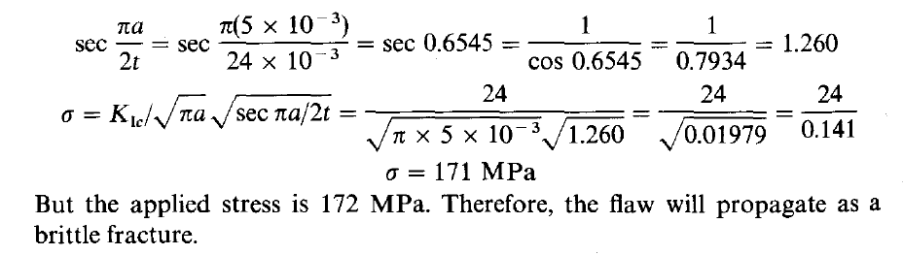
Exercise
The stress intensity for a partial-through thickness flaw is given by where a is the depth of penetration of the flaw through a wall thickness t. If the flaw is 5 mm deep in a wall 12 mm thick, determine whether the wall will support a stress of 172 MPa if it is made from 7075-T6 aluminum alloy with

Slide 23
Loading Rate
• Increased loading rate...
-- increases σ_{y} and TS
-- decreases %EL
• Why? An increased rate
gives less time for
dislocations to move past
obstacles.
σ
TS
ε
σ_{y}
larger
ε
TS
smaller
σ_{y}
ε

Slide 24
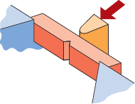
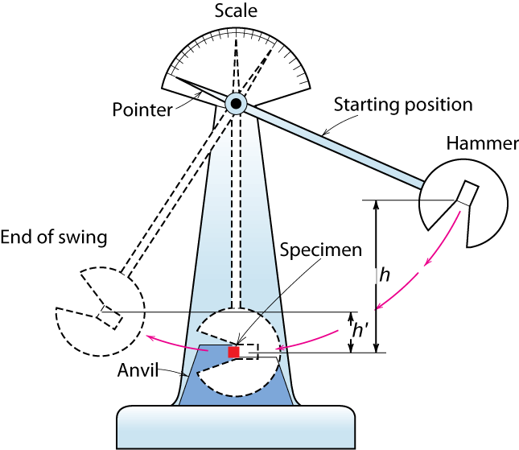
Impact Testing
• Impact loading:
-- severe testing case
-- makes material more brittle
-- decreases toughness
-- notch introduce triaxial state-of-stress
(Charpy)
Adapted from Fig. 11.12(b), Callister’s Materials Science and Engineering, Adapted Version.
(Fig. 11.12(b) is adapted from H.W. Hayden, W.G. Moffatt, and J. Wulff, The Structure and Properties of Materials, Vol. III, Mechanical Behavior, John Wiley and Sons, Inc. (1965) p. 13.)
final height
initial height

Slide 25
Temperature
• Increasing temperature...
--increases %EL and K_{c}
• Ductile-to-Brittle Transition Temperature (DBTT)...
FCC metals (e.g., Cu, Ni)
BCC metals (e.g., iron at T < 914°C)
polymers
Impact Energy
Brittle
More Ductile
High strength materials (
σ
y
> E/150)
From Fig. 11.15
Callister’s Materials Science and Engineering,
Adapted Version.
Temperature
Ductile-to-brittle
transition temperature

Slide 26
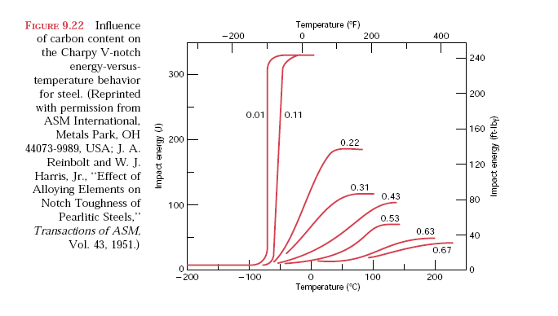
Effect of composition

Slide 27
Design Strategy: Stay Above The DBTT!
• Pre-WWII: The Titanic
• WWII: Liberty ships
Reprinted w/ permission from R.W. Hertzberg, "Deformation and Fracture Mechanics of Engineering Materials", (4th ed.) Fig. 7.1(a), p. 262, John Wiley and Sons, Inc., 1996. (Orig. source: Dr. Robert D. Ballard, The Discovery of the Titanic.)
Reprinted w/ permission from R.W. Hertzberg, "Deformation and Fracture Mechanics of Engineering Materials", (4th ed.) Fig. 7.1(b), p. 262, John Wiley and Sons, Inc., 1996. (Orig. source: Earl R. Parker, "Behavior of Engineering Structures", Nat. Acad. Sci., Nat. Res. Council, John Wiley and Sons, Inc., NY, 1957.)
• Problem: Used a type of steel with a DBTT ~ Room temp.

Slide 28
Creep – Why we need to study?
Materials are often placed in service at elevated temperatures
and exposed to static mechanical stresses (e.g., turbine
rotors in jet engines and steam generators that experience
centrifugal stresses, and high-pressure steam lines).
Deformation under such circumstances is termed creep. It
could be defined as the time-dependent and permanent
deformation of materials when subjected to a constant
load or stress.
Creep is normally an undesirable phenomenon and is often
the limiting factor in the lifetime of a part. It is observed in all
materials types; for metals it becomes important only
for temperatures greater than about 0.4T_{m}

Slide 29
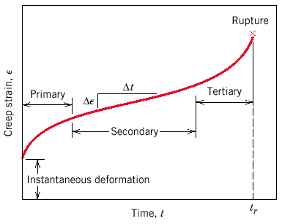
Creep
Sample deformation at a constant stress (σ) vs. time
σ
σ,ε
0
t
Primary Creep: slope (creep rate) decreases with time.
Secondary Creep: steady-state i.e., constant slope.
Tertiary Creep: slope (creep rate) increases with time, i.e. acceleration of rate.
From Fig. 11.28, Callister’s Materials Science and Engineering, Adapted Version.

Slide 30
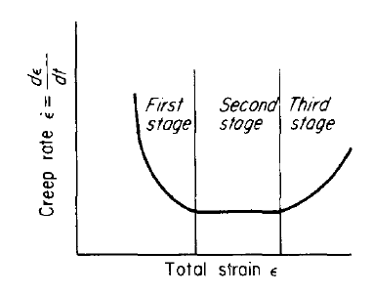
The three stages of Creep
Primary Creep: Creep resistance of the material increases by virtue of its own deformation.
Secondary Creep: Constant creep rate which results from a balance between the competing processes of strain hardening and recovery. For this reason, secondary creep is usually referred to as steady-state
creep.
Tertiary Creep: Occurs when there
is an effective reduction in cross-sectional area either because of necking or internal void formation.
Strain rate in creep test as function of total

Slide 31
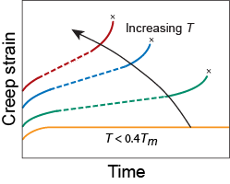
Creep
• Occurs at elevated temperature, T > 0.4 T_{m}
Applied stress has
also a similar effect
on creep behaviour
tertiary
primary
secondary
elastic
From Figs. 11.29, Callister’s Materials Science and Engineering, Adapted Version.

Slide 32
Mechanisms Of Creep Deformation
Dislocation glide − involves dislocations moving along slip
planes and overcoming barriers by thermal activation. This
mechanism occurs at high stress, σ/G > 10⁻².
Dislocation creep − involves the movement of dislocations
which overcome barriers by thermally assisted mechanisms
involving the diffusion of vacancies or interstitials. Occurs
for 10⁻⁴ < σ/G < 10⁻².
Diffusion creep − involves the flow of vacancies and
interstitials through a crystal under the influence of applied
stress. Occurs for σ/G < 10⁻⁴. This category includes Nabarro
-Herring and Coble creep (discussed in the next slides)
Grain boundary sliding − involves the sliding of grains past
each other

Slide 33

Diffusion Creep
Nabarro-Herring Creep – Occur at high temperature and low stress
The creep process is controlled by stress-directed atomic diffusion. Stress changes the chemical potential of the atoms on the surfaces of the grains in a polycrystal in such a way that there is a flow of vacancies from grain boundaries experiencing tensile stresses to those which have compressive stresses. Simultaneously, there is a corresponding flow of atoms in the opposite direction, and this leads to elongation of the grain. The Nabarro-Herring creep equation is
where d is the grain diameter and D_{v} is the lattice diffusion coefficient. We note that increasing the grain size reduces the creep rate.

Slide 34
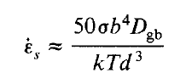
Diffusion Creep
Coble Creep - Occur at low temperature and low stress
At lower temperatures grain-boundary diffusion predominates. Coble-type creep is described by
where d is the grain diameter and D_{gb} is the grain-boundary diffusion coefficient.
Coble creep is more sensitive to grain size than
Nabarro-Herring Creep

Slide 35
Creep Failure
• Failure:
along grain boundaries.
• Estimate rupture time
S-590 Iron, T = 800°C, σ = 20 ksi
g.b. cavities
From Fig. 11.32, Callister’s Materials Science and Engineering, Adapted Version.
(Fig. 11.32 is from F.R. Larson and J. Miller, Trans. ASME, 74, 765 (1952).)
100
applied
stress
20
Stress, ksi
10
data for
From V.J. Colangelo and F.A. Heiser, Analysis of Metallurgical Failures (2nd ed.), Fig. 4.32, p. 87, John Wiley and Sons, Inc., 1987. (Orig. source: Pergamon Press, Inc.)
S-590 Iron
12
16
20
24
28
1
L(10
3
K-log hr)
24x10³ K-log hr
• Time to rupture, t_{r}
temperature
function of
applied stress
1073K
time to failure (rupture)
Ans: t_{r} = 233 hr
Larson-Miller parameter

Slide 36
Alloy for high temperature use
• Alloy should posses
-- higher melting point
-- higher elastic modulus
-- larger grain size
-- solid-solution alloying, and also by the addition
of a dispersed phase which is virtually insoluble in
the matrix

Slide 37
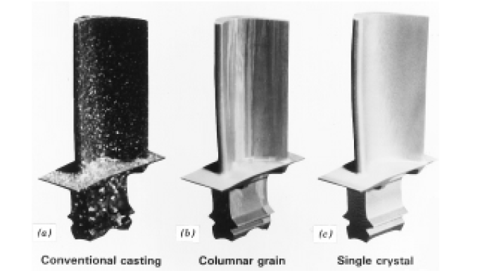
Alloy for high temperature use
Advanced processing techniques have been utilized to produce microstructure exhibiting higher creep resistance
One such technique is directional solidification, which
produces either highly elongated grains or single-crystal components

