Slide 1
Hardness
• Resistance to permanently indenting the surface.
• Large hardness means:
--resistance to plastic deformation or cracking in
compression.
--better wear properties.
apply known force
measure size
e.g.,
of indent after
10 mm sphere
removing load
Smaller indents
D
d
mean larger
hardness.
most
brasses
easy to machine
cutting
nitrided
plastics
Al alloys
steels
file hard
tools
steels
diamond
increasing hardness

Slide 2
Hardness: Measurement
Rockwell – A, B and C scale
No major sample damage
Each scale runs to 130 but only useful in range 20-100.
Minor load 10 kg
Major load 60 (A), 100 (B) & 150 (C) kg
A = diamond, B = 1/16 in. ball, C = diamond
Brinell Hardness - HB (Load 3,000 kg for hard materials or 500 kg for soft materials, dwell time = 30 sec)
TS (psia) = 500 x HB
TS (MPa) = 3.45 x HB

Slide 3
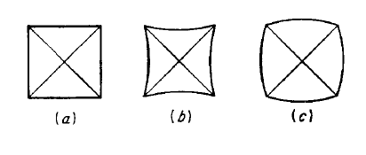
Hardness: Measurement
Vickers Hardness - HV
Use square based diamond pyramid as indenter
Received fairly wide acceptance in research
Not widely accepted for routine testing because it is slow, require grater surface preparation
Greater chance for personal error
Perfect Indentation (b) pincushion indentation due to sinking in (annealed materials) (c) barreled indentation due to piling up (cold worked materials)

Slide 4
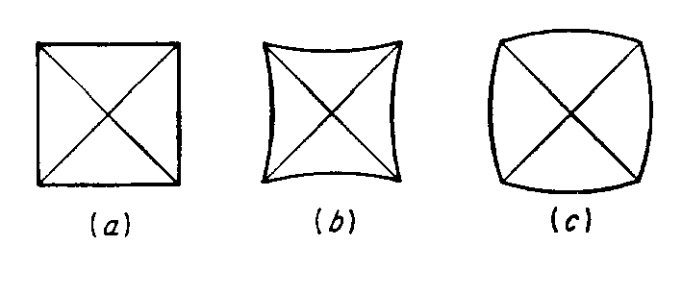
Hardness: Measurement
Pincushion indentation due to sinking in
Observed in annealed materials
Results in overestimation of the diagonal length
Measured hardness value is lower than the
actual
Barreled indentation due to piling up
Observed in cold worked materials
Results in underestimation of the diagonal
length
Measured hardness value is higher than the
actual

Slide 5
Hardness: Measurement
Knoop Hardness - HK
The Knoop indenter is a diamond ground to a pyramidal form
Produces a diamond-shaped indentation with long and short diagonals in the ration of 7:1
Suitable to take hardness of a thin layer or when testing brittle materials (where the tendency of materials to fracture is proportional to the volume of stressed materials )
Greater chance for error when the surface is not carefully polished

Slide 6
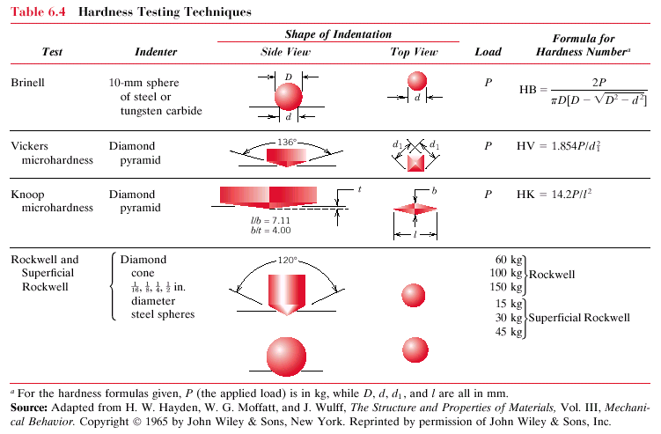
Hardness: Measurement
Table 9.14

Slide 7
Question: When making hardness measurements, what will be the effect of making an indentation very close to a preexisting indentation? Why?
Answer: The hardness measured from an indentation that is positioned very close to a pre-existing indentation will be high. The material in this vicinity was cold-worked when the first indentation was made.

Slide 8
Solve this problem
Determine the approximate Brinell hardness of a 99.75 wt% Fe-0.25 wt% C alloy. HB of ferrite and pearlite is 80 and 280, respectively
W_{p} = (C'₀ − 0.022)/0.74 = (0.25 − 0.022)/0.74= 0.308
W_{α'} =(0.76 − C'₀)/ 0.74 = (0.76 − 0.25)/0.74= 0.689
Now, we compute the Brinell hardness of the alloy as
HB_{alloy} = HB_{α'}W_{α'} + HB_{p}W_{p}
= (80)(0.689) + (280)(0.308) = 141

Slide 9
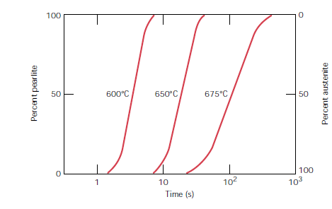
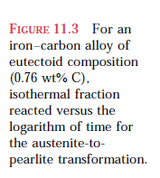
Heat Treatment
ISOTHERMAL TRANSFORMATION DIAGRAMS

Slide 10
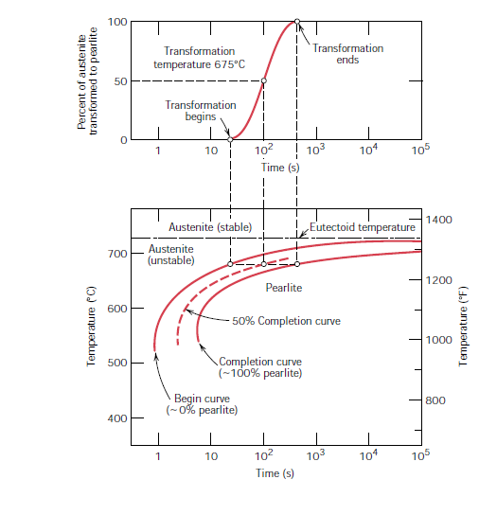
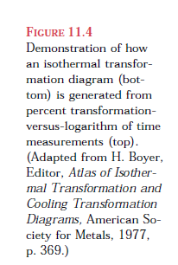
ISOTHERMAL TRANSFORMATION DIAGRAMS

Slide 11
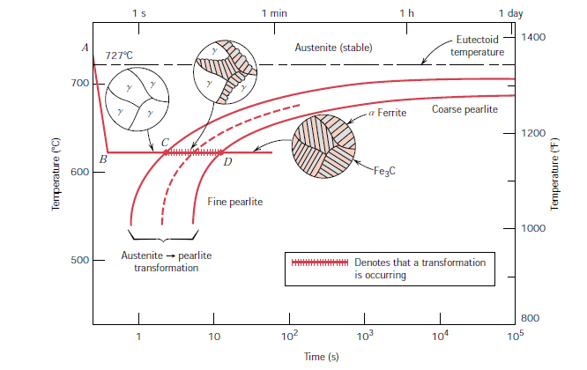
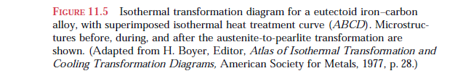
ISOTHERMAL TRANSFORMATION DIAGRAMS

Slide 12
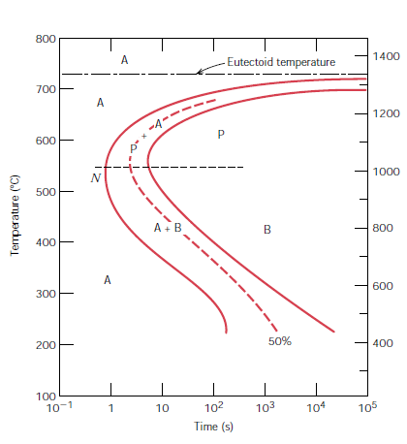
ISOTHERMAL TRANSFORMATION DIAGRAMS
Time – Temperature – Transformation Diagram of an eutectoid steel

Slide 13
Heat Treatments
800
Austenite (stable)
Normalizing
Annealing
T(°C)
T_{E}
A
P
c) Quenching
600
d) Tempering
B
400
A
Adapted from Fig. 8.22
Callister’s Materials Science and Engineering, Adapted Version.
100%
0%
50%
200
M + A
0%
M + A
50%
a)
90%
b)
c)
10
-1
10
10
3
10
5
time (s)

Slide 14
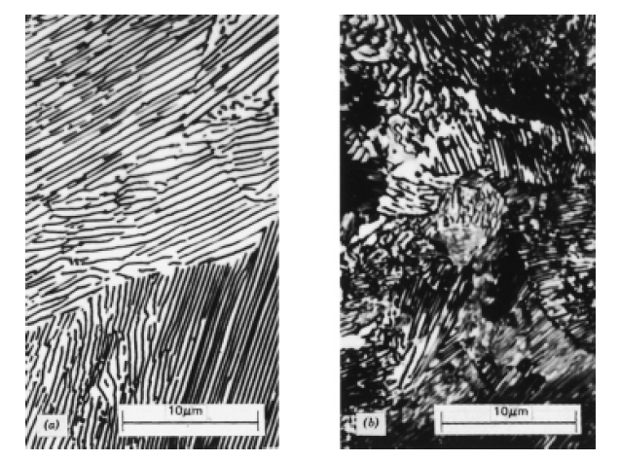

Normalizing vs. Annealing

Slide 15
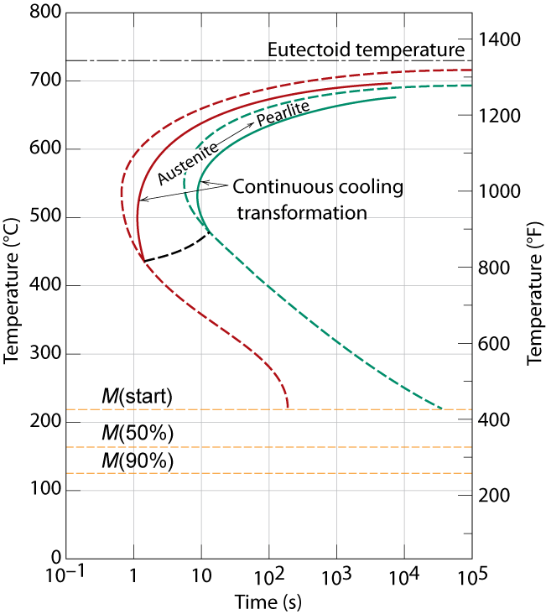
Cooling Curve
plot temp vs. time
From Fig. 8.25,
Callister’s Materials Science and Engineering,
Adapted Version.
Notes:
Actual processes involves cooling – not isothermal
Can’t cool at infinite speed

Slide 16
Mechanical Prop: Fe-C System
• Fine vs coarse pearlite vs spheroidite
Hypo
Hyper
Hypo
Hyper
90
320
fine
spheroidite
pearlite
60
240
coarse
pearlite
Ductility (%AR)
Brinell hardness
spheroidite
160
30
coarse
pearlite
fine
80
pearlite
1
0
0
0.5
wt%C
0
0.5
1
wt%C
• Hardness:
fine > coarse > spheroidite
From Fig. 8.30
Callister’s Materials Science and Engineering,
Adapted Version.
(Fig. 8.30 based on data from Metals Handbook: Heat Treating, Vol. 4, 9th ed., V. Masseria (Managing Ed.), American Society for Metals, 1981, pp. 9 and 17.)
• %RA:
fine < coarse < spheroidite

Slide 17
Mechanical Prop: Fe-C System
• Fine Pearlite vs Martensite:
Hypo
Hyper
From Fig. 10.32
Callister’s Materials Science and Engineering,
Adapted Version.
(Fig. 8.32 adapted from Edgar C. Bain, Functions of the Alloying Elements in Steel, American Society for Metals, 1939, p. 36; and R.A. Grange, C.R. Hribal, and L.F. Porter, Metall. Trans. A, Vol. 8A, p. 1776.)
600
martensite
Brinell hardness
400
200
fine pearlite
0
0
0.5
wt% C
1
• Hardness: fine pearlite << martensite.

Slide 18
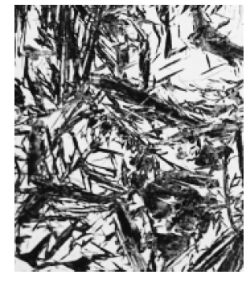
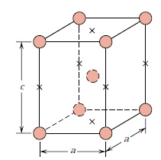

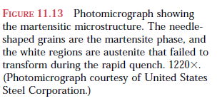
Martensite structure

Slide 19
Tempering of Martensite
• reduces brittleness of martensite,
• reduces internal stress caused by quenching.
TS(MPa)
YS(MPa)
1800
1600
TS
From Fig. 8.34, Callister’s Materials Science and Engineering,
Adapted Version.
(Fig. 8.34 adapted from Fig. furnished courtesy of Republic Steel Corporation.)
YS
From Fig. 8.33, Callister’s Materials Science and Engineering,
Adapted Version.
(Fig. 8.33 copyright by United States Steel Corporation, 1971.)
1400
9 μm
1200
60
1000
50
%RA
%RA
40
800
30
200
400
600
Tempering T (°C)
•
produces extremely small Fe₃C particles surrounded by α.
•
decreases TS, YS but increases %RA

Slide 20
Summary: Processing Options
Austenite (γ)
From Fig. 8.36, Callister’s Materials Science and Engineering,
Adapted Version.
slow
moderate
rapid
cool
cool
quench
Pearlite
(coarse)
Bainite
Martensite
Pearlite
(fine)
(BCT phase
Annealing
Normalizing
diffusionless
transformation)
Martensite
reheat
Tempered Martensite
bainite
Tempered
Strength
fine pearlite
Ductility
Martensite
coarse pearlite
(α + very fine
spheroidite
Fe₃C particles)
General Trends

Slide 21
Hardenability
• It may be defined as susceptibility of the steel to hardening
when quenched and related to depth and distribution of
hardness across a cross section
It is NOT related to maximum hardness

Slide 22
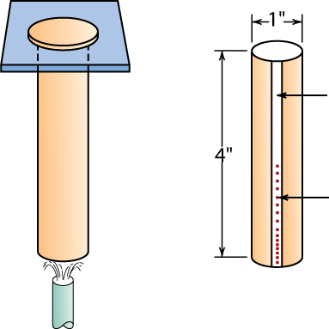
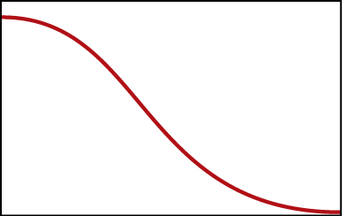
Hardenability--Steels
• Ability to form martensite
• Jominy end quench test to measure hardenability.
From Fig. 23.4, Callister’s MSE Adapted Version. (Fig. 23.4 adapted from A.G. Guy, Essentials of Materials Science, McGraw-Hill Book Company, New York, 1978.)
flat ground
specimen
(heated to γ
phase field)
Rockwell C hardness tests
24°C water
• Hardness versus distance from the quenched end.
Hardness, HRC
From Fig. 23.5
Callister’s Materials Science and Engineering, Adapted Version.
Distance from quenched end

Slide 23
Why Hardness Changes With Position
• The cooling rate varies with position.
60
40
Hardness, HRC
20
0
1
2
3
distance from quenched end (in)
T(°C)
0%
600
P
100%
A
→
From Fig. 23.6
Callister’s MSE Adapted Version.
(Fig. 23.6 adapted from H. Boyer (Ed.) Atlas of Isothermal Transformation and Cooling Transformation Diagrams, American Society for Metals, 1977, p. 376.)
400
M(start)
200
A
→
M
0
M(finish)
Pearlite
Martensite
Fine Pearlite
Martensite + Pearlite
0.1
1
10
100
1000
Time (s)

Slide 24

Hardenability vs Alloy Composition
• Jominy end quench
results, C = 0.4 wt% C
100
10
3
2
Cooling rate (°C/s)
60
100
4340
80
%M
Hardness, HRC
50
40
4140
From Fig. 23.7, Callister’s MSE Adapted Version.
(Fig. 23.7 adapted from figure furnished courtesy Republic Steel Corporation.)
8640
1040
5140
20
0
10
20
30
40
50
Distance from quenched end (mm)
• "Alloy Steels"
(4140, 4340, 5140, 8640)
--contain Ni, Cr, Mo
(0.2 to 2wt%)
--these elements shift
the "nose".
--martensite is easier
to form.
800
T(°C)
T_{E}
600
shift from
A
B
A to B due
400
to alloying
200
M(start)
M(90%)
0
-1
3
5
Time (s)
10
10
10
10

Slide 25
Hardenability vs. Grain size
• Finer the grain size of austenite, lesser the hardenability
Finer grain size favor the nucleation of pearlite and hence
decreases the tendency of martensite formation

Slide 26
Quenching Medium & Geometry
• Effect of quenching medium:
Medium
air
oil
water
Severity of Quench
low
moderate
high
Hardness
low
moderate
high
• Effect of geometry:
When surface-to-volume ratio increases:
--cooling rate increases
--hardness increases
Position
center
surface
Cooling rate
low
high
Hardness
low
high

