Slide 1
Chapter 20: Optical Properties
ISSUES TO ADDRESS...
• What happens when light shines on a material?
• Why do materials have characteristic colors?
• Why are some materials transparent and others not?
• Optical applications:
-- luminescence
-- photoconductivity
-- solar cell
-- optical communications fibers

Slide 2
Optical Properties
Light has both particulate and wavelike properties
Photons - with mass

Slide 3
Refractive Index, n
• Transmitted light distorts electron clouds.
electron
no
cloud
transmitted
+
transmitted
+
light
distorts
light
• Light is slower in a material vs vacuum.
n = refractive index
--Adding large, heavy ions (e.g., lead
can decrease the speed of light.
--Light can be
"bent"
Note: n = f (λ)
Typical glasses ca. 1.5 -1.7
Plastics 1.3 -1.6
PbO (Litharge) 2.67
Diamond 2.41
Selected values from Table 20.1
Callister’s Materials Science and Engineering, Adapted Version.

Slide 4
Total Internal Reflectance
n > n’
n’(low)
n (high)

Slide 5
Example: Diamond in air
Fiber optic cables are clad in low n material for this reason.

Slide 6
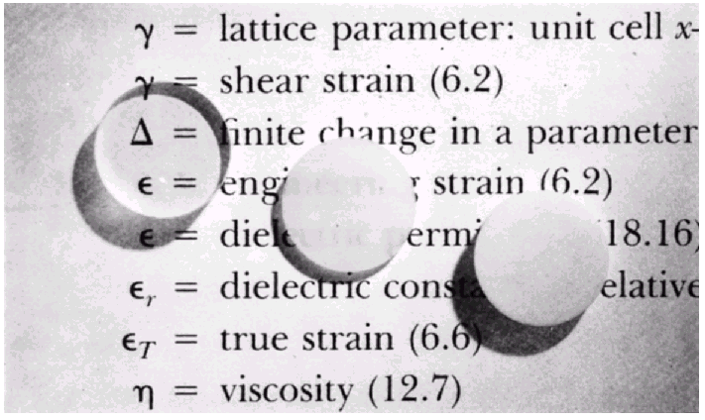
Light Interaction with Solids
• Incident light is either reflected, absorbed, or
transmitted:
Reflected: I_{R}
Absorbed: I_{A}
Transmitted: I_{T}
Incident: I₀
Scattered: I_{S}
• Optical classification of materials:
Transparent
Translucent
From Fig. 20.10, Callister’s MSE Adapted Version.
(Fig. 20.10 is by J. Telford, with specimen preparation by P.A. Lessing.)
Opaque
single crystal
polycrystalline dense
polycrystalline porous

Slide 7
Optical Properties of Metals: Absorption
• Absorption of photons by electron transition:
Energy of electron
unfilled states
ΔE = hν required!
Incident photon
h
ν
I
of energy
o
filled states
Planck’s constant
freq.
of
(6.63 x 10⁻³⁴ J.s)
incident
From Fig. 20.4(a)
Callister’s Materials Science and Engineering, Adapted Version.
light
• Metals have a fine succession of energy states.
• Near-surface electrons absorb visible light.

Slide 8
Light Absorption

Slide 9
Metals are opaque to all electromagnetic radiation on the low end of the frequency spectrum, from radio waves, through infrared, the visible, and into about the middle of the ultraviolet radiation. However, metals are transparent to high-frequency (x-ray and γ-ray) radiation – Why?
Answer: Metals are transparent to high-frequency X-ray and γ-ray radiation since the energies of these types of radiation are greater than for visible light; electron excitations corresponding to these energies (with energy absorption) are not possible because energies for such transitions would be to within an energy band gap beyond the highest partially-filled energy band.

Slide 10
Optical Properties of Metals: Reflection
• Electron transition emits a photon.
Energy of electron
I_{R}
unfilled states
“conducting” electron
re-emitted photon from material surface
ΔE
filled states
• Reflectivity = IR/Io is between 0.90 and 0.95.
• The perceived color is determined by the wavelength
distribution of the radiation that is reflected and not absorbed.
• Metals appear reflective (shiny)!

Slide 11
Reflectivity, R
Reflection
Metals reflect almost all light
Copper & gold absorb in blue & green => gold color
Example: Diamond

Slide 12
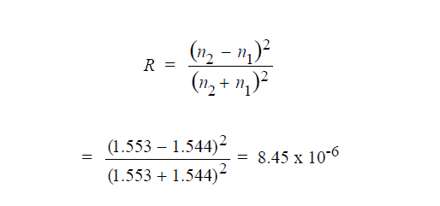
Problem
The index of refraction of quartz is anisotropic. Suppose that visible light is passing from one grain to another of different
crystallographic orientation and at normal incidence
to the grain boundary. Calculate the reflectivity at the boundary if the indices of refraction for the two grains are 1.544 and 1.553 in the direction of light propagation.
Solution

Slide 13
Selected Absorption: Semiconductors
• Absorption by electron transition occurs if hν > Egap
Energy of electron
unfilled states
blue light: hν = 3.1 eV
red light: hν = 1.7 eV
incident photon energy hν
E
gap
I
o
filled states
From Fig. 20.5(a), Callister’s MSE Adapted Version.
• If Egap < 1.8 eV, full absorption; color is black (Si, GaAs)
• If Egap > 3.1 eV, no absorption; colorless (diamond)
• If Egap in between, partial absorption; material has a color.

Slide 14
Wavelength vs. Band Gap
Example: What is the minimum wavelength absorbed by Ge?
E_{g} = 0.67 eV

Slide 15
Question: Are the elemental semiconductors silicon and germanium transparent to visible light? Why or why not?
Answer: We want to decide whether or not Si and Ge are transparent to visible light on the basis of their band gap energies. Semiconductors having band gap energies less than about 1.8 eV are opaque to visible light. Thus, both Si and Ge fall into this category, and all visible light is absorbed by valence-band-to-conduction-band-electron transitions across their reasonably narrow band gaps.

Slide 16
Photoconductivity
Charge carriers in semi-conductive material may be generated as a consequence of photon-induced electron transitions in which light is absorbed; the attendant increase in conductivity is called photoconductivity.
Thus, when a specimen of a photoconductive material is illuminated, the conductivity increases.

Slide 17
Question: Is the semiconductor zinc selenide (ZnSe), which has a band gap of 2.58 eV, photoconductive when exposed to visible light radiation? Why or why not?
Answer: Zinc selenide, having a band gap of 2.58 eV, is photoconductive. In order to be photoconductive, electrons must be excited from the valence band into the conduction band by the absorption of light radiation. The maximum band gap energy for which there may be absorption of visible light is 3.1 eV; since the band gap energy for ZnSe is less than this value, photoinduced valence-band-to-conduction-band electron transitions will occur.

Slide 18

Color of Nonmetals
• Color determined by sum of frequencies of
-- transmitted light,
-- re-emitted light from electron transitions.
• Ex: Cadmium Sulfide (CdS)
-- Egap = 2.4 eV,
-- absorbs higher energy visible light (blue, violet),
-- Red/yellow/orange is transmitted and gives it color.
• Ex: Ruby = Sapphire (Al2O3) + (0.5 to 2) at% Cr2O3
-- Sapphire is colorless
(i.e., Egap > 3.1eV)
-- adding Cr2O3 :
• alters the band gap
• blue light is absorbed
• yellow/green is absorbed
• red is transmitted
• Result: Ruby is deep
red in color.
80
sapphire
70
Transmittance (%)
ruby
60
50
λ (= c/ν)(μm)
40
wavelength,
0.3
0.5
0.7
0.9
From Fig. 20.9, Callister’s MSE Adapted Version.
(Fig. 20.9 adapted from "The Optical Properties of Materials" by A. Javan, Scientific American, 1967.)

Slide 19
Optical Fibers
Optical fibers can transmit, in one second, information
equivalent to three episodes of your favourite television
program.
Two small optical fibers can transmit the equivalent
of 24,000 telephone calls simultaneously. Furthermore,
it would require 30,000 kg (33 tons) of copper to transmit
the same amount of information as only 0.1 kg of optical
fiber material.

Slide 20
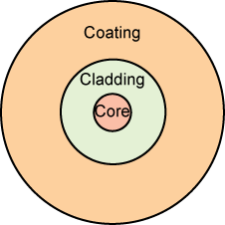
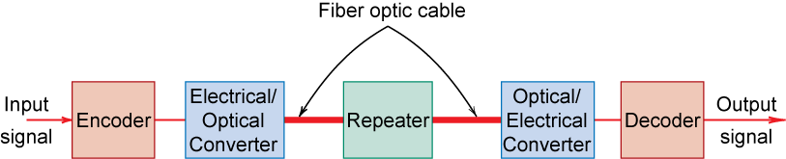
Optical Fibers
High-purity silica glass is used as the fiber material;
The fibers are relatively flaw free and, thus, remarkably strong;
Fig. 20.18, Callister’s MSE Adapted Version.

Slide 21
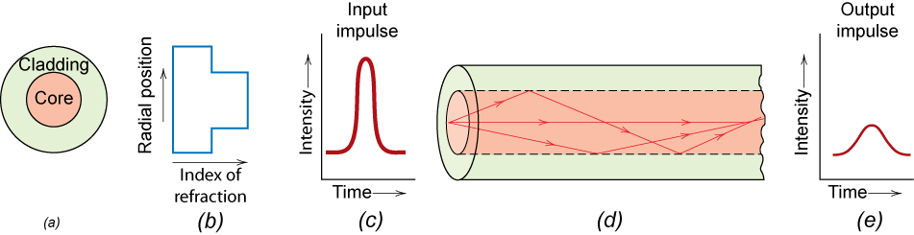
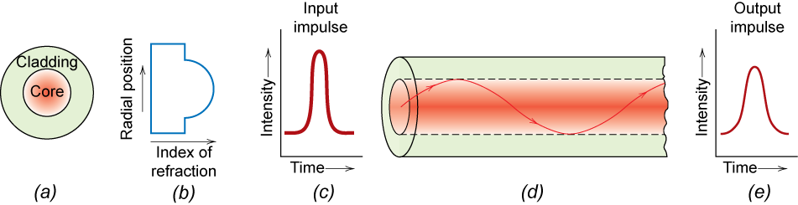
Optical Fiber Profiles
Step-index Optical Fiber
Graded-index Optical Fiber
Fig. 21.21, Callister 7e.
Fig. 20.22
Callister’s Materials Science and Engineering, Adapted Version.

Slide 22
Step-index Optical Fiber
For this design, the output pulse will be broader than the
input one this phenomenon that is undesirable since it limits
the rate of transmission.
Pulse broadening results because various light rays,
although being injected at approximately the same instant,
arrive at the output at different times; they traverse different
trajectories and, thus, have a variety of path lengths.

Slide 23
Graded-index Optical Fiber
Impurities such as boron oxide or germanium dioxide are
added to the silica glass such that the index of refraction is
made to vary parabolically across the cross section
Thus, the velocity of light within the core varies with radial
position, being greater at the periphery
It travel faster in this lower-index material, and arrive at the
output at approximately the same time as undeviated rays
that pass through the center portion of the core.

Slide 24
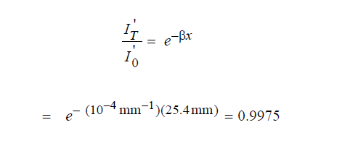
Problem
The intensity of light absorbed while passing through a 16-kilometer length of optical fiber glass is equivalent to the light intensity absorbed through for a 25-mm thickness of ordinary
window glass. Calculate the absorption coefficient (β)of the optical fiber glass if the value of β for the window glass is 10⁻⁴ mm⁻¹.
Solution
It is first necessary to compute the fraction of light transmitted
through the window glass

Slide 25
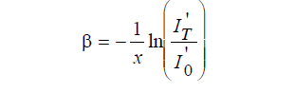
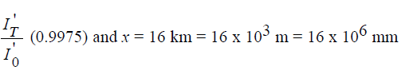
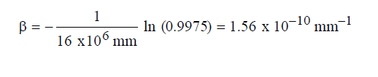
Solution…..Continues
And substitution into this expression the above value for

Slide 26
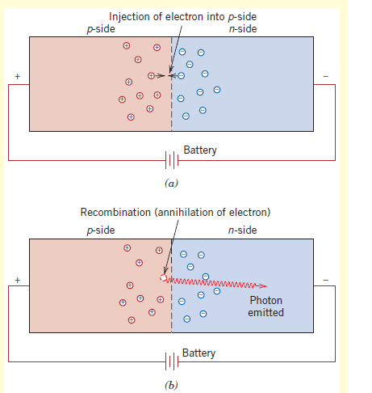
Light-Emitting Diodes
When a forward-biased potential of relatively high magnitude is applied across a p-n junction diode, visible light (or infrared
radiation) will be emitted. This conversion of electrical energy into light energy is termed electroluminescence, and the device that produces it is termed a light-emitting diode (LED).
Schematic diagram of a forward-biased semiconductor p-n junction showing (a) the injection of an electron from the n-side into the p-side, and (b) the emission of a photon of light as this electron recombines with a hole.

Slide 27
Problem
Gallium arsenide (GaAs) and gallium phosphide (GaP) are compound semiconductors that have room-temperature band
gap energies of 1.42 and 2.25 eV, respectively, and form solid solutions in all proportions. Furthermore, the band gap of the
alloy increases approximately linearly with GaP additions (in mol%). Alloys of these two materials are used for light-emitting
diodes wherein light is generated by conduction band-to-valence band electron transitions. Determine the composition of a GaAs–GaP alloy that will emit red light having a wavelength of 0.68 mm.
Solution
It first becomes necessary to compute the band-gap energy corresponding to this wavelength of light

Slide 28
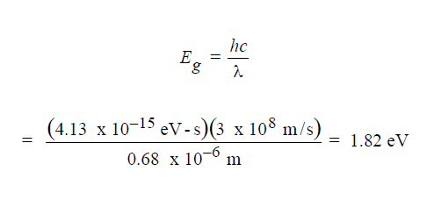
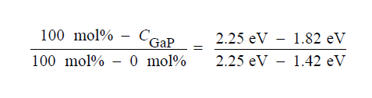
Solution….continues
Realizing that at 0 mol% GaP, Eg = 1.42 eV, while at 100 mol% GaP, Eg = 2.25 eV, it is possible to set up the relationship
Solving for C_{GaP}, the composition of GaP, we get C_{GaP} = 48.2 mol%.

Slide 29
SUMMARY
• When light (radiation) shines on a material, it may be:
-- reflected, absorbed and/or transmitted.
• Optical classification:
-- transparent, translucent, opaque
• Metals:
-- fine succession of energy states causes absorption
and reflection.
• Non-Metals:
-- may have full (Egap < 1.8eV) , no (Egap > 3.1eV), or
partial absorption (1.8eV < Egap = 3.1eV).
-- color is determined by light wavelengths that are
transmitted or re-emitted from electron transitions.
-- color may be changed by adding impurities which
change the band gap magnitude (e.g., Ruby)
• Refraction:
-- speed of transmitted light varies among materials.

