Slide 1
Optimization and Some Traditional Methods
Optimization
It is the process of finding the best one out of all feasible solutions
Example: Optimal Gear-Box → optimization is to be merged with traditional principle of machine design
Can provide with more efficient and cost effective design
Mathematically, if y = f(x) and f (x)=0 at a point x=x*, we say that either the optimum (minimum or maximum) or inflection point exists at that point
Inflection/Saddle point is a point that is neither a maximum nor a minimum

Slide 2
For further investigation of the nature of the point, let n be the first non-zero higher order derivative
Cases:
(i) If n is odd, x* is an inflection point,
(ii) If n is found to be an even number
If the value of derivative is seen to be positive → x* is a local minimum point,
If the value of the derivative is found to be negative → x* is a local maximum point.

Slide 3
A Practical Example
Wooden Pointer
Conditions : Light in weight ; No mechanical breakage ; Deflection of pointing end is negligible
Here d and L : Design/Decision variables;
ρ : pre-assigned parameter
d
L

Slide 4
Mathematical Formulation
Minimize Mass M=(Π d²Lρ)/12 } objective function
Subject to
deflection δ ≤ δ_{allowable}
strength s ≥ s_{required}
and
d^{min} ≤ d≤ d^{max}
L^{min} ≤ L≤ L^{max}
}
Functional or
behavior constraints
}
Geometric or
Side constraints or
Variables ranges

Slide 5
Classification of Optimization problems
1. Depending on the nature of equations involved → Linear or Non-linear optimization problems
Linear optimization
Maximize y=f(x₁,x₂)=2x₁+x₂
subject to
x₁+x₂ ≤ 3,
5x₁+2x₂ ≤ 10
and
x₁,x₂ ≥ 0
Non-linear optimization
Either the objective function or any of the functional constraints is non-linear

Slide 6
2. Based on the existence of any functional constraint
3. Depending on the nature of design variables
Un-constrained optimization problem → No functional constraint
Constrained optimization problem → At least one functional constraint is present
Integer Programming Problem → all design variables take integer values
Real-valued Programming Problem → all design variables take real values
Mixed-integer Programming Problem → some of the variables are integers and the remaining variables take real values

Slide 7
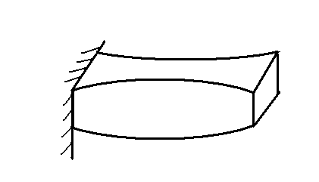
4. Static vs Dynamic Optimization Problems
Static optimization problem → a, b do not depend on L
Dynamic optimization problem → a, b are dependent on L
P
a
b
L
P
a(x)
b(x)
x
L

Slide 8
Principle of Optimization
Constrained Optimization Problem
Minimize y= f(x₁,x₂)= (x₁-a)²+(x₂-b)²
subject to
g_{i}(x₁,x₂) ≤ C_{i}; i=1,2,3…,n
and
x₁≥ x₁^{min},
x₂ ≥ x₂^{min}

Slide 9
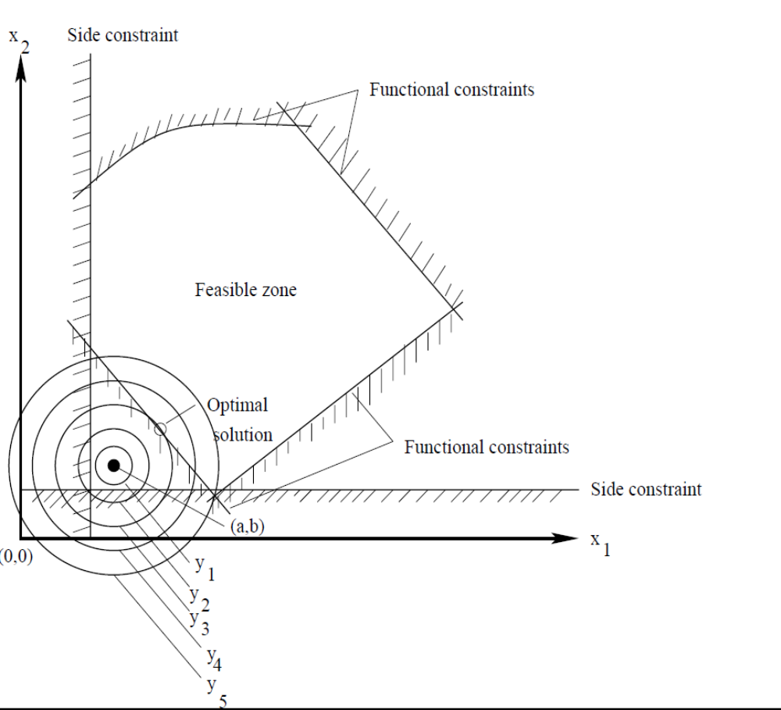
Principle of optimization
Free points: The points residing the feasible zone are called free points
Bound points: The points lying on boundary of the feasible zone are called bound points

Slide 10
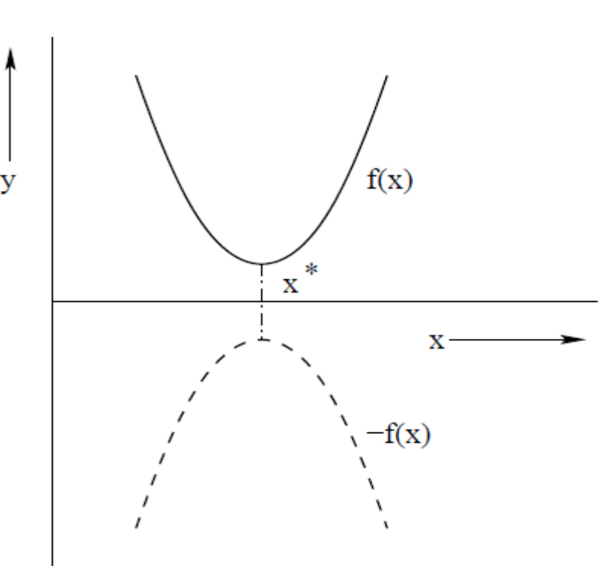
Duality Principle
Minimize y = f(x) equivalent Maximize –f(x)
Subject to to subject to
x ≥ 0.0 x ≥ 0.0

Slide 11
Conventional Optimization Methods
Linear Programming
Methods
Graphical Method
Simplex Method
Non-linear Programming Methods
Specialized Algorithms
Integer programming
Geometric programming
Dynamic programming

Slide 12
Single Variable problems
Multi-Variable problems
Analytical Method
Numerical Methods
Exhaustive Search
Dichotomous search
Fibonacci Method
Golden section Method
Direct search methods
Random Search Methods
Pattern Search Methods
Gradient-based
Methods
1. Steepest Descent Method etc..

Slide 13
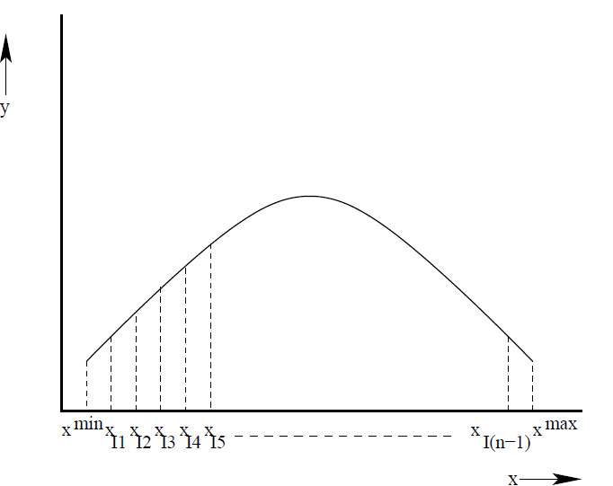
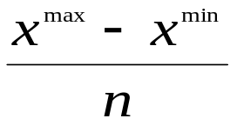
Exhaustive Search Method
Let us consider an optimization problem as given below.
Maximize y=f(x)
subject to
x^{min} ≤ x ≤ x^{max}
Let the range of x, that is, (x^{max}-x^{min}) is divided into n equal parts
small change in x, that is, Δx =

Slide 14
Step 1: We set
x₁=x^{min}
x₂ = x₁+Δx = x_{I1}
x₃ = x₂+Δx = x_{I2}
Step 2: We calculate the function values, that is, f(x₁),f(x₂),f(x₃) check for the maximum point
If f(x₁) ≤ f(x₂) ≥ f(x₃), the maximum point lies in the range of (x₁,x₃). We terminate the program,
Else
x₁ = x₂ (previous)
x₂ = x₃ (previous)
x₃ = x₂ (present) + Δx
Step 3: We check whether x₃ exceeds x^{max}.
If x₃ does not exceed x^{max}, we go to step2,
Else we say that the maximum does not lie in the range of
(x^{min}, x^{max}).

Slide 15
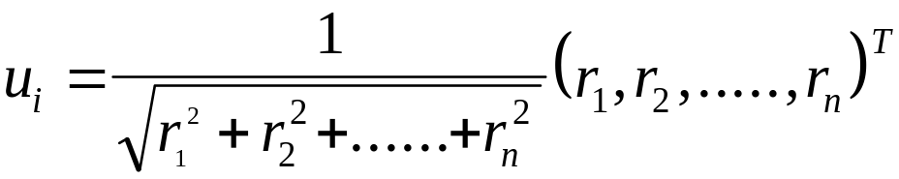
Random Walk Method
Direct search method, where the search is carried out using the objective function value
No derivative information is required
Present solution X_{i+1} is determined using the previous solution X_{i} as follows:
  X_{i+1} = X_{i} + λu_{i}
Where X = (x₁, x₂, ……, x_{m})^{T}
λ = step length
Where (r₁, r₂, …..,r_{n}) are the random numbers lying between -1.0 and 1.0
Note : n = m

Slide 16
Step 1: Set initial values of λ; ε (permissible minimum value of λ);
N (maximum number of iterations to be tried)
Start with an initial solution X₁, created at random
Determine the function value f₁ = f(x₁)
Step 2: Generate a set of n random numbers lying between -1.0 to
1.0 and calculate u₁
Step 3: Determine the function value f₂ = f(X₂)=f(X₁+λ u₁)
Step 4: If f₂ < f₁, then we set X₁= X₁+λ u₁; f₁= f₂, and repeat the
steps 2 through 4
Else
Repeat steps 2 through 4, up to the maximum number of
iterations N
Step 5: If a better point X_{i+1} is not obtained after running the
program for N iterations, reduce λ to 0.5λ
Step 6: Is the modified (new) λ < ε ?
If no, go to step 2,
Else we declare X* = X₁, f* = f₁, and terminate the program.

Slide 17
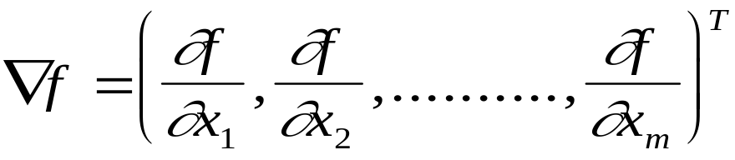
Steepest Descent Method
Gradient of a function
It is the gradient-based method
Not applicable to a discontinuous function
Let us consider a function
y = f(X) = f(x₁, x₂, ……., x_{m})
Gradient of the function
Note: Gradient direction is the direction of steepest ascent.

Slide 18
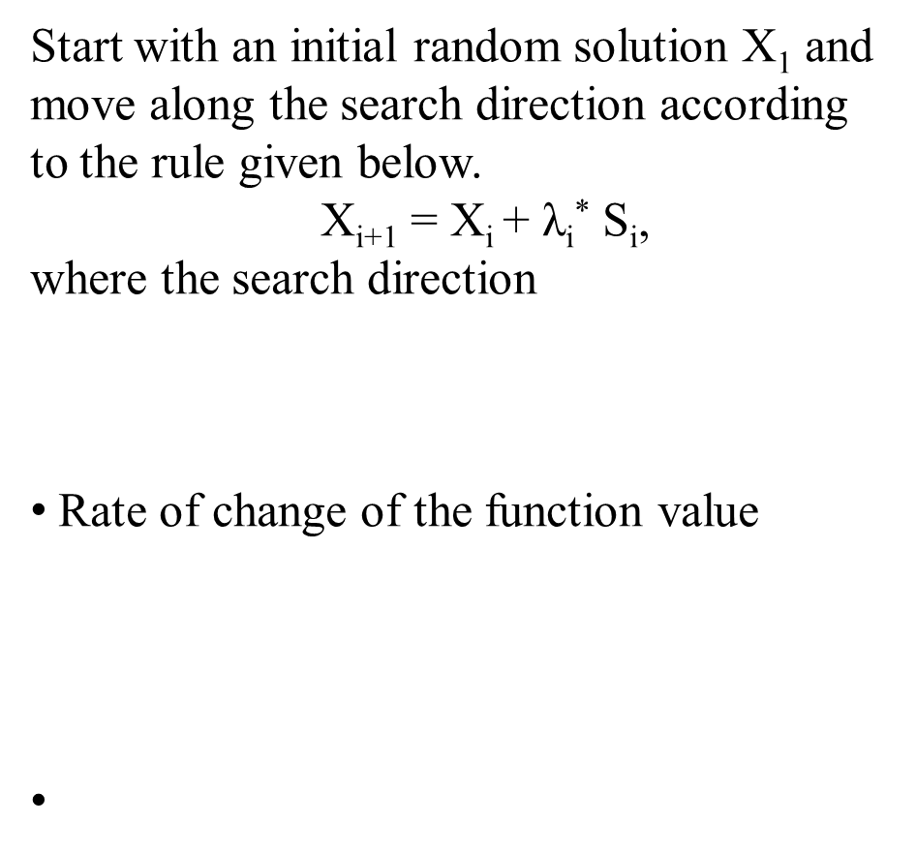

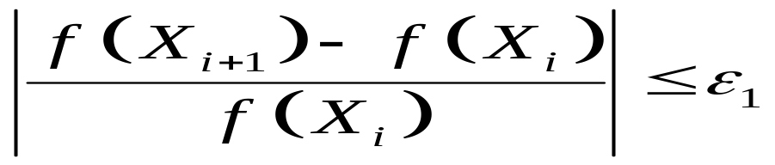
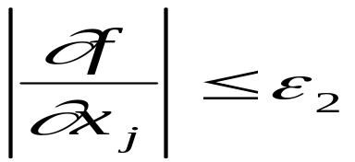
Principle of the Method
Termination Criteria

Slide 19
Advantages
Limitation of the Algorithm
It has a faster convergence rate
This algorithm is simple and easy to understand and implement
There is a chance of the solutions of this algorithm for being trapped into the local minima

Slide 20
Drawbacks of Traditional Optimization Methods
Final solution of an optimization problem depends on the randomly chosen initial solution. If the initial solution lies in the local basin, the final solution will get stuck at local optimum
Gadient-based methods cannot be used for discontinuous objective function
There is a chance of the solutions of a gradient-based optimization method for being trapped into the local minima
These methods may not be suitable for paralllel computing

Slide 21
Drawbacks of Traditional Optimization Methods (contd.)
Discrete/integer variables are difficult to handle using the traditional methods of optimization
A particular traditional method of optimization may not be suitable to solve a variety of problems

