Slide 1







SPACE WARS Group [401] Cha-Thai
BADS7205-Data Streaming & Real-Time Analytics

Slide 2
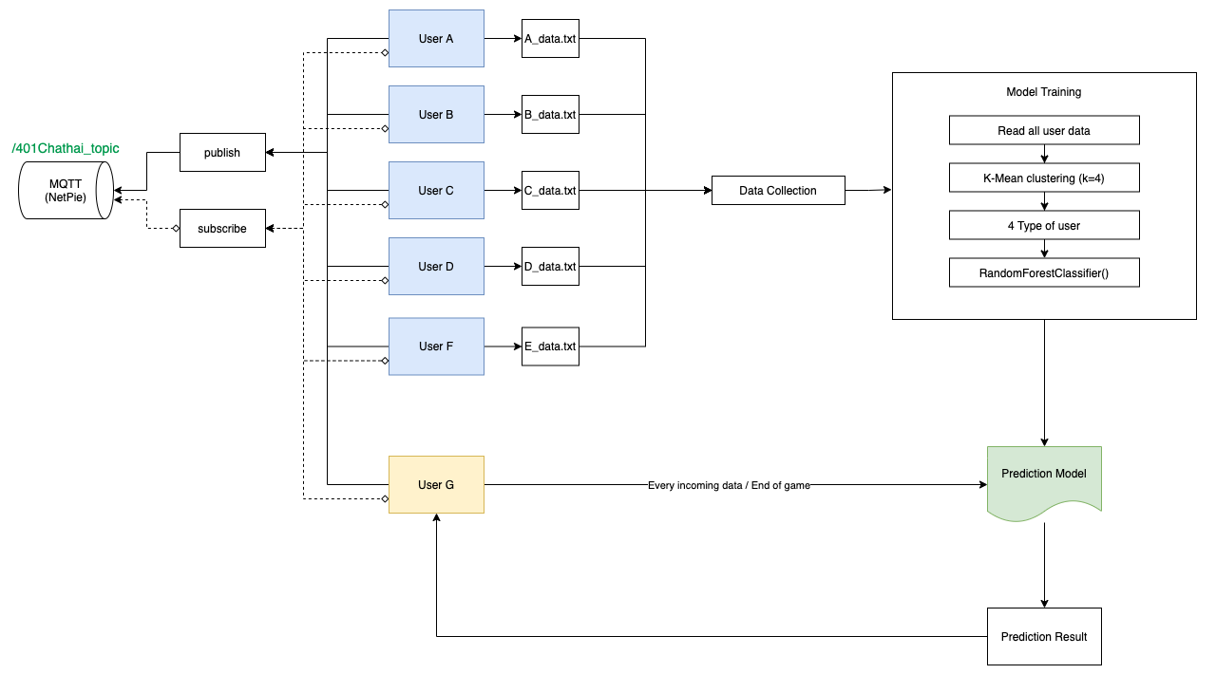
BATCH LEARNING

Slide 3
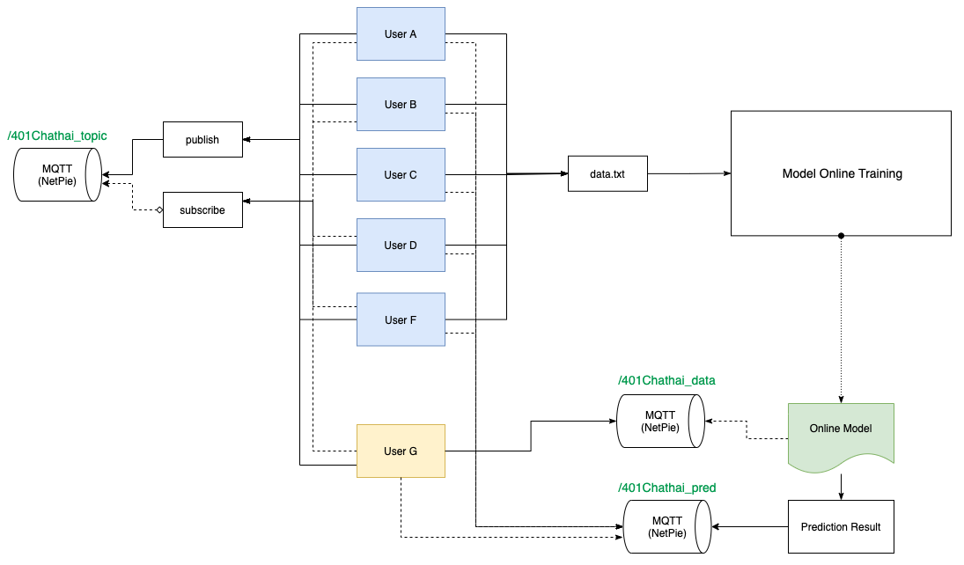
ONLINE LEARNING

Slide 4
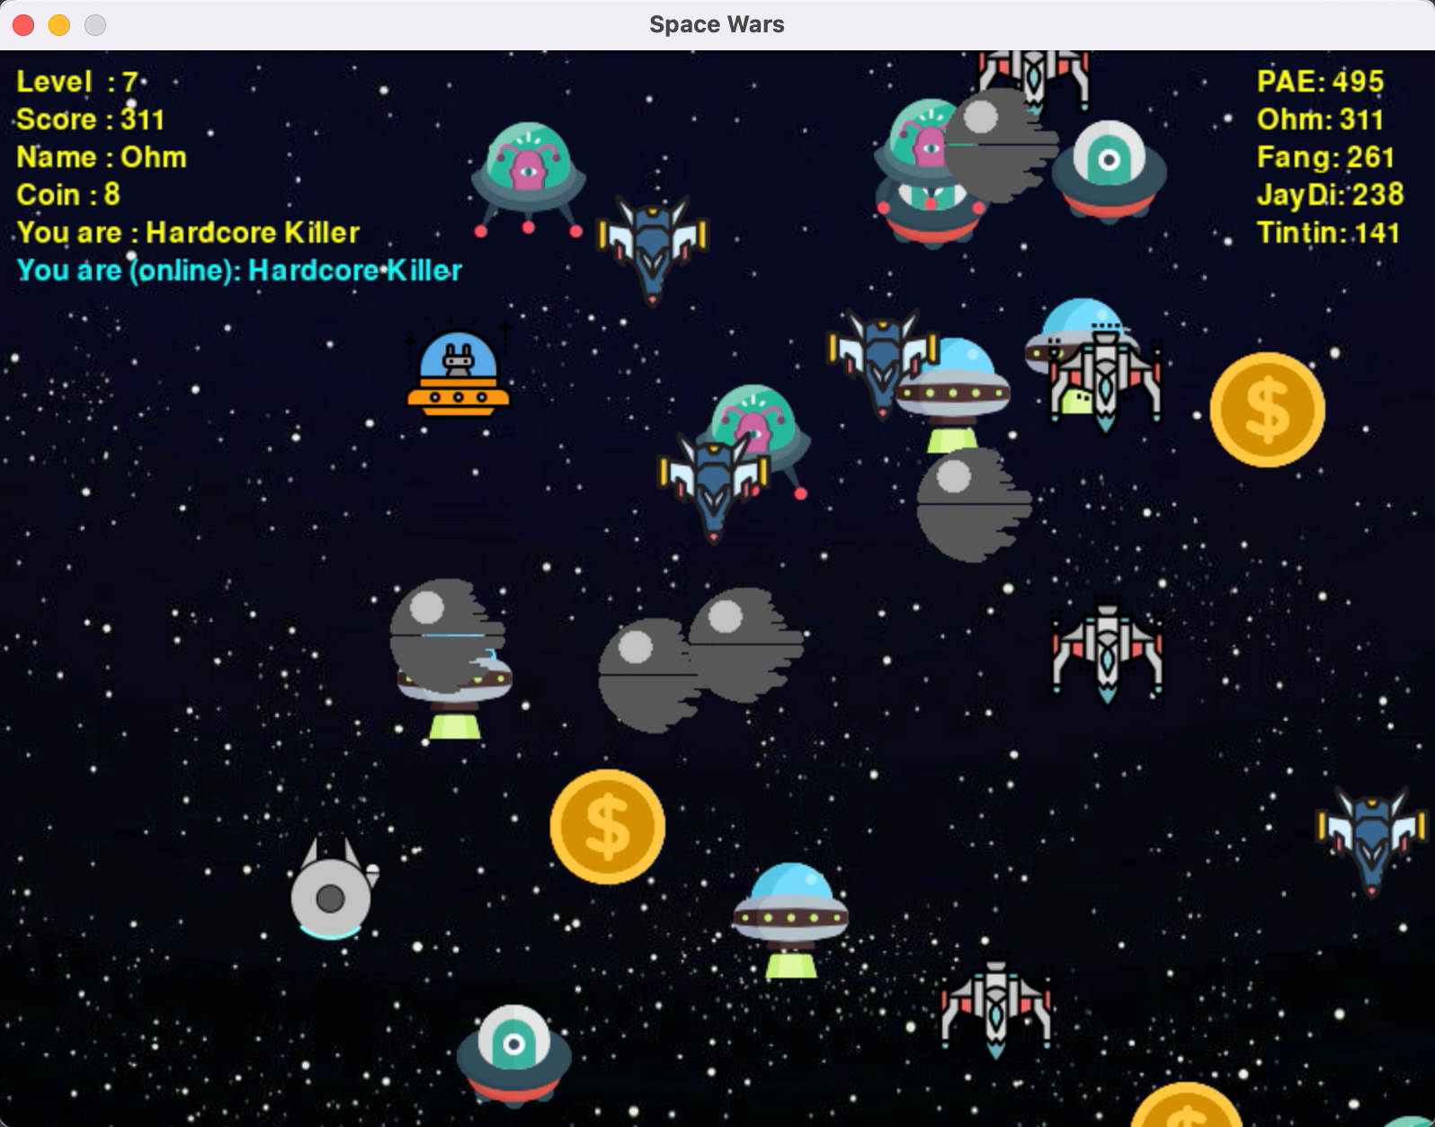
ONLINE LEARNING

Slide 5
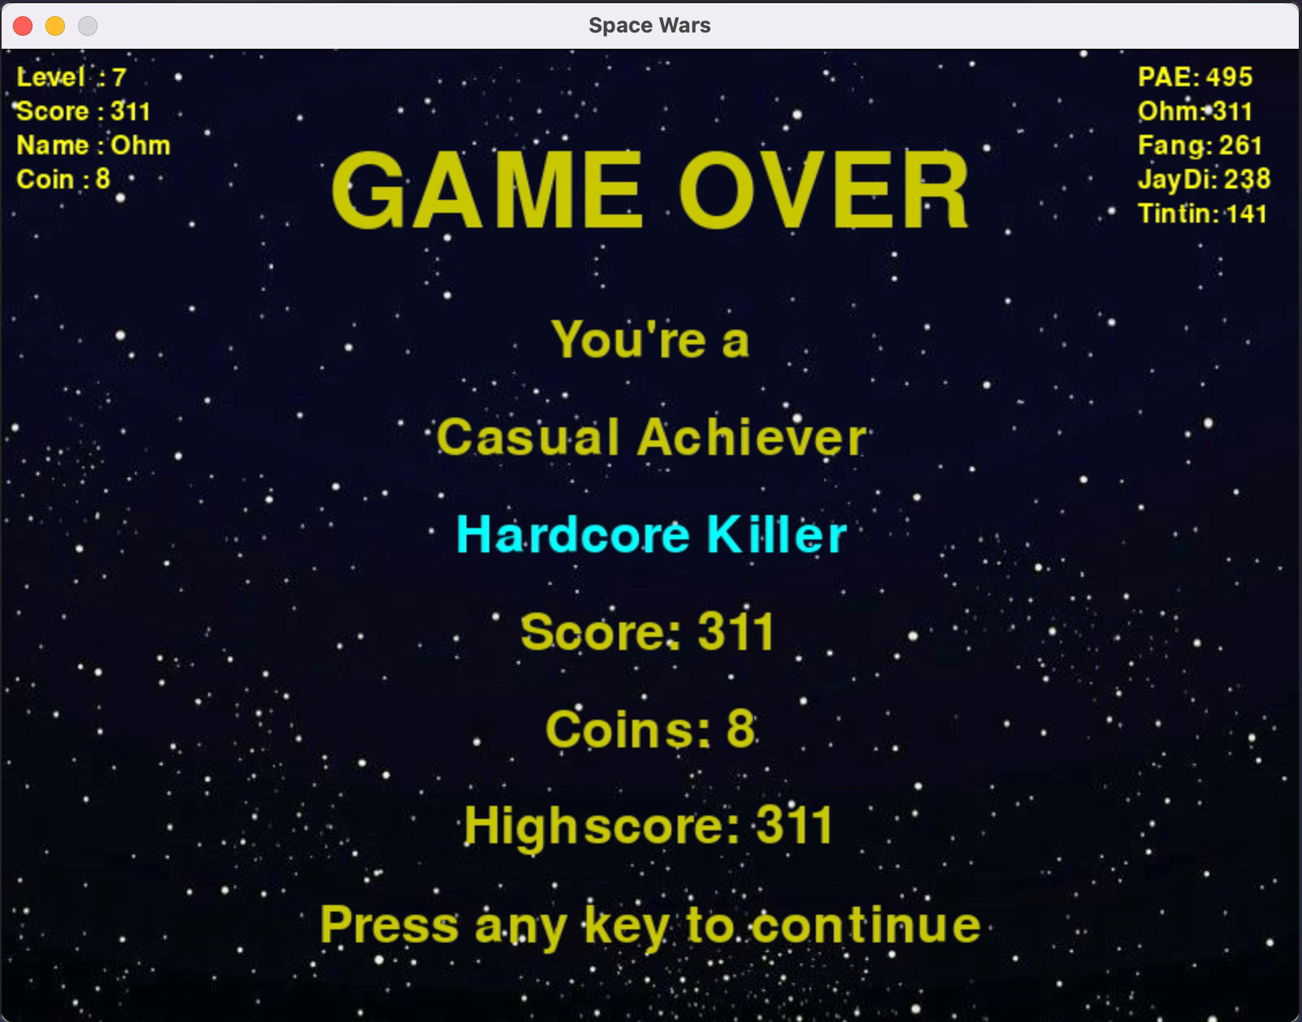
ONLINE LEARNING

Slide 6

QUESTIONAIRE RESULT
KITTISAK, ATHIWAT, PORNTIP, APINYA,
MAETHAVEE
ACHIEVER
KILLER
ATHIWAT
* HARDCORE
* MODERATE

Slide 7
RESULT
 | Maethavee | Athiwat | Kittisak | Porntip | Apinya
Questionnaire | Moderate Achiever | Hardcore Achiever & Killer | Hardcore Achiever | Hardcore Achiever | Hardcore Achiever
Offline | Casual Killer | Casual Achiever | Hardcore Achiever | Casual Killer | Casual Achiever
Online | Casual Killer | Hardcore Killer | Hardcore Achiever | Casual Achiever | Hardcore Killer

Slide 8
MEMBER
6220422078 Maethavee Sukul
6220422080 Athiwat Hirunworawongkun
6220422081 Kittasak Sukhantharat
6220422085 Porntip Kaewwaen
6220422086 Apinya Ketnu

