Slide 1


NEXT GEN EMPLOYABILITY PROGRAM
CREATING A FUTURE-READY WORKFORCE

Slide 2
Student Name : Athiyaman M
Student ID : STU63a5c8593b4db1671809113
College Name : IFET College of Engineering

Slide 3
CAPSTONE PROJECT SHOWCASE
Project Title : E-Commerce Sales Analysis using Power BI
Abstract | Problem Statement | Project Overview | Proposed Solution | Technology Used | Modelling & Results | Conclusion | Q&A

Slide 4

Abstract
This project focuses on leveraging the Power BI to analyze the e-commerce sales data into visual dashboard which shows insights about key performance indicators (KPIs), understand sales trends, identify top-performing products and inform data-driven decision-making that empower the sales e-commerce business stakeholders.
The interactive dashboard encompasses various analyses, including sales trends, product performance, customer segmentation, geographical insights, shipment and sales, profit forecasting.

Slide 5

Problem Statement
E-commerce businesses face the challenge of extracting meaningful insights from vast sales data they generate.
For the given dataset, we have to understand the sales trends, profit margin, customer behavior, optimizing marketing strategies and identifying geographical trends are critical for sustained growth.
This project addresses these challenges by providing a dynamic Power BI dashboard with summary analysis to diverse needs of e-commerce stakeholders.

Slide 6
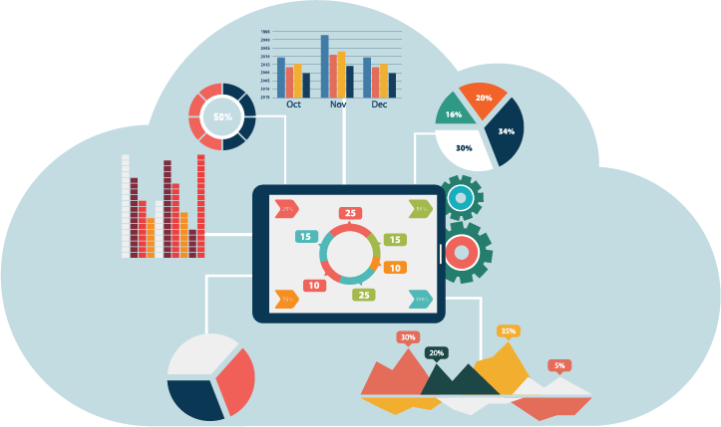
Project Overview
The dataset consists of 9995 rows and 23 columns having e-commerce sales related data’s such as sales and profit margin, customer segments, product categories and shipment regions.
My dashboard provides in-depth insights across six key areas,
Overall Sales & Profit Analysis
Category & Sub-Category Product Analysis
Customer Segment Analysis
Geographical Sales Analysis
Shipment & Orders Analysis
Discount & Forecast Analysis

Slide 7

Proposed Solution
The proposed solution involves the creation of six distinct Power BI sheets, each shows specific aspects of e-commerce sales analysis.
This dashboard leverages interactive visualizations to explore data at various levels by performing DAX functions.
Key metrics like sales trends, top-selling products, customer segmentation, regional performance and forecasting using charts like line charts, bar charts, area chart, donut chart, maps and clustered charts facilitate intuitive understanding.

Slide 8





Technology Used
Power BI Desktop: Dashboard creation, Data Modeling, DAX functions, Power Query Editor.
Excel : Data preprocessing, Data analysis.
GitHub : Deployment.
Canva : Designing, Prototype.
ChatGPT : Different analysis reference.

Slide 9
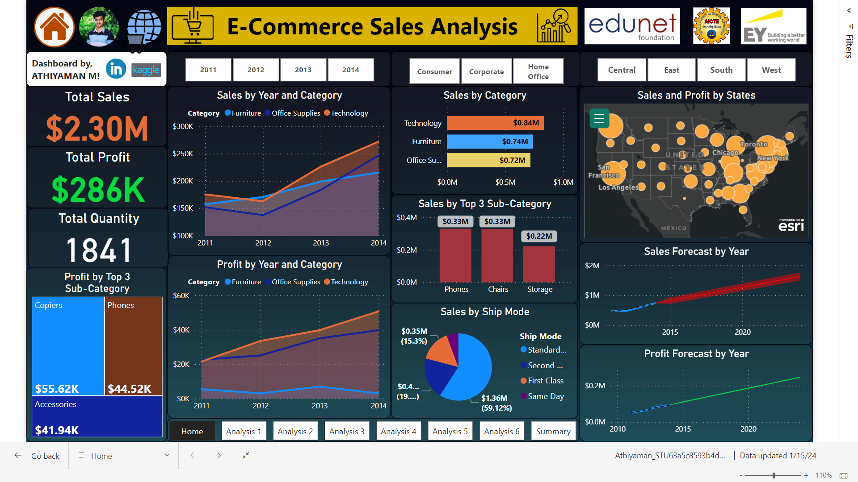
Modelling & Results
Live Link

Slide 10
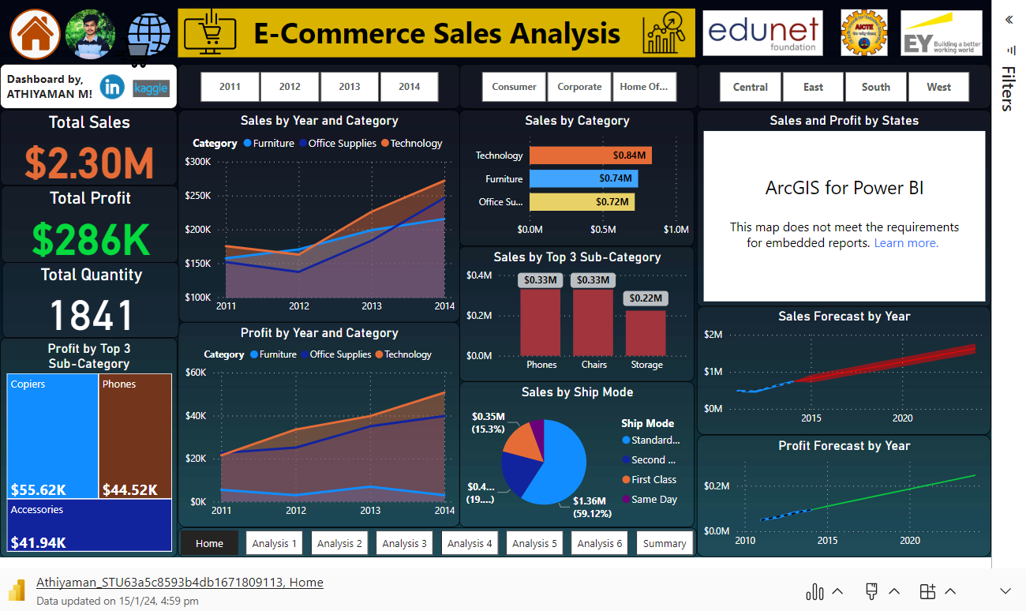

Slide 11

Conclusion
In summary, a detailed analysis of the given sales data indicates that while the Furniture category, particularly the Bookcases and Tables sub-categories, faces challenges with negative profit margins despite stable sales, the Office Supplies and Technology categories exhibit positive trends.
To maximize overall profitability, it is advisable to channel investments and marketing efforts towards the Technology and Office Supplies segments, while undertaking a thorough review of the Furniture category, focusing on opportunities for improvement in the Bookcases and Tables sub-categories.

Slide 12
Thank You!
Notes:
Thank You !!

