Slide 1

Healthcare Analytics for Doctor Visits
Student Name : Athiyaman M
AICTE ID : STU63a5c8593b4db1671809113
College : IFET College of Engineering

Slide 2

PROBLEM STATEMENT
Introduction :
Rising complexities in healthcare demand efficient data analysis.
Limited insights into doctor visit data hinder decision-making.
Challenges:
Inadequate use of data science in healthcare analytics.
Lack of tools for comprehensive doctor visit data analysis.
Objectives:
Develop a robust Python-based healthcare analytics system.
Address challenges in healthcare data analysis.
Provide actionable insights for improved decision-making.

Slide 3
Project Description
Overview :
Focus on Python tools for doctor visit data analysis.
Enhance understanding through advanced analytics.
Key Features :
Data Science Concepts
Terminologies and Processes
Python Libraries: NumPy, Pandas
Data Visualization: Matplotlib, Seaborn
Benefits :
Empower healthcare professionals with data-driven insights.
Enhance decision-making for better patient care.

Slide 4

WHO ARE THE END USERS?
Primary Users :
Healthcare Analysts
Doctors and Healthcare Professionals
Data Scientists
Secondary Users :
Healthcare Administrators
Researchers
Policy Makers

Slide 5

Technology Used
Python – for programming
Jupyter Notebook – for IDE
Pandas, NumPy – for computation
Matplotlib, Seaborn – for data visualization
GitHub – for documentation

Slide 6
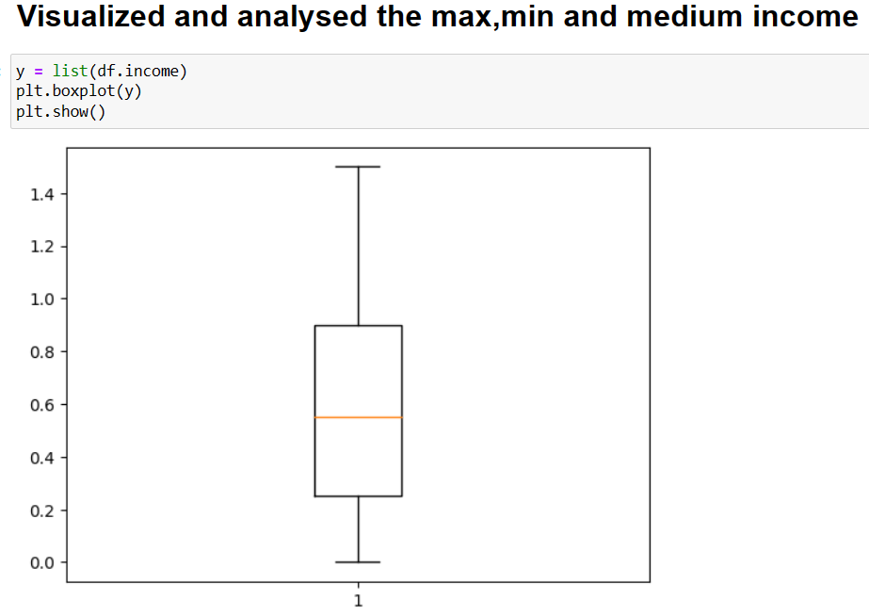
RESULTS
GitHub Link

Slide 7
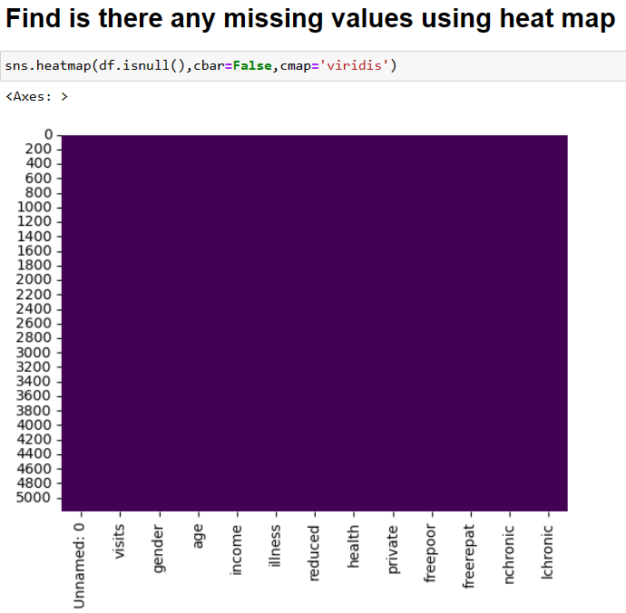
RESULTS
GitHub Link

Slide 8
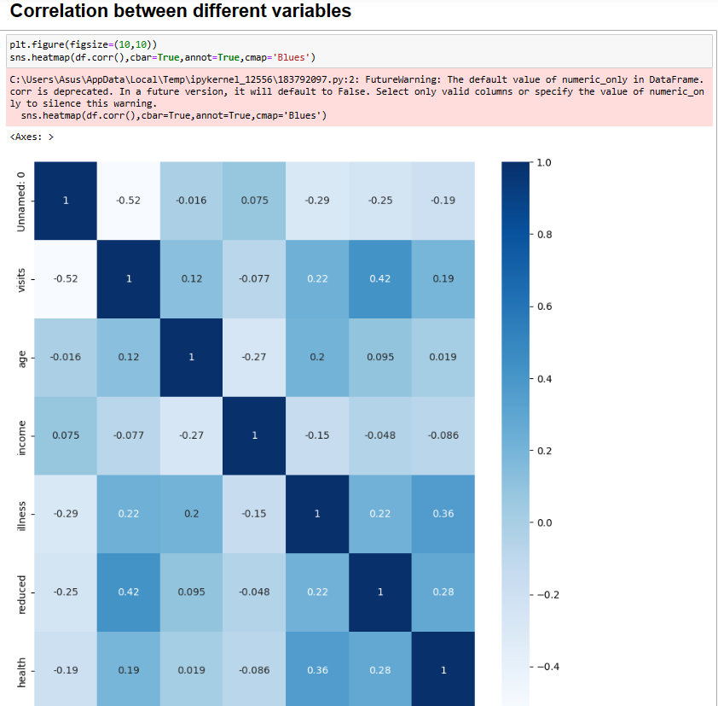
RESULTS
GitHub Link

Slide 9
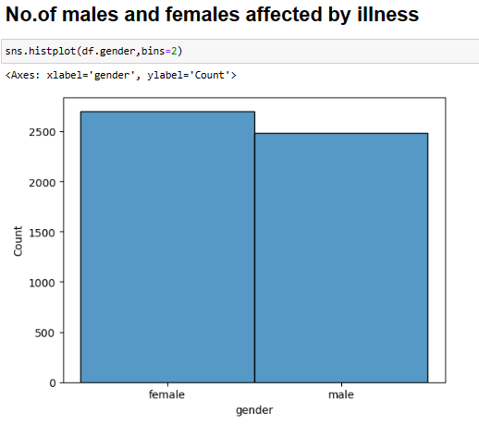
RESULTS
GitHub Link

Slide 10
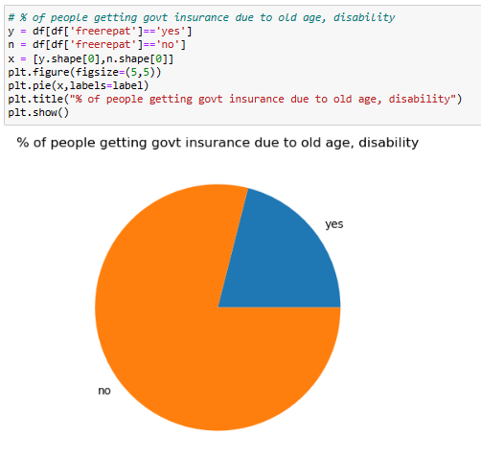
RESULTS
GitHub Link

Slide 11
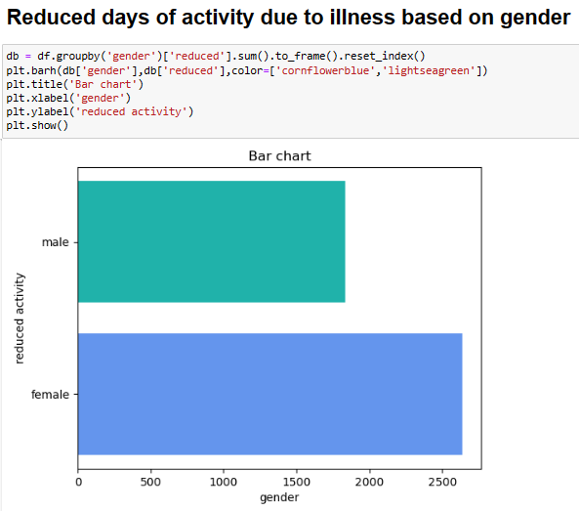
RESULTS
GitHub Link

Slide 12
Thank you
.
.

