Slide 1
Recognition Of Flower Species
Using CNN

Slide 2
Our Team
PROJECT GUIDE AND PROJECT MEMBERS
PROJECT LEADER
TEAM MEMBER
TEAM MEMBER
PROJECT GUIDE
ATHMAJA N
KAVYA K
NISHA PV
SARITH DIVAKAR
KSD17IT005
KSD17IT012
KSD17IT022
ASST.PROFFESOR

Slide 3
Contents
01
Introduction
.
02
Requirements
03
System Design
04
Reference
.

Slide 4
1.Introduction
Automatic identification and recognition of flower species is necessary to know about their existence .
Flower Species Recognition is a hard problem because there are millions of flower species around the world.
We can perform real-time flower species recognition using computer vision and machine learning algorithms with the help of python.
Hence in this proposed system, a Deep learning approach using Convolutional Neural Networks (CNN) is used to recognize flower species with high accuracy.
.
.
.

Slide 5
Our Approach
PROBLEM STATEMENT
Flower species recognition is one of the most challenging and difficult problem in computer vision due to a variety of reasons :
Availability of flower dataset
Millions of flower species around the world
High inter-class as well as intra-class variation
Fine-grained classification problem
Segmentation , View-point, Occlusion ,Illumination and so on.

Slide 6
Our Approach
PROPOSED SYSTEM
The Existing Systems are still seem to be quite difficult to analyze due to complex 3D structure and high intra-class variation of flower species, therefore in Proposed System :
CNN is used to Recognize Flower Species with high accuracy in less time.
CNN is the most efficient algorithm in AI for image processing.
The system detects flower in the image as well as recognize which species it belongs to.
The system performs real-time flower species recognition.
The automatic method detects the region around the flower in an image , then uses cropped images to learn a strong CNN classifier to distinguish different flower classes.

Slide 7
2.Requirements
z
Functional Requirements
The system has following functional modules
1. Collecting dataset.
2. Building the convolutional neural network.
3. Training the convolutional neural network.
4. Classification of images as flower species or not.

Slide 8
Tools And Technology Used
01
CNN
OPENCV
02
.
03
TENSOR FLOW
PYTHON
04
DATASETS
05

Slide 9
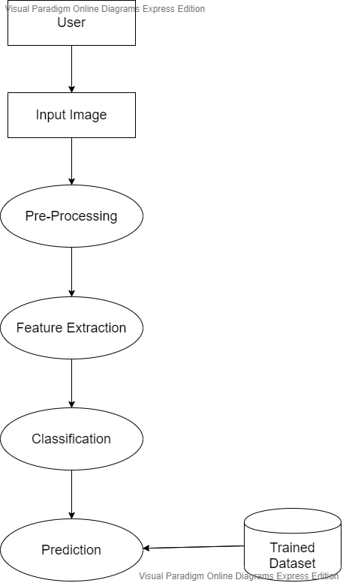
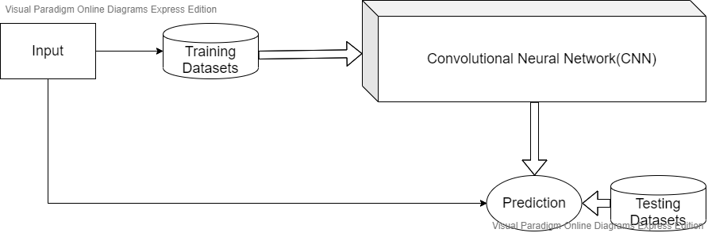
3.System Design
DATAFLOW DIAGRAM
ARCHITECTURE DESIGN

Slide 10

4.Reference
T. Saitoh and T. Kaneko, "Automatic recognition of wild Flowers", Pattern Recognition Proceedings. 15th International Conference on, vol. 2, no. 2, pp. 507-510, 2000.
N. Kumar, P.N. Belhumeur, A. Biswas, D.W. Jacobs, W.J. Kress, I.C. Lopez, et al., "Leafsnap: A computer vision system for automatic plant species identification", European Conference on Computer Vision, pp. 502-516, 2012.
D. Barthelemy, "The pl©ntnet project: A computational plant identification and collaborative information system", Technical report XIII World Forestry Congress, 2009.
M.E. Nilsback and A. Zisserman, "Automated flower classification over a large number of classes", Indian Conference on Computer Vision Graphics and Image Processing, pp. 722-729, 2008.
zemh@ju.edu.jo

Slide 11

Thank You

