Slide 1


Sacchon team6
Members
Charalampos Charalampidis
Athina Oikonomou
Markos Markoi
Ilektra Mitsi

Slide 2
Our team
Charalampos Charalampidis
Markos Markou
BSc Information Technology at Ionian University
Bsc of Science Computer Science and Telecommunications International Hellenic University
Msc of Science Applied Informatics
International Hellenic University
Athina Oikonomou
Ilektra Mitsi
Electrical and Computer Engineer AUTH
BSc in Physics at Aristotle University of Thessaloniki
MSc Computational Intelligence-Digital Media at Informatics AUTH

Slide 3
WORK FOR PROJECT | CHARALAMPOS | ATHINA | MARKOS | ILEKTRA
BACKEND | ✓ | ✓ |  | ✓
FRONTEND | ✓ | ✓ | ✓ | ✓

Slide 4












Work structure

Slide 5
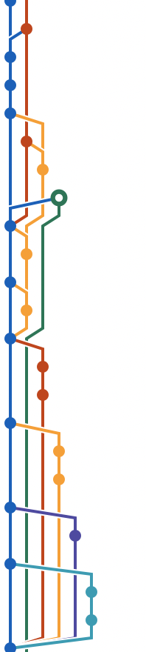
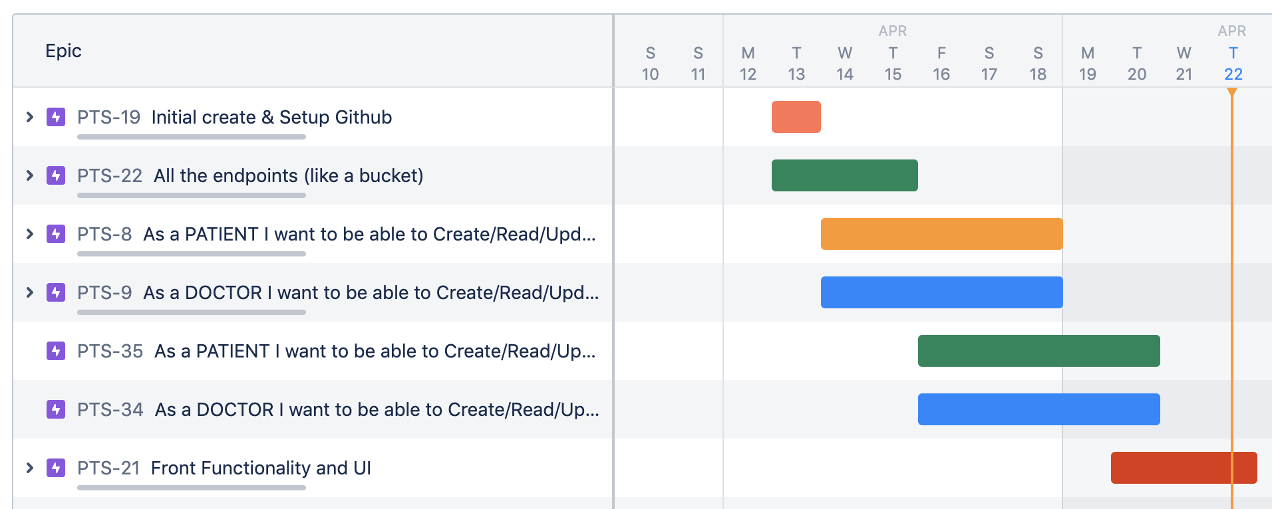

Slide 6
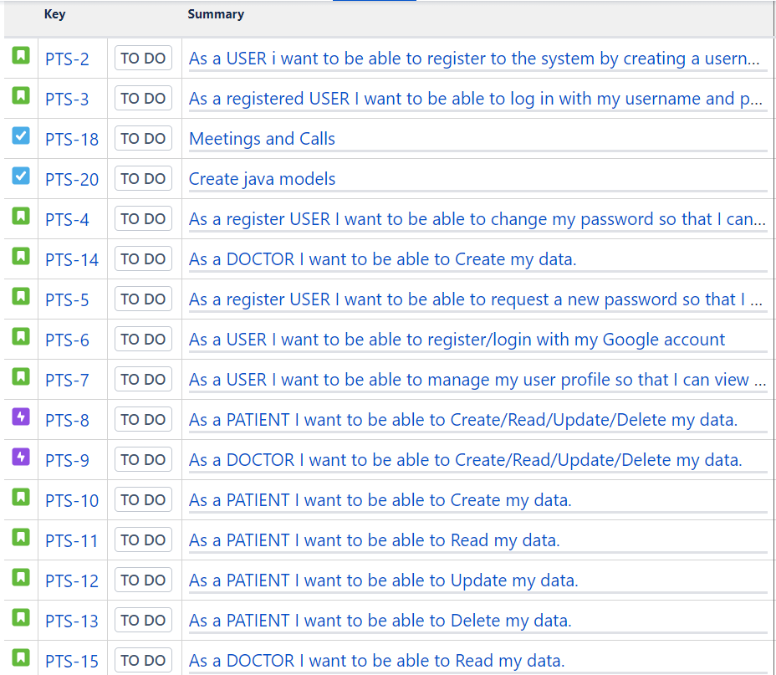
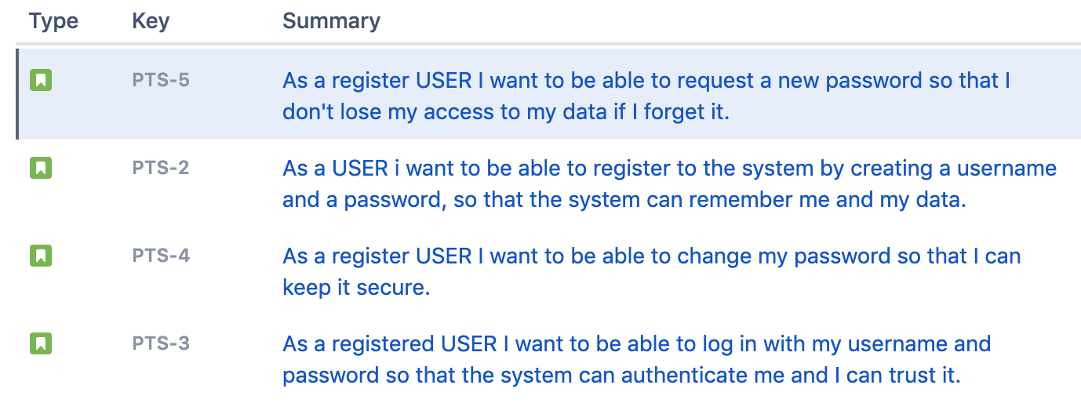
JIRA TASKS

Slide 7
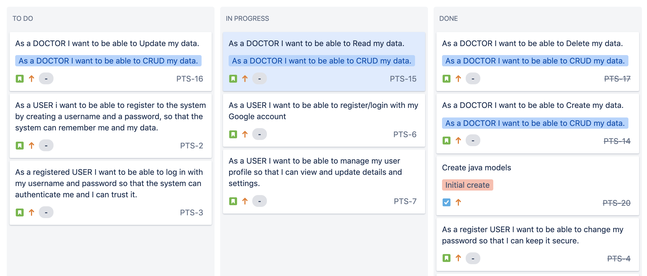

Slide 8
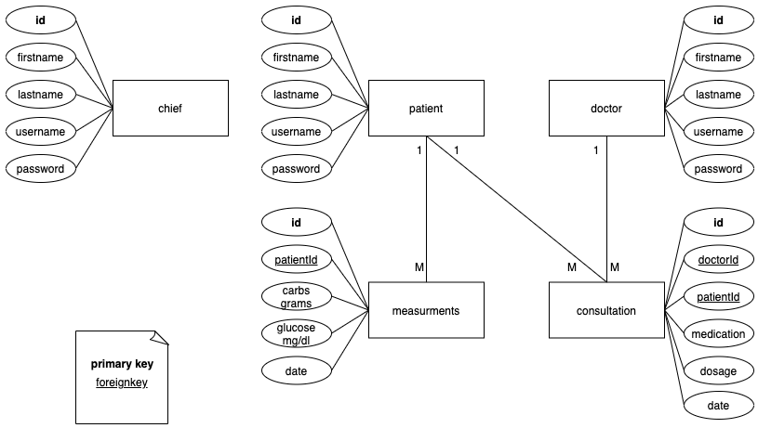
Database Diagram

Slide 9
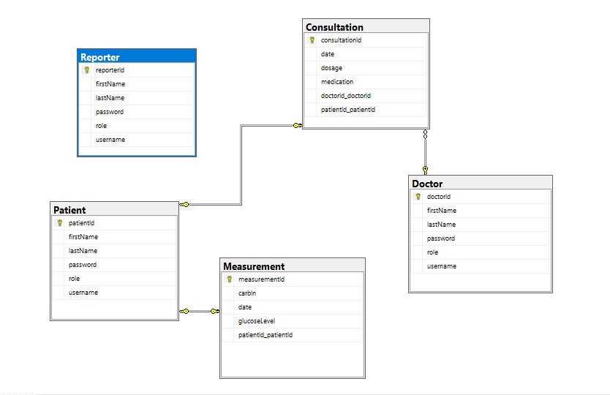
Database architecture

Slide 10
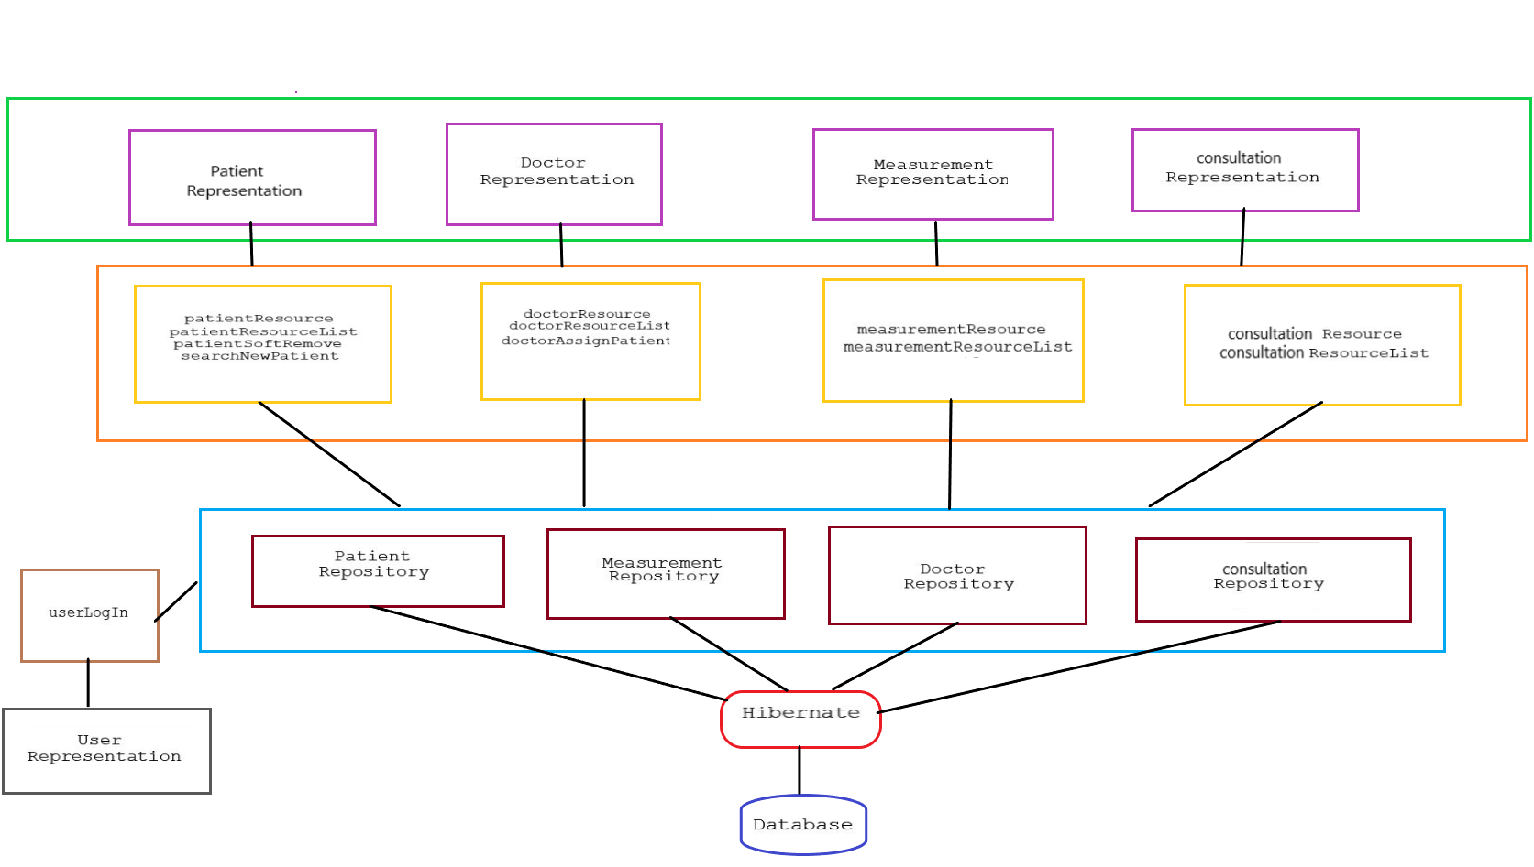
Hibernate flow

Slide 11
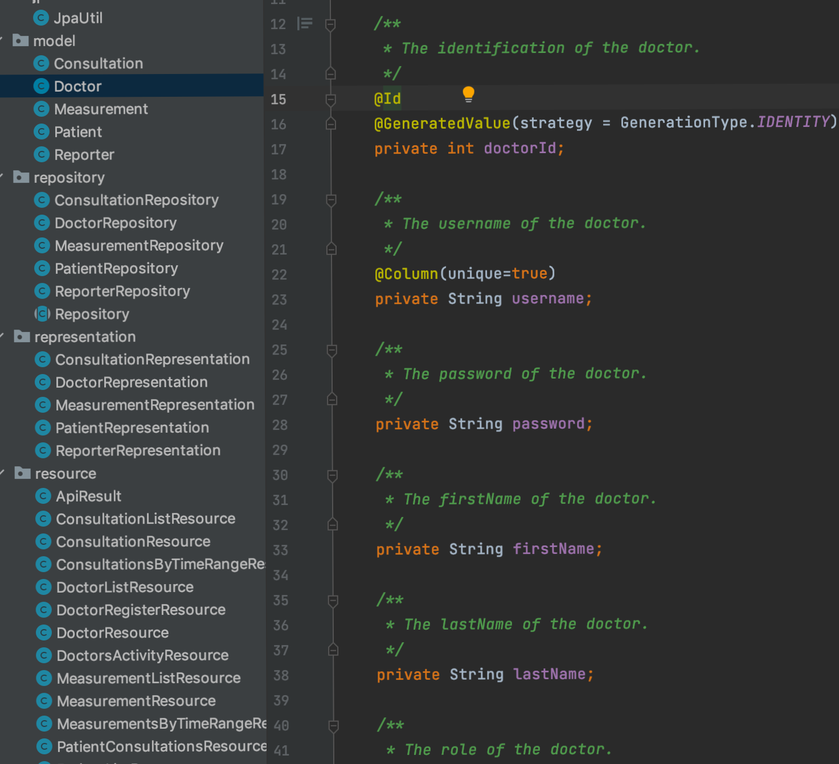
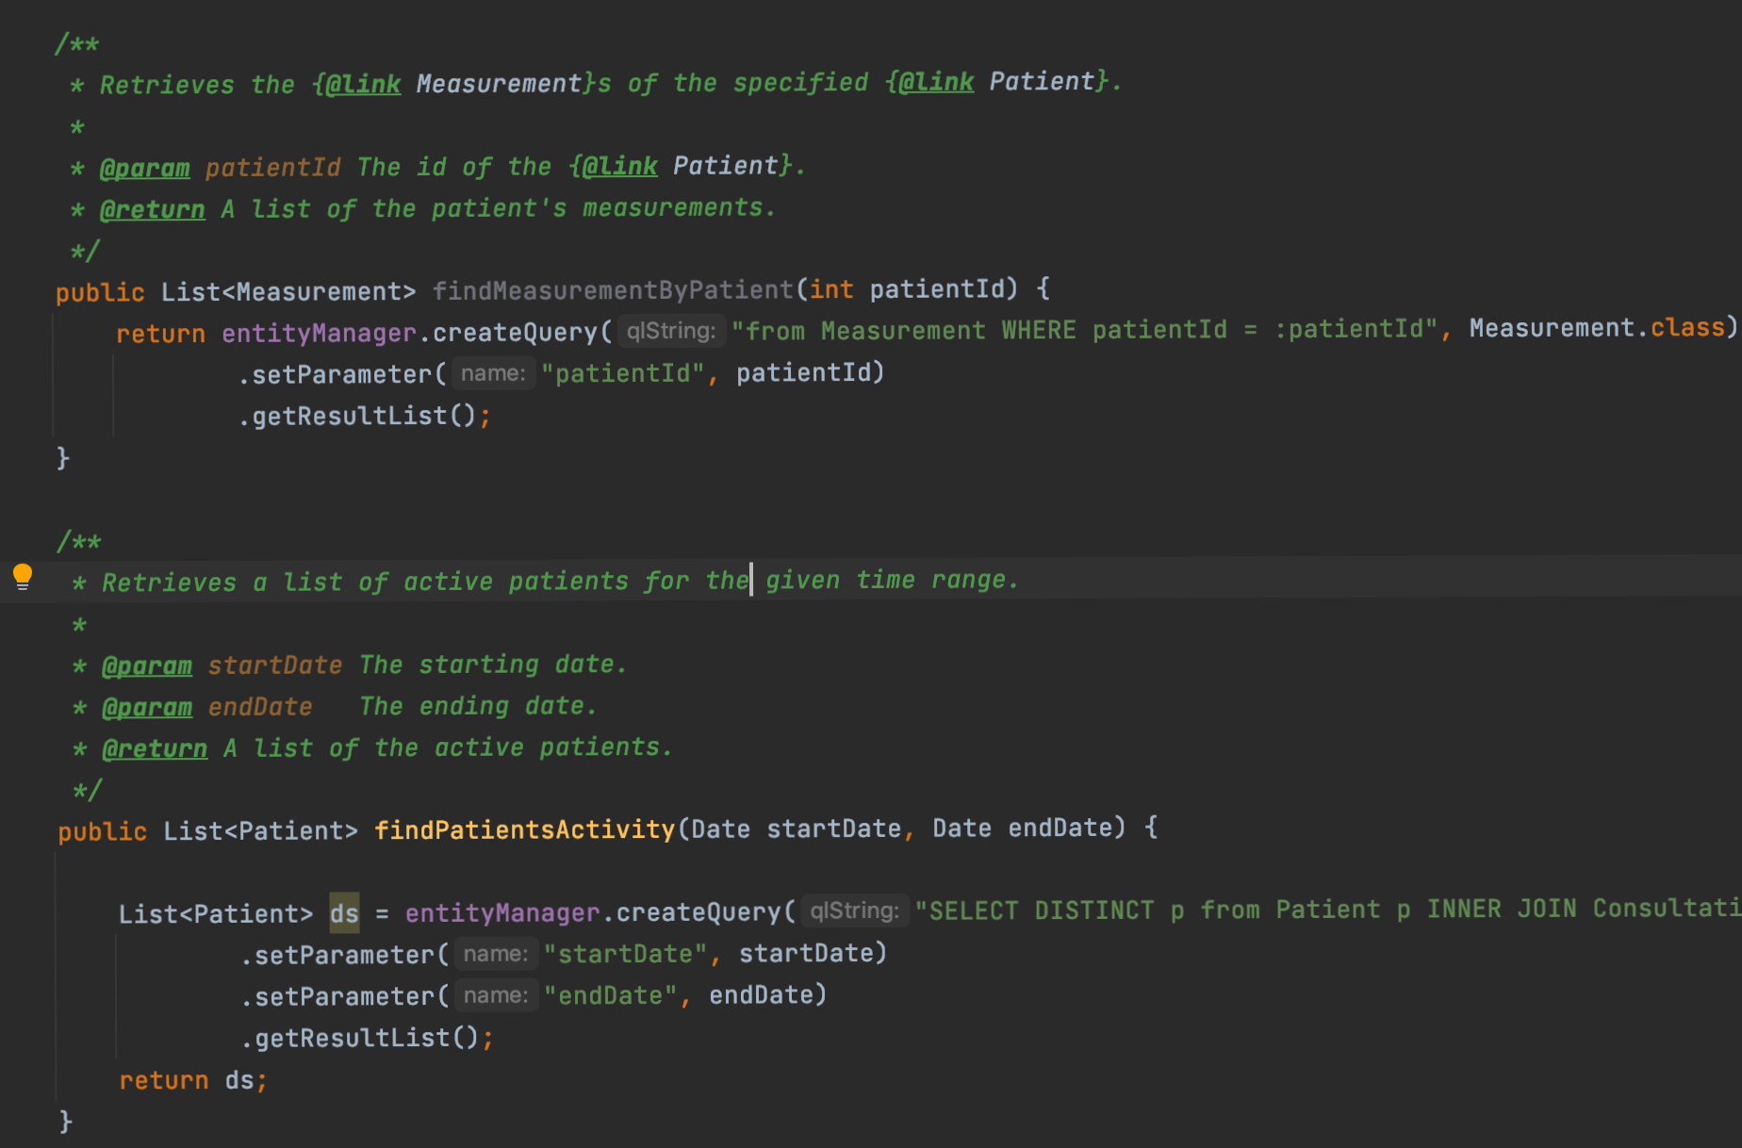

Slide 12
frontend
Design the FrontEnd part with Angular 8 Framework
Create modules and components
Verify the connection between BackEnd and FrontEnd
CRUD accomplishment for every entity
Designed routing modules with the login to be the parent and all the others the child modules

Slide 13
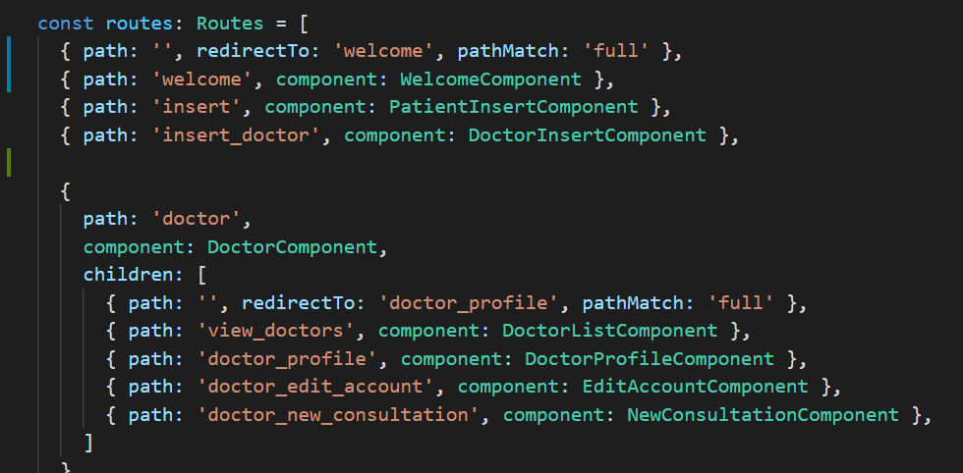

Slide 14
reflexions
What we did best:
Agile practices.
Team dynamics.
What did we omit:
UI for the “reporter”.
What we would do if we had more time:
Apply UI principles.
Engineer a more sophisticated measurement and consultation solution

Slide 15
Thank you for your time

