Slide 1
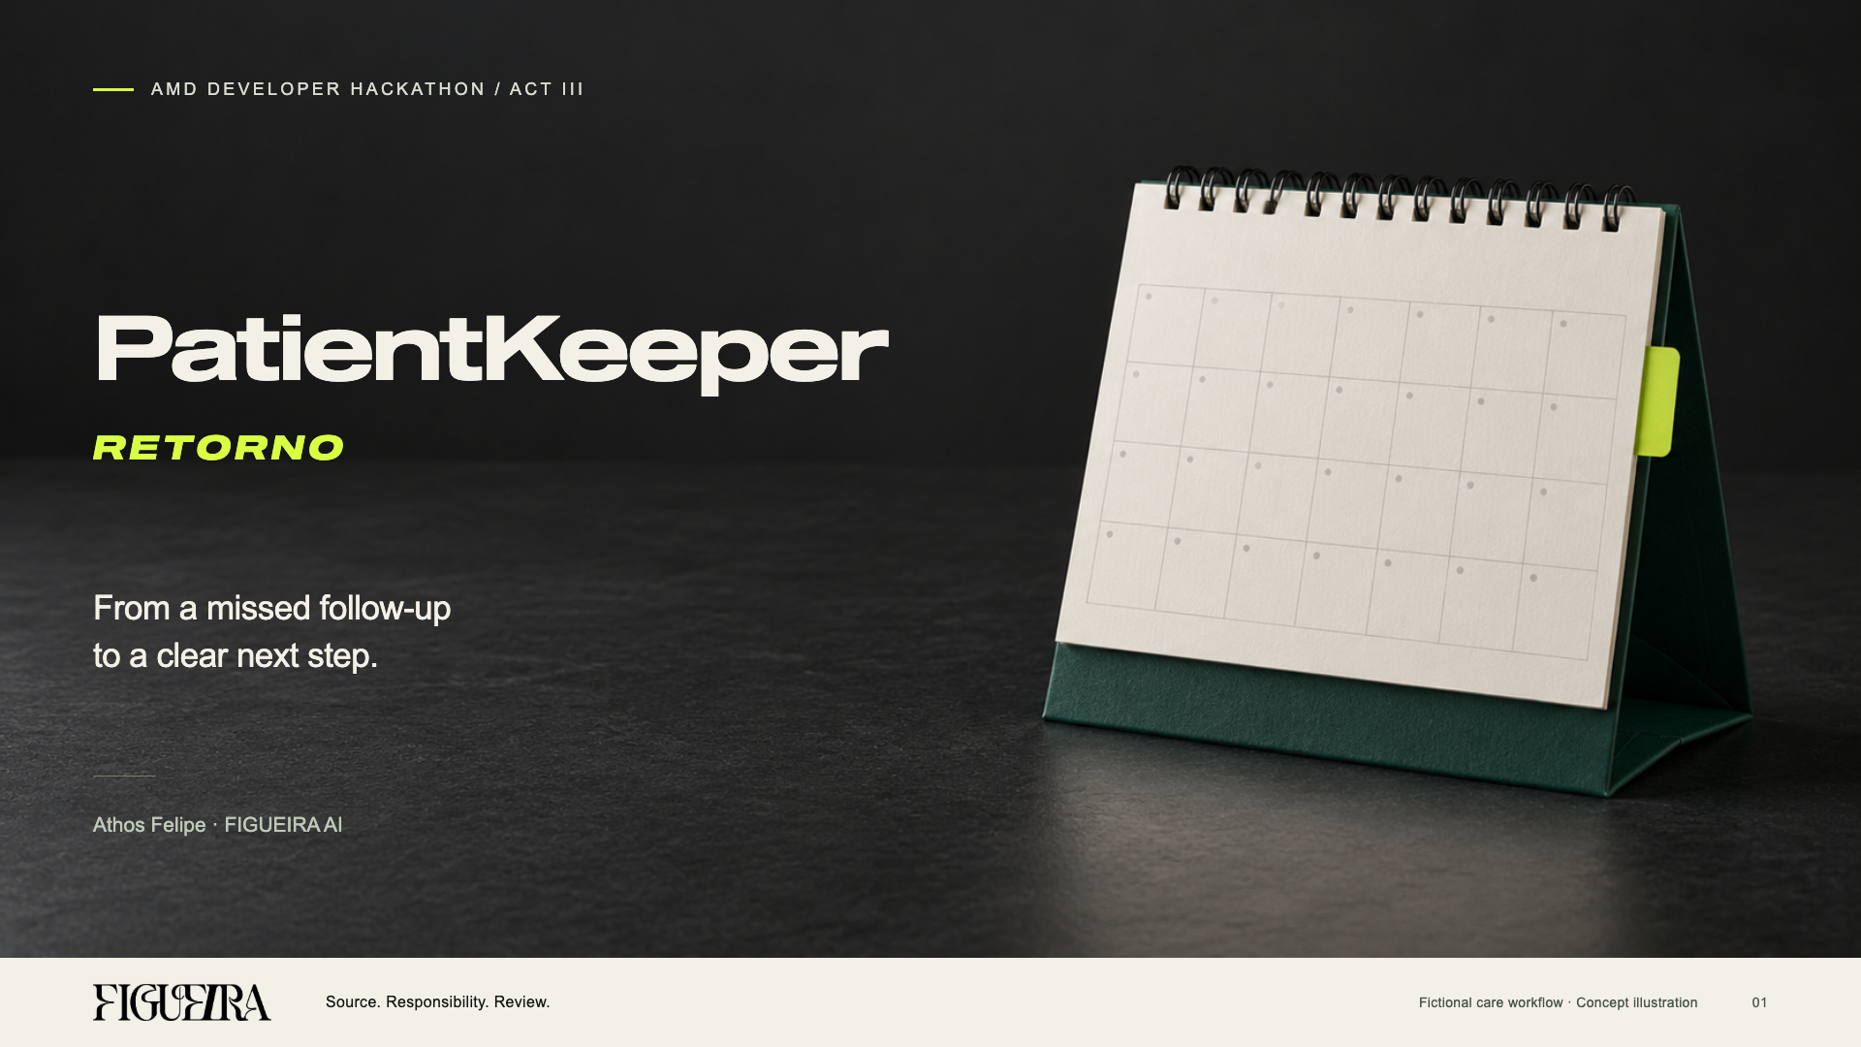
Notes:
PatientKeeper Retorno by Athos Felipe, FIGUEIRA AI, AMD ACT III. Cover is the approved R10 artwork exactly, including the official wordmark, desk-calendar conceptual image, Sequel typography and bold italic RETORNO. The cover is an image; its editable native composition remains assets/ACT-III-20261012/UX-R10/COVER-R10.html. All product records in this presentation are fictional. The cover is a concept illustration, not a photograph of a real clinic. R14 presentation accompanies the new video with human narration by Athos; no synthetic voice claim applies to that new narration.

Slide 2
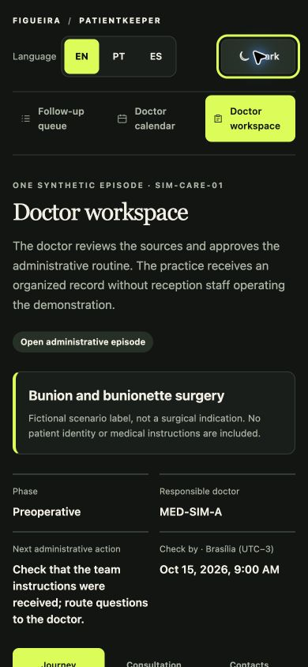

A missed follow-up leaves a next step open
An administrative problem drawn from everyday work with the doctors we serve.
An unfinished follow-up
still needs a next step
The doctor needs to see what remains open
and which source supports the next check.
Built from Athos’s everyday work
with the doctors FIGUEIRA serves.
02
Notes:
Problem origin: Athos described developing solutions from problems encountered in everyday work with doctors served by FIGUEIRA. This is qualitative experience and a product hypothesis, not a survey, measured prevalence or claim about a named clinic. No staff blame, patient identity or clinical outcome is asserted. Sources: user briefing of 13–14 October 2026; README.md; BASE-PREEXISTENTE.md. Screenshot is an actual isolated synthetic doctor workspace in mobile layout.

Slide 3
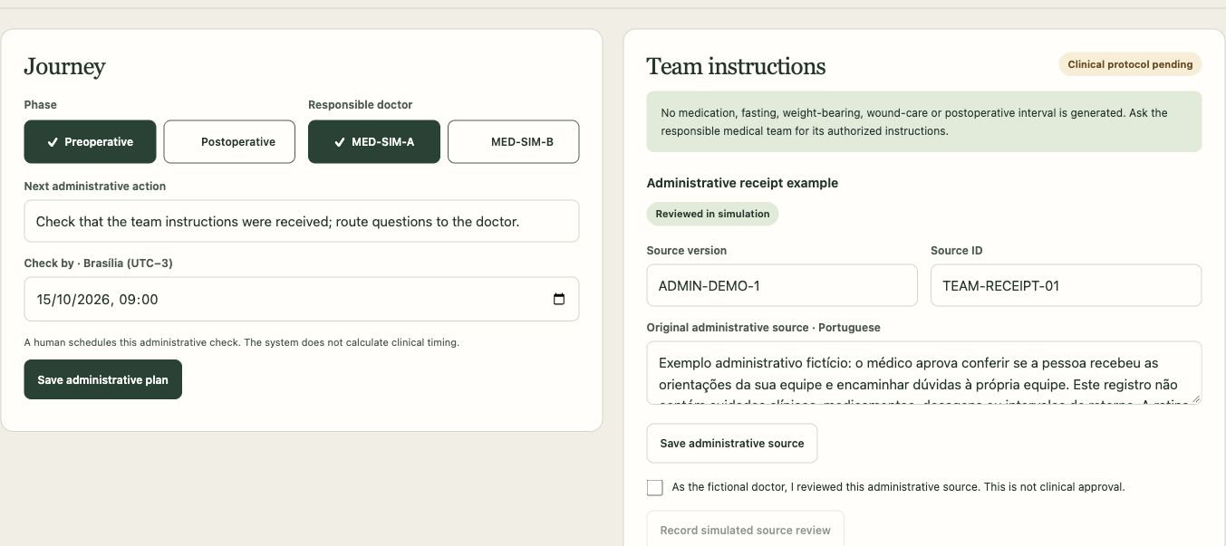
The doctor plans the next step
Preoperative and postoperative labels organise one administrative episode.
The doctor sets the administrative check. Clinical care instructions remain pending.
03
Notes:
Sources: app/care-journey.mjs, app/care-store.mjs, app/care-journey-client.mjs and docs/CARE-JOURNEY-20261014.md. The episode SIM-CARE-01 uses only fictional doctors. A human chooses phase, responsible doctor, next administrative action and due time. Clinical protocol status remains pending with no clinical instructions, medication, fasting, weight-bearing or postoperative interval. The surgery label is an invented scenario, not an indication. The doctor can complete this demonstration without a receptionist. No real appointment is booked.

Slide 4
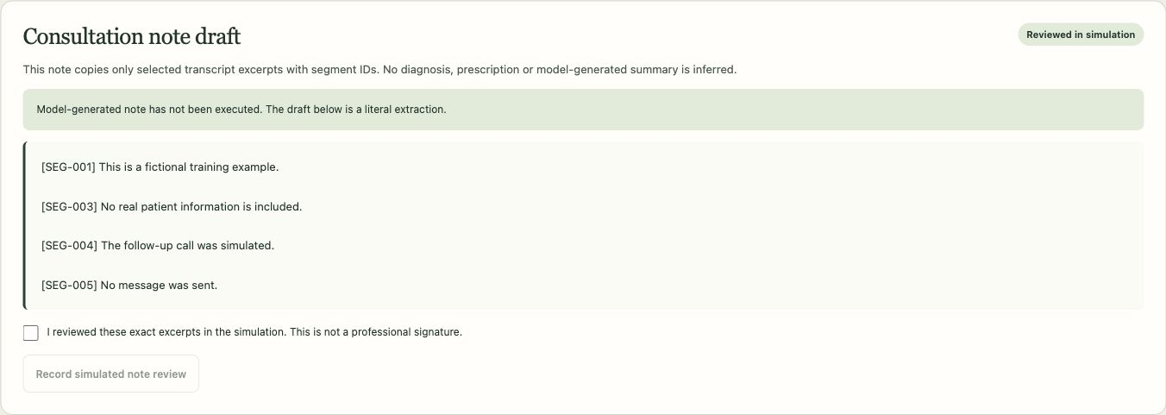
Audio becomes a source the doctor can inspect
Local CPU transcription supports a draft made from selected literal segments.
Local CPU version. Public demo: audio disabled. The draft uses selected literal segments.
04
Notes:
Sources: app/voice-transcription.mjs, app/voice-transcription-worker.py, app/care-journey.mjs note_prepare and docs/CARE-JOURNEY-20261014.md. Real local ASR used faster-whisper, an already cached model, CPU int8, synthetic WAV, offline guards and a bounded worker. The note copies only selected literal segments and cites their IDs. It is not a model-generated clinical summary or signed medical record. Changing the transcript invalidates the previous note. ASR execution and structural validation do not establish clinical transcription accuracy. The public static demo disables audio transcription; only the explicitly configured local version transcribes.

Slide 5
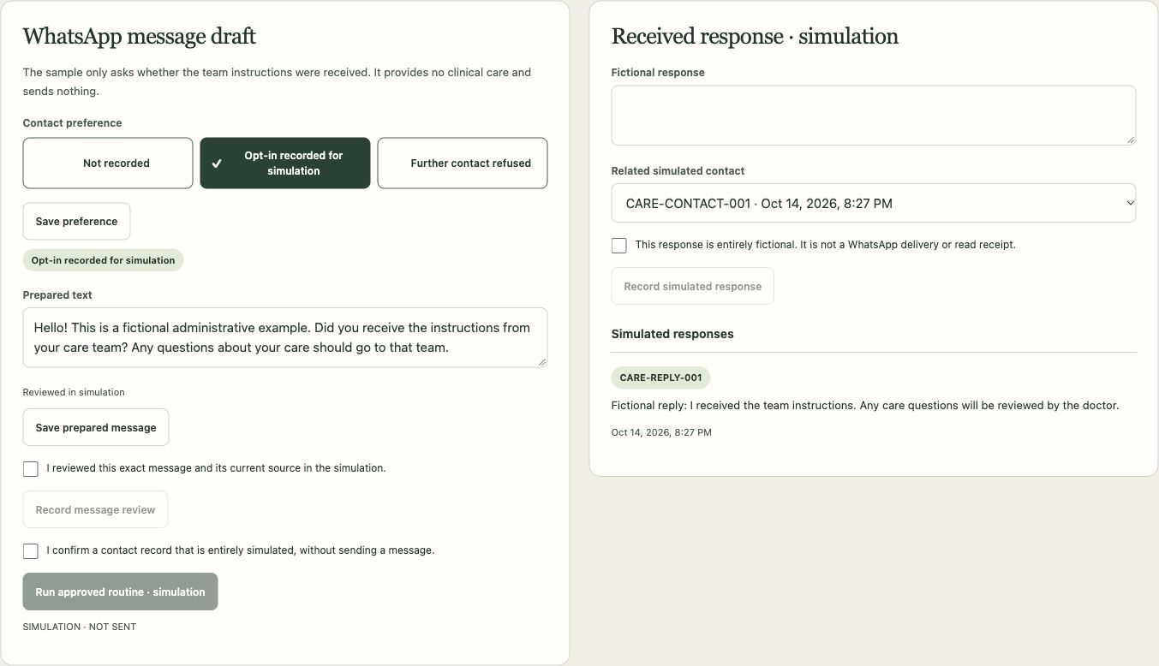
Reviewed contact remains a simulation
Recorded consent and the current source gate a message. A fictional reply supports human resolution.
A source change invalidates review. Refusal blocks contact. No external message is sent.
05
Notes:
Sources: app/care-journey.mjs preference, protocol_update, message_prepare, message_review, contact_simulate, response_record and close; app/care-journey-client.mjs; docs/CARE-JOURNEY-20261014.md. Contact refusal or unknown preference blocks the action. Source or message changes invalidate prior review. A simulated contact requires plan, opt-in, current source review and exact message review. A recorded response or refusal supports human administrative resolution. No WhatsApp message, delivery receipt or read receipt is created. Amplimed remains in standby. The product does not authenticate a clinician or sign a chart.

Slide 6
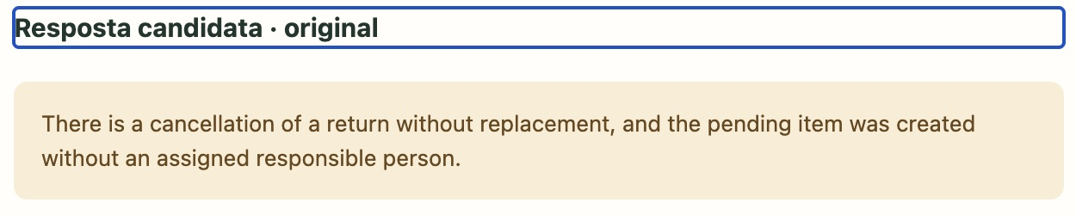
Gemma + Evolus: one local execution
16 October · PatientKeeper → Evolus → configured AMD Token Factory connection
Read-only candidate · Administrative state unchanged
8.149 s · 2 exact citations · Human review required
SIM02-CANCELAMENTO · Original Portuguese
“Ha um cancelamento de retorno sem reposicao.”
SIM02-HANDOFF · Original Portuguese
“A pendencia foi criada sem responsavel e sem proxima acao registrada.”
Configured Gemma connection; execution metadata does not independently verify model identity or hardware.
Public demo: recorded evidence, without live inference or audio transcription. One run is not a benchmark.
06
Notes:
Local 16 October pilot. Sources: evidence/GEMMA-RECHECK-20261016/LOCAL-APP-PILOT-RECEIPT.json, LOCAL-APP-RUNTIME-OBSERVATIONS.json, EVOLUS-APP-RUN-API-READBACK.json, EVOLUS-API-WORKSPACE-READBACK.json and PATIENTKEEPER-EVOLUS-GEMMA-LOCAL.png. A real UI-initiated application-to-API execution 20fc006b-93c9-f111-bf5b-6045bd9ce552 returned a candidate in 8149 ms with two exact literal source citations and mandatory human review. Before/after synthetic administrative state hashes match. The configured Evolus model key is own/gemma-4-31b-it, with the saved AMD Token Factory connection; execution metadata does not independently verify physical weights/model identity or AMD hardware. No new clinical note, message, booking or state mutation was produced. One successful run is not a performance or accuracy benchmark. Separate 14 October Gemma experiment: five unique attempts, three affirmative candidates, one missing-source abstention and one local timeout, preserved separately in docs/recorded-gemma-runs.json. Do not aggregate these into a clinical accuracy claim. The public demo displays recorded evidence, with no live model inference or audio transcription. Google/Evolus prize eligibility is not asserted. The screenshot is cropped only to remove browser surfaces; source records retain their original Portuguese spelling.

Slide 7
Sources and consent keep the limits visible
Human checks control the next step. Clinical protocol content remains pending.
Refusal blocks contact
5 October
Declared pre-event administrative scaffold.
A changed source invalidates review
12 October
Source review and real Qwen execution on AMD.
Recorded playback and interface improvements.
Conflicts and clinical questions
go to the responsible team
14 October
Doctor workspace and local CPU transcription.
Gemma service tests and recorded evidence.
The export remains a draft
for human review
16 October
PatientKeeper to Evolus with configured Gemma.
One real result; current-source and context checks.
Authorised surgical instructions remain pending.
07
Notes:
Sources: app/care-journey.mjs review invalidation and opt-out guards; app/evidence.mjs and app/server.mjs conflict/clinical/stale controls; BASE-PREEXISTENTE.md. The 5 October administrative scaffold predates ACT III and remains declared. Work of 12 October adds source review, cited receipts, model contract, real Qwen execution, recorded playback and UX. Work of 14 October adds a doctor workspace, local CPU ASR, extractive note and Gemma service tests/recorded evidence. Current-source checks and revisions block reuse of stale reviews. Clinical and known-conflict controls made zero provider requests in the Gemma pilot. Real surgical care instructions require a protocol authorised by the medical team; inspected educational PDFs do not supply that protocol. No baseline work is represented as newly created during the event. Work of 16 October adds an optional local Evolus API adapter using the saved Gemma connection, bounded workflow execution, polling, citation validation, stale-context and revision checks, plus a real application pilot with unchanged administrative state. The adapter defaults off and is not a public live backend. Sources: integration/evolus-pilot/ and evidence/GEMMA-RECHECK-20261016/. No pre-event work is represented as created during the hackathon.

Slide 8
Illustrative documentation scenario
A reported routine, an assisted-time assumption and a conditional difference
REPORTED BASELINE
ASSUMED ASSISTED TIME
CONDITIONAL DIFFERENCE
90 min/day
60 min/day
30 min/day
6 records × 15 minutes
Documentation time reported
by our team
6 records × 10 minutes
An assumption to be tested
Only if that assisted total
is achieved
Illustrative scenario - not a measured PatientKeeper result.
The 10-minute assumption includes preparation, doctor review, corrections and overhead.
Next: measure completion time and rework in a controlled practice pilot.
08
Notes:
The team reported six records per day and fifteen minutes of documentation per record, explicitly documentation rather than the whole consultation. Baseline: 6×15=90 minutes/day, reported rather than independently measured. Ten minutes of assisted total per record is an illustrative assumption including preparation, doctor review, corrections and overhead: 6×10=60 minutes/day. Conditional net difference: 90-60=30 minutes/day only if the assumed assisted total is achieved. This is not a measured PatientKeeper result or promised outcome. ASR and note drafting overlap and must not be counted twice. Model latency is not doctor time saved. A previous slide cited an informal experience with another product; R14 omits it to keep the PatientKeeper value hypothesis distinct and avoid attribution confusion. Current local ASR supports short fictional dictation up to 120 seconds; its output is an extractive source for review, not a generated clinical record. Public static demo has no audio transcription. Source: explicit user planning input and current source code/ASR receipts. Clinical outcomes, adoption and operational savings remain unmeasured.

Slide 9
A next step the practice can review
Hypothesis: clearer handoffs and fewer unfinished administrative checks.
The doctor retains control.
The practice receives a source-linked draft
and visible pending work.
Evidence: local CPU transcription, synthetic state persistence and the recorded Gemma/Evolus pilot.
Operational savings and clinical outcomes remain unmeasured.
PUBLIC DEMO · RECORDED EVIDENCE, NO LIVE INFERENCE
athosfif.github.io/patientkeeper-retorno-act-iii/
SOURCE CODE
github.com/athosfif/patientkeeper-retorno-act-iii
Next evaluation: completion time and rework in comparable fictional tasks.
09
Notes:
Sources: README.md; docs/CARE-JOURNEY-20261014.md; actual ASR receipts; evidence/GEMMA-RECHECK-20261016/LOCAL-APP-PILOT-RECEIPT.json and LOCAL-APP-RUNTIME-OBSERVATIONS.json. The proposed benefit remains a hypothesis: clearer review of unfinished administrative work while the doctor retains decisions. Evidence includes real local transcription of short synthetic audio, persisted synthetic progress, the separate recorded AMD service experiments and one real PatientKeeper-to-Evolus API result through a configured Gemma connection. This does not establish clinical accuracy, savings, adoption, ROI or prize eligibility. Public demo is a static demonstration/replay, without live inference or audio transcription. The accompanying new video uses human narration recorded by Athos via WhatsApp. This editable deck uses native Inter text and unchanged raster cover/logo/UI images. Final publication and LabLab update are separate actions by the root agent. URLs are canonical demo and public source repository. Next evaluation should measure task completion time and correction/rework effort in a controlled practice pilot before real clinical use.

