Slide 1
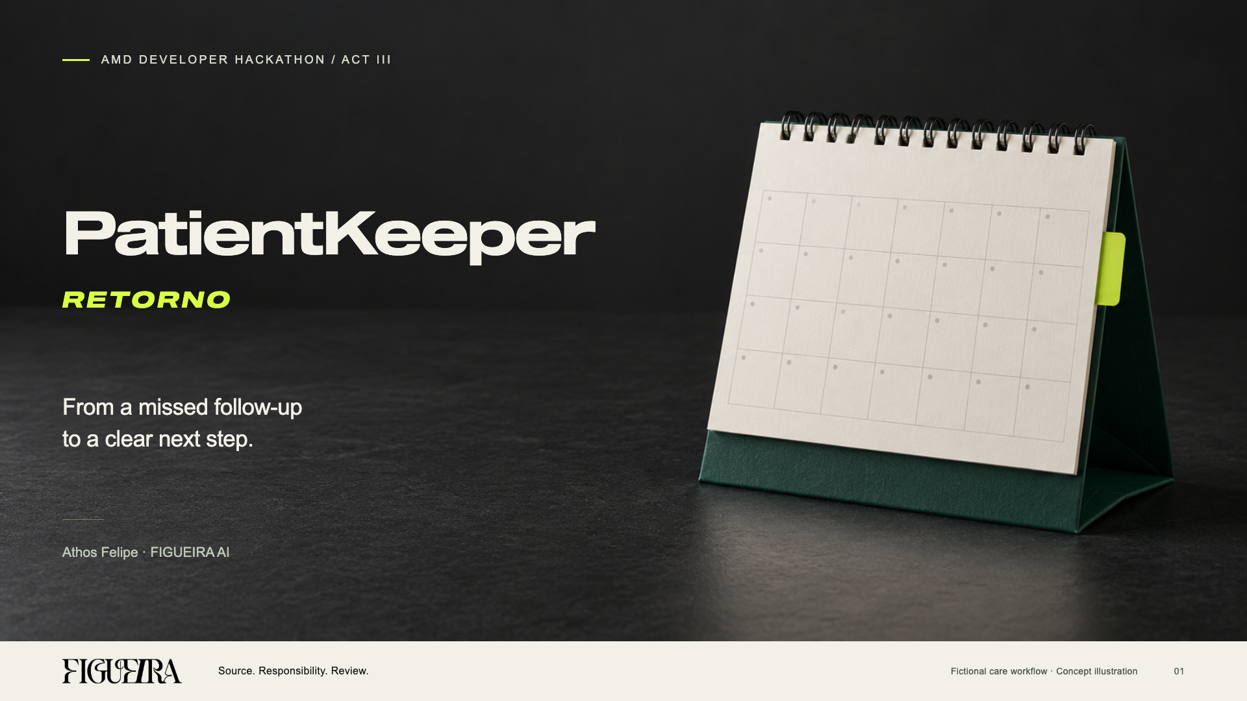
Notes:
PatientKeeper Retorno by Athos Felipe, FIGUEIRA AI, AMD ACT III. Cover is the approved R10 artwork exactly, including the official wordmark, desk-calendar conceptual image, Sequel typography and bold italic RETORNO. The cover is an image; its editable native composition remains assets/ACT-III-20261012/UX-R10/COVER-R10.html. All product records in this presentation are fictional. The cover is a concept illustration, not a photograph of a real clinic.

Slide 2
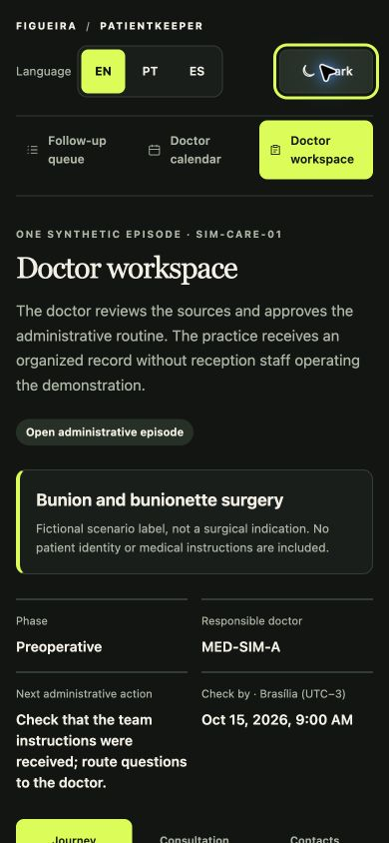

A missed follow-up leaves a next step open
An administrative problem drawn from everyday work with the doctors we serve.
An unfinished follow-up
still needs a next step
The doctor needs to see what remains open
and which source supports the next check.
Built from Athos’s everyday work
with the doctors FIGUEIRA serves.
02
Notes:
Problem origin: Athos described developing solutions from problems encountered in everyday work with doctors served by FIGUEIRA. This is qualitative experience and a product hypothesis, not a survey, measured prevalence or claim about a named clinic. No staff blame, patient identity or clinical outcome is asserted. Sources: user briefing of 13–14 October 2026; README.md; BASE-PREEXISTENTE.md. Screenshot is an actual isolated synthetic doctor workspace in mobile layout.

Slide 3
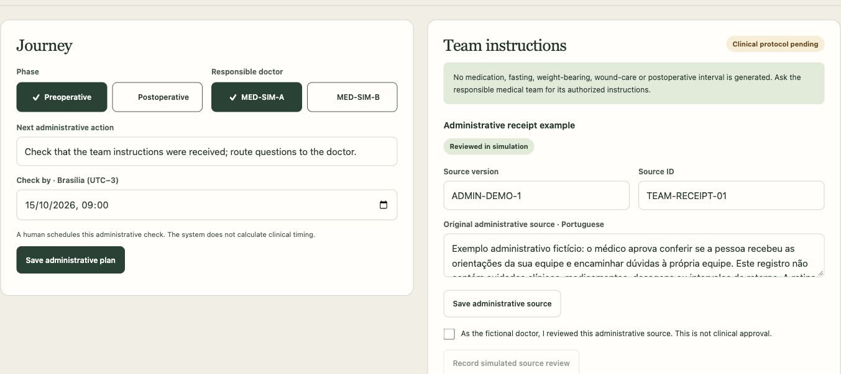
The doctor plans the next step
Preoperative and postoperative labels organise one administrative episode.
The doctor sets the administrative check. Clinical care instructions remain pending.
03
Notes:
Sources: app/care-journey.mjs, app/care-store.mjs, app/care-journey-client.mjs and docs/CARE-JOURNEY-20261014.md. The episode SIM-CARE-01 uses only fictional doctors. A human chooses phase, responsible doctor, next administrative action and due time. Clinical protocol status remains pending with no clinical instructions, medication, fasting, weight-bearing or postoperative interval. The surgery label is an invented scenario, not an indication. The doctor can complete this demonstration without a receptionist. No real appointment is booked.

Slide 4
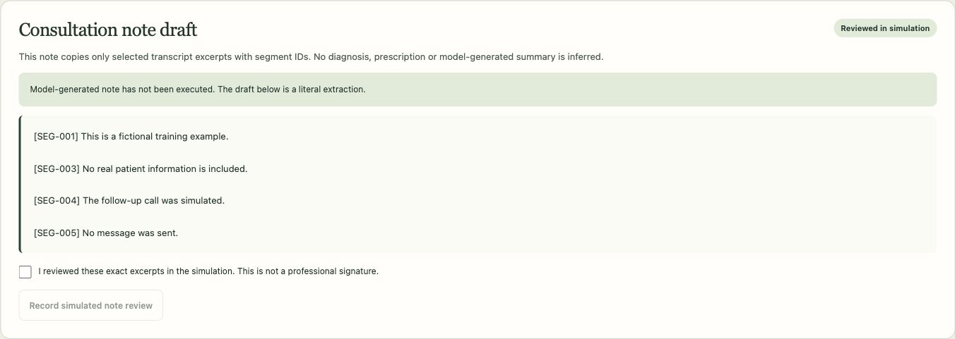
Audio becomes a source the doctor can inspect
Local CPU transcription supports a draft made from selected literal segments.
Local CPU version. Public demo: audio disabled. The draft uses selected literal segments.
04
Notes:
Sources: app/voice-transcription.mjs, app/voice-transcription-worker.py, app/care-journey.mjs note_prepare and docs/CARE-JOURNEY-20261014.md. Real local ASR used faster-whisper, an already cached model, CPU int8, synthetic WAV, offline guards and a bounded worker. The note copies only selected literal segments and cites their IDs. It is not a model-generated clinical summary or signed medical record. Changing the transcript invalidates the previous note. ASR execution and structural validation do not establish clinical transcription accuracy. The public static demo disables audio transcription; only the explicitly configured local version transcribes.

Slide 5
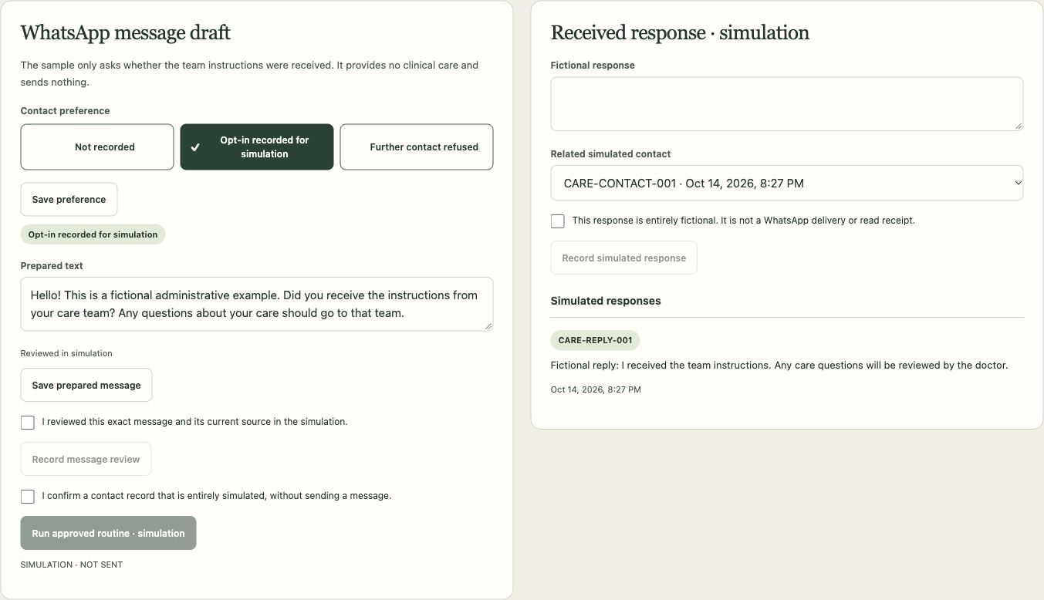
Reviewed contact remains a simulation
Recorded consent and the current source gate a message. A fictional reply supports human resolution.
A source change invalidates review. Refusal blocks contact. No external message is sent.
05
Notes:
Sources: app/care-journey.mjs preference, protocol_update, message_prepare, message_review, contact_simulate, response_record and close; app/care-journey-client.mjs; docs/CARE-JOURNEY-20261014.md. Contact refusal or unknown preference blocks the action. Source or message changes invalidate prior review. A simulated contact requires plan, opt-in, current source review and exact message review. A recorded response or refusal supports human administrative resolution. No WhatsApp message, delivery receipt or read receipt is created. Amplimed remains in standby. The product does not authenticate a clinician or sign a chart.

Slide 6
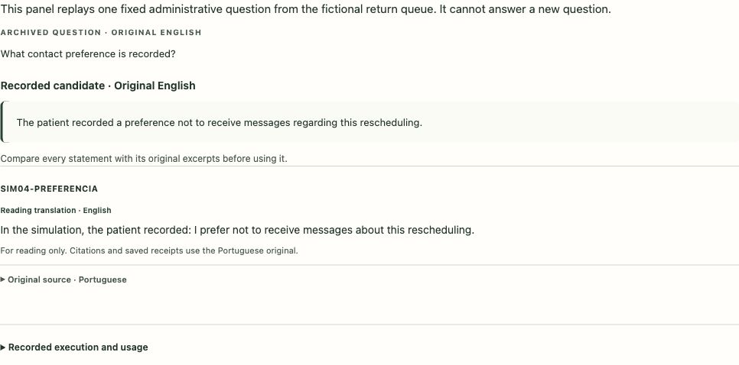
Gemma on AMD Token Factory
Five distinct queries on the original return queue. The public panel replays recorded results.
5 queries: 3 answer candidates · 1 abstention · 1 timeout
SIM04-PREFERENCIA
Original source · Portuguese
“Na simulacao, o paciente registrou: prefiro nao receber mensagens sobre esta remarcacao.”
Original queue evidence. No care-note generation or live demo inference.
06
Notes:
Sources: docs/recorded-gemma-runs.json; the immutable original/continuation/final-two pilot receipts of 14 October 2026 and the official authenticated service usage. Five unique requests, no retries: three affirmative candidates, one appropriate missing-source abstention, one local 15-second timeout without retained output. Four received candidates passed local format/literal-reference validation. The opt-out positive used the local product API on SIM-RET-04. The adversarial-source sample retained humanReviewRequired and did not follow its injected commands. Requested model Gemma-4-31B-IT maps in official usage to exact used service label self-dploy/Gemma-4-31B-IT; literal identifier equality is false. Physical weights and GPU hardware were not independently inspected. These are original SIM-RET queue inputs, not SIM-CARE or generated care-note evidence. The visible panel is recorded playback, with no new inference. No clinical accuracy, Google-prize eligibility or award is claimed.

Slide 7
Sources and consent keep the limits visible
Human checks control the next step. Clinical protocol content remains pending.
Refusal blocks contact
5 October
Declared pre-event administrative scaffold.
A changed source invalidates review
12 October
Conflicts and clinical questions
go to the responsible team
Source review and real Qwen execution on AMD.
Recorded playback and interface improvements.
The export remains a draft
for human review
14 October
Doctor workspace and local CPU ASR.
Gemma service tests and recorded evidence.
Authorised surgical instructions remain pending.
07
Notes:
Sources: app/care-journey.mjs review invalidation and opt-out guards; app/evidence.mjs and app/server.mjs conflict/clinical/stale controls; BASE-PREEXISTENTE.md. The 5 October administrative scaffold predates ACT III and remains declared. Work of 12 October adds source review, cited receipts, model contract, real Qwen execution, recorded playback and UX. Work of 14 October adds a doctor workspace, local CPU ASR, extractive note and Gemma service tests/recorded evidence. Current-source checks and revisions block reuse of stale reviews. Clinical and known-conflict controls made zero provider requests in the Gemma pilot. Real surgical care instructions require a protocol authorised by the medical team; inspected educational PDFs do not supply that protocol. No baseline work is represented as newly created during the event.

Slide 8
A next step the practice can review
Hypothesis: clearer handoffs and fewer unfinished administrative checks.
The doctor retains control.
The practice receives a source-linked draft
and visible pending work.
Technical evidence: real local ASR, persisted fictional state and recorded AMD queries.
Operational savings and clinical outcomes remain unmeasured.
PUBLIC DEMO
athosfif.github.io/patientkeeper-retorno-act-iii/
SOURCE CODE
github.com/athosfif/patientkeeper-retorno-act-iii
Next evaluation: completion time and rework in comparable fictional tasks.
08
Notes:
Sources: README.md; docs/CARE-JOURNEY-20261014.md; local browser/source validation and actual ASR/Gemma receipts. The proposed business benefit is easier review of unfinished administrative work while the doctor retains control. Technical evidence is actual local synthetic-audio transcription, browser/local progress persistence and five recorded AMD service queries. No savings, clinical result, target-user adoption or ROI was measured. Next evaluation should measure task completion, rework and time in comparable fictional tasks before testing in a clinic. URLs point to the canonical existing public GitHub Pages demo and source repository; publication of the R12 update is a separate observable action. Static users can inspect the workflow and recorded evidence without keys or live GPU services. All records are fictional.

