Slide 1

NYPD Shooting Incident Data Analysis
Presenter: Ran(Ryan) Li

Slide 2
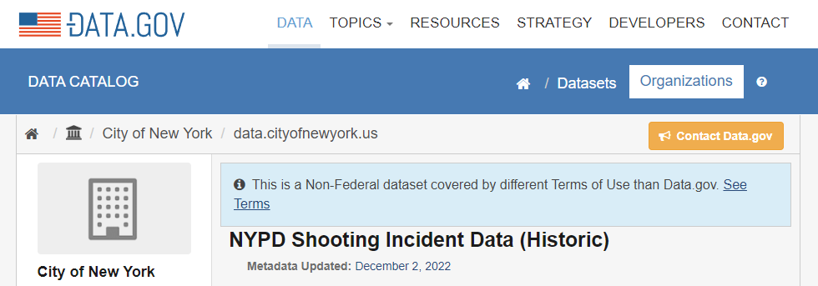
Introduction

Slide 3
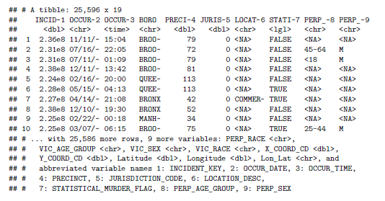
Description of the Data
19 columns of raw data
Incident_Key
Date & Time columns
Boro, Precinct, Jurisdiction_Code, Location_Desc
Statistical_Murder_Flag
Perpetrators Info columns
Victim Info columns
Latitude & Longitude

Slide 4
Analysis topics
Topic 1: Initial analysis on different boros in New York City
How many boros does New York City have?
Which boro has the most number of shooting cases?
Do we have enough information about the criminals?
Topic 2: Deep dive into the boro who has the most shooting cases
Does this boro have almost same number of cases every year?
Does number of criminals follow the same trend?
Potential correlation between victim numbers and criminal info numbers?

Slide 5
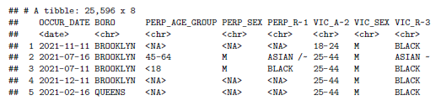
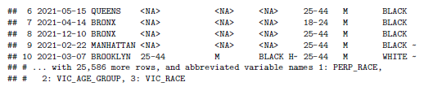
Cleaned Data
8 columns of cleaned data
Date column
2006 – 2021
Boro column
5 boros in NYC
Perpetrators Info columns
some NA
Victim Info columns
Age, Sex, Race

Slide 6
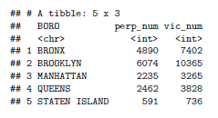
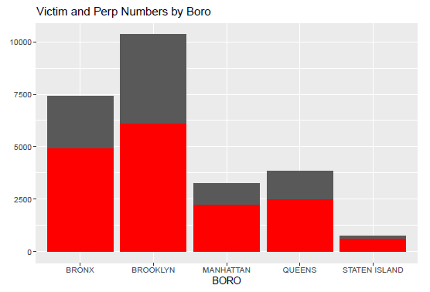
Analysis case 1: Initial analysis on different boros in New York City
Brooklyn has the most number of shooting cases
It also has the most number of victims without perpetrator info

Slide 7
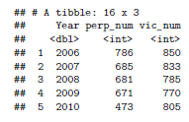
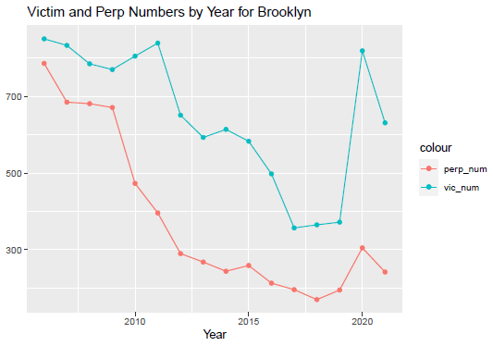
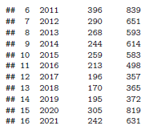
Analysis case 2: Deep dive into the Brooklyn (the boro having most shooting cases)
Number of shootings declined since 2006 except 2020
Number of perpetrators follow almost the same trend

Slide 8
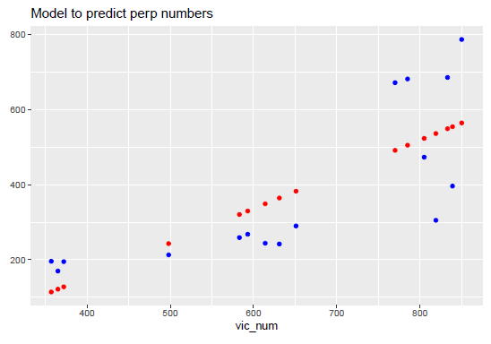
Data Model to predict perpetrators
Blue dots are actual, red dots are predicted
Number of victims and number of perpetrators are positive correlated

Slide 9

Potential bias
- The analysis was based on considering all NA in perp columns as criminal not found.
- Potential bias: criminal are actually found and they are not published because of privacy issue.

