Slide 1
AI-RAN ALLIANCE · WORKING GROUP 3 (AI-ON-RAN)
Closed-Loop RAN Care
A voice agent that hears a customer's problem, reads it against live RAN signals, and proposes the fix a NOC engineer would — with a person still deciding what touches the network.
Athul Prasad · Cloudera AI · prasad.athul@gmail.com

Slide 2
01
The gap today
CX
Customer-facing support
NOC
Network operations tooling
Reasons over account and billing data.
No visibility into the radio network
actually carrying the call.
Reasons over alarms, counters and
configuration. No notion a customer is
on the phone right now, describing it.
no shared signal today
Two investigations of the same fault, on two timelines, reconciled by neither system.

Slide 3
02
One reasoning layer, two interaction surfaces
Live RAN signals
alarms · counters · topology
Caller
reports a symptom
Voice agent
STT · LLM · TTS
Diagnosis
sandboxed analysis
Human approval
guardrails checked first
Network change
confirms recovery · calls the customer back

Slide 4
03
Grounding reasoning in a certified ontology
Generate
LLM proposes terms + relationships
from alarm / perf / config data
Certify
A domain expert reviews before a
term is ever trusted
Answer
Checks answerability, retrieves only
the relevant certified terms
Diagnosis
(previous slide)
Neither prototype has a semantic layer today — a network agent's tools are fixed function calls, and which one answers a question lives only in its prompt. NVIDIA's Auto Ontology frames the fix as generate → certify → answer: a certified vocabulary of alarms, counters, configuration, and — once built — the subscriber-to-cell relationship, so the agent's first move is finding the right certified term, not guessing which tool to call.

Slide 5
04
Worked example
illustrative — synthetic network, staged fault
“My calls keep dropping near my house.”
1
Ontology narrows the question to Handover Success Rate and Neighbour Relation.
2
Live RAN signals show handover success degraded on the serving sector.
3
Sandboxed analysis traces it to a PCI reused by a small cell commissioned nearby that morning.
4
A fix is proposed, checked against guardrails, and paused for human approval.
5
Once approved: recovery is confirmed, and the agent calls the customer back.

Slide 6
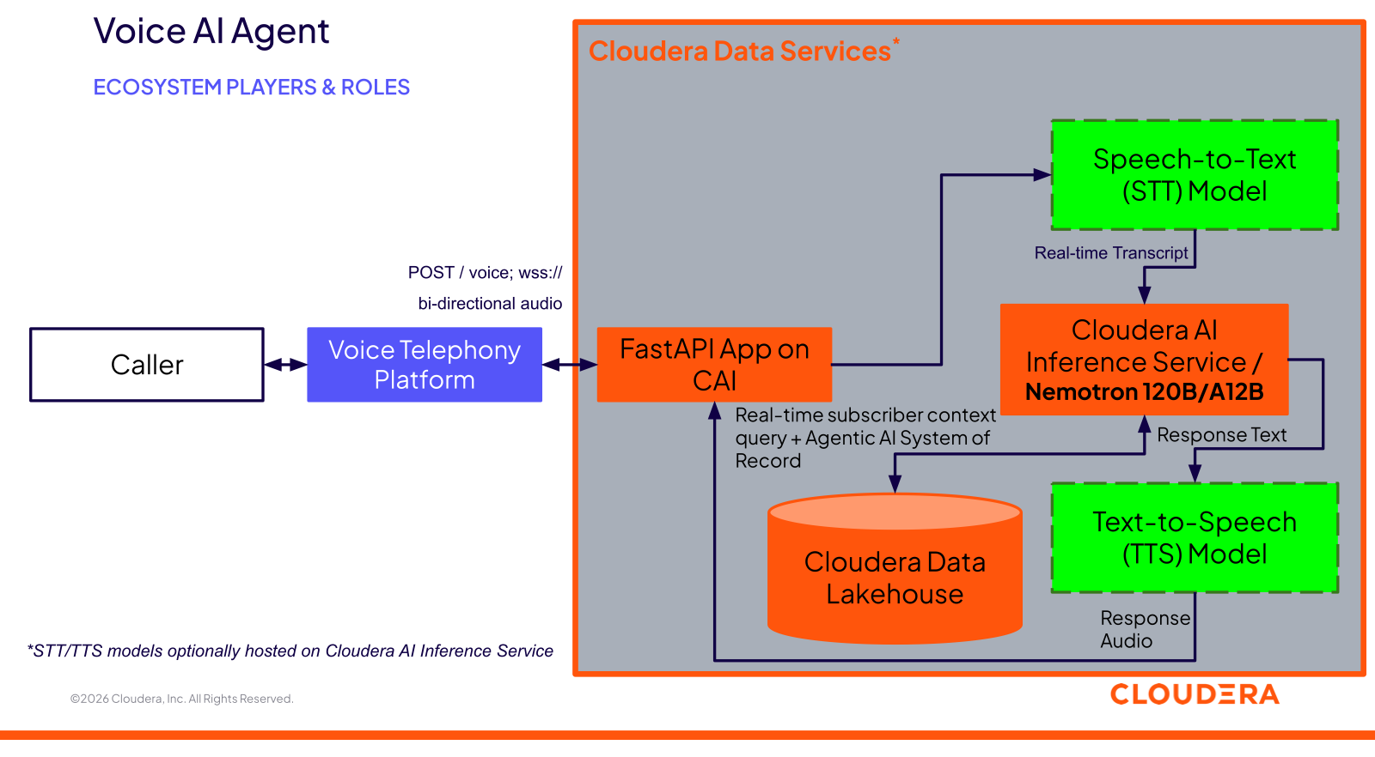
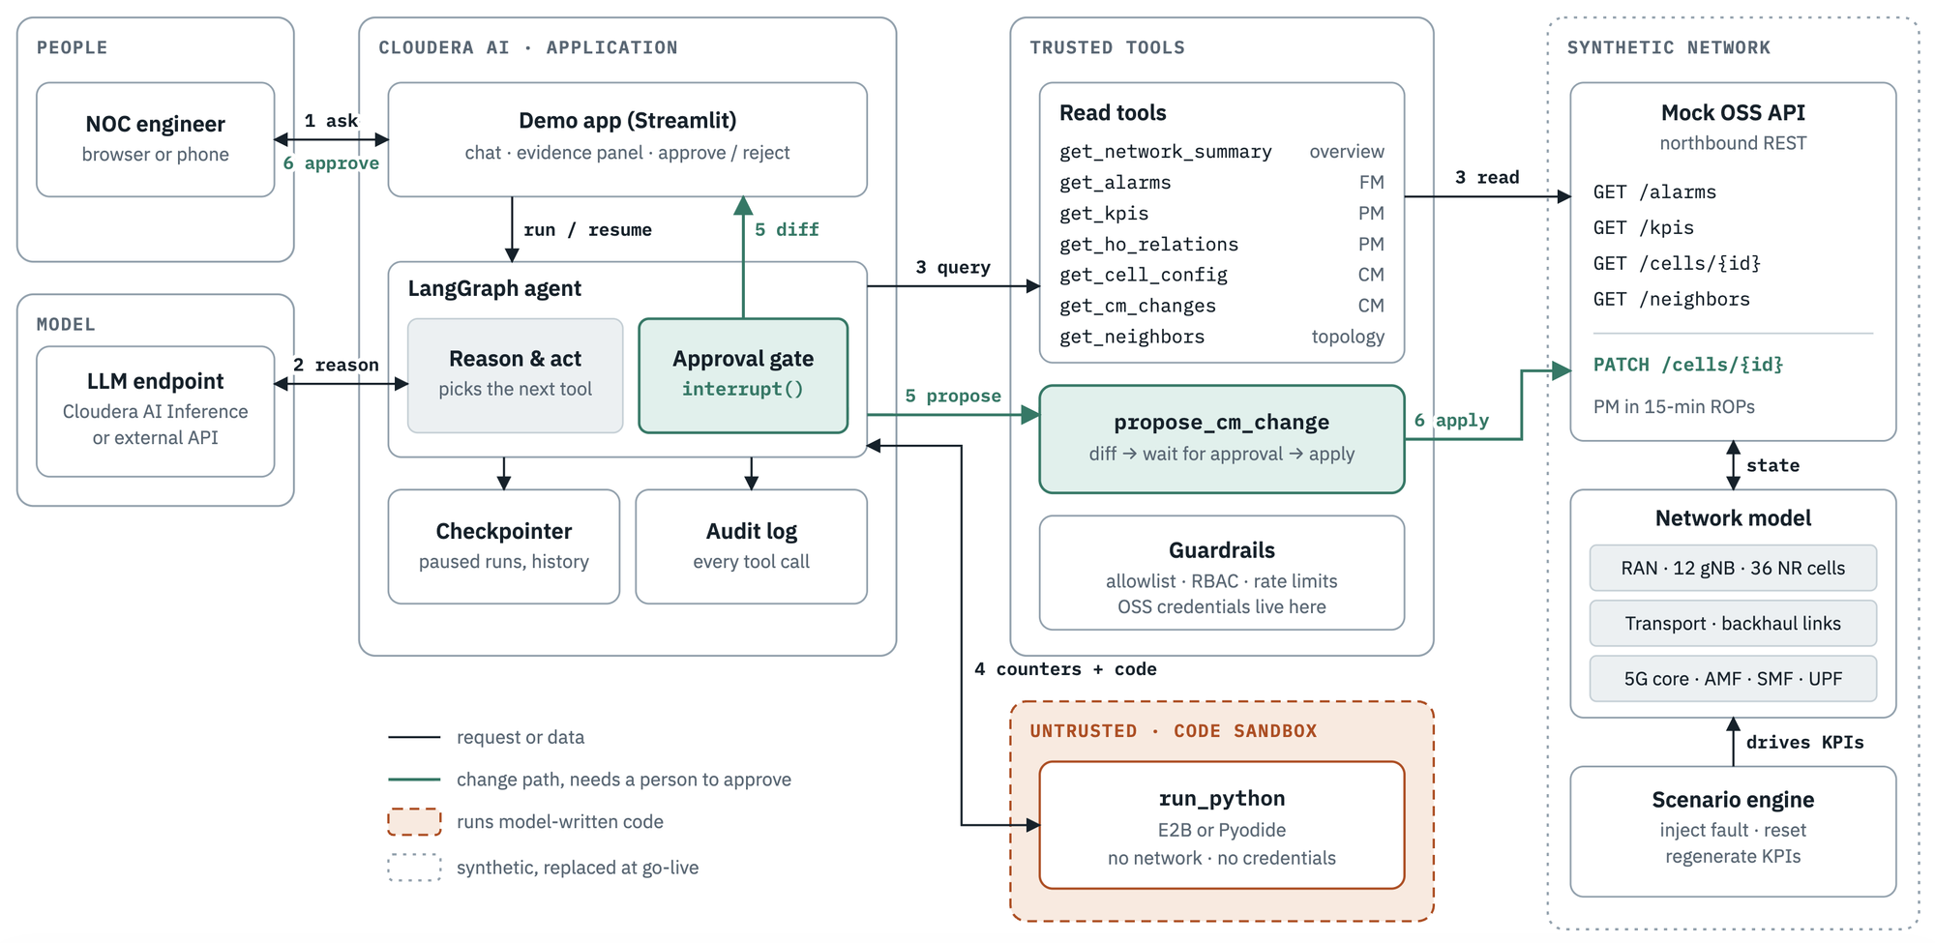
05
What's proven today
Both halves already run, each in its own repository — these are the architectures as published.
PROVEN
PROVEN
voice-ai-agent — real-time call handling, Cloudera AI Inference Service, pluggable STT/TTS
mobile-noc-agent-demo — LangGraph investigation agent, sandboxed analysis, guardrailed approval

Slide 7
05
What's proven, and what's proposed
PIECE
PIECE
STATUS
STATUS
WHAT'S DEMONSTRATED
WHAT'S DEMONSTRATED
Voice agent
Real-time phone calls over Twilio Media Streams; pluggable STT/TTS; LLM reasoning grounded in account context on Cloudera AI Inference Service.
PROVEN
Network agent
A LangGraph agent investigates a staged PCI-confusion fault on a synthetic 12-gNB, 36-cell network — sandboxed analysis, human approval, full audit log.
PROVEN
Subscriber-to-cell correlation
A static home cell ID, checked against a cell-health lookup on every call, now runs end to end — surfaced live on the dashboard and raised proactively by the agent.
PHASE 1 PROVEN
Shared reasoning + data plane
Joining the two agents so a caller's report can trigger the real network investigation.
PROPOSED
RAN-edge colocation
Both agents run centrally today; moving inference closer to the radio is an open question to validate jointly.
PROPOSED
Ontology layer
No certified vocabulary yet — generate / certify / answer (previous slide) is new work.
PROPOSED

Slide 8
06
Why this belongs in WG3
RAN-native signals
Driven by alarms, counters and topology — not just account data. That's the core premise of AI-on-RAN.
1
RAN-edge colocation
Targets colocated inference as the deployment model to work toward, not a cloud-only system applied to telecom.
2
RIC-style control loop
Propose-and-approve maps onto an xApp / rApp: observe, reason, recommend — a person still in the actuation path.
3
Trust by design
The human-approval gate is designed in from the start, not added later once someone asks about it.
4
Auditable reasoning
A certified ontology records what data the agent was even allowed to consider — checkable before the diagnosis is.
5

Slide 9
07
What we're asking
1
Whether this concept fits WG3's current charter and roadmap, and where it would sit alongside existing workstreams.
2
Interest in a working session to walk through both running prototypes and the integration plan in more depth.
3
Whether a reference operator would be open to validating the concept against anonymized real network data, once the synthetic integration works end to end.

Slide 10
Thank you
Athul Prasad · Cloudera AI
prasad.athul@gmail.com

