Slide 1
Customer Demographic & Financial Analysis
Professional Data Analysis Report
Created by: Shreedhar Kumbhar

Slide 2
Project Overview
Objective:
Analyze customer demographic, financial, and credit-related data using exploratory data analysis (EDA).
Dataset Summary:
• Total Records: 50000
• Key Variables: Age, Annual Income, Credit Score, Occupation.
• Techniques: Histograms, Scatter Plot, Distribution Analysis.
Business Goal:
Understand customer characteristics and identify patterns useful for banking, finance, and credit risk analysis.

Slide 3
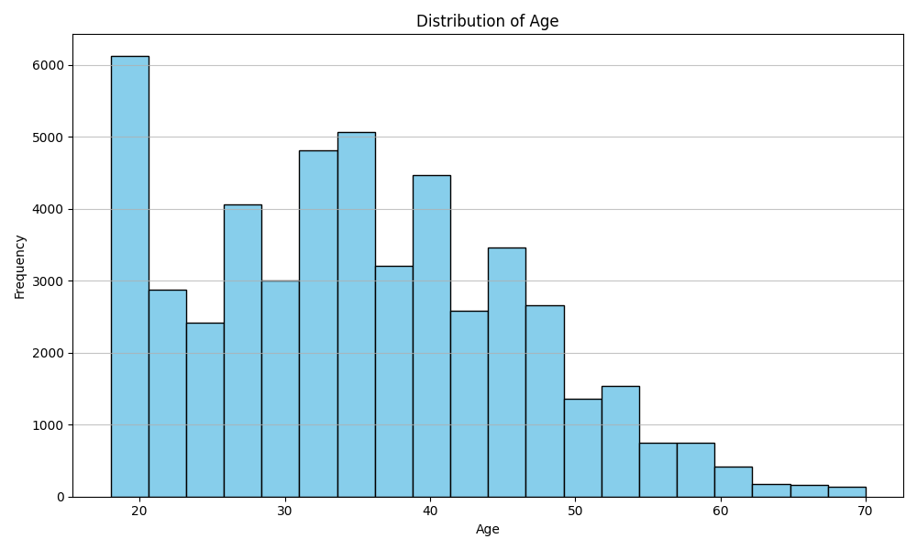
Age Distribution
• Majority of customers are between 25 and 45 years.
• Young adults form the largest customer segment.
• Very few customers are above 60 years, indicating an aging population is underrepresented.
• Marketing campaigns should focus on working-age professionals.

Slide 4
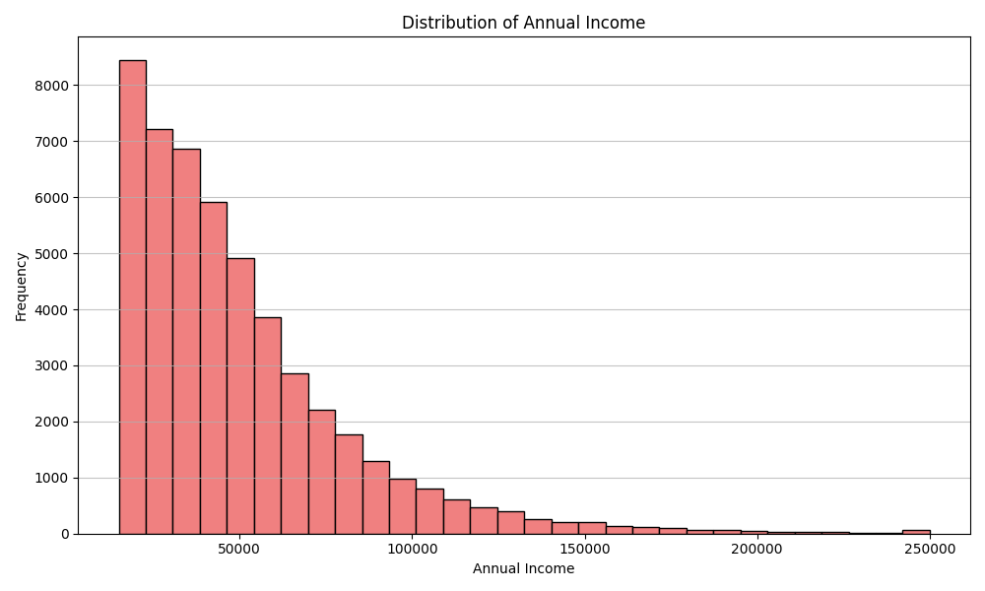
Annual Income Distribution
• Income distribution is highly right-skewed.
• Most customers earn between $20,000 and $80,000 annually.
• A small number of high-income customers create a long tail.
• Premium financial products can target these high-income individuals.

Slide 5
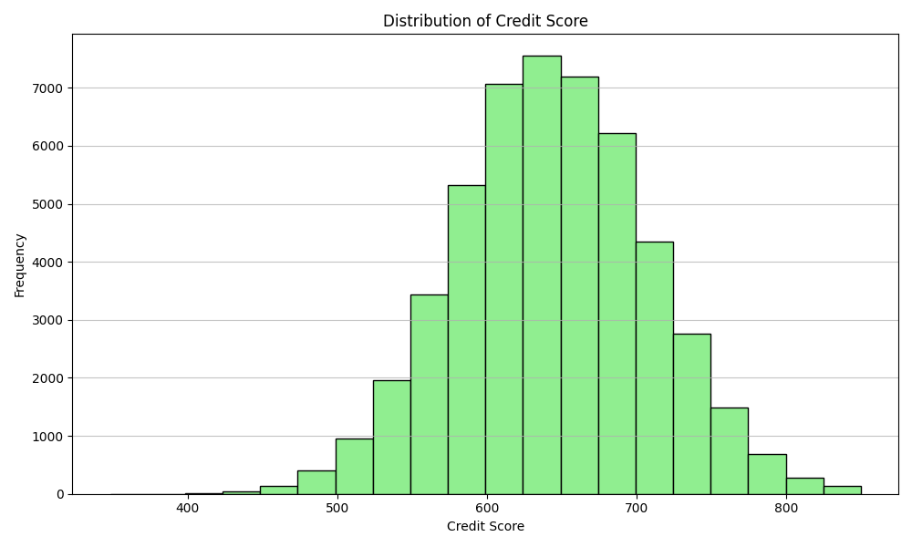
Credit Score Distribution
• Credit scores approximately follow a normal distribution.
• Most customers have scores between 600 and 700.
• Extremely low and extremely high scores are uncommon.
• This indicates a balanced customer credit profile.

Slide 6
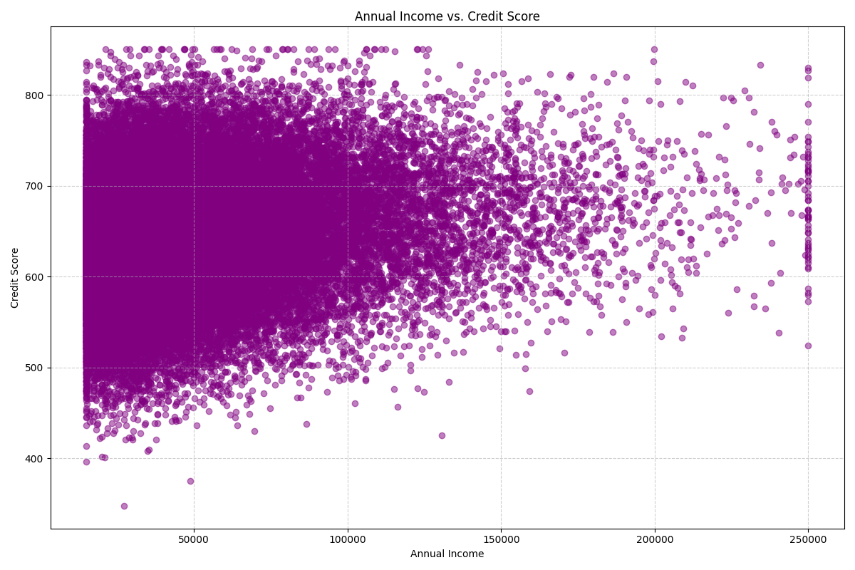
Income vs Credit Score
• Weak positive relationship between annual income and credit score.
• Higher income alone does not guarantee a better credit score.
• Other factors likely influence creditworthiness.
• Useful for predictive modeling and customer segmentation.

Slide 7
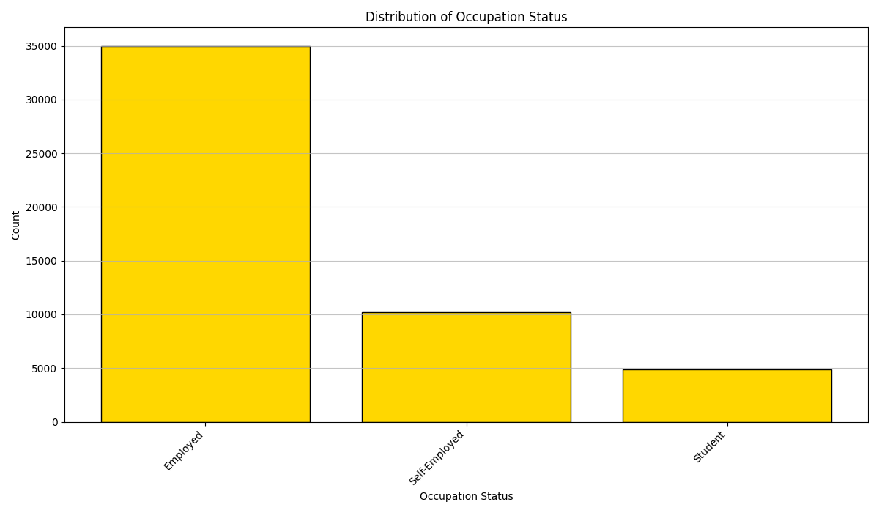
Occupation Status Distribution
• Employed customers represent the largest segment.
• Self-employed customers form a moderate share.
• Students represent the smallest customer group.
• Employment status can be used for loan eligibility segmentation.

Slide 8
Key Business Insights
1. Working-age employed individuals dominate the dataset.
2. Income distribution is uneven with a small high-income segment.
3. Credit scores are concentrated around average values.
4. Income and credit score show only a weak positive relationship.
5. Occupation can improve customer segmentation and targeted financial offerings.
6. Results support data-driven lending, marketing, and customer profiling.

Slide 9
Conclusion
The exploratory analysis provides valuable insights into customer demographics and financial characteristics.
The dataset indicates a stable customer base with moderate credit profiles and varying income levels.
These findings can support customer segmentation, loan approval strategies, personalized financial products, and predictive analytics.
Thank You
Created by: Shreedhar Kumbhar

