Slide 1
WELCOME
PAKO ENGINEERS
MANUFACTURE & EXPORTER OF
PRECISION MACHINED COMPONENTS & PUMP ASSEMBLIES

Slide 2
INTRODUCTION
NAME OF THE COMPANY: PAKO ENGINEERS
YEAR OF ESTABLISHMENT: 1994
ISO 9001:2015 CERTIFIED
KEY PERSONS:
MR. SUDARSHAN KHOT (CEO) +91-9921854252
MR. SUHAS KHOT (M.D.) +91-9860269972
ACTIVITIES:
Manufacture and export of precision machined components, pump assemblies, shafts, sleeves, couplings, lock nuts, retainer rings, Thordon bearings, gears and pump parts in all materials of construction.
MANPOWER:
Engineers = 2
Officers = 2
Technical Supervisors = 3
Quality Control = 2
Programmers = 2
Skilled Labour = 14
Semi-Skilled Labour = 10
Helping Staff = 12
Total Strength = 47

Slide 3
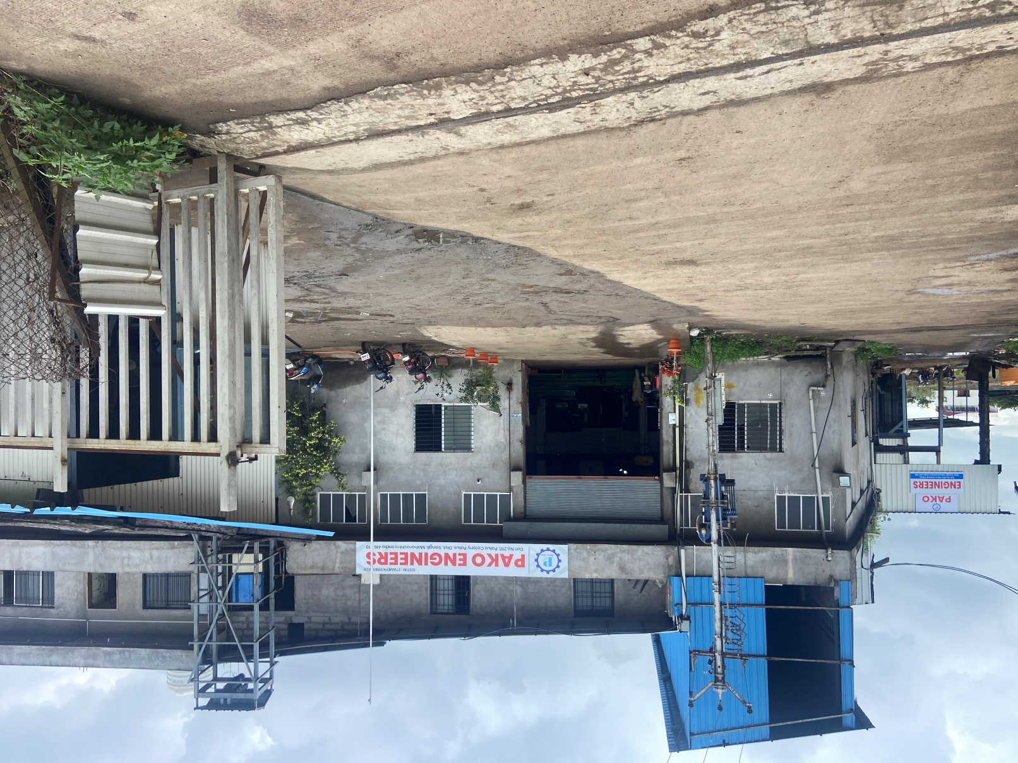
PAKO ENGINEERS

Slide 4
ORGANIZATIONAL STRUCTURE
CEO
Mr. SUDARSHAN KHOT
MD
Mr. SUHAS KHOT
PRODUCTION
QUALITY
Mr. TEJAS SURVE Mr. SUHAS KHOT
ACCOUNT
Mr. DIPAK BOBADE
IN HOUSE
Mr. YOGESH MANGAVE
OUT SOURCE
Mr. AMIT PAWAR

Slide 5
TEST FACILITIES (IN-HOUSE / OUTSIDE)
IN-HOUSE:-
HARDNESS TESTING
SURFACE CHECK
NDT - DYE PENETRANT TEST (DPT)
OUTSOURCED:-
ULTRASONIC TESTING
METALLURGICAL TESTING (PHYSICAL & CHEMICAL)
HEAT TREATMENT
NDT - RADIOGRAPHY
PMI
The production department has all necessary calibrated measuring instruments including calipers, micrometers and gauges.

Slide 6
PRODUCT DETAILS
PRODUCT | MATERIAL | SIZE | FINISH
SHAFT | Stainless Steel, Duplex, Super Duplex, Nitronic 50 | Diameter = 50 mm to 1500 mm Length = 0.5 mtr to 8 mtr | 10 to 50 microns.
SLEEVES | Stainless Steel, Duplex, Super Duplex, Nitronic 50 | Diameter = 50 mm to 400 mm Length = 0.1 mtr to 1 mtr | 10 to 50 microns.
COUPLINGS | Stainless Steel, Duplex, Super Duplex, Nitronic 50 | Diameter = 50 mm to 400 mm Length = 0.1 mtr to 1 mtr | 10 to 50 microns.
PUMP PARTS & ACCESSORIES | Stainless Steel, Duplex, Super Duplex, Nitronic 50 | Customised | 10 to 50 microns.

Slide 7
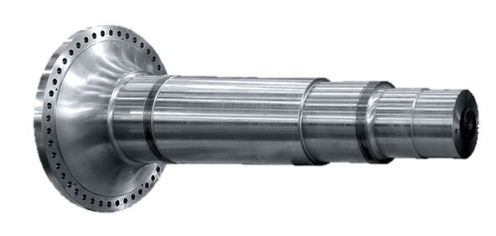
Flange / Concrete Shaft
Capacity-
Machining-50 mm to 1500 mm in diameter up to 8000 mm length
Grinding – 50 mm to 800 mm diameter up to 6500 mm length

Slide 8
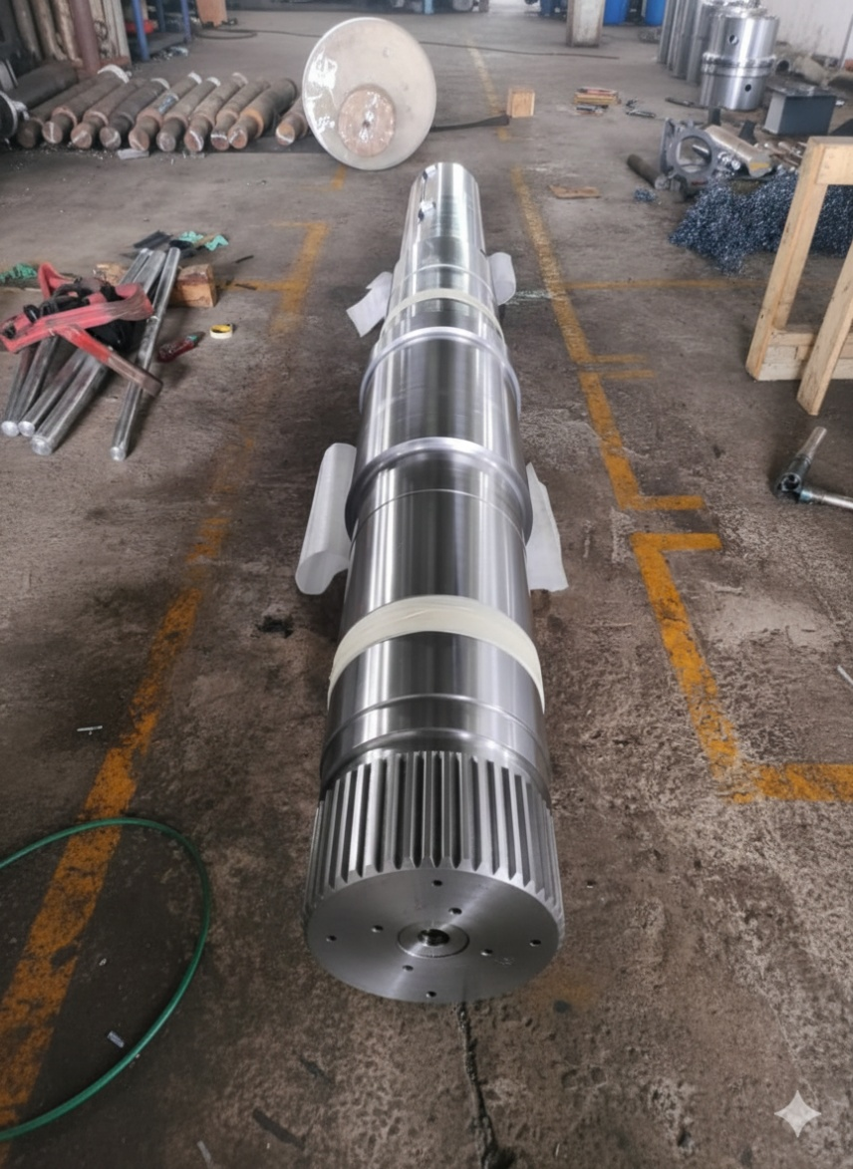
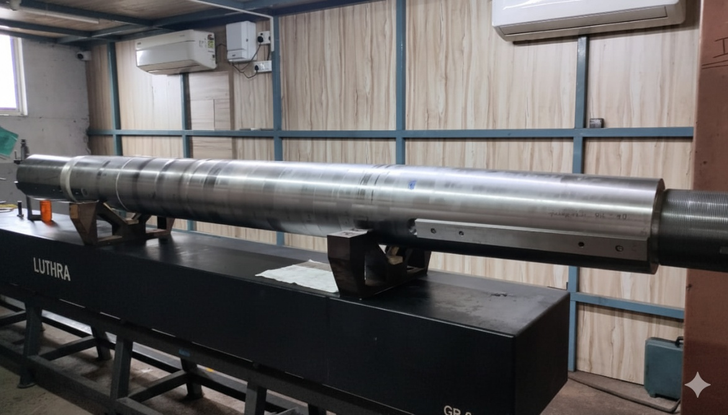
Shaft
Capacity-
Machining-50 mm to 1500 mm in diameter up to 8000 mm length
Grinding – 50 mm to 800 mm diameter up to 6500 mm length

Slide 9
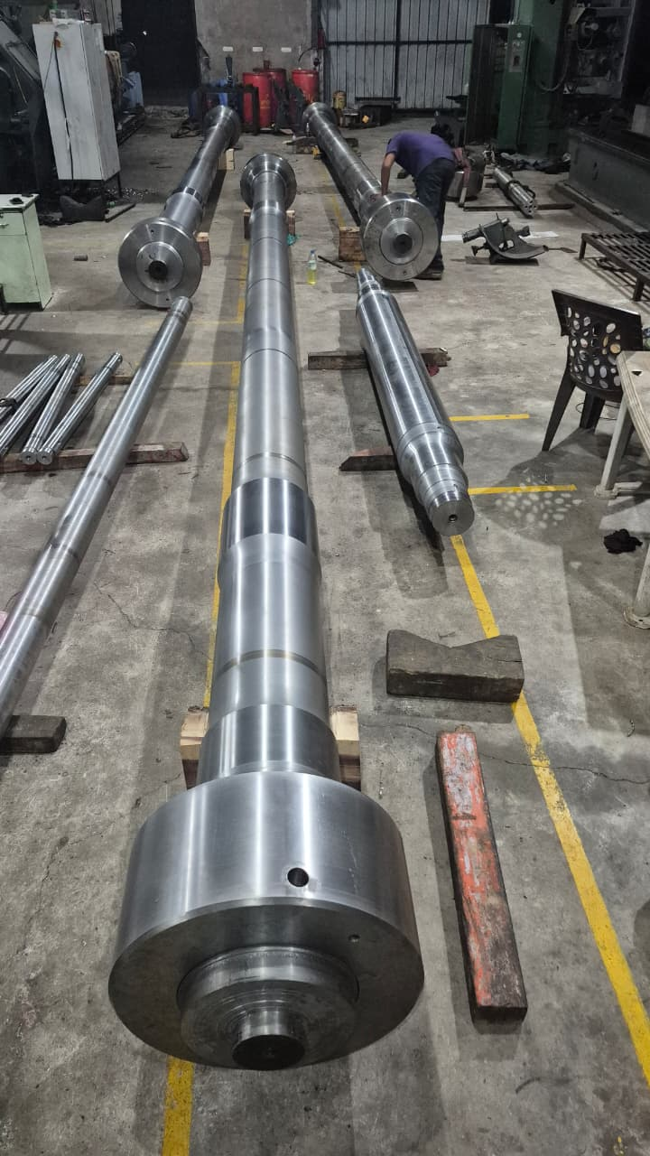
SPECIAL SHAFTS
SHAFT DIMENSIONS
DIAMETER: 400 mm
LENGTH: 9500 mm
THREAD LENGTH: 390 mm

Slide 10
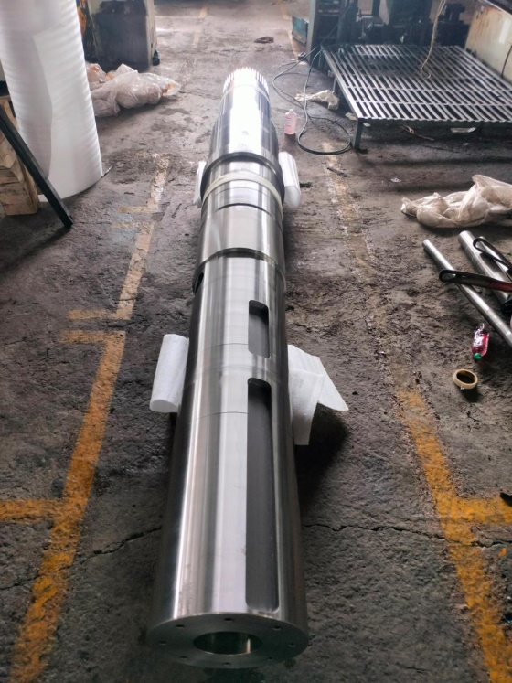
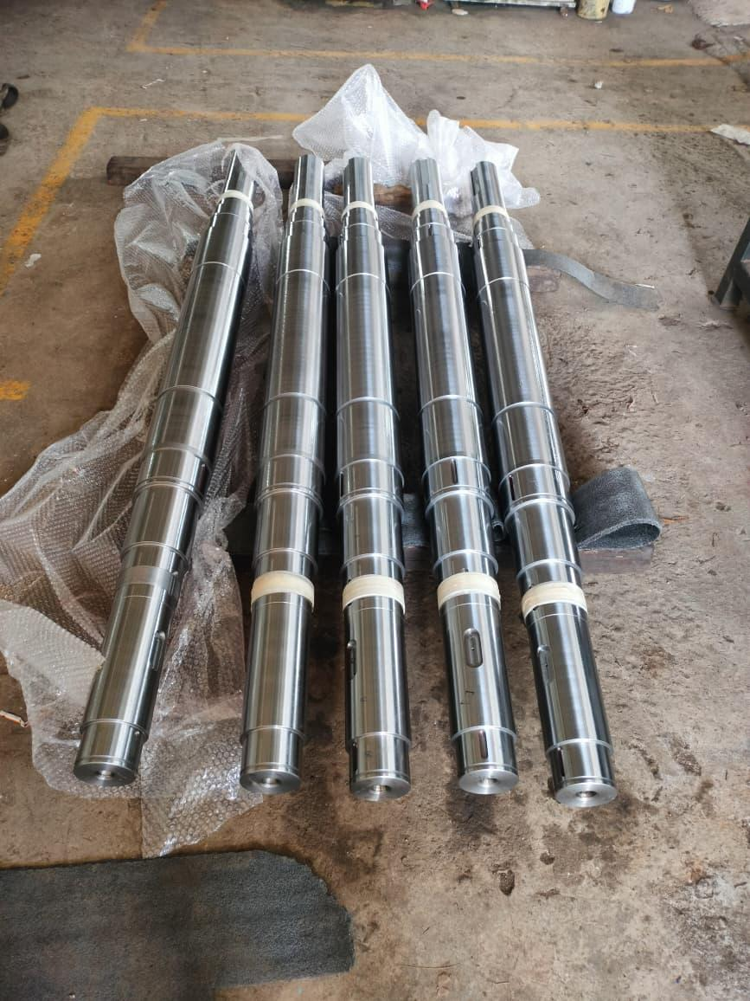
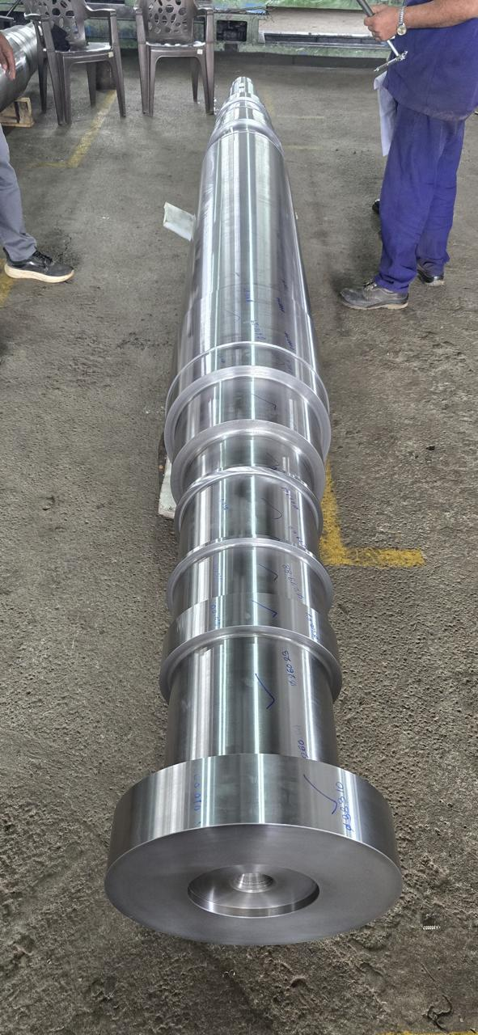
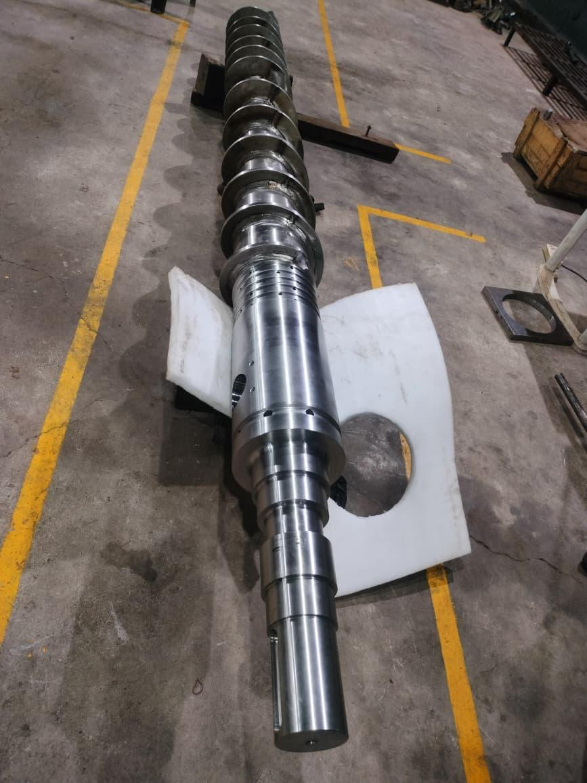
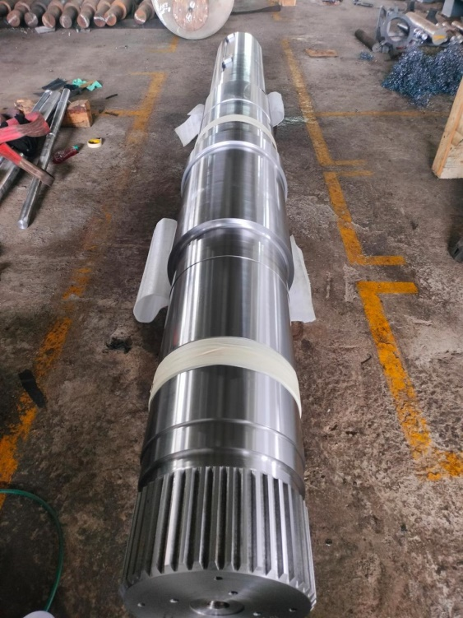
SHAFTS PHOTOGRAPH

Slide 11
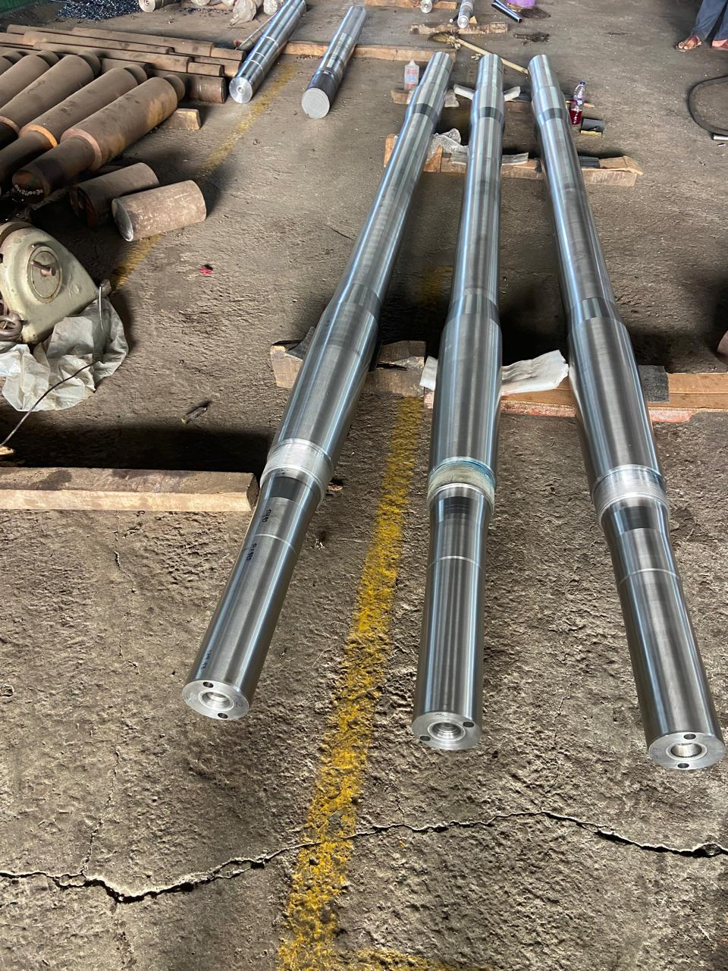
SPECIAL GRADE MATERIAL
DIAMETER: 200 mm
LENGTH: 4882 mm
MATERIAL: X2CrNiMoN 22-5-3

Slide 12
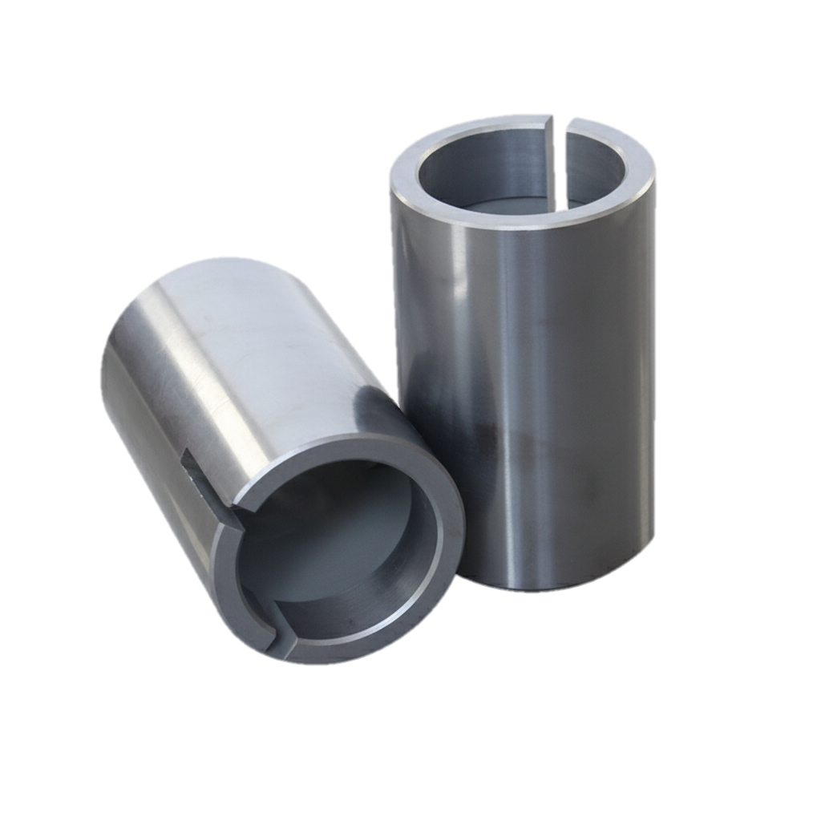
Sleeve / Muff Coupling / Bushes
Capacity -
Machining-50 mm to 1500 mm in diameter
Grinding-50 mm to 500 mm internal diameter up to 1000 mm length
50 mm to 800 mm outer diameter up to 1000 mm length
Internal Key-Way -1200 mm

Slide 13
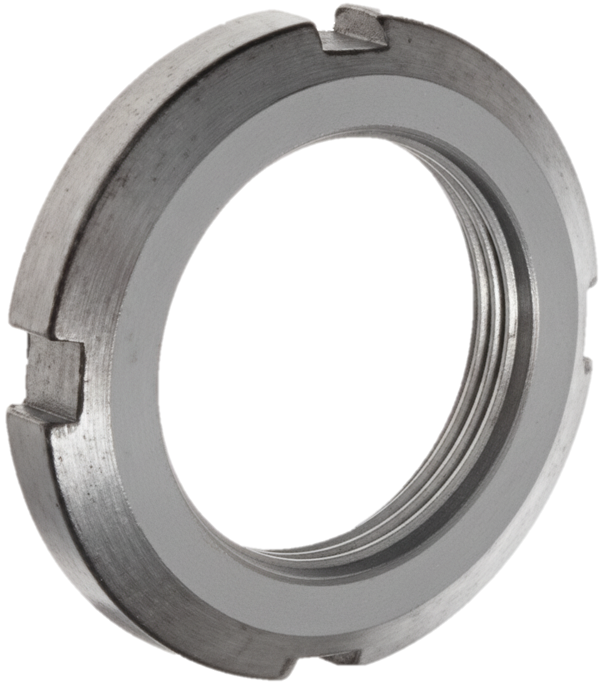
Lock Nut
Capacity-
Machining-30 mm to 750 mm in diameter
Threading -1 mm to 120 mm pitch (metric)

Slide 14
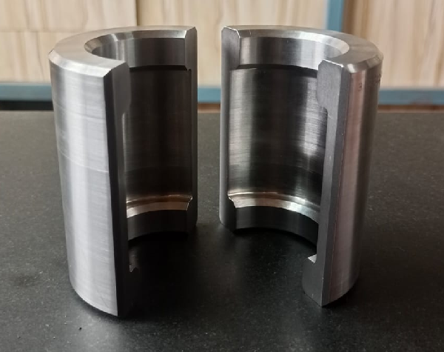
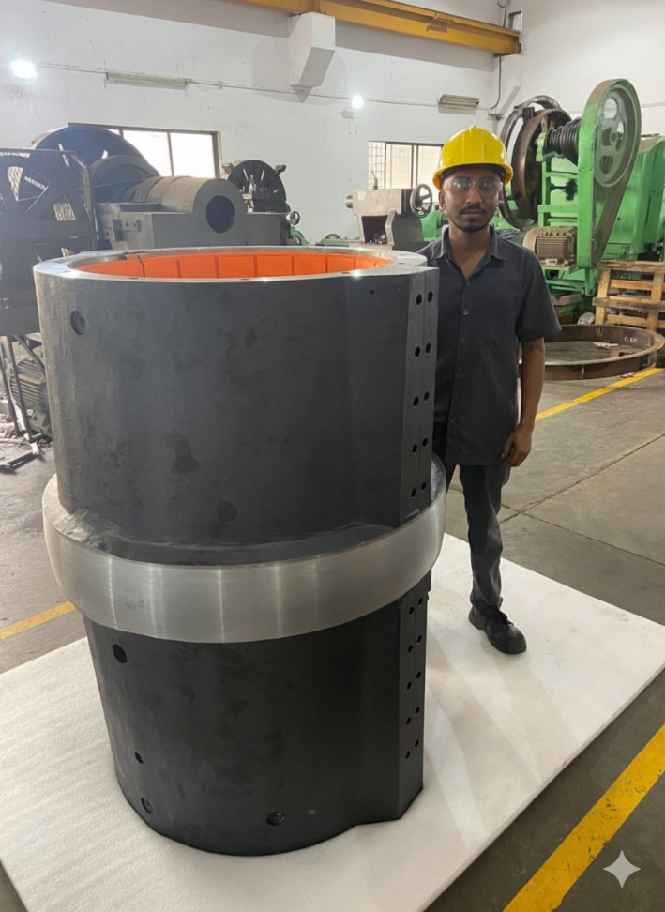
Retainer Ring / Thordon Bearing
Capacity-
Machining- 70 mm to 700 mm in diameter

Slide 15
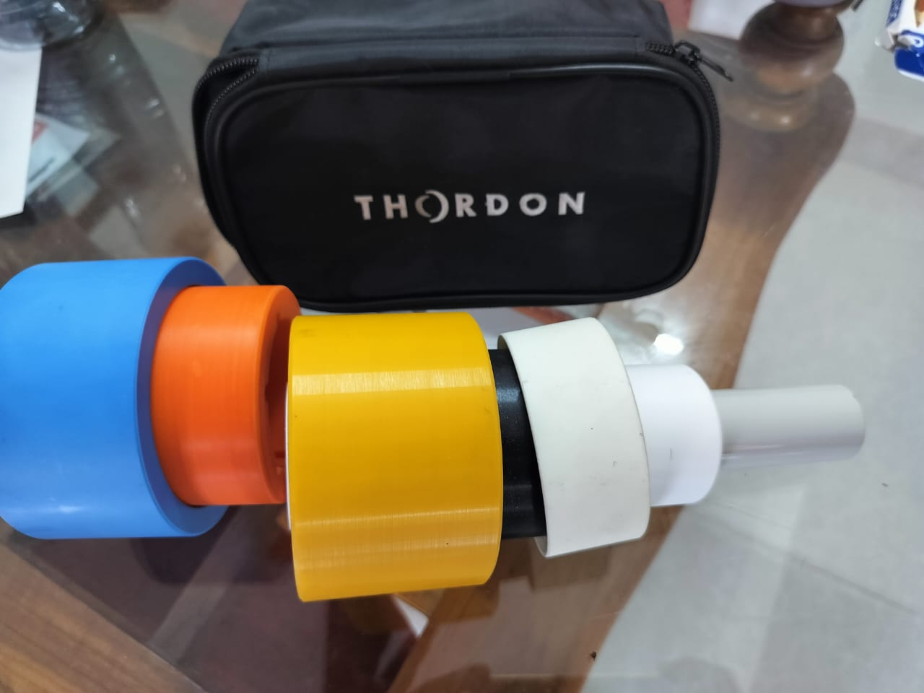
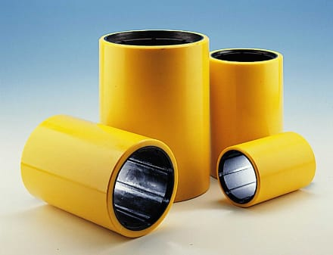
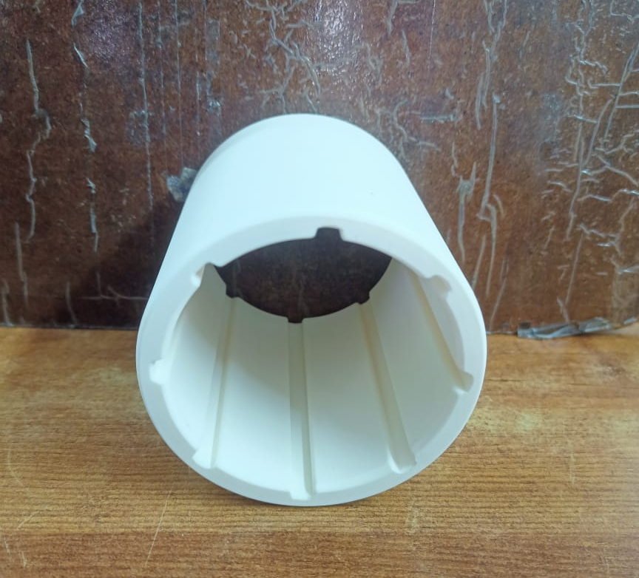
Thordon Bearing

Slide 16
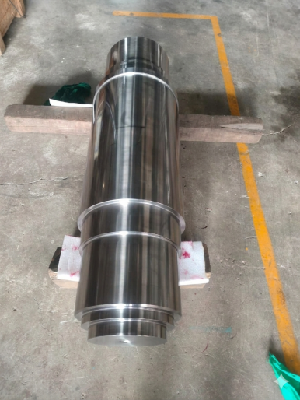
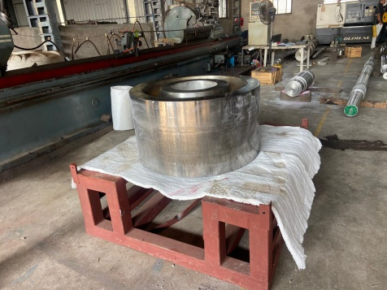
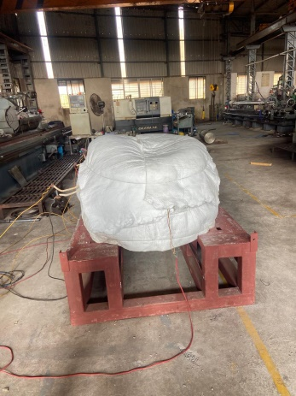
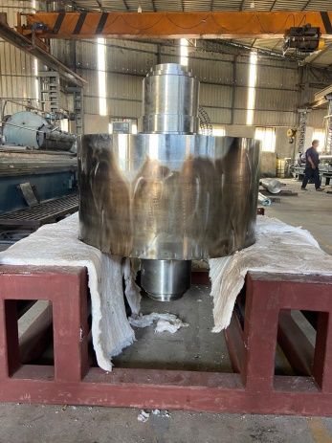
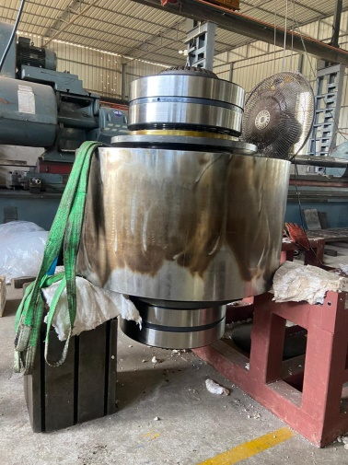
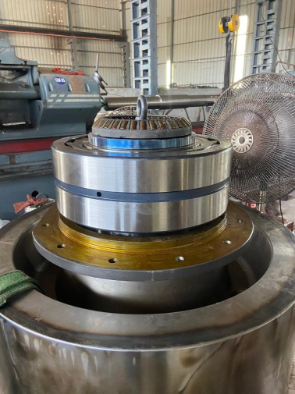
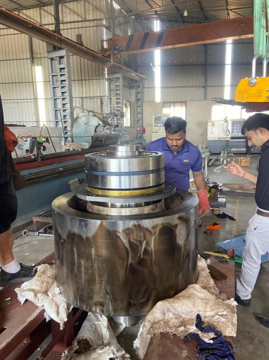
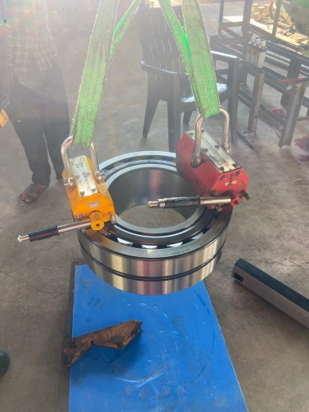
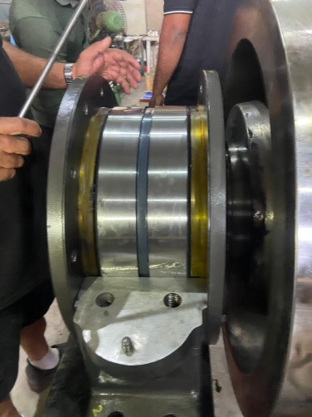
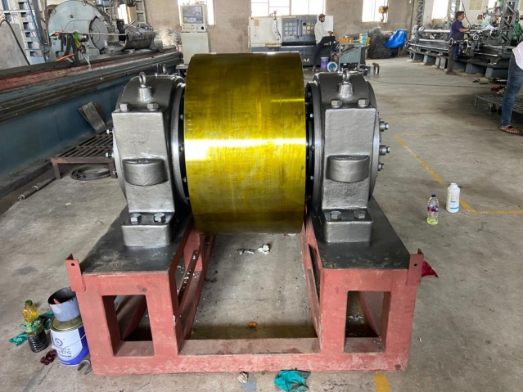
ASSEMBLY DONE IN-HOUSE

Slide 17

COMPLETE ASSEMBLY PICTURE
PROJECT NAME: ES-562

Slide 18
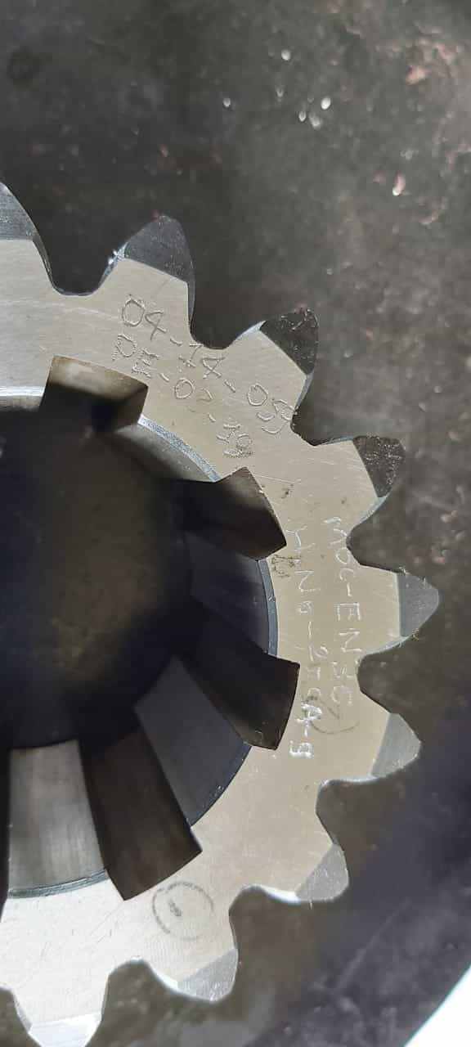
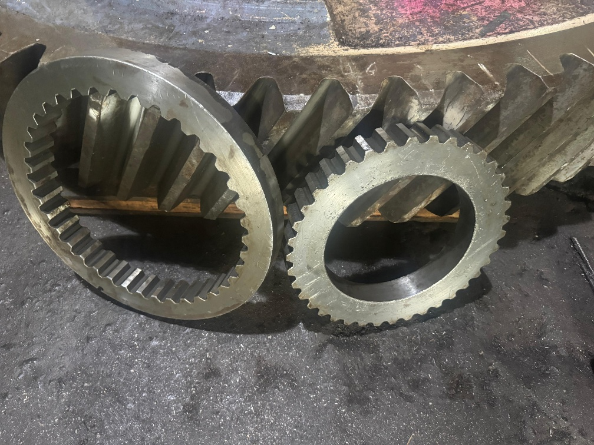
Gears
Custom spur and helical gears are manufactured as per customer drawings and requirements.

Slide 19
Material Grades
ALL GRADES OF STAINLESS STEEL
ALL GRADES OF DUPLEX & SUPER DUPLEX
ALL GRADES OF EN-SERIES STEELS
SPECIAL MATERIAL GRADES SUCH AS
K-MONEL 400 & 500
FOR BUSHES
GUNMETAL, FEROFORM F363, NEOPRENE RUBBER, RG12, THORDON

Slide 20
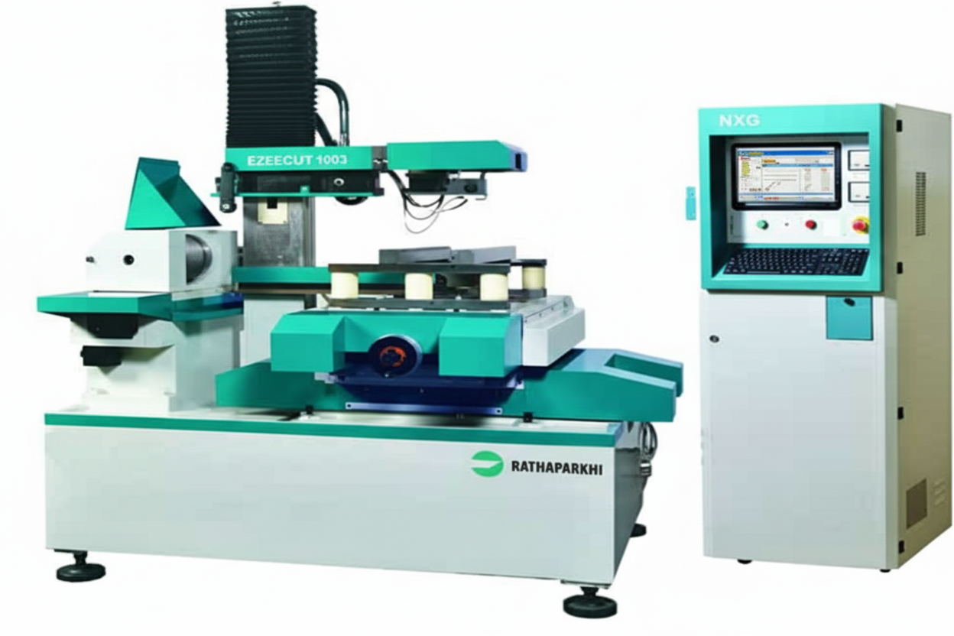
NXG EZEECUT Wire-Cut Machine

Slide 21
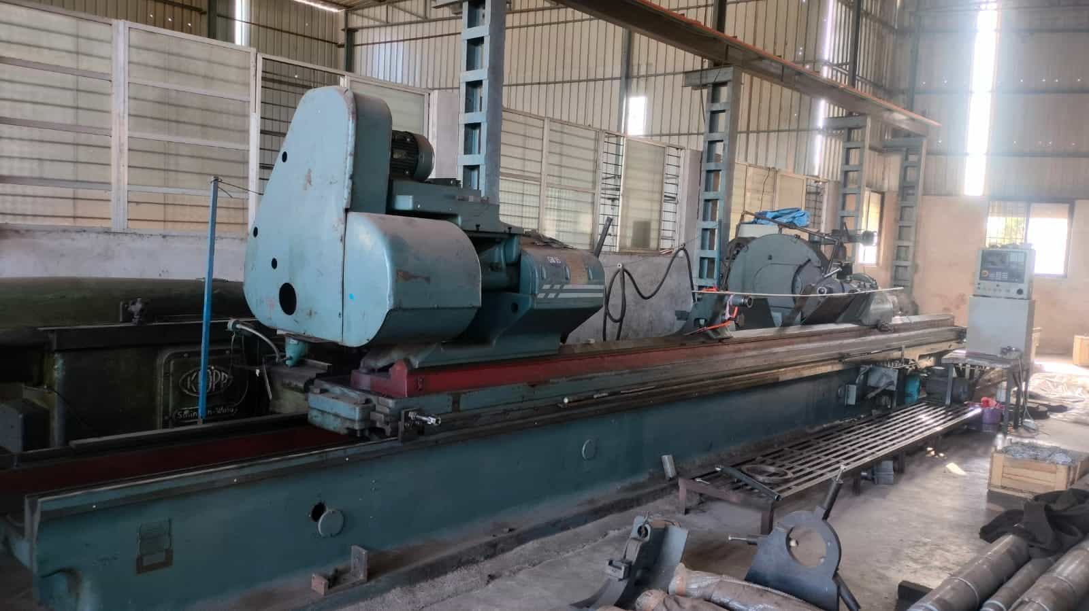
Grinding Machine

Slide 22
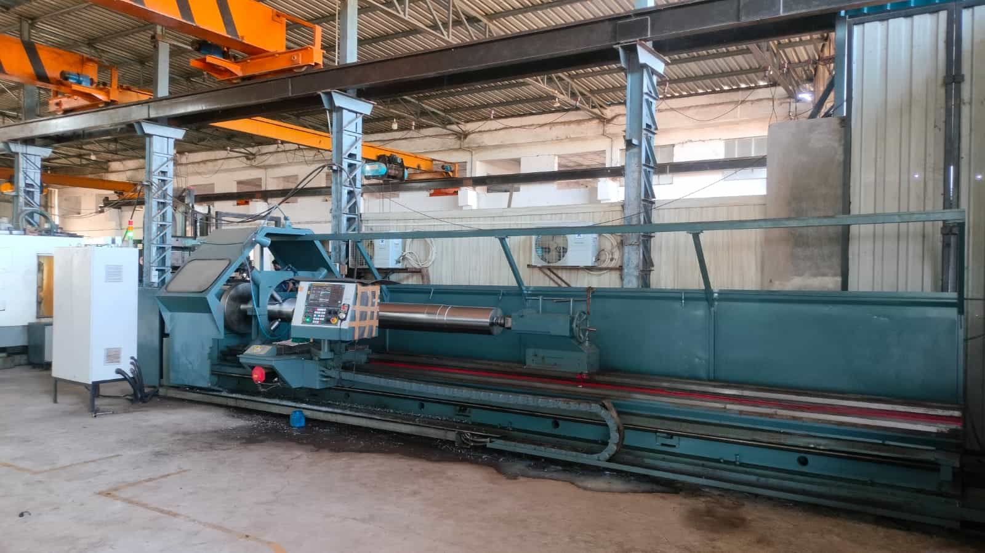
LENGTH: 10000 mm DIAMETER: 500 mm
CNC LATHE

Slide 23










CLIENTS

Slide 24












CLIENTS

Slide 25

WORLDWIDE EXPORT COUNTRIES
Canada
Netherlands
Germany
France
Italy
South Korea
Switzerland
Japan
United States
UAE
Saudi Arabia
Oman

Slide 26
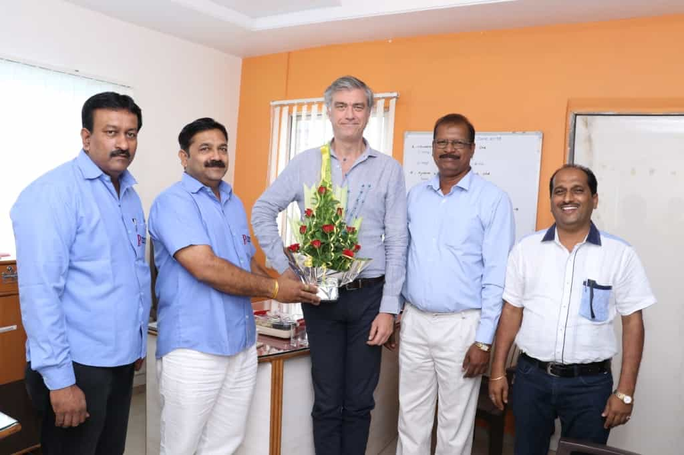
Flowserve Corporation
Mr. Fabrizio Baccani
Director, Manufacturing
Mr. Jayakumar Jagadeeshan
Supply Chain

Slide 27
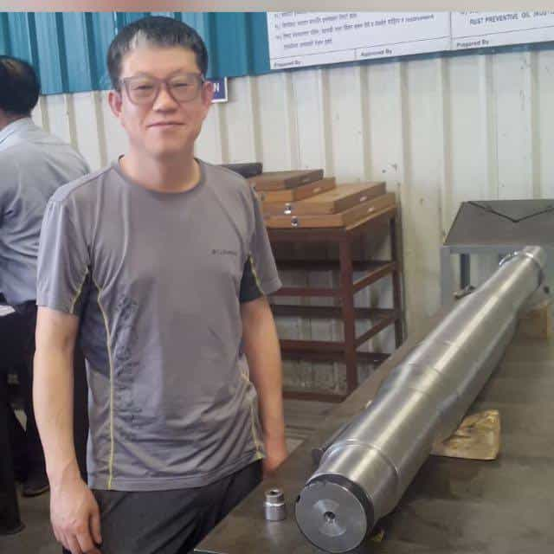
NASH TEAM
Korean quality expert visit
For Inspection

Slide 28
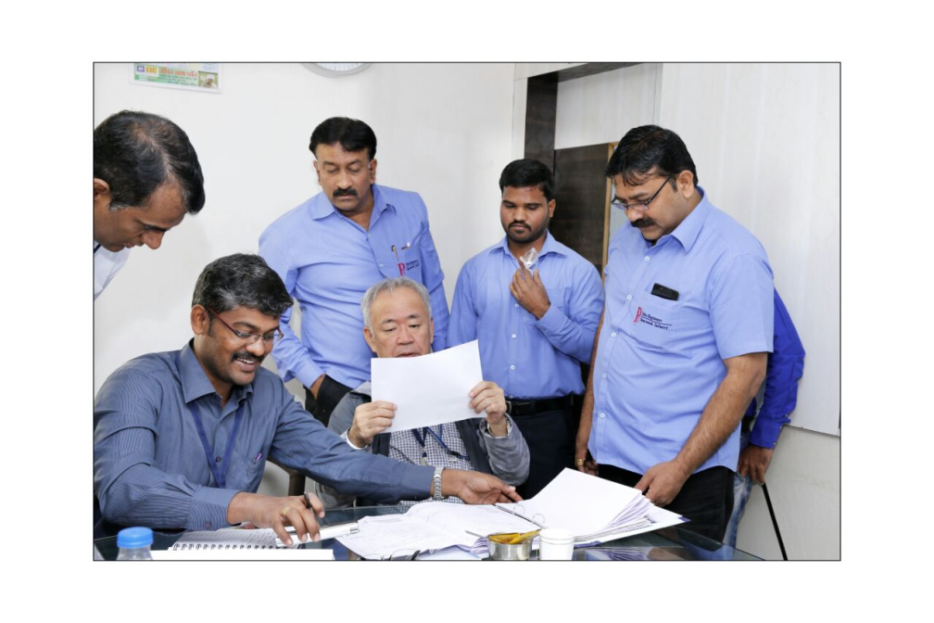
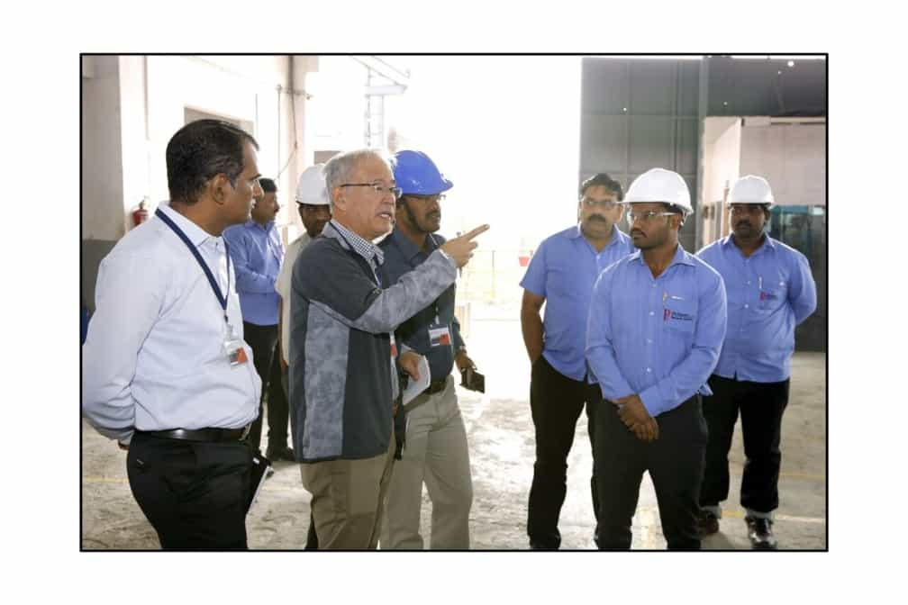
TMEIC TEAM
MR. KATSUKI MANABU ( JAPANESE EXPERT)
MR. BALASUBRAMANIAM -(MANAGER, MANUFACTURING ENGINEERING)
MR. ANESH PANDIT -(MANAGER, VENDOR DEVELOPMENT)
MR. SAILESH H. PURANIK -(HEAD, SCM & PROCUREMENT)

Slide 29
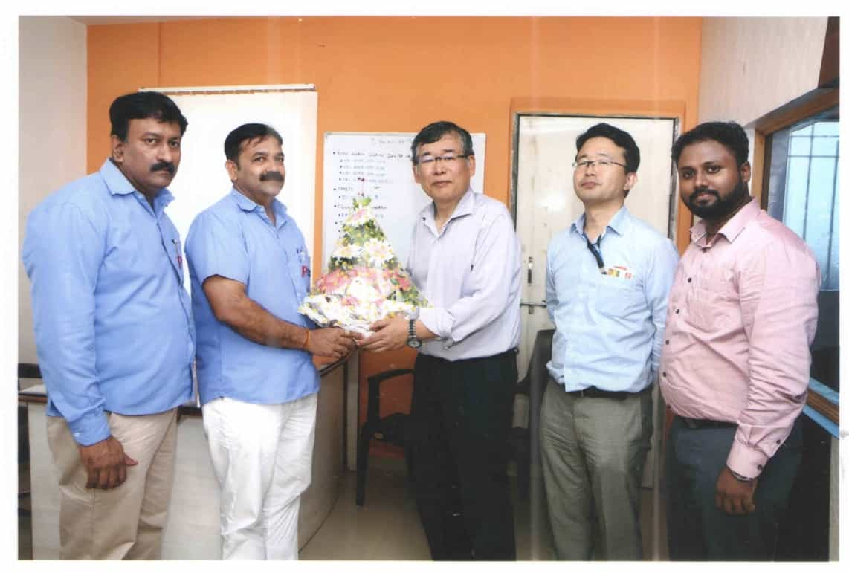
EBARA MACHINERY INDIA PRIVATE LIMITED
Mr. Hiroshi Suzuki
(Director)
Mr. Yusuke Chikamori
(Procurement)
Mr. Rajamanikandan K
Deputy Manager, Procurement

Slide 30
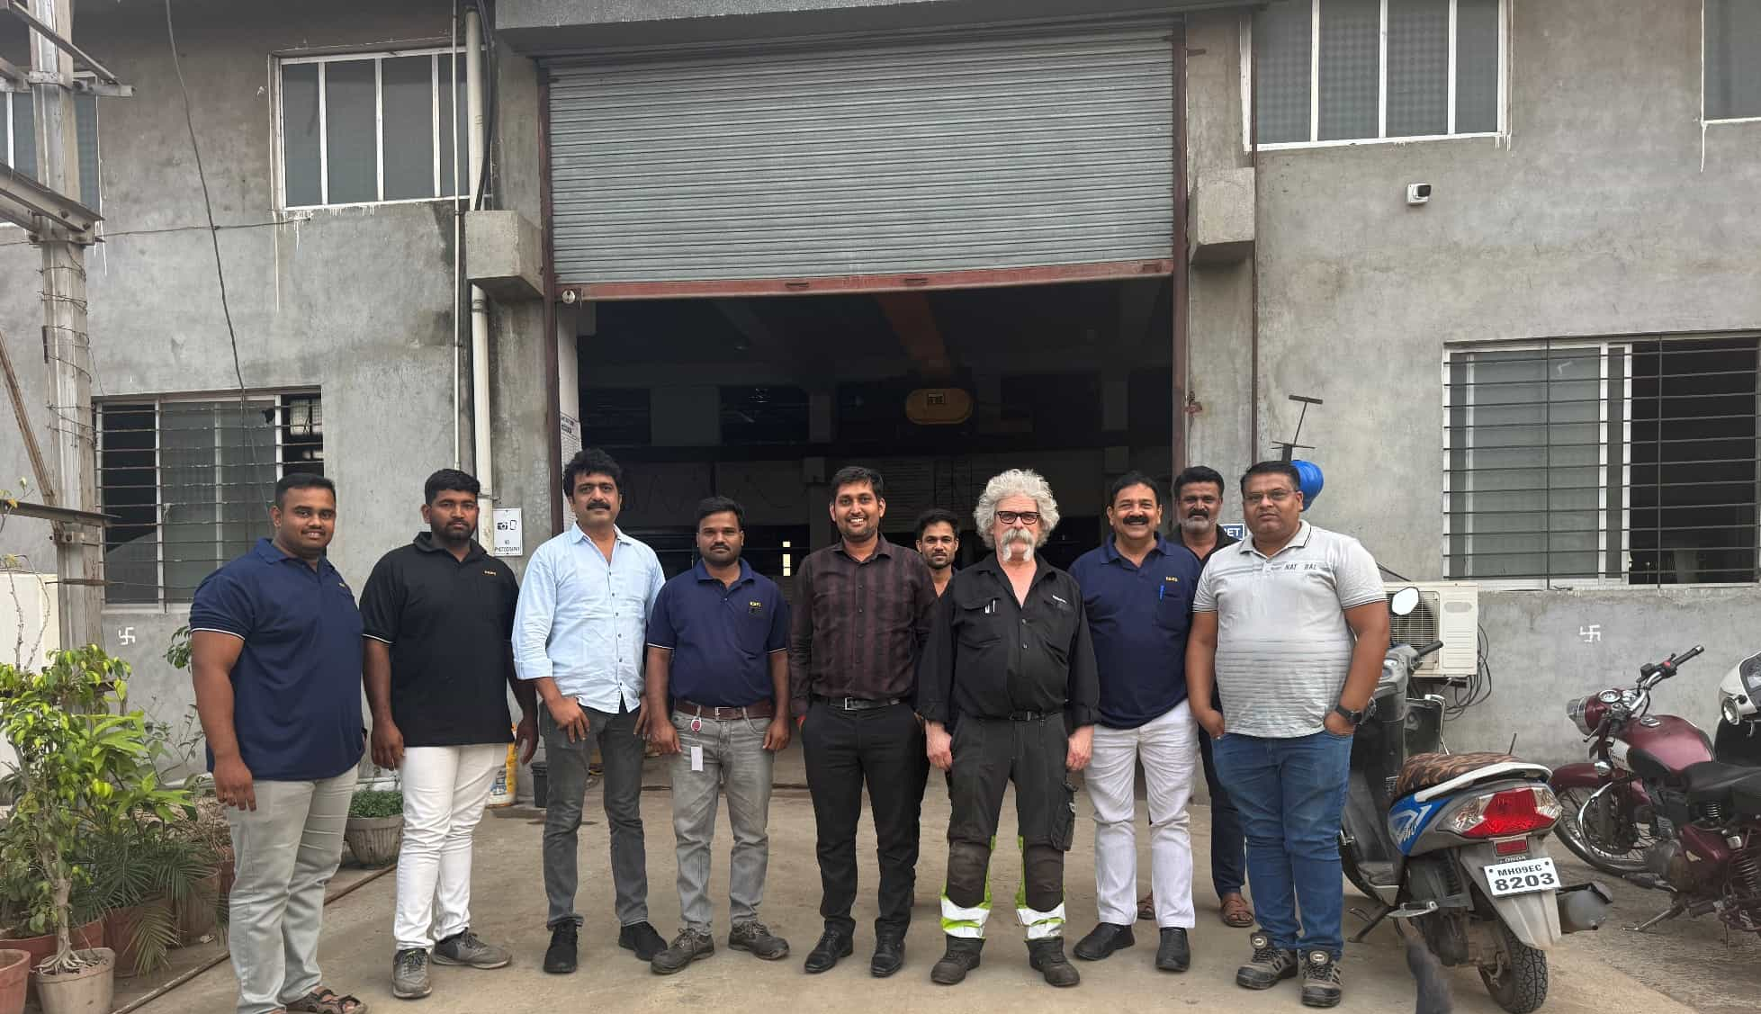
Valmet, Sweden

Slide 31
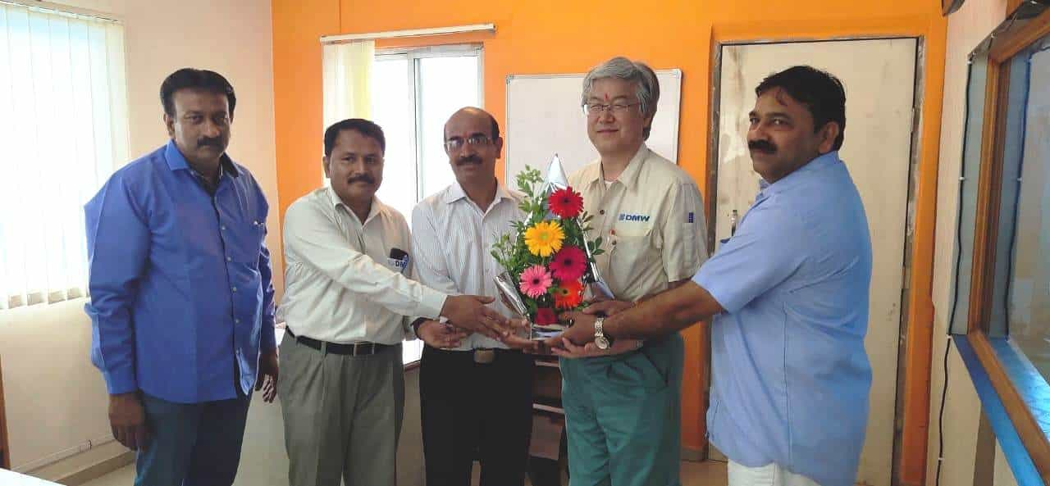
DMW Corporation Ltd.
Mr. Taizo Kobayashi (DMW Japan - Costing Sales
Mr. Ashok Yadav
DMW Pune - Factory Manager
Mr. Gajanan Lokhande
DMW Pune - QA Manager

Slide 32
THANK YOU

