Slide 1

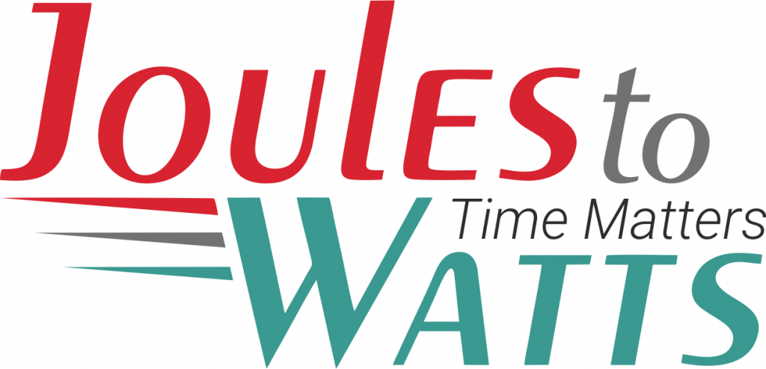




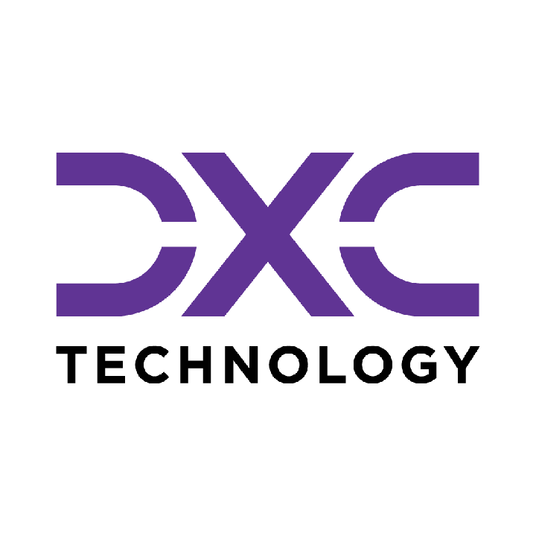









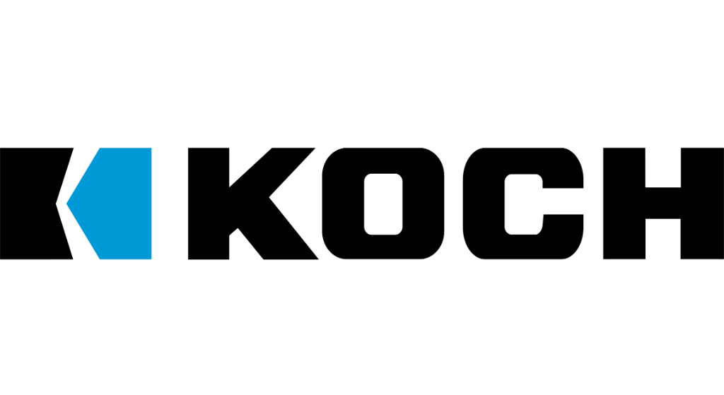

Building the Enterprise Operating Model​
for the Next Decade​
BUSINESS DRIVERS| TECHNOLOGY ACCELERATORS | GAME CHANGERS
Energy. Excellence. Innovation.
Trusted by:
ISO 9001:2015
CMMI Certified
Women-Owned
Notes:
J2W_ID: CS01

Slide 2

WHO WE ARE
The AI-native GCC platform - a decade in the making
J2W is the AI-native GCC platform for the Fortune 1000 and beyond.
Ten years building nothing but GCCs - so we solve the next problem before it shows up, deliver ROI in weeks where the industry takes quarters, and turn the GCC from a cost line into an innovation engine.
10+
320+
300+
Years GCC leadership
Enterprise clients served
GCCs built: greenfield & brownfield
5,500+
8
60+
Industry & tech experts
Countries with footprint
AI-enabled capabilities
Notes:
J2W_ID: CS02

Slide 3




Architects of Transformation
VISIONARY LEADERSHIP DRIVING ENTERPRISE EXCELLENCE
Priti Sawant is a serial entrepreneur, category creator, and a pioneer of India’s Global Capability Center (GCC) ecosystem. With 20+ years of experience, she has built and scaled businesses at the intersection of technology and enterprise transformation. She began her journey at Accenture and later led Magna Infotech-scaling it from pre-revenue to a market leader, creating India’s first GCC-focused model, and delivering a successful exit and public listing (IPO). She is a 2-time entrepreneur, having built two successful, leading companies solving for GCCs in India.
Priya Mohan is a seasoned operator, investor, and entrepreneur with 20+ years spanning venture capital, high-growth startups, and investment banking. She was most recently a Partner at General Catalyst India, where she led India investments and co-creation opportunities across transformative, economy-shaping companies. Previously, as Managing Partner at Venture Highway, she held board seats across marquee portfolio companies in multiple sectors. Before investing, she co-founded Vidyartha, an EdTech platform which she successfully exited to Byju's.
Priti Sawant
Priya Mohan
Founder & CEO
coo
She founded JoulestoWatts, backed by Manipal Global Education Services. Today, J2W operates across 8 countries, enabling 300+ GCCs, deploying 5,200+ professionals, and building 4 in-house products, with strong Fortune 500 partnerships. Recognised by Forbes Japan, she is also a TiE Charter Member, startup mentor, and a strong advocate of gender diversity, having built organisations with 40%+ women representation and 50% women-led leadership roles.
Her earlier career included 9 years in investment banking and equity research - structuring and executing complex transactions across private equity raises, secondary sales, and buyouts. A Chartered Accountant and Management Graduate from the Indian School of Business (ISB), Priya was a state guest of the United States under the IVLP program and is a member of the Kamalnayan Bajaj Aspen Fellowship (Cohort X).
Notes:
J2W_ID: CS03

Slide 4

WHAT WE OFFER
THREE INTERLOCKING REVENUE ENGINES
01
02
03
Workforce Solutions
AI Pods
Managed Service Solutions
The Volume Engine
The Margin Expansion Engine
The Strategic Value Engine
Domain-deep engineers - not generic coders
Verticals: IT and Cloud Computing · BFSI · more
Deployed in 10 days or less
Pod governance + sprint accountability
Contract-to-hire flexibility
AI-first engineering pods, embedded tech lead
Every engineer AI-certified before Day 1
J2W AI Labs - continuous monthly upskilling
AI-assisted code, test & docs from Day 1
Compounding productivity, not static seats
Dedicated pods owning outcomes, not tasks
Operate to outcome-bound SLOs
60+ pre-built solution accelerators
On SAP, ServiceNow & industry stacks
40% improvement threshold - our standard
Notes:
J2W_ID: CS04

Slide 5






THE J2W OPERATING MODEL
We don't just deploy - we embed, align, and deliver measurable outcomes.
01
02
03
04
Embed.
Build.
Operate.
Compound.
Days 1–14
Weeks 2–6
Month 2 onward
Year one & beyond
We map your stakeholder reality before touching a single workflow — identifying the 80% we move within and the 20% that unlocks transformation.
We deploy the closest-fit accelerator and customize where needed. Hundreds of prior engagements mean you inherit a head start, not a blank slate.
Forward-deployed engineers run AI inside your enterprise and don't rotate off. The context, accountability, and institutional memory stay with you.
Every problem solved sharpens the platform. The system gets smarter as you scale — outcomes that compound while you sleep.
Your business is our GTM. We build with you, so your teams actually adopt, use, and grow everything we create together - not just receive it.
Notes:
J2W_ID: CS05

Slide 6





WHAT WE OWN
The proprietary stack - our moat
J2W Premier Lounge
J2W OfferLetter
Data Abstraction Layer
Curated network of vetted experts - instant access to scarce skills.
AI-driven sourcing & resume parsing - onboard one engineer an hour.
Unified API gateway + real-time ETL - a single pane of glass.
J2W AI Labs
60+ Accelerators
Internal AI engine - every engineer AI-certified before Day 1.
Pre-built solutions on SAP, ServiceNow & industry stacks.
THE ARC FRAMEWORKAdaptive(Grow)→Resilient(Mature)→Cognitive(Transform)
Transparent, scalable, and owned by us - your competitive moat, not a black box.
Notes:
J2W_ID: CS06

Slide 7



Managed Service Solutions
OUTCOME-BOUND DELIVERY - NOT JUST A VENDOR WITH A STATEMENT OF WORK.
Solution Accelerators
Service Model Comparison
60+ pre-built accelerators across SAP, ServiceNow, Salesforce, and industry stacks - deployed fast, customized to fit, never forced.
Dimension
Traditional Managed Services
J2W Managed Solutions
Engagement
Model
SOW-based, scope-
locked
Outcome-bound, SLO-governed
Cross-Function Coverage
From AI CoE and Data CoE to Digital Engineering, Quality, and Cybersecurity - we operate across the full enterprise function map, not just the easy wins.
Starting Point
Build from scratch
60+ accelerators, deploy in weeks
Proven ROI, Not Projections
Performance Standard
Contractual minimums
40% improvement threshold
Every accelerator comes with a benchmark from prior deployments. 80% reduction in reporting effort. 55% faster month-end close. 65% faster testing cycles. Numbers you inherit, not numbers we promise.
Coverage
Single-function specialization
Cross-stack: SAP, ServiceNow, Salesforce + more
Knowledge Retention
Exits with the team
Captured, compounding, stays with you
AI Readiness
Optional add-on
Embedded from Day 1
From scattered pilots to governed programs. From manual reporting to real-time intelligence. From legacy stacks to modernized platforms. J2W Managed Solutions operate until the outcome is real - then keep compounding.
Notes:
J2W_ID: CS18

Slide 8










Strategic Managed Services Offerings
COMPREHENSIVE CAPABILITIES DRIVING DIGITAL TRANSFORMATION
AI Solutions (AI CoE)
Quality Engineering
GenAI strategies, agents, LLM workflows, predictive models, knowledge bots, and enterprise-grade AI governance & value realization frameworks.
Intelligent QA and Test Automation at scale - covering functional, performance, security, CI/CD pipelines, and TaaS delivery pods.
01
06
Data Migration & Infra Support
Call Centre Optimization
Seamless migration across on-prem & cloud, with data quality, cleansing, secure pipelines, infra ops, and cloud governance across AWS/Azure/GCP.
Transforming contact centers through operational assessment, workforce analytics, real-time dashboards, agent assist AI, and IVA-based automation.
02
07
Cybersecurity
SAP Services
Full-spectrum security including assessment, red-team, cloud security, managed SOC/MDR, compliance (ISO, PCI, RBI), incident response & digital forensics.
End-to-end SAP modernization - from S/4HANA migrations to BTP, Fiori, SuccessFactors, and enterprise-wide rollout with managed SAP support.
03
08
Digital Engineering & Automation
Salesforce Services
Spanning full-stack & UI/UX development, intelligent automation, AI-augmented RPA, and end-to-end process orchestration.
Complete Salesforce transformation across Sales, Service, Marketing, Financial Services Cloud, and MuleSoft - backed by org audits and managed support.
04
09
Data Analytics & Dashboarding
ServiceNow
Interactive dashboards across Power BI, Tableau, and Qlik - enabling real-time operational, financial, and leadership insights.
End-to-end ServiceNow enablement across ITSM, ITOM, CSM, CMDB, automation workflows, and CoE setup for scalable, multi-instance operations.
05
10
Notes:
J2W_ID: CS19

Slide 9
OPERATIONAL DIGITAL TWIN
CLIENT: Leading Energy Utility | DOMAIN: Energy
The Challenge
The Solution
An offshore oil and gas operator running aging platforms across the North Sea managed asset health through scheduled inspections, manual technician readings, and calendar-based maintenance. A compressor on one platform showed irregular vibration signatures for 11 days before a bearing failure took it offline, a £2.1 million unplanned shutdown requiring weather-dependent crew mobilization and 14 days off-production. The data that would have predicted it was being collected; nobody was watching it, and no engineer held a view across the full platform fleet at any given moment.
An AI-embedded operational digital twin was deployed across the platform fleet, ingesting live sensor, PLC, and SCADA streams into a continuously maintained digital replica of every critical asset. Operational health scoring runs continuously against equipment performance and system interdependencies, surfacing degradation before it reaches the production threshold. Engineers now work from a unified dashboard across all platforms, seeing asset condition, trend, and warranted intervention, without leaving the control room.
Key Capabilities Developed
Live Asset Mirroring
Operational Health Scoring
Predictive Maintenance
Real-time sensor, PLC, and SCADA streams maintain a continuously updated digital replica across platforms and asset classes.
Flags degradation trajectories and failure probability before output is affected, across interdependent systems.
Anticipates failures and optimal intervention windows from telemetry and load history, replacing calendar-based scheduling.
Anomaly Detection and Root Cause Isolation
Scenario Simulation
Unified Operations Dashboard
Triggers corrective workflows before cascading failures develop.
Tests load changes and equipment swaps against the live twin without touching real systems.
Consolidates asset health, performance, and risk scores with drill-down visibility across platforms.
30
20
25
40% reduction in unplanned downtime
30% improvement in asset utilisation
35% faster fault detection and resolution

Slide 10
LOAD BALANCING AND DEMAND RESPONSE
CLIENT: Leading Energy Utility | DOMAIN: Energy
The Challenge
The Solution
An energy and utilities operator managing distributed sites relied on rule-based controls and manual intervention for load balancing and demand response. There was no real-time intelligence to act on dynamic grid conditions, peak demand signals, or consumption anomalies before they escalated into penalties. Idle capacity went undetected across sites, grid penalty charges accumulated, and response times consistently lagged behind the market windows that determined whether a demand response action would actually count.
An agentic optimization engine was deployed to continuously monitor consumption patterns across all distributed assets, recommend and execute load balancing actions autonomously, and trigger demand response measures in real time. The system anticipates peak windows using historical profiles and weather signals, enabling pre-emptive load shedding before a peak event hits rather than reacting once it has already started. Energy management shifted from manual scheduling to proactive, grid-aligned action with no additional infrastructure investment required.
Key Capabilities Developed
Real-Time Consumption Monitoring
Predictive Peak Demand Forecasting
Autonomous Load Balancing Engine
Continuously tracks energy usage across all distributed sites, detecting deviations, spikes, and anomalies.
Anticipates peak windows using historical profiles and weather signals to enable pre-emptive load shedding.
Recommends and executes load redistribution autonomously, eliminating manual scheduling bottlenecks.
Demand Response Trigger
Grid Condition Anomaly Detection
Energy Intelligence Dashboard
Automatically executes actions aligned to utility signals and market windows without operator input.
Flags voltage fluctuations and abnormal draw patterns in real time to prevent grid instability.
Provides unified visibility tracking utilization, response history, cost avoidance, and grid alignment scores.
15
30
20
25% reduction in peak load consumption via autonomous response
40% faster grid response time, replacing manual intervention
30% fewer energy penalty charges through real-time intelligence

Slide 11









NEXT STEPS
FLEXIBLE ENGAGEMENT MODELS TAILORED TO YOUR THREE-YEAR ROADMAP
Discovery Workshop
LOW TOUCH
Assessment & PoC
STRATEGIC
Build & Run Models
PARTNERSHIP
Duration: ~90 Minutes
Duration: 4 Weeks
Duration: Multi-Year
KEY DELIVERABLES
KEY DELIVERABLES
COMMERCIAL MODELS
Use case identification & prioritization
Target state architecture design
Fixed Scope: For defined project builds
Value hypothesis definition
Working pilot / MVP implementation
Managed Service: SLA-driven operations
High-level roadmap aligned to 70/30 strategy
Detailed ROI model & rollout plan
Outcome-Based: Gain-share pricing tied to value
Vendor integration assessment
SAMPLE IMPLEMENTATION ROADMAP
DISCOVERY
Q1
PILOT / POC
Q2
SCALE
Q3
OPTIMIZE
Q4
Assess readiness, define scope, select initial use cases
MVP build, user testing, architecture validation
Production deployment, integration, vendor onboarding
Run ops, process tuning, continuous improvement
Initiation
Validation
Execution
Refinement
Notes:
J2W_ID: CS07

Slide 12




"Let's win together"
Notes:
J2W_ID: CS08

Slide 13
PLANFORGE AI - AGENTIC PRODUCTION PLANNING
CLIENT: Leading Manufacturing Enterprise | DOMAIN: Manufacturing
The Challenge
The Solution
A manufacturer's planners spent 6 to 10 hours per disruption event stitching ERP, MRP, supplier, and material data into spreadsheets just to assess the situation. A 2 to 4 day gap separated a real-world signal from a revised plan, meaning cascades were discovered days late through email and spreadsheet chains. Compound disruption scenarios were rarely modelled before the plan changed, so recovery choices were made on instinct and revenue at risk only became visible after orders ran late.
An agentic production planning engine was deployed connecting order books, factory capacity, supplier reliability, and material readiness in a unified model. The system simulates disruption scenarios before the plan changes and compares recovery options side by side, replacing instinct with evidence-based choices. Every plan change is logged with the reasoning behind it, giving planners a complete decision trail and giving management full audit of what was known and when.
Key Capabilities Developed
Unified Planning View
Scenario Simulation
Disruption Response and Audit
Brings order books, capacity, supplier reliability, and material readiness into one model so a cascade is visible as it starts.
Models compound disruptions before the plan changes and compares recovery options side by side, replacing instinct with evidence-based decisions.
Surfaces revenue at risk within the response window, enables cross-plant rebalancing on signal, and logs why each plan changed.
Signal-to-Plan Automation
Cross-Plant Rebalancing
Revenue-at-Risk Quantification
Connects real-world signals directly to plan updates, reducing the lag between disruption and revised schedule.
Evaluates rebalancing options across plants simultaneously when a disruption hits, rather than sequentially per plant.
Calculates the financial exposure of each disruption scenario so planners prioritize by commercial impact, not just operational urgency.
6
2
100%
10 hours of planner time freed per disruption event through automated data stitching
4 day signal-to-plan lag reduced toward real time
decision trail with every plan change logged

