Slide 1

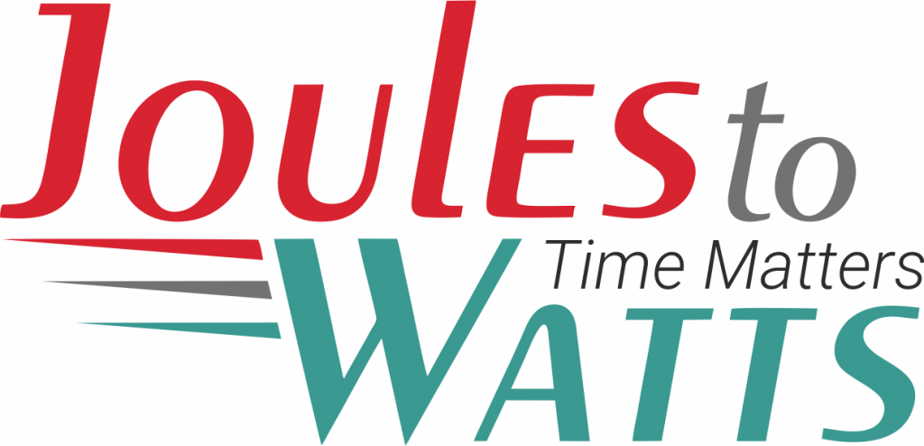




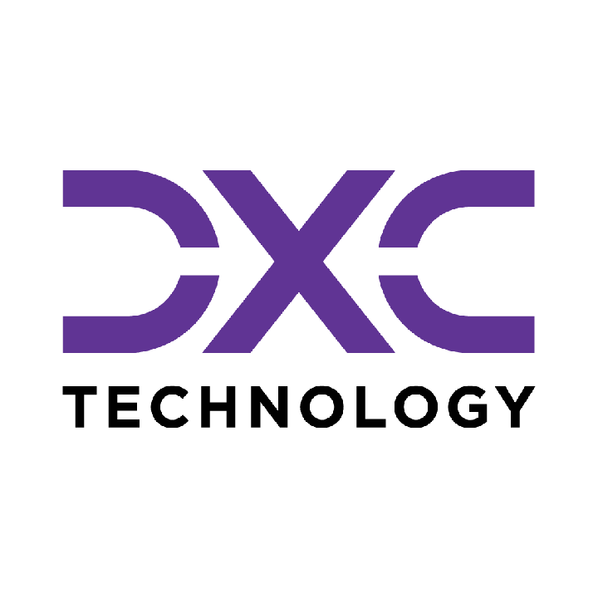











Building the Enterprise Operating Model​
for the Next Decade​
BUSINESS DRIVERS| TECHNOLOGY ACCELERATORS | GAME CHANGERS
Energy. Excellence. Innovation.
Trusted by:
ISO 9001:2015
CMMI Certified
Women-Owned
Notes:
J2W_ID: CS01

Slide 2

WHO WE ARE
The AI-native GCC platform - a decade in the making
J2W is the AI-native GCC platform for the Fortune 1000 and beyond.
Ten years building nothing but GCCs - so we solve the next problem before it shows up, deliver ROI in weeks where the industry takes quarters, and turn the GCC from a cost line into an innovation engine.
10+
320+
300+
Years GCC leadership
Enterprise clients served
GCCs built: greenfield & brownfield
5,500+
8
60+
Industry & tech experts
Countries with footprint
AI-enabled capabilities
Notes:
J2W_ID: CS02

Slide 3




Architects of Transformation
VISIONARY LEADERSHIP DRIVING ENTERPRISE EXCELLENCE
Priti Sawant is a serial entrepreneur, category creator, and a pioneer of India’s Global Capability Center (GCC) ecosystem. With 20+ years of experience, she has built and scaled businesses at the intersection of technology and enterprise transformation. She began her journey at Accenture and later led Magna Infotech-scaling it from pre-revenue to a market leader, creating India’s first GCC-focused model, and delivering a successful exit and public listing (IPO). She is a 2-time entrepreneur, having built two successful, leading companies solving for GCCs in India.
Priya Mohan is a seasoned operator, investor, and entrepreneur with 20+ years spanning venture capital, high-growth startups, and investment banking. She was most recently a Partner at General Catalyst India, where she led India investments and co-creation opportunities across transformative, economy-shaping companies. Previously, as Managing Partner at Venture Highway, she held board seats across marquee portfolio companies in multiple sectors. Before investing, she co-founded Vidyartha, an EdTech platform which she successfully exited to Byju's.
Priti Sawant
Priya Mohan
Founder & CEO
coo
She founded JoulestoWatts, backed by Manipal Global Education Services. Today, J2W operates across 8 countries, enabling 300+ GCCs, deploying 5,200+ professionals, and building 4 in-house products, with strong Fortune 500 partnerships. Recognised by Forbes Japan, she is also a TiE Charter Member, startup mentor, and a strong advocate of gender diversity, having built organisations with 40%+ women representation and 50% women-led leadership roles.
Her earlier career included 9 years in investment banking and equity research - structuring and executing complex transactions across private equity raises, secondary sales, and buyouts. A Chartered Accountant and Management Graduate from the Indian School of Business (ISB), Priya was a state guest of the United States under the IVLP program and is a member of the Kamalnayan Bajaj Aspen Fellowship (Cohort X).
Notes:
J2W_ID: CS03

Slide 4

WHAT WE OFFER
THREE INTERLOCKING REVENUE ENGINES
01
02
03
Workforce Solutions
AI Pods
Managed Service Solutions
The Volume Engine
The Margin Expansion Engine
The Strategic Value Engine
Domain-deep engineers - not generic coders
Verticals: IT and Cloud Computing · BFSI · more
Deployed in 10 days or less
Pod governance + sprint accountability
Contract-to-hire flexibility
AI-first engineering pods, embedded tech lead
Every engineer AI-certified before Day 1
J2W AI Labs - continuous monthly upskilling
AI-assisted code, test & docs from Day 1
Compounding productivity, not static seats
Dedicated pods owning outcomes, not tasks
Operate to outcome-bound SLOs
60+ pre-built solution accelerators
On SAP, ServiceNow & industry stacks
40% improvement threshold - our standard
Notes:
J2W_ID: CS04

Slide 5






THE J2W OPERATING MODEL
We don't just deploy - we embed, align, and deliver measurable outcomes.
01
02
03
04
Embed.
Build.
Operate.
Compound.
Days 1–14
Weeks 2–6
Month 2 onward
Year one & beyond
We map your stakeholder reality before touching a single workflow — identifying the 80% we move within and the 20% that unlocks transformation.
We deploy the closest-fit accelerator and customize where needed. Hundreds of prior engagements mean you inherit a head start, not a blank slate.
Forward-deployed engineers run AI inside your enterprise and don't rotate off. The context, accountability, and institutional memory stay with you.
Every problem solved sharpens the platform. The system gets smarter as you scale — outcomes that compound while you sleep.
Your business is our GTM. We build with you, so your teams actually adopt, use, and grow everything we create together - not just receive it.
Notes:
J2W_ID: CS05

Slide 6





WHAT WE OWN
The proprietary stack - our moat
J2W Premier Lounge
J2W OfferLetter
Data Abstraction Layer
Curated network of vetted experts - instant access to scarce skills.
AI-driven sourcing & resume parsing - onboard one engineer an hour.
Unified API gateway + real-time ETL - a single pane of glass.
J2W AI Labs
60+ Accelerators
Internal AI engine - every engineer AI-certified before Day 1.
Pre-built solutions on SAP, ServiceNow & industry stacks.
THE ARC FRAMEWORKAdaptive(Grow)→Resilient(Mature)→Cognitive(Transform)
Transparent, scalable, and owned by us - your competitive moat, not a black box.
Notes:
J2W_ID: CS06

Slide 7









01
WORKFORCE SOLUTIONS
Domain-deep engineering talent - deployed, governed, and continuously upskilled
We don't place people. We deploy domain-certified engineers into governed pods - with sprint accountability, AI-powered sourcing, and a contract-to-hire model that keeps your risk low and your velocity high
10 days or less to
deploy
300+ in-house recruiters,
zero subcontracting
Contract-to-hire flexibility
built in
Pod governance + sprint
accountability from Day 1
Scale your engineering capacity with domain depth and delivery accountability.
Notes:
J2W_ID: CS09

Slide 8





Workforce & Talent Solutions
A MANAGED, AI-DRIVEN WORKFORCE UNIT - NOT JUST STAFFING WITH A WRAPPER.
Sourcing Engine
Human + AI Teams
Fully Managed
AI-First L&D
AI-driven talent matching across 8,500+ active consultants and 1,250+ skills - niche to mainstream.
Blended delivery with AI productivity tools embedded from Day 1. Capability stacks over role pyramids.
J2W owns payroll, compliance, onboarding and HR. Zero admin burden on the client side.
Continuous upskilling via J2W CoE - contextual, hands-on AI training powered by Research Wing.
Dimension
Traditional Staffing
J2W Workforce
Speed to Deploy
Weeks to months
1 engineer onboarded per hour
Team Composition
Single-role profile deployments
Human + AI blended capability stacks
Governance
Client's burden
J2W-owned - HRBP implant at every site
Performance Issues
Escalation after the fact
Proactive monitoring & intervention
Knowledge Retention
Lost with attrition
Captured in J2W Knowledge Repository
AI Readiness
Ad hoc
Embedded from Day 1
5,500+
1,250+
320+
0%
1/hr
Active Consultants
Skills Covered
Enterprise Clients
Attrition (6-Mo Pilot)
Engineers Onboarded
Notes:
J2W_ID: CS10

Slide 9



WORKFORCE SOLUTIONS - HOW WE DELIVER
From sourcing to sprint governance - a structured operating model, not a staffing drop.
01
Scope & Source
02
AI-Assess
03
Deploy in 10 Days
Role definition + domain-specific talent pool activation. TalentAI matching + voice-agent pre-screen. Shortlist in 72 hrs.
Live coding + domain scenario assessment via TalentSphere. Technical bar validated by J2W before client interview.
Offer → onboarding → Day-1 productivity. J2W payroll, compliance, IT provisioning - fully managed.
04
Govern & Upskill
05
POFU - 90-Day Funnel
06
Scale or Convert
Sprint accountability via Pod Manager. Monthly AI upskilling in J2W Labs. Weekly performance telemetry.
Post-Offer Follow-Up: milestone touchpoints, counter-offer inoculation, manager connects. Dropout rate → single digits.
C2H → permanent conversion on Day 91. Scale the pod up or down. Quarterly Business Review with ROI data.
Notes:
J2W_ID: CS11

Slide 10





STRUCTURAL DIFFERENTIATION
WORKFORCE SOLUTIONS
Five structural differences that change the engagement from transactional to transformational.
No Subcontracting
300+ in-house recruiters. 7,200+ professionals on J2W payroll. Zero subcontracting layer diluting quality, speed, or accountability.
GCC-Native Intelligence
Forged through 300+ active GCC deployments. We see the next problem before it shows up because we have already solved it somewhere else.
AI at Every Step
TalentAI + TalentSphere: AI-ranked pools, voice-agent screening, skill graphs, predictive placement. Every tool passed our 40% improvement gate internally.
Pod Governance Built In
A dedicated Pod Manager - not billed to client - owns sprint governance, performance tracking, and L&D coordination. This is a pod, not a staffing drop.
Validated Playbooks
Every tool, process, and accelerator has passed our internal 40% improvement gate. Clients benefit from completed learning - not our experimentation.
Notes:
J2W_ID: CS12

Slide 11


WHY J2W - NOT THE BIG 4 OR LARGE SIs
THE SMARTER CHOICE FOR AI & DIGITAL TRANSFORMATION AT SCALE
JoulesToWatts + J2W
Big 4 / Top IT SIs
Staffing Agencies
Outcome-driven from Day 1 - aligned to your milestones, CXO ROI expectations & project KPIs
Heavy retainers + longer payback cycles. High technical debt risk on failed transformations
Headcount model only. Zero delivery ownership or outcome accountability
ROI & Outcome Model
Production-ready Gen & Agentic AI PoCs in weeks via 50+ accelerators across SAP, Oracle, ServiceNow & more
Lengthy consulting cycles with SI-driven models - higher costs & slower results
Time-To-Value
Not offered
Pre-built guardrails. Mission-critical delivery in regulated industries (Fortune 500 MedTech). Data stays in your environment
Claims excellence, but multiple public incidents (e.g. Deloitte AU govt penalties) undermine credibility
AI / Data Governance
Not offered
30-40% reduction in AI OPEX via Query Routing, Semantic Caching, Precision RAG & in-house SLMs
SI incentivised to maximise licences & tokens - not to optimise your cost
AI OPEX Optimisation
Not offered
7,200+ in-house consultants · 300+ recruiters · 2 proprietary hiring platforms · No subcontracting
Frequently subcontract. No proprietary hiring platforms
Lacks SME depth & governance. Outcome ownership absent
Talent & Managed Services
KEY METRICS
5,500
60+
30-40%
Weeks
0
In-house Consultants
AI Accelerators
AI OPEX Reduction
PoC to Production
Subcontracting
Notes:
J2W_ID: CS13

Slide 12
02
AI PODS
AI-first engineering pods - governed, certified, and compounding from Day 1
This is a fully governed, outcome-bound delivery model-not traditional staff augmentation. We embed complete engineering units that integrate directly into your sprint cycles, governed by strict SLAs and continuous AI upskilling.
10-day onboarding
90-day POFU
85% sprint completion target
0.5 defect density threshold
Scale your engineering footprint with absolute control and measurable outcomes.
Notes:
J2W_ID: CS14

Slide 13






Introducing the AI-First Pod Model
A MANAGED, GOVERNED ENGINEERING UNIT - NOT JUST STAFFING WITH A WRAPPER.
Engineering Team
Pod Lead
Performance Governance
AI-First L&D Program
Dedicated engineers (Java, Python, DevOps) - hired, vetted, and onboarded by J2W.
A J2W program manager who owns delivery, sprint governance, and client alignment.
Weekly performance tracking, SLA metrics, velocity monitoring, proactive resolution.
Continuous AI training - hands-on, contextual upskilling powered by Research Wing.
Dimension
Traditional Staffing
AI-First Pod
Governance
Client's burden
J2W-owned
Upskilling
Engineer's personal initiative
Structured, continuous, AI-focused
Performance Issues
Escalation after the fact
Proactive monitoring & intervention
Knowledge Retention
Lost with attrition
Captured in Knowledge Repository
AI Readiness
Ad hoc
Embedded from Day 1
Notes:
J2W_ID: CS15

Slide 14








The J2W AI Research Wing
YOUR POD'S SECRET WEAPON
What Is the AI Research Wing?
A dedicated team of AI researchers and engineers working on cutting-edge enterprise AI - agentic AI systems, LLM orchestration, model governance, and applied ML
Currently building and publishing research on agentic AI architectures, prompt engineering frameworks, and enterprise AI adoption strategies
Powers J2W's proprietary platforms: the J2W Agentic Platform, Qualizen (GenAI-assisted quality engineering), and Talk2Data (conversational BI)
How Pod Members Benefit
Weekly AI workshops led by our research team - covering practical, project-applicable AI skills
Access to the J2W iLAB - Innovation Points program for building PoCs, hackathons, and rapid prototyping
Contextual AI training - hands-on training tailored to the specific technology stack and domain
Benchmarking against global best practices - continuous measurement against industry-leading standards
The result: Your engineers don't just work - they get better every week. And that compounding improvement is something no staffing model can deliver.
Notes:
J2W_ID: CS16

Slide 15
AI PODS • J2W DELIVERY
AI PODS CASE STUDIES
AI-first engineering pod delivery, quality engineering, and DevSecOps across industries.
Notes:
J2W_ID: CS21

Slide 16


APP STORE RATING RECOVERY FOR DIGITAL BANK
Mobile QA · App Store · Android · iOS · UX Testing · Fintech
Client: Leading Digital Bank | Domain: Banking & Financial Services | Function: AI Pod Delivery
THE CHALLENGE
THE SOLUTION
Digital bank saw significant App Store/Play Store rating drop due to poor performance causing customer churn. Performance inconsistencies across iOS/Android across multiple regions made diagnosis and fix through internal teams difficult.
Cross-device analysis and bug tracking approach deployed using JIRA to integrate user feedback into fix cycle. App benchmarked against competitor apps. Functional retests conducted on every new app version before release.
⚙ KEY CAPABILITIES
Cross-Device Analysis
App Store Feedback Integration
Competitor Benchmarking
User experience evaluation across Android and iOS in multiple regions identifying device/region-specific issues.
User reviews from App Store and Play Store integrated into JIRA for faster identification and resolution.
App performance compared against leading competitors to identify improvement targets.
Functional Retest on Every Version
Region-Specific Diagnostics
Fix Cycle Acceleration
Thorough retests on each new version validating previously identified issues before release.
Performance issues isolated by region and device type enabling targeted remediation.
Direct feedback loop from user reviews to development team compressing issue-to-release time.
3.0→4.0
3.5→4.8
Improved
App Store Rating (3 months)
Play Store Rating (3 months)
User Retention & Organic Growth
Notes:
J2W_ID: CS29

Slide 17
DEVSECOPS PIPELINE FOR OPEN BANKING
DevSecOps · AWS · GitHub Actions · HashiCorp Vault · ARGO CD · Open Banking
Client: Global Banking Leader | Domain: Banking & Financial Services | Function: AI Pod Delivery
THE CHALLENGE
THE SOLUTION
Global bank's Open Banking initiative required fully automated, security-compliant DevSecOps pipeline across multiple microservices and source control repositories — adhering to strict global banking regulations and managing complex multi-service release cycles.
Comprehensive AWS-powered DevSecOps pipeline implemented integrating GitHub Actions, HashiCorp Vault, Veracode SAST/SCA, JFrog, ARGO CD, and Lacework across Dev, Staging, and Production environments with formal approval gates.
⚙ KEY CAPABILITIES
Stakeholder-Balanced Pipeline Design
Multi-Repository Microservice Integration
Near 100% Test Automation
Architecture balancing technical requirements and business stakeholder needs across all environments.
Seamless integration across multiple source control repositories and microservice boundaries.
Automated QE and security testing across every release candidate without manual regression.
Streamlined Release Train Model
Security-First Pipeline Architecture
Banking Regulatory Compliance
Multi-service coordinated release model cutting deployment times significantly.
SAST, SCA, dependency validation, and Lacework monitoring embedded throughout the pipeline.
Architecture ensuring adherence to global banking regulatory standards at every release gate.
~100%
Reduced
Full
Test Automation Across Microservices
Deployment Cycle Time
QE & Security Automation
Notes:
J2W_ID: CS30

Slide 18
SAP PERFORMANCE TESTING FOR HIGH-LOAD HEALTH INSURANCE
SAP · LoadRunner · Performance Testing · 5000 Users · Insurance · Benchmarking
Client: Leading Health Insurance Company | Domain: Insurance | Function: AI Pod Delivery
THE CHALLENGE
THE SOLUTION
Health insurance company needed to validate SAP system under 5,000 concurrent users with strict benchmarks: dialog response <1 second, CPU/memory <65%, 99% DB cache hit ratio — across complex batch processes and varied network latency scenarios.
Detailed performance testing using HP LoadRunner VUGEN with production-data-based user scenarios. Gradual load increase tests, batch process impact evaluation, and targeted database optimization recommendations including secondary index creation delivered.
⚙ KEY CAPABILITIES
Production-Based Load Simulation
HP LoadRunner VUGEN Scripts
Gradual Load Testing Protocol
Test scenarios built from real user interaction and transaction data to accurately simulate usage.
Performance scripts for frequently used SAP T-Codes comprehensively covering critical functions.
Progressive load increase with/without network latency to identify stress points.
Batch Process Performance Isolation
Database Optimization Recommendations
Latency Impact Analysis
Analysis with/without concurrent batch processes to quantify batch impact on response times.
Targeted secondary index recommendations improving peak-load data retrieval.
Identification of response time jumps at specific latency levels guiding infrastructure remediation.
5,000
100%
Full
Concurrent Users Validated
Strict Performance Benchmarks Met
Optimization Roadmap Delivered
Notes:
J2W_ID: CS32

Slide 19
WORKFORCE SOLUTIONS • J2W DELIVERY
WORKFORCE SOLUTIONS CASE STUDIES
Talent acquisition, managed services, GCC setup, and workforce transformation across industries.
Notes:
J2W_ID: CS35

Slide 20
GREENFIELD TO APAC INNOVATION HUB — 15-YEAR BFSI EVOLUTION
GCC · APAC · Banking · AI Credit Risk · KYC/AML · Multi-City
Client: Global Banking Leader, APAC | Domain: Banking & Financial Services | Function: GCC & ODC Setup
THE CHALLENGE
THE SOLUTION
Global bank needed to build, evolve, and scale a multi-city APAC hub across 15+ years — from lean greenfield foundation to fully automated excellence hub supporting €1.3 trillion in assets across 15 countries, with increasing compliance and AI integration requirements.
Phase 1: 120 professionals, core BFSI CoE. Phase 2: 450+ specialists, AI-driven risk automation, 98% fraud detection. Phase 3: 700+ professionals across APAC with automated KYC/AML, real-time reporting, $1.2B annual value generation.
⚙ KEY CAPABILITIES
Phase 1 Banking GCC Foundation
Phase 2 Digital Transformation
Phase 3 APAC Excellence Hub
120 professionals establishing core BFSI CoE operations with compliance engine and risk framework.
450+ specialists driving AI-powered risk accuracy improvement of 30% and retail banking automation of 45%.
700+ professionals across multi-city hub with automated KYC/AML and real-time reporting across 15 countries.
AI-Powered Credit Risk Modelling
Regulatory Compliance at Scale
Continuous Innovation Engine
92% accuracy in AI-driven credit risk modelling supporting enterprise-scale financial decision-making.
100% regulatory compliance maintained across all APAC jurisdictions throughout every phase.
Sustainable innovation frameworks ensuring the hub remains at the forefront of BFSI operations.
700+
92%
$1.2B
Professionals Across APAC
AI Credit-Risk Modeling Accuracy
Annual Value Generation
Notes:
J2W_ID: CS38

Slide 21
FINANCE & TECHNOLOGY COE BUILD — GLOBAL INDUSTRIAL LEADER (SULZER)
BOT Model · 150 Hires · RPA · Finance · ServiceNow · GCC
Client: Global Industrial Engineering Leader (Sulzer) | Domain: Industrial Engineering | Function: GCC & ODC Setup
THE CHALLENGE
THE SOLUTION
Global industrial leader needed 150-member India CoE across Finance and Technology within 6 months — niche roles including ServiceNow engineers, SAP architects, finance transformation specialists, and data engineering leads requiring rapid scaling and operational maturity.
Build-Operate-Transfer model across 3 phases: infrastructure + 100% recruitment (months 1-2), knowledge transfer + RPA rollout (months 2-4), operational maturity with controlled transfer (months 4-6). Client Vantage dashboard integrated for real-time visibility.
⚙ KEY CAPABILITIES
BOT Operating Model
Finance Tower Excellence
C2H for Critical Roles
Build-Operate-Transfer structure with Sulzer assuming control at month 6 and advisory continuing post-transfer.
O2C, P2P, R2R, and FP&A each built with embedded control frameworks, compliance, and efficiency benchmarks.
Contract-to-Hire at 45-50% of year-1 compensation with 85% mis-hire risk reduction and day-91 permanent conversion.
RPA & AI Workflow Automation
Client Vantage Dashboard
ServiceNow & Cloud Enablement
SAP P2P, O2C, R2R automation targeting 25-30% manual effort reduction across all Finance towers.
Real-time performance visibility and predictive pipeline analytics from day 1 for leadership oversight.
Full deployment and CRM optimization for the 50-person technology track.
150
25-30%
15-20%
Hires Completed in 6 Months
Manual Effort Reduction
Improvement in Operational Leverage
Notes:
J2W_ID: CS39

Slide 22
CA & FINANCE TALENT PIPELINE — GLOBAL ALTERNATIVE ASSET MANAGER
CA Hiring · RPO · TalentAI · POFU · GCC · Finance Talent
Client: Leading Global Alternative Asset Manager | Domain: Banking & Financial Services | Function: Talent Acquisition & Deployment
THE CHALLENGE
THE SOLUTION
India GCC faced 17-18% offer dropout rate from long notice periods, mandatory WFO, competition from Big 4, and fragmented hiring demand. Traditional partners couldn't address structural causes of dropout at required scale.
4-pillar talent engine: pre-mapped CA warm bench, structured 90-day POFU rhythm, WFO employer brand strategy, and Managed RPO consolidating recruitment across all business units. TalentAI and TalentSphere for AI-ranked sourcing.
⚙ KEY CAPABILITIES
Pre-Vetted Immediate Joiners Pipeline
90-Day POFU Rhythm
WFO Employer Brand Strategy
Warm bench of CAs mapped and ready before demand hits, drawn from campus, Big 4, and competitor pools.
Structured post-offer follow-up with milestone touchpoints, manager connects, and counter-offer inoculation.
Repositioned 5-day office as career accelerator with same-role-as-HQ messaging.
Managed RPO Partnership
TalentAI & TalentSphere
Zero Subcontracting Policy
Consolidated recruitment across all business units with dedicated team eliminating vendor fragmentation.
AI-ranked candidate pools with skill-graph matching and voice-agent pre-screening for faster, higher-quality shortlisting.
300+ in-house recruiters handling all sourcing with no subcontracting layer diluting quality.
<5%
24 Hrs
100%
Offer Dropout (Down from 17-18%)
Time to First Shortlist
Candidates Double-Screened
Notes:
J2W_ID: CS41

Slide 23









NEXT STEPS
FLEXIBLE ENGAGEMENT MODELS TAILORED TO YOUR THREE-YEAR ROADMAP
Discovery Workshop
LOW TOUCH
Assessment & PoC
STRATEGIC
Build & Run Models
PARTNERSHIP
Duration: ~90 Minutes
Duration: 4 Weeks
Duration: Multi-Year
KEY DELIVERABLES
KEY DELIVERABLES
COMMERCIAL MODELS
Use case identification & prioritization
Target state architecture design
Fixed Scope: For defined project builds
Value hypothesis definition
Working pilot / MVP implementation
Managed Service: SLA-driven operations
High-level roadmap aligned to 70/30 strategy
Detailed ROI model & rollout plan
Outcome-Based: Gain-share pricing tied to value
Vendor integration assessment
SAMPLE IMPLEMENTATION ROADMAP
DISCOVERY
Q1
PILOT / POC
Q2
SCALE
Q3
OPTIMIZE
Q4
Assess readiness, define scope, select initial use cases
MVP build, user testing, architecture validation
Production deployment, integration, vendor onboarding
Run ops, process tuning, continuous improvement
Initiation
Validation
Execution
Refinement
Notes:
J2W_ID: CS07

Slide 24




"Let's win together"
Notes:
J2W_ID: CS08

