Slide 1

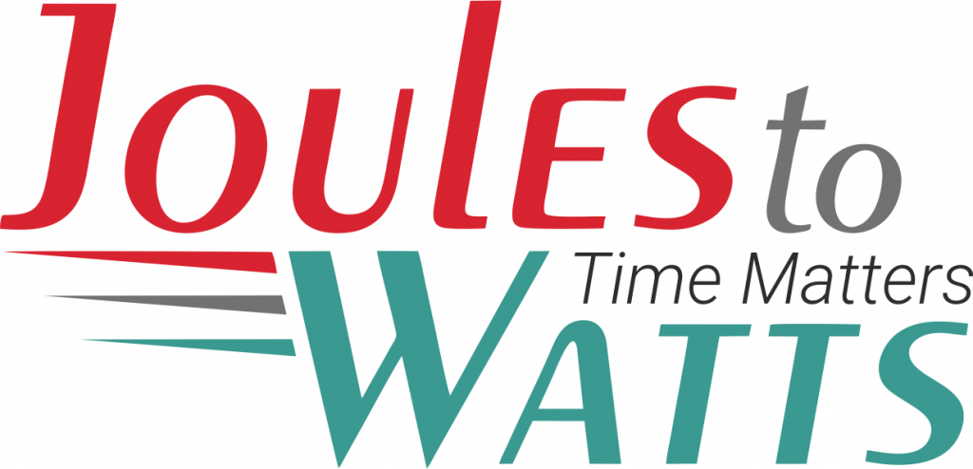



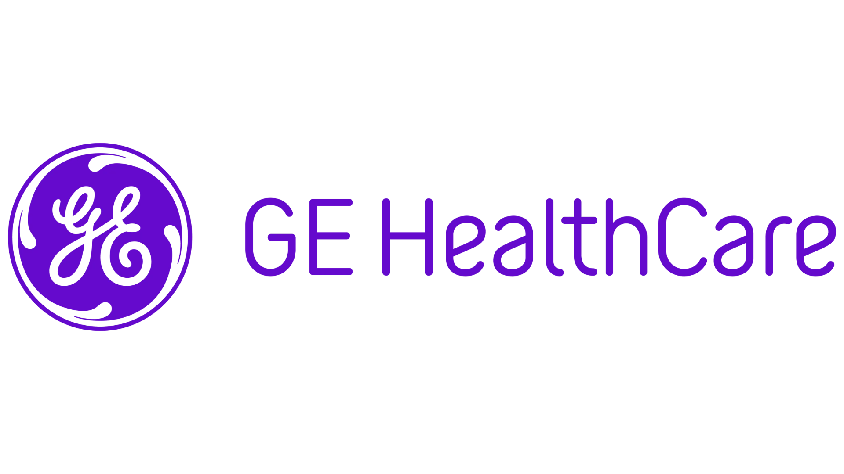
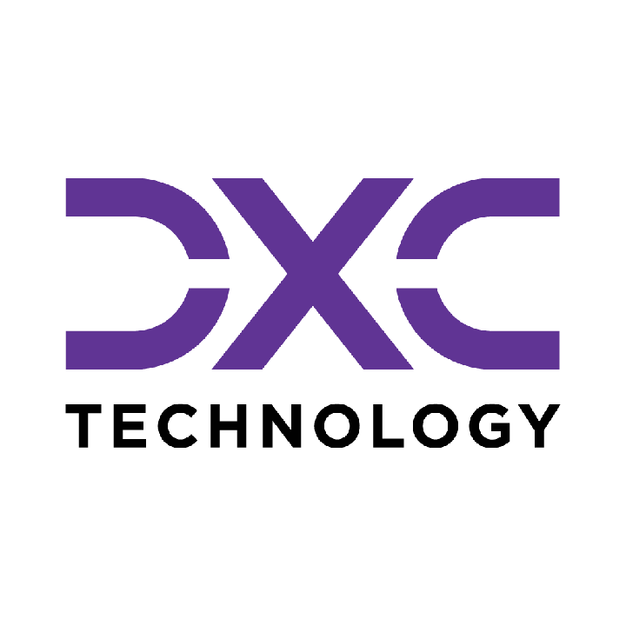









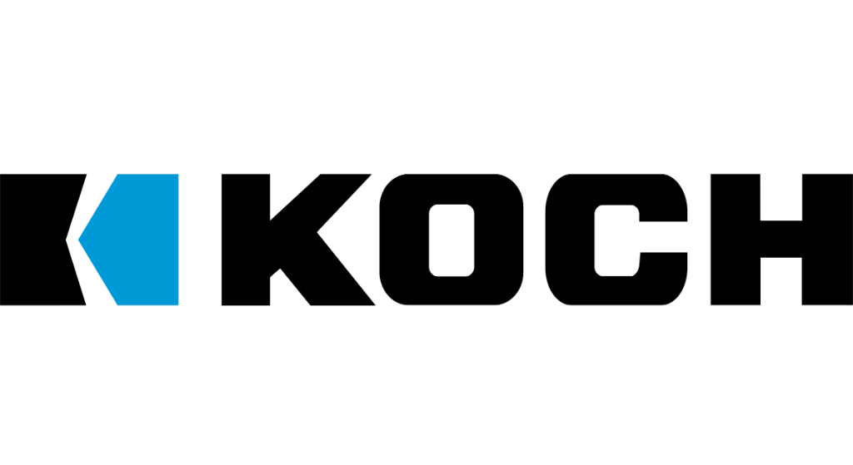

Building the Enterprise Operating Model​
for the Next Decade​
BUSINESS DRIVERS| TECHNOLOGY ACCELERATORS | GAME CHANGERS
Energy. Excellence. Innovation.
Trusted by:
ISO 9001:2015
CMMI Certified
Women-Owned
Notes:
J2W_ID: CS01

Slide 2

WHO WE ARE
The AI-native GCC platform - a decade in the making
J2W is the AI-native GCC platform for the Fortune 1000 and beyond.
Ten years building nothing but GCCs - so we solve the next problem before it shows up, deliver ROI in weeks where the industry takes quarters, and turn the GCC from a cost line into an innovation engine.
10+
320+
300+
Years GCC leadership
Enterprise clients served
GCCs built: greenfield & brownfield
5,500+
8
60+
Industry & tech experts
Countries with footprint
AI-enabled capabilities
Notes:
J2W_ID: CS02

Slide 3




Architects of Transformation
VISIONARY LEADERSHIP DRIVING ENTERPRISE EXCELLENCE
Priti Sawant is a serial entrepreneur, category creator, and a pioneer of India’s Global Capability Center (GCC) ecosystem. With 20+ years of experience, she has built and scaled businesses at the intersection of technology and enterprise transformation. She began her journey at Accenture and later led Magna Infotech-scaling it from pre-revenue to a market leader, creating India’s first GCC-focused model, and delivering a successful exit and public listing (IPO). She is a 2-time entrepreneur, having built two successful, leading companies solving for GCCs in India.
Priya Mohan is a seasoned operator, investor, and entrepreneur with 20+ years spanning venture capital, high-growth startups, and investment banking. She was most recently a Partner at General Catalyst India, where she led India investments and co-creation opportunities across transformative, economy-shaping companies. Previously, as Managing Partner at Venture Highway, she held board seats across marquee portfolio companies in multiple sectors. Before investing, she co-founded Vidyartha, an EdTech platform which she successfully exited to Byju's.
Priti Sawant
Priya Mohan
Founder & CEO
coo
She founded JoulestoWatts, backed by Manipal Global Education Services. Today, J2W operates across 8 countries, enabling 300+ GCCs, deploying 5,200+ professionals, and building 4 in-house products, with strong Fortune 500 partnerships. Recognised by Forbes Japan, she is also a TiE Charter Member, startup mentor, and a strong advocate of gender diversity, having built organisations with 40%+ women representation and 50% women-led leadership roles.
Her earlier career included 9 years in investment banking and equity research - structuring and executing complex transactions across private equity raises, secondary sales, and buyouts. A Chartered Accountant and Management Graduate from the Indian School of Business (ISB), Priya was a state guest of the United States under the IVLP program and is a member of the Kamalnayan Bajaj Aspen Fellowship (Cohort X).
Notes:
J2W_ID: CS03

Slide 4

WHAT WE OFFER
THREE INTERLOCKING REVENUE ENGINES
01
02
03
Workforce Solutions
AI Pods
Managed Service Solutions
The Volume Engine
The Margin Expansion Engine
The Strategic Value Engine
Domain-deep engineers - not generic coders
Verticals: IT and Cloud Computing · BFSI · more
Deployed in 10 days or less
Pod governance + sprint accountability
Contract-to-hire flexibility
AI-first engineering pods, embedded tech lead
Every engineer AI-certified before Day 1
J2W AI Labs - continuous monthly upskilling
AI-assisted code, test & docs from Day 1
Compounding productivity, not static seats
Dedicated pods owning outcomes, not tasks
Operate to outcome-bound SLOs
60+ pre-built solution accelerators
On SAP, ServiceNow & industry stacks
40% improvement threshold - our standard
Notes:
J2W_ID: CS04

Slide 5






THE J2W OPERATING MODEL
We don't just deploy - we embed, align, and deliver measurable outcomes.
01
02
03
04
Embed.
Build.
Operate.
Compound.
Days 1–14
Weeks 2–6
Month 2 onward
Year one & beyond
We map your stakeholder reality before touching a single workflow — identifying the 80% we move within and the 20% that unlocks transformation.
We deploy the closest-fit accelerator and customize where needed. Hundreds of prior engagements mean you inherit a head start, not a blank slate.
Forward-deployed engineers run AI inside your enterprise and don't rotate off. The context, accountability, and institutional memory stay with you.
Every problem solved sharpens the platform. The system gets smarter as you scale — outcomes that compound while you sleep.
Your business is our GTM. We build with you, so your teams actually adopt, use, and grow everything we create together - not just receive it.
Notes:
J2W_ID: CS05

Slide 6





WHAT WE OWN
The proprietary stack - our moat
J2W Premier Lounge
J2W OfferLetter
Data Abstraction Layer
Curated network of vetted experts - instant access to scarce skills.
AI-driven sourcing & resume parsing - onboard one engineer an hour.
Unified API gateway + real-time ETL - a single pane of glass.
J2W AI Labs
60+ Accelerators
Internal AI engine - every engineer AI-certified before Day 1.
Pre-built solutions on SAP, ServiceNow & industry stacks.
THE ARC FRAMEWORKAdaptive(Grow)→Resilient(Mature)→Cognitive(Transform)
Transparent, scalable, and owned by us - your competitive moat, not a black box.
Notes:
J2W_ID: CS06

Slide 7



Managed Service Solutions
OUTCOME-BOUND DELIVERY - NOT JUST A VENDOR WITH A STATEMENT OF WORK.
Solution Accelerators
Service Model Comparison
60+ pre-built accelerators across SAP, ServiceNow, Salesforce, and industry stacks - deployed fast, customized to fit, never forced.
Dimension
Traditional Managed Services
J2W Managed Solutions
Engagement
Model
SOW-based, scope-
locked
Outcome-bound, SLO-governed
Cross-Function Coverage
From AI CoE and Data CoE to Digital Engineering, Quality, and Cybersecurity - we operate across the full enterprise function map, not just the easy wins.
Starting Point
Build from scratch
60+ accelerators, deploy in weeks
Proven ROI, Not Projections
Performance Standard
Contractual minimums
40% improvement threshold
Every accelerator comes with a benchmark from prior deployments. 80% reduction in reporting effort. 55% faster month-end close. 65% faster testing cycles. Numbers you inherit, not numbers we promise.
Coverage
Single-function specialization
Cross-stack: SAP, ServiceNow, Salesforce + more
Knowledge Retention
Exits with the team
Captured, compounding, stays with you
AI Readiness
Optional add-on
Embedded from Day 1
From scattered pilots to governed programs. From manual reporting to real-time intelligence. From legacy stacks to modernized platforms. J2W Managed Solutions operate until the outcome is real - then keep compounding.
Notes:
J2W_ID: CS18

Slide 8










Strategic Managed Services Offerings
COMPREHENSIVE CAPABILITIES DRIVING DIGITAL TRANSFORMATION
AI Solutions (AI CoE)
Quality Engineering
GenAI strategies, agents, LLM workflows, predictive models, knowledge bots, and enterprise-grade AI governance & value realization frameworks.
Intelligent QA and Test Automation at scale - covering functional, performance, security, CI/CD pipelines, and TaaS delivery pods.
01
06
Data Migration & Infra Support
Call Centre Optimization
Seamless migration across on-prem & cloud, with data quality, cleansing, secure pipelines, infra ops, and cloud governance across AWS/Azure/GCP.
Transforming contact centers through operational assessment, workforce analytics, real-time dashboards, agent assist AI, and IVA-based automation.
02
07
Cybersecurity
SAP Services
Full-spectrum security including assessment, red-team, cloud security, managed SOC/MDR, compliance (ISO, PCI, RBI), incident response & digital forensics.
End-to-end SAP modernization - from S/4HANA migrations to BTP, Fiori, SuccessFactors, and enterprise-wide rollout with managed SAP support.
03
08
Digital Engineering & Automation
Salesforce Services
Spanning full-stack & UI/UX development, intelligent automation, AI-augmented RPA, and end-to-end process orchestration.
Complete Salesforce transformation across Sales, Service, Marketing, Financial Services Cloud, and MuleSoft - backed by org audits and managed support.
04
09
Data Analytics & Dashboarding
ServiceNow
Interactive dashboards across Power BI, Tableau, and Qlik - enabling real-time operational, financial, and leadership insights.
End-to-end ServiceNow enablement across ITSM, ITOM, CSM, CMDB, automation workflows, and CoE setup for scalable, multi-instance operations.
05
10
Notes:
J2W_ID: CS19

Slide 9


NX CAD TOOLKIT & MACRO CONSOLIDATION
NX Open · CATVBA · Macro Automation · Unified Engineering Dashboard · Change-Driven Efficiency
Client: Global Industrial Equipment Manufacturer | Domain: Manufacturing | Function: Product Engineering
THE CHALLENGE
THE SOLUTION
Engineering teams managed macros scattered across NX environments, requiring manual search, setup, and execution. Overlay comparison, BOM export, and drawing checks lacked a unified interface. No logging, error handling, or consistent deployment across global teams.
A unified NX Open-based engineering toolkit with a single, categorised GUI dashboard consolidating all macros. Engineers execute scripts via one-click buttons with input forms, logging, and error handling — deployed on a shared network.
⚙ KEY CAPABILITIES
Unified Macro Dashboard
NX Open Automation
Overlay & Comparison
All macros consolidated into a single categorised GUI — engineers find and run any process in one click with no script-hunting.
Full scripting coverage across NX Open Python API — parameters passed via input forms, not hardcoded.
Automated geometric overlay comparison between part revisions and PDF report generated without manual steps.
Version-Aware Execution Logging
Drawing Standards & Attribute Checks
Extensible Macro Registry
Every macro run logged with user, timestamp, parameters, and success/fail status — full audit trail across all engineering teams.
Automated validation of naming conventions, GD&T standards, mandatory attributes, and BOM export — enforced at run-time.
New macros added via drag-and-drop + 5-field metadata form — no bespoke code required. Scales to any number of scripts.
20+
80%
30+
Macros Consolidated into One Toolkit
Faster Execution (<30 sec vs 5-10 min)
Users with Simultaneous Consistent Rollout
Notes:
J2W_ID: CS48

Slide 10
8D, FMEA AND DOCUMENT INTELLIGENCE
8D Reports · FMEA · PLM · NLP · Automotive · Quality Engineering
Client: Leading Automotive Components Manufacturer | Domain: Manufacturing | Function: Quality Engineering
THE CHALLENGE
THE SOLUTION
Automotive components manufacturer's engineering team had no automated way to retrieve or reuse engineering knowledge across quality events. Engineers manually searched PLM systems for drawings, simulation reports, and specifications, then built 8D reports, FMEA updates, and fishbone diagrams by hand. Document retrieval alone consumed significant hours per cycle.
AI layer deployed to auto-tag engineering documents, extract specifications from drawings and PDFs, and enable natural language retrieval of artifacts across PLM systems. System automatically generates 8D reports, updates FMEAs, and builds fishbone diagrams directly from linked quality data, connecting events to artifacts without manual cross-referencing.
⚙ KEY CAPABILITIES
Natural Language Document Retrieval
Auto-Tagging and Artifact Linking
8D Report Auto-Generation
Engineers query PLM systems in plain language to instantly surface drawings, reports, and specifications.
Automatically links engineering documents to quality events, change records, and failure history.
Generates structured 8D reports from linked quality data, failure patterns, and corrective actions.
FMEA Intelligent Update
Fishbone Diagram Automation
Spec Extraction from Drawings & PDFs
Detects relevant quality events and updates risk assessments without manual cross-referencing.
Builds cause-and-effect diagrams directly from failure data and engineering artifacts.
Extracts structured specifications, tolerances, and parameters from unstructured engineering documents.
70-80%
25-35%
40-50%
Reduction in Documentation Effort
Faster Investigation Cycle Times
Improvement in Engineering Knowledge Reuse
Notes:
J2W_ID: CS70

Slide 11
GENERATIVE AI FOR PRODUCT DESIGN
Text-to-CAD · 2D-to-3D · GenAI · Sheet Metal · Pipe Routing · Manufacturing
Client: Global Industrial Equipment Manufacturer | Domain: Manufacturing | Function: Product Engineering
THE CHALLENGE
THE SOLUTION
Global industrial equipment manufacturer's product engineering teams managed mechanical component design, 2D-to-3D reconstruction, pipe routing, harness layout, and sheet metal preparation through manual CAD workflows. Packaging constraints, frequent change requests, and variant complexity stretched concept-to-prototype cycles, delaying production readiness.
GenAI-powered design engine deployed, converting multi-angle 2D images into exportable 3D models and generating mechanical components from natural language prompts through text-to-CAD. AI-driven routing automation and sheet metal optimization generate CAD-ready outputs optimized for manufacturability and cost.
⚙ KEY CAPABILITIES
2D-to-3D AI Reconstruction Engine
Text-to-CAD Generative Design
CAD-Ready Feasibility Validator
Converts multi-angle 2D images into exportable 3D models automatically.
Generates mechanical components from natural language prompts with parametric outputs.
Validates generated designs against manufacturability and cost rules before they advance.
Pipe and Cable Harness Routing
Sheet Metal Optimizer
Variant Complexity Handling
AI-driven routing using bend radius, clearance, collision, and manufacturability rules.
Automates flattening, nesting, and bend-sequence planning with cost-aware tooling suggestions.
Manages packaging constraints and change requests across design variants without restarting the CAD workflow from scratch.
50-60%
90-95%
35%
Reduction in Model Reconstruction Effort
Reduction in Routing Time
Faster Design Finalisation
Notes:
J2W_ID: CS111

Slide 12









NEXT STEPS
FLEXIBLE ENGAGEMENT MODELS TAILORED TO YOUR THREE-YEAR ROADMAP
Discovery Workshop
LOW TOUCH
Assessment & PoC
STRATEGIC
Build & Run Models
PARTNERSHIP
Duration: ~90 Minutes
Duration: 4 Weeks
Duration: Multi-Year
KEY DELIVERABLES
KEY DELIVERABLES
COMMERCIAL MODELS
Use case identification & prioritization
Target state architecture design
Fixed Scope: For defined project builds
Value hypothesis definition
Working pilot / MVP implementation
Managed Service: SLA-driven operations
High-level roadmap aligned to 70/30 strategy
Detailed ROI model & rollout plan
Outcome-Based: Gain-share pricing tied to value
Vendor integration assessment
SAMPLE IMPLEMENTATION ROADMAP
DISCOVERY
Q1
PILOT / POC
Q2
SCALE
Q3
OPTIMIZE
Q4
Assess readiness, define scope, select initial use cases
MVP build, user testing, architecture validation
Production deployment, integration, vendor onboarding
Run ops, process tuning, continuous improvement
Initiation
Validation
Execution
Refinement
Notes:
J2W_ID: CS07

Slide 13


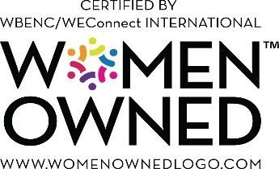

"Let's win together"
Notes:
J2W_ID: CS08

