Slide 1

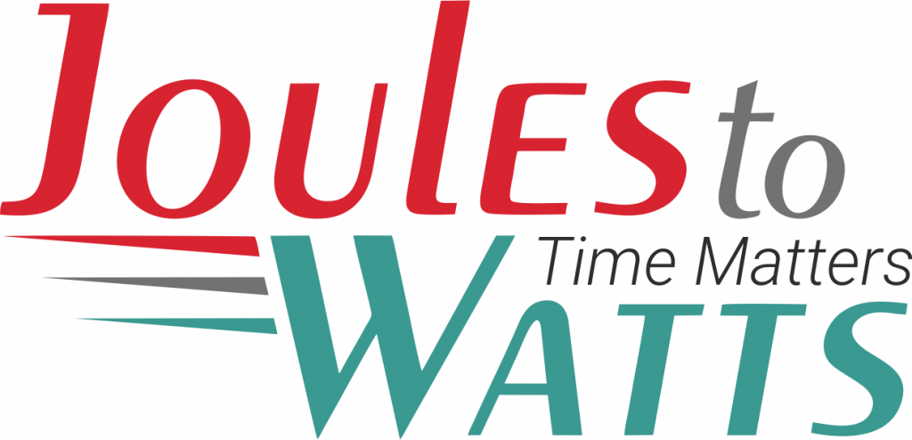














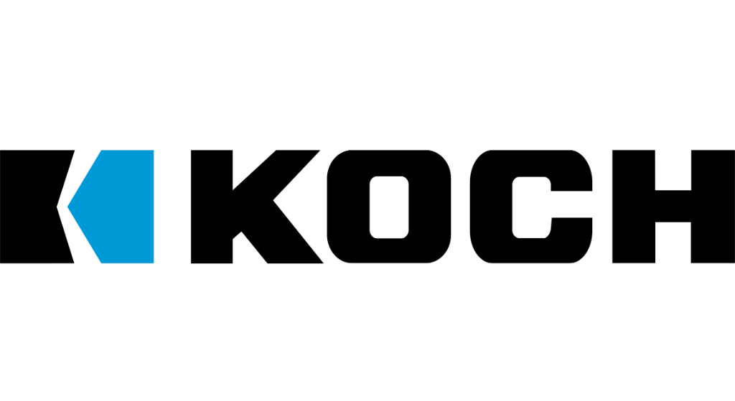

Building the Enterprise Operating Model​
for the Next Decade​
BUSINESS DRIVERS| TECHNOLOGY ACCELERATORS | GAME CHANGERS
Energy. Excellence. Innovation.
Trusted by:
ISO 9001:2015
CMMI Certified
Women-Owned
Notes:
J2W_ID: CS01

Slide 2
Transforming Aviation MRO with Predictive Maintenance and AIOps
Predictive Maintenance · AIOps · Efficiency · Cost Reduction
• Reduced aircraft downtime by 30% through predictive analytics, enhancing operational efficiency.
• Achieved a 25% reduction in maintenance costs by optimizing resource allocation with AIOps.
• Improved safety compliance by 40% with real-time monitoring and proactive issue resolution.
• Enabled data-driven decision-making, leading to a 20% increase in overall fleet reliability.
Generated slide — replace with the real J2W template

