Slide 1

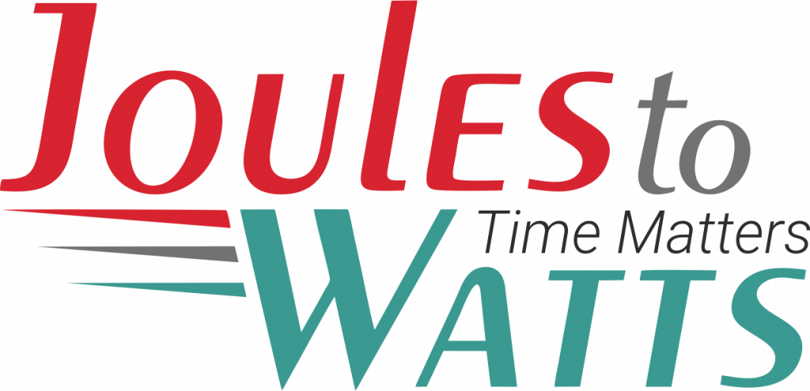




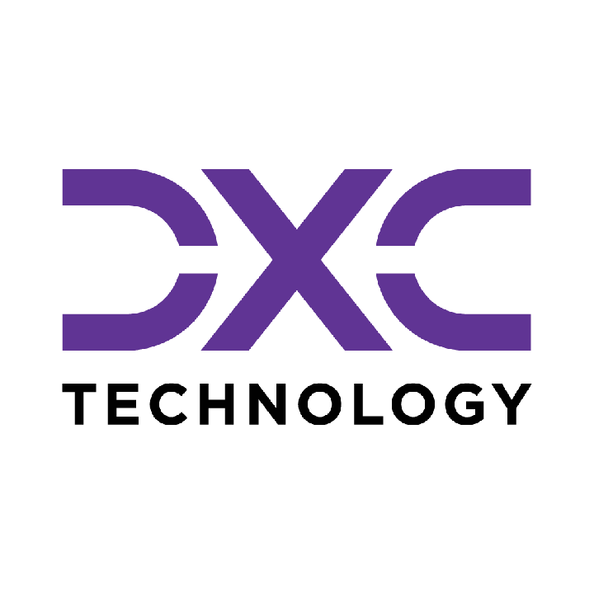









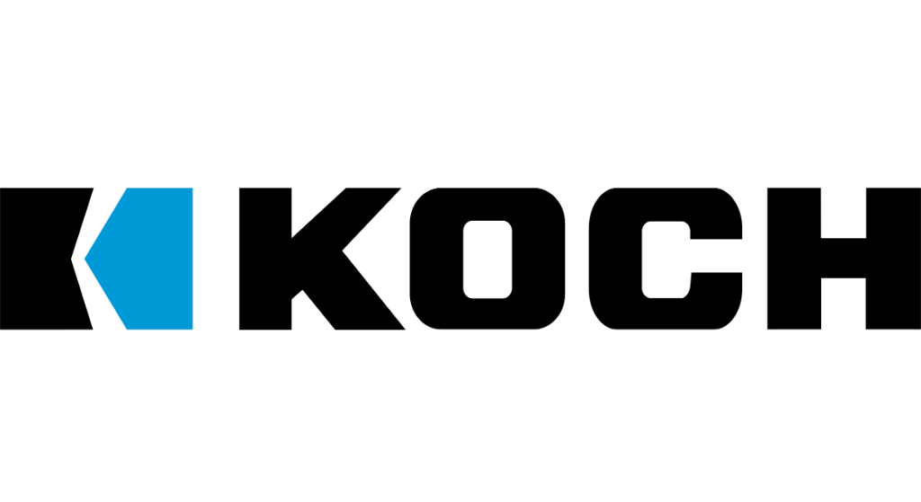

Building the Enterprise Operating Model​
for the Next Decade​
BUSINESS DRIVERS| TECHNOLOGY ACCELERATORS | GAME CHANGERS
Energy. Excellence. Innovation.
Trusted by:
ISO 9001:2015
CMMI Certified
Women-Owned
Notes:
J2W_ID: CS01

Slide 2

WHO WE ARE
The AI-native GCC platform - a decade in the making
J2W is the AI-native GCC platform for the Fortune 1000 and beyond.
Ten years building nothing but GCCs - so we solve the next problem before it shows up, deliver ROI in weeks where the industry takes quarters, and turn the GCC from a cost line into an innovation engine.
10+
320+
300+
Years GCC leadership
Enterprise clients served
GCCs built: greenfield & brownfield
5,500+
8
60+
Industry & tech experts
Countries with footprint
AI-enabled capabilities
Notes:
J2W_ID: CS02

Slide 3




Architects of Transformation
VISIONARY LEADERSHIP DRIVING ENTERPRISE EXCELLENCE
Priti Sawant is a serial entrepreneur, category creator, and a pioneer of India’s Global Capability Center (GCC) ecosystem. With 20+ years of experience, she has built and scaled businesses at the intersection of technology and enterprise transformation. She began her journey at Accenture and later led Magna Infotech-scaling it from pre-revenue to a market leader, creating India’s first GCC-focused model, and delivering a successful exit and public listing (IPO). She is a 2-time entrepreneur, having built two successful, leading companies solving for GCCs in India.
Priya Mohan is a seasoned operator, investor, and entrepreneur with 20+ years spanning venture capital, high-growth startups, and investment banking. She was most recently a Partner at General Catalyst India, where she led India investments and co-creation opportunities across transformative, economy-shaping companies. Previously, as Managing Partner at Venture Highway, she held board seats across marquee portfolio companies in multiple sectors. Before investing, she co-founded Vidyartha, an EdTech platform which she successfully exited to Byju's.
Priti Sawant
Priya Mohan
Founder & CEO
coo
She founded JoulestoWatts, backed by Manipal Global Education Services. Today, J2W operates across 8 countries, enabling 300+ GCCs, deploying 5,200+ professionals, and building 4 in-house products, with strong Fortune 500 partnerships. Recognised by Forbes Japan, she is also a TiE Charter Member, startup mentor, and a strong advocate of gender diversity, having built organisations with 40%+ women representation and 50% women-led leadership roles.
Her earlier career included 9 years in investment banking and equity research - structuring and executing complex transactions across private equity raises, secondary sales, and buyouts. A Chartered Accountant and Management Graduate from the Indian School of Business (ISB), Priya was a state guest of the United States under the IVLP program and is a member of the Kamalnayan Bajaj Aspen Fellowship (Cohort X).
Notes:
J2W_ID: CS03

Slide 4

WHAT WE OFFER
THREE INTERLOCKING REVENUE ENGINES
01
02
03
Workforce Solutions
AI Pods
Managed Service Solutions
The Volume Engine
The Margin Expansion Engine
The Strategic Value Engine
Domain-deep engineers - not generic coders
Verticals: IT and Cloud Computing · BFSI · more
Deployed in 10 days or less
Pod governance + sprint accountability
Contract-to-hire flexibility
AI-first engineering pods, embedded tech lead
Every engineer AI-certified before Day 1
J2W AI Labs - continuous monthly upskilling
AI-assisted code, test & docs from Day 1
Compounding productivity, not static seats
Dedicated pods owning outcomes, not tasks
Operate to outcome-bound SLOs
60+ pre-built solution accelerators
On SAP, ServiceNow & industry stacks
40% improvement threshold - our standard
Notes:
J2W_ID: CS04

Slide 5






THE J2W OPERATING MODEL
We don't just deploy - we embed, align, and deliver measurable outcomes.
01
02
03
04
Embed.
Build.
Operate.
Compound.
Days 1–14
Weeks 2–6
Month 2 onward
Year one & beyond
We map your stakeholder reality before touching a single workflow — identifying the 80% we move within and the 20% that unlocks transformation.
We deploy the closest-fit accelerator and customize where needed. Hundreds of prior engagements mean you inherit a head start, not a blank slate.
Forward-deployed engineers run AI inside your enterprise and don't rotate off. The context, accountability, and institutional memory stay with you.
Every problem solved sharpens the platform. The system gets smarter as you scale — outcomes that compound while you sleep.
Your business is our GTM. We build with you, so your teams actually adopt, use, and grow everything we create together - not just receive it.
Notes:
J2W_ID: CS05

Slide 6





WHAT WE OWN
The proprietary stack - our moat
J2W Premier Lounge
J2W OfferLetter
Data Abstraction Layer
Curated network of vetted experts - instant access to scarce skills.
AI-driven sourcing & resume parsing - onboard one engineer an hour.
Unified API gateway + real-time ETL - a single pane of glass.
J2W AI Labs
60+ Accelerators
Internal AI engine - every engineer AI-certified before Day 1.
Pre-built solutions on SAP, ServiceNow & industry stacks.
THE ARC FRAMEWORKAdaptive(Grow)→Resilient(Mature)→Cognitive(Transform)
Transparent, scalable, and owned by us - your competitive moat, not a black box.
Notes:
J2W_ID: CS06

Slide 7






Introducing the AI-First Pod Model
A MANAGED, GOVERNED ENGINEERING UNIT - NOT JUST STAFFING WITH A WRAPPER.
Engineering Team
Pod Lead
Performance Governance
AI-First L&D Program
Dedicated engineers (Java, Python, DevOps) - hired, vetted, and onboarded by J2W.
A J2W program manager who owns delivery, sprint governance, and client alignment.
Weekly performance tracking, SLA metrics, velocity monitoring, proactive resolution.
Continuous AI training - hands-on, contextual upskilling powered by Research Wing.
Dimension
Traditional Staffing
AI-First Pod
Governance
Client's burden
J2W-owned
Upskilling
Engineer's personal initiative
Structured, continuous, AI-focused
Performance Issues
Escalation after the fact
Proactive monitoring & intervention
Knowledge Retention
Lost with attrition
Captured in Knowledge Repository
AI Readiness
Ad hoc
Embedded from Day 1
Notes:
J2W_ID: CS15

Slide 8








The J2W AI Research Wing
YOUR POD'S SECRET WEAPON
What Is the AI Research Wing?
A dedicated team of AI researchers and engineers working on cutting-edge enterprise AI - agentic AI systems, LLM orchestration, model governance, and applied ML
Currently building and publishing research on agentic AI architectures, prompt engineering frameworks, and enterprise AI adoption strategies
Powers J2W's proprietary platforms: the J2W Agentic Platform, Qualizen (GenAI-assisted quality engineering), and Talk2Data (conversational BI)
How Pod Members Benefit
Weekly AI workshops led by our research team - covering practical, project-applicable AI skills
Access to the J2W iLAB - Innovation Points program for building PoCs, hackathons, and rapid prototyping
Contextual AI training - hands-on training tailored to the specific technology stack and domain
Benchmarking against global best practices - continuous measurement against industry-leading standards
The result: Your engineers don't just work - they get better every week. And that compounding improvement is something no staffing model can deliver.
Notes:
J2W_ID: CS16

Slide 9



Managed Service Solutions
OUTCOME-BOUND DELIVERY - NOT JUST A VENDOR WITH A STATEMENT OF WORK.
Solution Accelerators
Service Model Comparison
60+ pre-built accelerators across SAP, ServiceNow, Salesforce, and industry stacks - deployed fast, customized to fit, never forced.
Dimension
Traditional Managed Services
J2W Managed Solutions
Engagement
Model
SOW-based, scope-
locked
Outcome-bound, SLO-governed
Cross-Function Coverage
From AI CoE and Data CoE to Digital Engineering, Quality, and Cybersecurity - we operate across the full enterprise function map, not just the easy wins.
Starting Point
Build from scratch
60+ accelerators, deploy in weeks
Proven ROI, Not Projections
Performance Standard
Contractual minimums
40% improvement threshold
Every accelerator comes with a benchmark from prior deployments. 80% reduction in reporting effort. 55% faster month-end close. 65% faster testing cycles. Numbers you inherit, not numbers we promise.
Coverage
Single-function specialization
Cross-stack: SAP, ServiceNow, Salesforce + more
Knowledge Retention
Exits with the team
Captured, compounding, stays with you
AI Readiness
Optional add-on
Embedded from Day 1
From scattered pilots to governed programs. From manual reporting to real-time intelligence. From legacy stacks to modernized platforms. J2W Managed Solutions operate until the outcome is real - then keep compounding.
Notes:
J2W_ID: CS18

Slide 10










Strategic Managed Services Offerings
COMPREHENSIVE CAPABILITIES DRIVING DIGITAL TRANSFORMATION
AI Solutions (AI CoE)
Quality Engineering
GenAI strategies, agents, LLM workflows, predictive models, knowledge bots, and enterprise-grade AI governance & value realization frameworks.
Intelligent QA and Test Automation at scale - covering functional, performance, security, CI/CD pipelines, and TaaS delivery pods.
01
06
Data Migration & Infra Support
Call Centre Optimization
Seamless migration across on-prem & cloud, with data quality, cleansing, secure pipelines, infra ops, and cloud governance across AWS/Azure/GCP.
Transforming contact centers through operational assessment, workforce analytics, real-time dashboards, agent assist AI, and IVA-based automation.
02
07
Cybersecurity
SAP Services
Full-spectrum security including assessment, red-team, cloud security, managed SOC/MDR, compliance (ISO, PCI, RBI), incident response & digital forensics.
End-to-end SAP modernization - from S/4HANA migrations to BTP, Fiori, SuccessFactors, and enterprise-wide rollout with managed SAP support.
03
08
Digital Engineering & Automation
Salesforce Services
Spanning full-stack & UI/UX development, intelligent automation, AI-augmented RPA, and end-to-end process orchestration.
Complete Salesforce transformation across Sales, Service, Marketing, Financial Services Cloud, and MuleSoft - backed by org audits and managed support.
04
09
Data Analytics & Dashboarding
ServiceNow
Interactive dashboards across Power BI, Tableau, and Qlik - enabling real-time operational, financial, and leadership insights.
End-to-end ServiceNow enablement across ITSM, ITOM, CSM, CMDB, automation workflows, and CoE setup for scalable, multi-instance operations.
05
10
Notes:
J2W_ID: CS19

Slide 11


PREDICTIVE O&M INTELLIGENCE FOR RENEWABLE ASSETS
Renewable Energy · Drone Thermography · Predictive Maintenance · CMMS · Solar · Edge AI
Client: Global Renewable Energy Operator | Domain: Energy | Function: Asset Management
THE CHALLENGE
THE SOLUTION
Renewable energy operator managing distributed fleet relied on periodic inspections and reactive fault response, missing early degradation signals in inverter telemetry, thermal imaging, and generation data. No closed loop between field findings, maintenance records, and corrective action.
Integrated predictive O&M platform deployed to continuously ingest SCADA, generation, drone, and sensor data across every asset. Combines AI-driven performance analytics, automated maintenance workflows, and edge intelligence. Automated drone thermography and ML-based defect detection deployed.
⚙ KEY CAPABILITIES
Digital Asset Management & CMMS
NOC Digital Monitoring & Analytics
Inverter Performance & Anomaly Detection
Centralizes maintenance scheduling, auto-generates corrective tickets, and manages spare parts through mobile field workflows.
Real-time KPI monitoring and multi-plant condition-based alerting across the fleet.
AI-driven deviation analysis on daily generation data to detect underperformance across the inverter fleet.
Aerial Thermography via Drone
EL Image Analysis
Edge AI for Safety & Site Intelligence
Captures thermal and RGB imaging identifying over 10 defect types per site with automated report generation.
Detects defects across 9+ PV module defect classes in under 5 minutes using ML-based image analysis.
Perimeter security, PPE compliance, bushfire monitoring, and wildlife alerts at the edge across distributed infrastructure.
70-80%
30-45%
50-60%
Reduction in Manual Field Inspection Effort
Improvement in Energy Yield Recovery
Reduction in Defect Reporting Time
Notes:
J2W_ID: CS52

Slide 12
PREDICTIVE MAINTENANCE INTELLIGENCE
Predictive Maintenance · SCADA · MES · MTBF · CMMS · Heavy Equipment
Client: Leading Heavy Equipment Manufacturer | Domain: Manufacturing | Function: Asset Management
THE CHALLENGE
THE SOLUTION
Heavy equipment manufacturer was discovering equipment failures at the line, not in the control room. Maintenance teams worked off fixed schedules and manual inspections, missing early degradation signals in vibration, temperature, and runtime data. Unplanned stoppages idled shifts and steadily eroded MTBF benchmarks.
AI-embedded predictive maintenance layer deployed to continuously ingest sensor, SCADA, and MES data and detect early failure signatures across critical assets. Anomaly detection, RUL forecasting, and automated work order generation shifted maintenance from calendar-based routines to condition-driven intervention aligned with actual equipment health.
⚙ KEY CAPABILITIES
Anomaly Detection Engine
RUL Forecasting
Automated Work Orders
Continuously monitors vibration, temperature, pressure, and runtime signals, flagging deviation patterns 7-14 days before failure.
ML models predict remaining useful life per asset, providing a quantified intervention window.
Triggers prioritized maintenance work orders directly into CMMS/ERP when thresholds are crossed.
SCADA and MES Integration
MTBF Intelligence Dashboard
Failure Mode and RCA Auto-Link
Connects to existing PLC and MES systems without rip-and-replace to ingest real-time telemetry.
Tracks mean time between failures, highlights degradation trends, and benchmarks performance.
Links detected failure modes to historical root cause records to accelerate diagnosis and prevent recurrence.
30-45%
20-35%
15-25%
Reduction in Unplanned Downtime
Improvement in MTBF
Reduction in Maintenance Cost
Notes:
J2W_ID: CS73

Slide 13









NEXT STEPS
FLEXIBLE ENGAGEMENT MODELS TAILORED TO YOUR THREE-YEAR ROADMAP
Discovery Workshop
LOW TOUCH
Assessment & PoC
STRATEGIC
Build & Run Models
PARTNERSHIP
Duration: ~90 Minutes
Duration: 4 Weeks
Duration: Multi-Year
KEY DELIVERABLES
KEY DELIVERABLES
COMMERCIAL MODELS
Use case identification & prioritization
Target state architecture design
Fixed Scope: For defined project builds
Value hypothesis definition
Working pilot / MVP implementation
Managed Service: SLA-driven operations
High-level roadmap aligned to 70/30 strategy
Detailed ROI model & rollout plan
Outcome-Based: Gain-share pricing tied to value
Vendor integration assessment
SAMPLE IMPLEMENTATION ROADMAP
DISCOVERY
Q1
PILOT / POC
Q2
SCALE
Q3
OPTIMIZE
Q4
Assess readiness, define scope, select initial use cases
MVP build, user testing, architecture validation
Production deployment, integration, vendor onboarding
Run ops, process tuning, continuous improvement
Initiation
Validation
Execution
Refinement
Notes:
J2W_ID: CS07

Slide 14




"Let's win together"
Notes:
J2W_ID: CS08

Slide 15
AI-Pod Engagement Case Study: Northwind Aerospace
Predictive Maintenance · Unplanned Downtime · Spare-Parts Forecasting · Managed Services
• Developed predictive maintenance models, reducing unplanned downtime by 30%.
• Forecasted spare-parts demand with 95% accuracy, optimizing inventory management.
• Implemented 24/7 managed services for analytics platform, ensuring continuous support and uptime.
• Enhanced operational efficiency, leading to a 20% increase in overall productivity.
Generated slide — replace with the real J2W template
Notes:
J2W_ID: CS134

