Slide 1

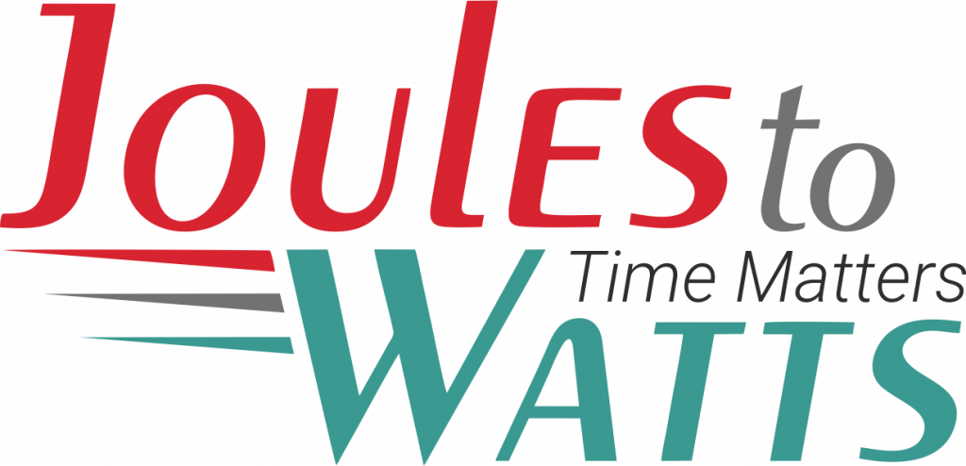



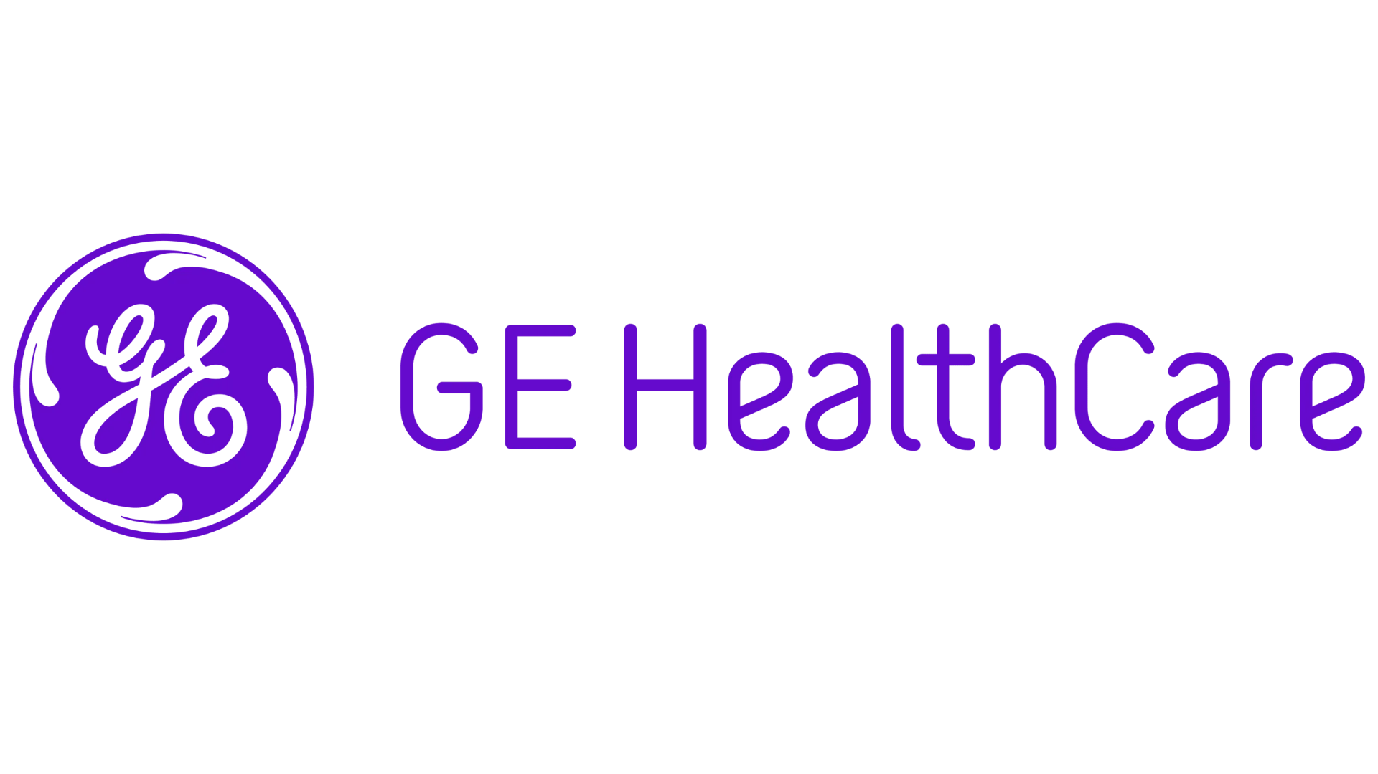
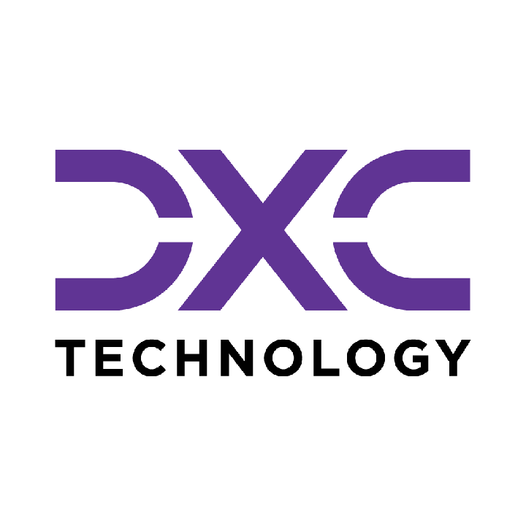








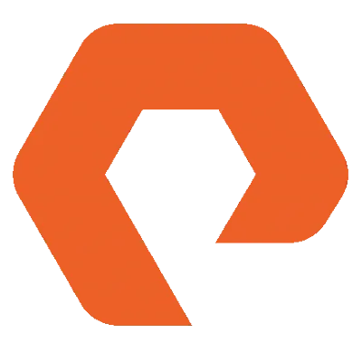
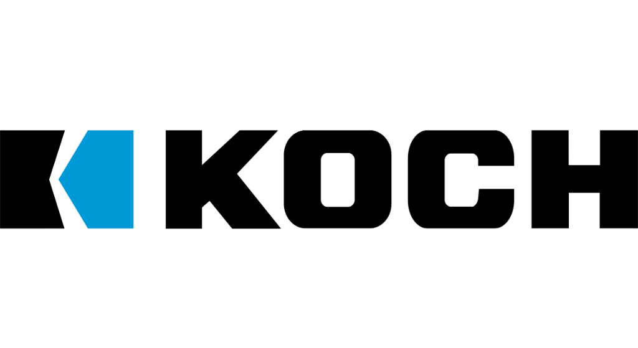

Building the Enterprise Operating Model​
for the Next Decade​
BUSINESS DRIVERS| TECHNOLOGY ACCELERATORS | GAME CHANGERS
Energy. Excellence. Innovation.
Trusted by:
ISO 9001:2015
CMMI Certified
Women-Owned
Notes:
J2W_ID: CS01

Slide 2

WHO WE ARE
The AI-native GCC platform - a decade in the making
J2W is the AI-native GCC platform for the Fortune 1000 and beyond.
Ten years building nothing but GCCs - so we solve the next problem before it shows up, deliver ROI in weeks where the industry takes quarters, and turn the GCC from a cost line into an innovation engine.
10+
320+
300+
Years GCC leadership
Enterprise clients served
GCCs built: greenfield & brownfield
5,500+
8
60+
Industry & tech experts
Countries with footprint
AI-enabled capabilities
Notes:
J2W_ID: CS02

Slide 3




Architects of Transformation
VISIONARY LEADERSHIP DRIVING ENTERPRISE EXCELLENCE
Priti Sawant is a serial entrepreneur, category creator, and a pioneer of India’s Global Capability Center (GCC) ecosystem. With 20+ years of experience, she has built and scaled businesses at the intersection of technology and enterprise transformation. She began her journey at Accenture and later led Magna Infotech-scaling it from pre-revenue to a market leader, creating India’s first GCC-focused model, and delivering a successful exit and public listing (IPO). She is a 2-time entrepreneur, having built two successful, leading companies solving for GCCs in India.
Priya Mohan is a seasoned operator, investor, and entrepreneur with 20+ years spanning venture capital, high-growth startups, and investment banking. She was most recently a Partner at General Catalyst India, where she led India investments and co-creation opportunities across transformative, economy-shaping companies. Previously, as Managing Partner at Venture Highway, she held board seats across marquee portfolio companies in multiple sectors. Before investing, she co-founded Vidyartha, an EdTech platform which she successfully exited to Byju's.
Priti Sawant
Priya Mohan
Founder & CEO
coo
She founded JoulestoWatts, backed by Manipal Global Education Services. Today, J2W operates across 8 countries, enabling 300+ GCCs, deploying 5,200+ professionals, and building 4 in-house products, with strong Fortune 500 partnerships. Recognised by Forbes Japan, she is also a TiE Charter Member, startup mentor, and a strong advocate of gender diversity, having built organisations with 40%+ women representation and 50% women-led leadership roles.
Her earlier career included 9 years in investment banking and equity research - structuring and executing complex transactions across private equity raises, secondary sales, and buyouts. A Chartered Accountant and Management Graduate from the Indian School of Business (ISB), Priya was a state guest of the United States under the IVLP program and is a member of the Kamalnayan Bajaj Aspen Fellowship (Cohort X).
Notes:
J2W_ID: CS03

Slide 4

WHAT WE OFFER
THREE INTERLOCKING REVENUE ENGINES
01
02
03
Workforce Solutions
AI Pods
Managed Service Solutions
The Volume Engine
The Margin Expansion Engine
The Strategic Value Engine
Domain-deep engineers - not generic coders
Verticals: IT and Cloud Computing · BFSI · more
Deployed in 10 days or less
Pod governance + sprint accountability
Contract-to-hire flexibility
AI-first engineering pods, embedded tech lead
Every engineer AI-certified before Day 1
J2W AI Labs - continuous monthly upskilling
AI-assisted code, test & docs from Day 1
Compounding productivity, not static seats
Dedicated pods owning outcomes, not tasks
Operate to outcome-bound SLOs
60+ pre-built solution accelerators
On SAP, ServiceNow & industry stacks
40% improvement threshold - our standard
Notes:
J2W_ID: CS04

Slide 5






THE J2W OPERATING MODEL
We don't just deploy - we embed, align, and deliver measurable outcomes.
01
02
03
04
Embed.
Build.
Operate.
Compound.
Days 1–14
Weeks 2–6
Month 2 onward
Year one & beyond
We map your stakeholder reality before touching a single workflow — identifying the 80% we move within and the 20% that unlocks transformation.
We deploy the closest-fit accelerator and customize where needed. Hundreds of prior engagements mean you inherit a head start, not a blank slate.
Forward-deployed engineers run AI inside your enterprise and don't rotate off. The context, accountability, and institutional memory stay with you.
Every problem solved sharpens the platform. The system gets smarter as you scale — outcomes that compound while you sleep.
Your business is our GTM. We build with you, so your teams actually adopt, use, and grow everything we create together - not just receive it.
Notes:
J2W_ID: CS05

Slide 6





WHAT WE OWN
The proprietary stack - our moat
J2W Premier Lounge
J2W OfferLetter
Data Abstraction Layer
Curated network of vetted experts - instant access to scarce skills.
AI-driven sourcing & resume parsing - onboard one engineer an hour.
Unified API gateway + real-time ETL - a single pane of glass.
J2W AI Labs
60+ Accelerators
Internal AI engine - every engineer AI-certified before Day 1.
Pre-built solutions on SAP, ServiceNow & industry stacks.
THE ARC FRAMEWORKAdaptive(Grow)→Resilient(Mature)→Cognitive(Transform)
Transparent, scalable, and owned by us - your competitive moat, not a black box.
Notes:
J2W_ID: CS06

Slide 7



Managed Service Solutions
OUTCOME-BOUND DELIVERY - NOT JUST A VENDOR WITH A STATEMENT OF WORK.
Solution Accelerators
Service Model Comparison
60+ pre-built accelerators across SAP, ServiceNow, Salesforce, and industry stacks - deployed fast, customized to fit, never forced.
Dimension
Traditional Managed Services
J2W Managed Solutions
Engagement
Model
SOW-based, scope-
locked
Outcome-bound, SLO-governed
Cross-Function Coverage
From AI CoE and Data CoE to Digital Engineering, Quality, and Cybersecurity - we operate across the full enterprise function map, not just the easy wins.
Starting Point
Build from scratch
60+ accelerators, deploy in weeks
Proven ROI, Not Projections
Performance Standard
Contractual minimums
40% improvement threshold
Every accelerator comes with a benchmark from prior deployments. 80% reduction in reporting effort. 55% faster month-end close. 65% faster testing cycles. Numbers you inherit, not numbers we promise.
Coverage
Single-function specialization
Cross-stack: SAP, ServiceNow, Salesforce + more
Knowledge Retention
Exits with the team
Captured, compounding, stays with you
AI Readiness
Optional add-on
Embedded from Day 1
From scattered pilots to governed programs. From manual reporting to real-time intelligence. From legacy stacks to modernized platforms. J2W Managed Solutions operate until the outcome is real - then keep compounding.
Notes:
J2W_ID: CS18

Slide 8










Strategic Managed Services Offerings
COMPREHENSIVE CAPABILITIES DRIVING DIGITAL TRANSFORMATION
AI Solutions (AI CoE)
Quality Engineering
GenAI strategies, agents, LLM workflows, predictive models, knowledge bots, and enterprise-grade AI governance & value realization frameworks.
Intelligent QA and Test Automation at scale - covering functional, performance, security, CI/CD pipelines, and TaaS delivery pods.
01
06
Data Migration & Infra Support
Call Centre Optimization
Seamless migration across on-prem & cloud, with data quality, cleansing, secure pipelines, infra ops, and cloud governance across AWS/Azure/GCP.
Transforming contact centers through operational assessment, workforce analytics, real-time dashboards, agent assist AI, and IVA-based automation.
02
07
Cybersecurity
SAP Services
Full-spectrum security including assessment, red-team, cloud security, managed SOC/MDR, compliance (ISO, PCI, RBI), incident response & digital forensics.
End-to-end SAP modernization - from S/4HANA migrations to BTP, Fiori, SuccessFactors, and enterprise-wide rollout with managed SAP support.
03
08
Digital Engineering & Automation
Salesforce Services
Spanning full-stack & UI/UX development, intelligent automation, AI-augmented RPA, and end-to-end process orchestration.
Complete Salesforce transformation across Sales, Service, Marketing, Financial Services Cloud, and MuleSoft - backed by org audits and managed support.
04
09
Data Analytics & Dashboarding
ServiceNow
Interactive dashboards across Power BI, Tableau, and Qlik - enabling real-time operational, financial, and leadership insights.
End-to-end ServiceNow enablement across ITSM, ITOM, CSM, CMDB, automation workflows, and CoE setup for scalable, multi-instance operations.
05
10
Notes:
J2W_ID: CS19

Slide 9


AIOPS CONTROL TOWER
AIOps · Observability · Alert Noise · Auto-Remediation · IT Operations · AI
Client: Global Enterprise IT Operator | Domain: Software & Technology | Function: IT Operations
THE CHALLENGE
THE SOLUTION
Global enterprise IT ran on metrics, logs, events, and traces scattered across siloed observability tools with no unified view. Alert noise at 70-80% false positives overwhelming operations teams and masking incidents that actually mattered. Manual correlation slowed root cause identification.
AI-powered AIOps platform deployed to ingest metrics, logs, events, and traces into a single intelligence layer. Correlation and noise filtering reduce false positives before reaching operators. Anomaly detection and predictive insights feed an AI agent layer for auto-remediation and RCA.
⚙ KEY CAPABILITIES
Unified Observability
Alert Noise Reduction
Automated RCA
End-to-end visibility across hybrid infrastructure from a single platform.
AI filtering suppresses false positives before they reach operations teams.
Correlation-driven root cause identification across infrastructure and application layers.
Anomaly Detection & Predictive Insights
AI Agent Auto-Remediation
Real-Time Decision Support
Identifies abnormal patterns and predicts incidents before they escalate.
Executes automated remediation and recommendations based on detected root cause.
Ops teams receive real-time monitoring and recommendations to act on immediately.
73%
8 Min
91%
Reduction in Alert Noise
Average Incident Detection Speed
Auto-Resolved via Self-Healing Workflows
Notes:
J2W_ID: CS58

Slide 10
AUTONOMOUS INCIDENT REMEDIATION
LangGraph · ServiceNow · Multi-Agent · Autonomous RCA · IT Operations · ITSM
Client: Global Enterprise IT Operator | Domain: Software & Technology | Function: IT Operations
THE CHALLENGE
THE SOLUTION
Global enterprise IT operations team was overwhelmed by routine infrastructure incidents like Docker crashes and network drops. Manual diagnosis led to high MTTR, inconsistent resolution quality, and operational fatigue from handling the same incident types repeatedly. Lack of real-time visibility delayed critical service restoration.
Autonomous remediation layer deployed using multi-agent LangGraph orchestration, integrating directly with ServiceNow to automate root cause analysis and fix execution. Specialized agents diagnose root causes across infrastructure domains. Human-in-the-loop gate holds sensitive security escalations for explicit approval.
⚙ KEY CAPABILITIES
Real-Time Incident Monitoring
Autonomous RCA Engine
Multi-Agent Orchestration
Detects issues in Docker containers, MID servers, and system services with sub-second latency and auto-triggering pipelines.
Specialized agents diagnose root causes across infrastructure domains using domain-specific diagnostic tools.
LangGraph-powered workflows ensure seamless transitions between diagnosis, planning, and execution steps.
ServiceNow Bi-Sync
Transparent Audit Trails
Human-in-the-Loop Approvals
Synchronizes incident states, work notes, and resolution metrics with enterprise ITSM platforms in real time.
Maintains full traceability of AI reasoning, tool calls, and execution logs for enterprise compliance.
Secure approval gates for sensitive operations, ensuring human oversight on high-risk changes.
50-65%
75%+
Sub-Second
Reduction in MTTR for Routine Incidents
Incidents Remediated Autonomously
Incident Detection Latency
Notes:
J2W_ID: CS81

Slide 11
MULTI-CLOUD GOVERNANCE & INTEGRATION FRAMEWORK
AWS · Azure · GCP · Multi-Cloud · Data Residency · Cloud Governance
Client: Global Enterprise IT Organization | Domain: Software & Technology | Function: Cloud Governance
THE CHALLENGE
THE SOLUTION
Global enterprise ran workloads across AWS, Azure, and GCP with no unified governance layer. Security baselines, access policies, and cost practices differed by environment. Data moved between clouds with no clear ownership or residency controls. Enterprise had no documented position on where customer data resided or how cross-cloud flows were authorized.
Unified governance framework established across all 3 clouds, defining security baselines, resource standards, identity policies, and cost accountability in one model. Integration patterns formalized, data residency model defined ahead of enforcement, and unified monitoring layer created consistent visibility for operations, compliance, and cost teams.
⚙ KEY CAPABILITIES
Multi-Cloud Governance Framework
Data Residency and Classification
Cross-Cloud Integration Standards
Unifies policies covering security, identity, cost, and resource standards across AWS, Azure, and GCP.
Categorizes data by sensitivity with documented storage, access, and transfer rules per environment.
Formalizes API and data exchange patterns, replacing ungoverned point-to-point connections.
Identity and Access Baseline
Cost Management and Accountability
Compliance and Unified Observability
Enforces consistent role definitions and access controls uniformly across AWS, Azure, and GCP.
Provides spend visibility, allocation, and optimization across multi-cloud workloads from a single view.
Runs continuous checks with audit-ready reporting through a single monitoring layer across all 3 clouds.
3 Clouds
Single Layer
Consistent
Under One Control Model
Observability Across All Workloads
Security Baseline Reducing Blind Spots
Notes:
J2W_ID: CS84

Slide 12









NEXT STEPS
FLEXIBLE ENGAGEMENT MODELS TAILORED TO YOUR THREE-YEAR ROADMAP
Discovery Workshop
LOW TOUCH
Assessment & PoC
STRATEGIC
Build & Run Models
PARTNERSHIP
Duration: ~90 Minutes
Duration: 4 Weeks
Duration: Multi-Year
KEY DELIVERABLES
KEY DELIVERABLES
COMMERCIAL MODELS
Use case identification & prioritization
Target state architecture design
Fixed Scope: For defined project builds
Value hypothesis definition
Working pilot / MVP implementation
Managed Service: SLA-driven operations
High-level roadmap aligned to 70/30 strategy
Detailed ROI model & rollout plan
Outcome-Based: Gain-share pricing tied to value
Vendor integration assessment
SAMPLE IMPLEMENTATION ROADMAP
DISCOVERY
Q1
PILOT / POC
Q2
SCALE
Q3
OPTIMIZE
Q4
Assess readiness, define scope, select initial use cases
MVP build, user testing, architecture validation
Production deployment, integration, vendor onboarding
Run ops, process tuning, continuous improvement
Initiation
Validation
Execution
Refinement
Notes:
J2W_ID: CS07

Slide 13
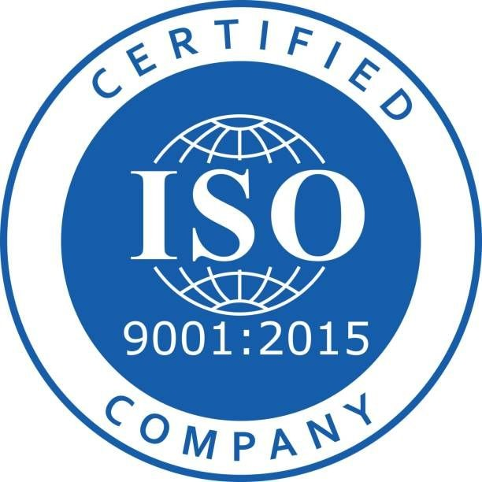

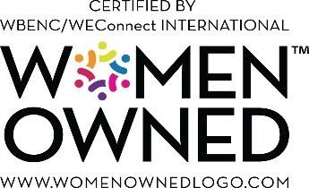

"Let's win together"
Notes:
J2W_ID: CS08

