Slide 1

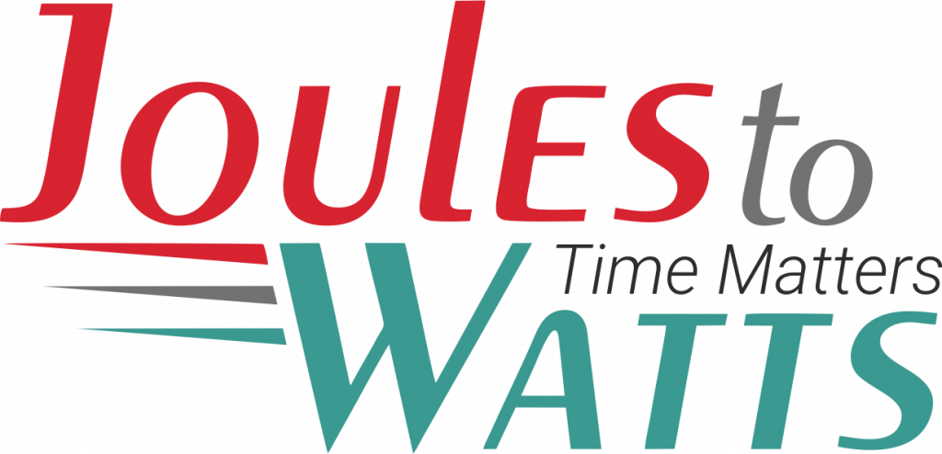




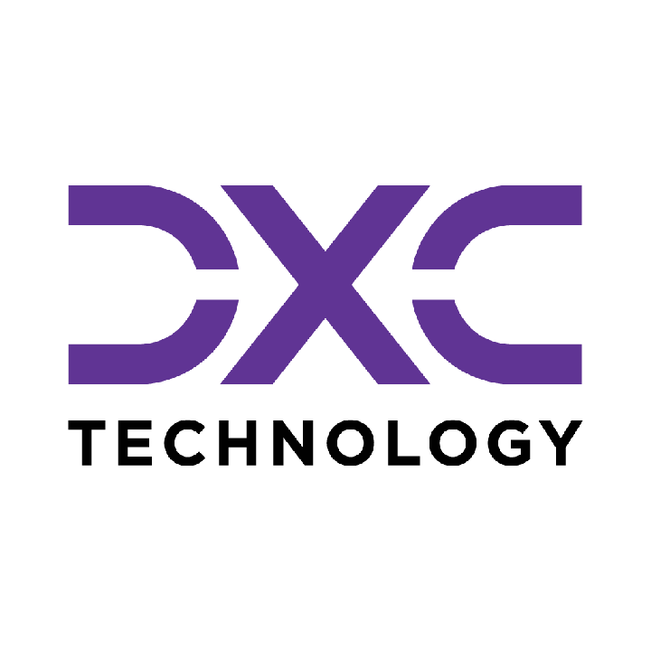











Building the Enterprise Operating Model​
for the Next Decade​
BUSINESS DRIVERS| TECHNOLOGY ACCELERATORS | GAME CHANGERS
Energy. Excellence. Innovation.
Trusted by:
ISO 9001:2015
CMMI Certified
Women-Owned
Notes:
J2W_ID: CS01

Slide 2




Managed Service Solutions
OUTCOME-BOUND DELIVERY - NOT JUST A VENDOR WITH A STATEMENT OF WORK.
Solution Accelerators
Service Model Comparison
60+ pre-built accelerators across SAP, ServiceNow, Salesforce, and industry stacks - deployed fast, customized to fit, never forced.
Dimension
Traditional Managed Services
J2W Managed Solutions
Engagement
Model
SOW-based, scope-
locked
Outcome-bound, SLO-governed
Cross-Function Coverage
From AI CoE and Data CoE to Digital Engineering, Quality, and Cybersecurity - we operate across the full enterprise function map, not just the easy wins.
Starting Point
Build from scratch
60+ accelerators, deploy in weeks
Proven ROI, Not Projections
Performance Standard
Contractual minimums
40% improvement threshold
Every accelerator comes with a benchmark from prior deployments. 80% reduction in reporting effort. 55% faster month-end close. 65% faster testing cycles. Numbers you inherit, not numbers we promise.
Coverage
Single-function specialization
Cross-stack: SAP, ServiceNow, Salesforce + more
Knowledge Retention
Exits with the team
Captured, compounding, stays with you
AI Readiness
Optional add-on
Embedded from Day 1
From scattered pilots to governed programs. From manual reporting to real-time intelligence. From legacy stacks to modernized platforms. J2W Managed Solutions operate until the outcome is real - then keep compounding.
Notes:
J2W_ID: CS18

Slide 3










Strategic Managed Services Offerings
COMPREHENSIVE CAPABILITIES DRIVING DIGITAL TRANSFORMATION
AI Solutions (AI CoE)
Quality Engineering
GenAI strategies, agents, LLM workflows, predictive models, knowledge bots, and enterprise-grade AI governance & value realization frameworks.
Intelligent QA and Test Automation at scale - covering functional, performance, security, CI/CD pipelines, and TaaS delivery pods.
01
06
Data Migration & Infra Support
Call Centre Optimization
Seamless migration across on-prem & cloud, with data quality, cleansing, secure pipelines, infra ops, and cloud governance across AWS/Azure/GCP.
Transforming contact centers through operational assessment, workforce analytics, real-time dashboards, agent assist AI, and IVA-based automation.
02
07
Cybersecurity
SAP Services
Full-spectrum security including assessment, red-team, cloud security, managed SOC/MDR, compliance (ISO, PCI, RBI), incident response & digital forensics.
End-to-end SAP modernization - from S/4HANA migrations to BTP, Fiori, SuccessFactors, and enterprise-wide rollout with managed SAP support.
03
08
Digital Engineering & Automation
Salesforce Services
Spanning full-stack & UI/UX development, intelligent automation, AI-augmented RPA, and end-to-end process orchestration.
Complete Salesforce transformation across Sales, Service, Marketing, Financial Services Cloud, and MuleSoft - backed by org audits and managed support.
04
09
Data Analytics & Dashboarding
ServiceNow
Interactive dashboards across Power BI, Tableau, and Qlik - enabling real-time operational, financial, and leadership insights.
End-to-end ServiceNow enablement across ITSM, ITOM, CSM, CMDB, automation workflows, and CoE setup for scalable, multi-instance operations.
05
10
Notes:
J2W_ID: CS19

