Slide 1

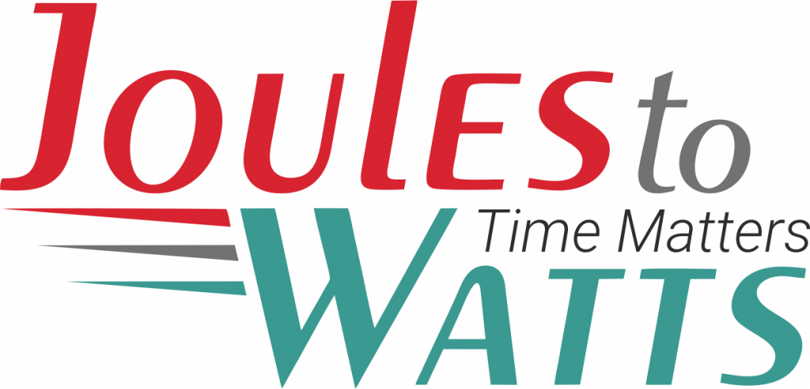




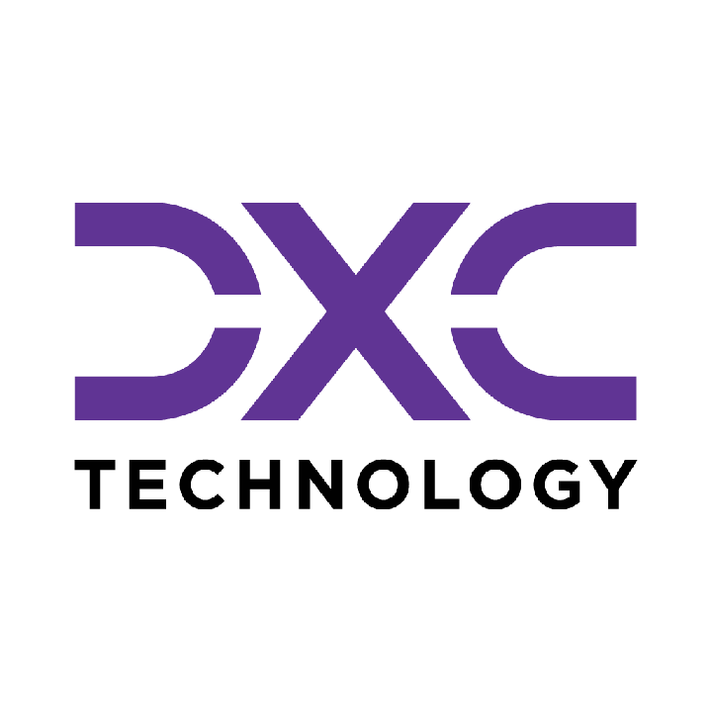









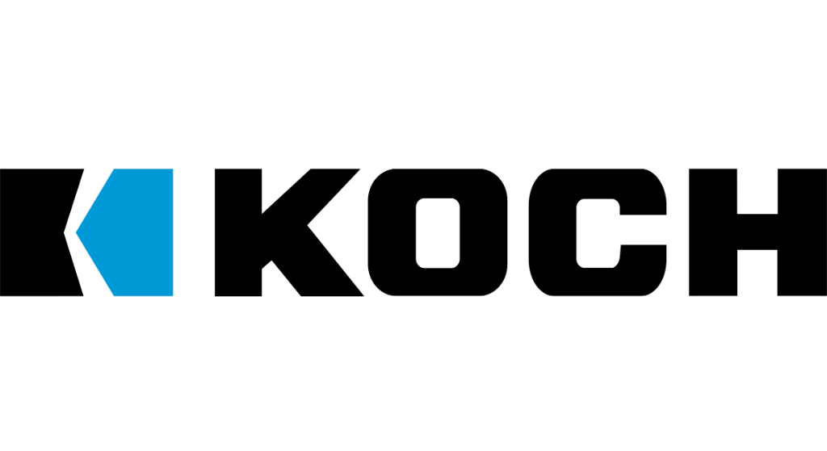

Building the Enterprise Operating Model​
for the Next Decade​
BUSINESS DRIVERS| TECHNOLOGY ACCELERATORS | GAME CHANGERS
Energy. Excellence. Innovation.
Trusted by:
ISO 9001:2015
CMMI Certified
Women-Owned
Notes:
J2W_ID: CS01

Slide 2

WHO WE ARE
The AI-native GCC platform - a decade in the making
J2W is the AI-native GCC platform for the Fortune 1000 and beyond.
Ten years building nothing but GCCs - so we solve the next problem before it shows up, deliver ROI in weeks where the industry takes quarters, and turn the GCC from a cost line into an innovation engine.
10+
320+
300+
Years GCC leadership
Enterprise clients served
GCCs built: greenfield & brownfield
5,500+
8
60+
Industry & tech experts
Countries with footprint
AI-enabled capabilities
Notes:
J2W_ID: CS02

Slide 3




Architects of Transformation
VISIONARY LEADERSHIP DRIVING ENTERPRISE EXCELLENCE
Priti Sawant is a serial entrepreneur, category creator, and a pioneer of India’s Global Capability Center (GCC) ecosystem. With 20+ years of experience, she has built and scaled businesses at the intersection of technology and enterprise transformation. She began her journey at Accenture and later led Magna Infotech-scaling it from pre-revenue to a market leader, creating India’s first GCC-focused model, and delivering a successful exit and public listing (IPO). She is a 2-time entrepreneur, having built two successful, leading companies solving for GCCs in India.
Priya Mohan is a seasoned operator, investor, and entrepreneur with 20+ years spanning venture capital, high-growth startups, and investment banking. She was most recently a Partner at General Catalyst India, where she led India investments and co-creation opportunities across transformative, economy-shaping companies. Previously, as Managing Partner at Venture Highway, she held board seats across marquee portfolio companies in multiple sectors. Before investing, she co-founded Vidyartha, an EdTech platform which she successfully exited to Byju's.
Priti Sawant
Priya Mohan
Founder & CEO
coo
She founded JoulestoWatts, backed by Manipal Global Education Services. Today, J2W operates across 8 countries, enabling 300+ GCCs, deploying 5,200+ professionals, and building 4 in-house products, with strong Fortune 500 partnerships. Recognised by Forbes Japan, she is also a TiE Charter Member, startup mentor, and a strong advocate of gender diversity, having built organisations with 40%+ women representation and 50% women-led leadership roles.
Her earlier career included 9 years in investment banking and equity research - structuring and executing complex transactions across private equity raises, secondary sales, and buyouts. A Chartered Accountant and Management Graduate from the Indian School of Business (ISB), Priya was a state guest of the United States under the IVLP program and is a member of the Kamalnayan Bajaj Aspen Fellowship (Cohort X).
Notes:
J2W_ID: CS03

Slide 4

WHAT WE OFFER
THREE INTERLOCKING REVENUE ENGINES
01
02
03
Workforce Solutions
AI Pods
Managed Service Solutions
The Volume Engine
The Margin Expansion Engine
The Strategic Value Engine
Domain-deep engineers - not generic coders
Verticals: IT and Cloud Computing · BFSI · more
Deployed in 10 days or less
Pod governance + sprint accountability
Contract-to-hire flexibility
AI-first engineering pods, embedded tech lead
Every engineer AI-certified before Day 1
J2W AI Labs - continuous monthly upskilling
AI-assisted code, test & docs from Day 1
Compounding productivity, not static seats
Dedicated pods owning outcomes, not tasks
Operate to outcome-bound SLOs
60+ pre-built solution accelerators
On SAP, ServiceNow & industry stacks
40% improvement threshold - our standard
Notes:
J2W_ID: CS04

Slide 5






THE J2W OPERATING MODEL
We don't just deploy - we embed, align, and deliver measurable outcomes.
01
02
03
04
Embed.
Build.
Operate.
Compound.
Days 1–14
Weeks 2–6
Month 2 onward
Year one & beyond
We map your stakeholder reality before touching a single workflow — identifying the 80% we move within and the 20% that unlocks transformation.
We deploy the closest-fit accelerator and customize where needed. Hundreds of prior engagements mean you inherit a head start, not a blank slate.
Forward-deployed engineers run AI inside your enterprise and don't rotate off. The context, accountability, and institutional memory stay with you.
Every problem solved sharpens the platform. The system gets smarter as you scale — outcomes that compound while you sleep.
Your business is our GTM. We build with you, so your teams actually adopt, use, and grow everything we create together - not just receive it.
Notes:
J2W_ID: CS05

Slide 6





WHAT WE OWN
The proprietary stack - our moat
J2W Premier Lounge
J2W OfferLetter
Data Abstraction Layer
Curated network of vetted experts - instant access to scarce skills.
AI-driven sourcing & resume parsing - onboard one engineer an hour.
Unified API gateway + real-time ETL - a single pane of glass.
J2W AI Labs
60+ Accelerators
Internal AI engine - every engineer AI-certified before Day 1.
Pre-built solutions on SAP, ServiceNow & industry stacks.
THE ARC FRAMEWORKAdaptive(Grow)→Resilient(Mature)→Cognitive(Transform)
Transparent, scalable, and owned by us - your competitive moat, not a black box.
Notes:
J2W_ID: CS06

Slide 7





Workforce & Talent Solutions
A MANAGED, AI-DRIVEN WORKFORCE UNIT - NOT JUST STAFFING WITH A WRAPPER.
Sourcing Engine
Human + AI Teams
Fully Managed
AI-First L&D
AI-driven talent matching across 8,500+ active consultants and 1,250+ skills - niche to mainstream.
Blended delivery with AI productivity tools embedded from Day 1. Capability stacks over role pyramids.
J2W owns payroll, compliance, onboarding and HR. Zero admin burden on the client side.
Continuous upskilling via J2W CoE - contextual, hands-on AI training powered by Research Wing.
Dimension
Traditional Staffing
J2W Workforce
Speed to Deploy
Weeks to months
1 engineer onboarded per hour
Team Composition
Single-role profile deployments
Human + AI blended capability stacks
Governance
Client's burden
J2W-owned - HRBP implant at every site
Performance Issues
Escalation after the fact
Proactive monitoring & intervention
Knowledge Retention
Lost with attrition
Captured in J2W Knowledge Repository
AI Readiness
Ad hoc
Embedded from Day 1
5,500+
1,250+
320+
0%
1/hr
Active Consultants
Skills Covered
Enterprise Clients
Attrition (6-Mo Pilot)
Engineers Onboarded
Notes:
J2W_ID: CS10

Slide 8



WORKFORCE SOLUTIONS - HOW WE DELIVER
From sourcing to sprint governance - a structured operating model, not a staffing drop.
01
Scope & Source
02
AI-Assess
03
Deploy in 10 Days
Role definition + domain-specific talent pool activation. TalentAI matching + voice-agent pre-screen. Shortlist in 72 hrs.
Live coding + domain scenario assessment via TalentSphere. Technical bar validated by J2W before client interview.
Offer → onboarding → Day-1 productivity. J2W payroll, compliance, IT provisioning - fully managed.
04
Govern & Upskill
05
POFU - 90-Day Funnel
06
Scale or Convert
Sprint accountability via Pod Manager. Monthly AI upskilling in J2W Labs. Weekly performance telemetry.
Post-Offer Follow-Up: milestone touchpoints, counter-offer inoculation, manager connects. Dropout rate → single digits.
C2H → permanent conversion on Day 91. Scale the pod up or down. Quarterly Business Review with ROI data.
Notes:
J2W_ID: CS11

Slide 9


WHY J2W - NOT THE BIG 4 OR LARGE SIs
THE SMARTER CHOICE FOR AI & DIGITAL TRANSFORMATION AT SCALE
JoulesToWatts + J2W
Big 4 / Top IT SIs
Staffing Agencies
Outcome-driven from Day 1 - aligned to your milestones, CXO ROI expectations & project KPIs
Heavy retainers + longer payback cycles. High technical debt risk on failed transformations
Headcount model only. Zero delivery ownership or outcome accountability
ROI & Outcome Model
Production-ready Gen & Agentic AI PoCs in weeks via 50+ accelerators across SAP, Oracle, ServiceNow & more
Lengthy consulting cycles with SI-driven models - higher costs & slower results
Time-To-Value
Not offered
Pre-built guardrails. Mission-critical delivery in regulated industries (Fortune 500 MedTech). Data stays in your environment
Claims excellence, but multiple public incidents (e.g. Deloitte AU govt penalties) undermine credibility
AI / Data Governance
Not offered
30-40% reduction in AI OPEX via Query Routing, Semantic Caching, Precision RAG & in-house SLMs
SI incentivised to maximise licences & tokens - not to optimise your cost
AI OPEX Optimisation
Not offered
7,200+ in-house consultants · 300+ recruiters · 2 proprietary hiring platforms · No subcontracting
Frequently subcontract. No proprietary hiring platforms
Lacks SME depth & governance. Outcome ownership absent
Talent & Managed Services
KEY METRICS
5,500
60+
30-40%
Weeks
0
In-house Consultants
AI Accelerators
AI OPEX Reduction
PoC to Production
Subcontracting
Notes:
J2W_ID: CS13

Slide 10






STRUCTURAL DIFFERENTIATION
WORKFORCE SOLUTIONS
Five structural differences that change the engagement from transactional to transformational.
No Subcontracting
300+ in-house recruiters. 7,200+ professionals on J2W payroll. Zero subcontracting layer diluting quality, speed, or accountability.
GCC-Native Intelligence
Forged through 300+ active GCC deployments. We see the next problem before it shows up because we have already solved it somewhere else.
AI at Every Step
TalentAI + TalentSphere: AI-ranked pools, voice-agent screening, skill graphs, predictive placement. Every tool passed our 40% improvement gate internally.
Pod Governance Built In
A dedicated Pod Manager - not billed to client - owns sprint governance, performance tracking, and L&D coordination. This is a pod, not a staffing drop.
Validated Playbooks
Every tool, process, and accelerator has passed our internal 40% improvement gate. Clients benefit from completed learning - not our experimentation.
Notes:
J2W_ID: CS12

Slide 11
CLOUD MIGRATION AND 24x7 INFRASTRUCTURE SUPPORT
CLIENT: Leading Healthcare Technology Enterprise | DOMAIN: Healthcare Technology
The Challenge
The Solution
A global healthcare SaaS provider faced performance issues and delays during migration of more than 140 workloads to a hybrid cloud environment. Fragmented visibility across the migration program and downtime events were impacting critical applications relied upon by healthcare customers.
A certified DevOps and infrastructure team was deployed to execute phased migration using Infrastructure-as-Code best practices. A 24/7 managed services team with proactive monitoring and structured incident response was established simultaneously. All 140 or more workloads were migrated on schedule with post-migration uptime and P1 resolution targets defined and tracked from day one.
Key Capabilities Developed
Certified DevOps and Infrastructure Team
Phased Migration via IaC
24/7 Managed Services
Domain-certified engineers deployed specifically for hybrid cloud migration and managed services.
Infrastructure-as-Code best practices applied across all workload migrations ensuring repeatability and reducing risk.
Continuous proactive monitoring and incident response maintaining operations across all post-migration environments.
Structured Incident Response Framework
Migration Governance
Hybrid Cloud Architecture
Defined escalation and resolution procedures for P1, P2, and P3 incidents with response SLA accountability.
End-to-end program tracking across all 140 or more workloads with milestone-based delivery visibility.
Multi-environment setup supporting cloud and on-premise workloads within a single managed operations layer.
100%
99.95%
95%
on-time migration of 140 or more workloads
uptime post-migration
P1 incidents resolved within 4 hours

Slide 12









NEXT STEPS
FLEXIBLE ENGAGEMENT MODELS TAILORED TO YOUR THREE-YEAR ROADMAP
Discovery Workshop
LOW TOUCH
Assessment & PoC
STRATEGIC
Build & Run Models
PARTNERSHIP
Duration: ~90 Minutes
Duration: 4 Weeks
Duration: Multi-Year
KEY DELIVERABLES
KEY DELIVERABLES
COMMERCIAL MODELS
Use case identification & prioritization
Target state architecture design
Fixed Scope: For defined project builds
Value hypothesis definition
Working pilot / MVP implementation
Managed Service: SLA-driven operations
High-level roadmap aligned to 70/30 strategy
Detailed ROI model & rollout plan
Outcome-Based: Gain-share pricing tied to value
Vendor integration assessment
SAMPLE IMPLEMENTATION ROADMAP
DISCOVERY
Q1
PILOT / POC
Q2
SCALE
Q3
OPTIMIZE
Q4
Assess readiness, define scope, select initial use cases
MVP build, user testing, architecture validation
Production deployment, integration, vendor onboarding
Run ops, process tuning, continuous improvement
Initiation
Validation
Execution
Refinement
Notes:
J2W_ID: CS07

Slide 13




"Let's win together"
Notes:
J2W_ID: CS08

Slide 14
GREENFIELD TO APAC INNOVATION HUB - 15-YEAR BFSI EVOLUTION
CLIENT: Leading Banking Institution | DOMAIN: Banking
The Challenge
The Solution
A global bank needed to build, evolve, and scale a multi-city APAC hub across more than a decade - from a lean greenfield foundation to a fully automated excellence hub supporting €1.3 trillion in assets across 15 countries. Each phase raised the bar with more complexity, tighter compliance, and deeper AI integration requirements.
3 phases of delivery were executed. Phase 1 established 120 professionals with a core BFSI Center of Excellence and compliance engine. Phase 2 scaled to 450 or more specialists with AI-driven risk automation and fraud detection at 98%. Phase 3 reached 700 or more professionals across APAC with automated KYC/AML, real-time reporting, and $1.2 billion in annual value generation.
Key Capabilities Developed
Phase 1 Banking GCC Foundation
Phase 2 Digital Transformation
Phase 3 APAC Excellence Hub
120 professionals establishing core BFSI CoE operations with compliance engine and risk framework.
450 or more specialists driving AI-powered risk accuracy improvement of 30% and retail banking automation of 45%.
700 or more professionals across multi-city hub with automated KYC/AML and real-time reporting across 15 countries.
AI-Powered Credit Risk Modelling
Regulatory Compliance at Scale
Continuous Innovation Engine
92% accuracy in AI-driven credit risk modelling supporting enterprise-scale financial decision-making.
100% regulatory compliance maintained across all APAC jurisdictions throughout every phase.
Sustainable innovation frameworks ensuring the hub remains at the forefront of BFSI operations.
700
92%
$1.2
or more professionals across APAC supporting €1.3 trillion in assets
AI credit-risk modeling accuracy
billion annual value generation

Slide 15
GREENFIELD AI-READY GCC BUILD FOR MAJOR US AIRLINE
CLIENT: Leading Aviation Operator | DOMAIN: Aviation
The Challenge
The Solution
A major US airline needed to build a greenfield GCC in Hyderabad targeting up to 1,000 technology professionals for AI leadership and global parity. The mandate required competing for scarce senior tech talent, building an employer brand from scratch in an aviation domain unfamiliar to India's engineering market, and meeting a compressed timeline with an AI-first mandate from leadership.
A Greenfield GCC Playbook was deployed covering sourcing, employer branding, and AI certification. Intelligence-led sourcing using open-source contribution signals, TalentAI, and TalentSphere semantic search was combined with a 5-stage technical screen. Every engineer was AI-certified before day 1, and a dedicated tech lead was embedded at no additional cost for sprint velocity and code quality governance.
Key Capabilities Developed
Greenfield GCC Playbook
Intelligence-Led Sourcing
5-Stage Technical Screen
Operating model, governance, KPI architecture, and regulatory compliance delivered 60-70% faster than industry timelines.
Deep signal sourcing using open-source contributions and TalentAI semantic search with skill-graph scoring.
LinkedIn triage, DSA assessment, architecture review, client panel, and structured onboarding in sequence.
J2W AI Labs Certification
AI-First Engineering Pod
Employer Brand Architecture
Every engineer AI-certified before day 1 with AI-assisted code review, LLM documentation, and automated test generation.
Embedded tech lead at no client cost with sprint velocity and code quality KPIs, engineers shipping from week 3.
Positioned as same role as US HQ with in-person AI mentorship, differentiating from standard GCC narrative.
Time-to-shortlist
1
0%
reduced from weeks to days
engineer onboarded per hour at peak
attrition at 6 months

Slide 16
FINANCE AND TECHNOLOGY COE BUILD
CLIENT: Leading Industrial Engineering Enterprise | DOMAIN: Industrial Engineering
The Challenge
The Solution
A global industrial engineering leader needed to build a 150-member India Center of Excellence across Finance and Technology functions within 6 months, covering niche roles including ServiceNow platform engineers, SAP architects, finance transformation specialists, and data engineering leads - requiring simultaneous rapid scaling, operational maturity, and strategic transformation.
A Build-Operate-Transfer model was implemented across 3 phases: full infrastructure, regulatory readiness, IT provisioning, governance framework, and 100% recruitment in months 1 to 2; knowledge transfer, process optimization, RPA rollout, and SLA validation in months 2 to 4; and operational maturity with controlled transfer in months 4 to 6. RPA was deployed across 4 Finance towers, and the Client Vantage dashboard was integrated for real-time leadership visibility.
Key Capabilities Developed
BOT Operating Model
Finance Tower Excellence
C2H for Critical Roles
Build-Operate-Transfer structure with the client assuming control at month 6 and advisory continuing post-transfer.
O2C, P2P, R2R, and FP&A each built with embedded control frameworks, compliance standards, and efficiency benchmarks.
Contract-to-Hire at 45-50% of year-1 compensation with 85% mis-hire risk reduction and day-91 permanent conversion.
RPA and AI Workflow Automation
Client Vantage Dashboard
ServiceNow and Cloud Enablement
SAP P2P, O2C, R2R automation targeting 25-30% manual effort reduction across all Finance towers.
Real-time performance visibility and predictive pipeline analytics from day 1 for leadership oversight.
Full deployment and CRM optimization for the 50-person technology track.
150
25
15
hires completed in 6 months
30% manual effort reduction
20% improvement in operational leverage

Slide 17
CORE BANKING TRANSFORMATION AND SUPPORT OPTIMIZATION
CLIENT: Leading Banking Institution | DOMAIN: Banking
The Challenge
The Solution
A private bank operating across 600 or more branches suffered frequent SLA violations and escalating incident volumes caused by fragmented vendor management, non-uniform SOPs, and lack of support standardization across locations. The absence of a centralized support layer meant each branch operated with inconsistent processes and response quality.
A 60-member L1 to L3 support team was deployed across India with ServiceNow integrated into the client's systems and centralized SLA monitoring enabled. Domain-aligned ITIL training was conducted across all support tiers, and SOPs were standardized across all branches. A single governance layer replaced the fragmented multi-vendor model.
Key Capabilities Developed
60-Member Multi-Tier Support Team
ServiceNow Integration
Domain-Aligned ITIL Training
L1 to L3 coverage deployed nationally across India, providing unified support across all branch locations.
End-to-end ITSM integration with centralized SLA monitoring replacing fragmented ticket management.
All support tiers trained to banking-domain ITIL standards ensuring consistent incident resolution quality.
Standardized SOPs Across 600+ Branches
Centralized SLA Monitoring
Vendor Consolidation Model
Uniform operating procedures deployed across the full branch network eliminating process inconsistency.
Real-time visibility into SLA status across all tiers enabling proactive breach prevention.
Single delivery partner replacing fragmented vendor management and associated governance overhead.
42%
99.8%
25%
reduction in average ticket turnaround time
SLA compliance sustained
cost savings from support consolidation

Slide 18
RPO FOR GLOBAL E-COMMERCE AND CLOUD COMPUTING LEADER
CLIENT: Leading Technology Enterprise | DOMAIN: Technology
The Challenge
The Solution
A global e-commerce and cloud computing giant needed to rapidly scale its engineering workforce in a highly competitive talent marketplace, hiring 350 engineers through 75 to 80 talent specialists while maintaining a compelling employer brand, upholding Diversity and Inclusion principles, and keeping core business operations uninterrupted.
A Recruitment Process Outsourcing model was deployed managing the entire recruitment lifecycle. Tech communities, university partnerships, boot camps, and online forums were used for sourcing alongside rigorous skill assessments, tech challenges, incentivized employee referrals, and advanced recruitment technologies for real-time insights.
Key Capabilities Developed
RPO Model Deployment
Multi-Faceted Sourcing
Rigorous Skill Assessment
End-to-end management of sourcing, screening, interviewing, and onboarding across the full recruitment lifecycle.
Tech communities, universities, boot camps, and professional networks activated simultaneously for pipeline volume.
Technical challenges and live coding assessments validating engineering competency before client interview.
Diversity and Inclusion Alignment
Advanced Recruitment Technology
Employee Referral Program
Broad sourcing strategies ensuring inclusive hiring across gender, background, and geography.
Real-time insights dashboards and reporting systems providing transparency across the hiring pipeline.
Incentivized internal referral mechanism integrated into the sourcing strategy for quality pipeline augmentation.
300
85
Significant
software development engineers hired in a single month at peak
talent specialists deployed by J2W
increase in candidate satisfaction scores

Slide 19
SAP AND SUPPLY CHAIN CAPABILITY BUILD FOR LUXURY VEHICLE MANUFACTURER
CLIENT: Leading Automotive Engineering Enterprise | DOMAIN: Automotive Engineering
The Challenge
The Solution
A leading luxury and commercial vehicle manufacturer needed to enhance its SAP Warehousing and Supply Chain modules to optimize goods flow and information across its supply chain. Building a holistic customized solution, integrating native iOS and Android mobile development with SAP, managing complex integrations, and recruiting highly specialized SAP warehousing and supply chain experts - a rare talent profile - presented compounding challenges.
An integrated SAP capability development program was delivered covering ongoing implementation and support for advanced inventory and order processing modules. Customized workflows, automated validations, predictive analytics, real-time dashboards, and native mobile applications on iOS and Android were delivered. 50 senior-level professionals were onboarded in the first year through a targeted high-performance talent acquisition engine.
Key Capabilities Developed
Integrated SAP Capability
Predictive Analytics and Real-Time Dashboards
Native Mobile Development
Implementation and support for advanced inventory and order processing modules across the supply chain.
Live visibility into supply chain operations enabling proactive decision-making.
iOS and Android applications tightly integrated with SAP warehousing and supply chain modules.
Workflow Automation
High-Performance Talent Acquisition
Skill Development Programs
Custom workflows and automated validations reducing manual processing across supply chain touchpoints.
50 senior professionals onboarded in year 1 through targeted sourcing and assessment.
Tailored training ensuring proficiency in new SAP technologies across the placed team.
50
Significantly
Reduced lead
senior-level professionals onboarded in the first year
improved supply chain operational efficiency
times and eliminated supply chain bottlenecks

Slide 20
NETWORK AND INFRASTRUCTURE MODERNIZATION
CLIENT: Leading Manufacturing Enterprise | DOMAIN: Manufacturing
The Challenge
The Solution
A Fortune 500 engineering and manufacturing company's legacy infrastructure was causing network outages and security lapses across 7 industrial sites. The internal IT team lacked certified personnel at all locations and had no centralized visibility into site-level uptime or incident patterns.
An L2 to L3 certified infrastructure team was deployed across all 7 industrial sites, the core network was reconfigured, remote monitoring dashboards were enabled, and NOC governance was implemented. Security posture was rebuilt alongside network reliability, with site-level visibility established for the first time.
Key Capabilities Developed
L2-L3 Certified Infra Team Across 7 Sites
Core Network Reconfiguration
Remote Monitoring Dashboards
Domain-certified infrastructure engineers deployed at every industrial location, replacing the gap in certified personnel.
Full network architecture review and rebuild resolving the root causes of recurring outages.
Centralized visibility into site-level uptime and incident patterns across all 7 locations in real time.
NOC Governance Implementation
Security Posture Rebuild
Compliance Score Improvement
Network operations center governance establishing defined processes for incident detection, escalation, and resolution.
Systematic remediation of security lapses identified during infrastructure assessment across all sites.
Tracked and reported compliance metrics across sites with structured remediation plans.
67%
35%
98%
reduction in network incidents
improvement in compliance score
uptime across all plant sites

Slide 21
CAIRO CUSTOMER ENGAGEMENT CENTER EXPANSION
CLIENT: Leading Technology Enterprise | DOMAIN: Technology
The Challenge
The Solution
A leading global technology hardware company needed to stand up a scalable, high-performance Customer Engagement Center in Cairo to manage multilingual global support for EMEA, maintaining strict SLAs and high customer satisfaction at speed and scale. Replicating the success of a proven 900-seat India CEC in a new geography with zero execution risk and a fixed November 1st launch commitment presented the core challenge.
A lift-and-scale of the proven India CEC model into Cairo was proposed and executed, applying the identical playbook, tools, workflows, and governance already delivering results for the client in India. A prime Cairo site was identified with phased capacity from 50 to 400 seats, a pre-trained bilingual talent pool of 50 resources was ready for day 1, and end-to-end IT infrastructure including CRM and CTI integration was established.
Key Capabilities Developed
Proven Delivery Model Lift-and-Scale
Pre-Trained Bilingual Talent Pipeline
End-to-End IT and Infrastructure Setup
Identical India CEC playbook applied to Cairo eliminating learning curve and minimizing execution risk.
50 multilingual resources trained and ready for day 1 deployment with capacity to scale to 400.
Full workstation, connectivity, and telephony with seamless CRM and CTI integration.
Joint Client-J2W Governance
GDPR and ISO 27001 Compliance
Innovation Roadmap Integration
Shared governance board with real-time dashboards and daily health-check calls during launch.
Data privacy, security compliance, dual ISP redundancy, and 24/7 SOC monitoring from go-live.
AI-driven interaction monitoring, RPA for repetitive tasks, and predictive analytics dashboards planned from day one.
98%
50
5
or more SLA adherence sustained at the India CEC blueprint
resources ready for day 1 deployment, scaling to 400 seats
year contractual partnership established

