Slide 1


















Building the Enterprise Operating Model​
for the Next Decade​
BUSINESS DRIVERS| TECHNOLOGY ACCELERATORS | GAME CHANGERS
Energy. Excellence. Innovation.
Trusted by:
ISO 9001:2015
CMMI Certified
Women-Owned
Notes:
J2W_ID: CS01

Slide 2

WHO WE ARE
The AI-native GCC platform - a decade in the making
J2W is the AI-native GCC platform for the Fortune 1000 and beyond.
Ten years building nothing but GCCs - so we solve the next problem before it shows up, deliver ROI in weeks where the industry takes quarters, and turn the GCC from a cost line into an innovation engine.
10+
320+
300+
Years GCC leadership
Enterprise clients served
GCCs built: greenfield & brownfield
5,500+
8
60+
Industry & tech experts
Countries with footprint
AI-enabled capabilities
Notes:
J2W_ID: CS02

Slide 3


OUR DELIVERY FOOTPRINT IN Banking & Financial Services
Our J2W delivery track record in this industry
163
10
TOP 3 FREQUENTLY HIRED SKILLS
Consultants deployed
Companies served
1
Java (4 companies)
with Banking & Financial Services
in this sector
2
SQL / Databases (4 companies)
3
Data Analytics (3 companies)
7
39
Functions delivered
Distinct skills
Function Distribution
across projects
deployed
Industry delivery snapshot — figures reflect current J2W capacity in Banking & Financial Services

Slide 4





WHERE J2W HAS DELIVERED — QA & Testing · Java
Skills J2W has deployed — track record & reach
DEPLOYMENT SUMMARY
▸ QA & Testing — 108 consultants · 32 companies GE Healthcare (15), Infosys Consulting (12), Boston Scientific (9), Infosys ADM (7) +28 more ▸ Java — 123 consultants · 23 companies Flipkart (28), GE Healthcare (27), Coupang (24), SocGen (12) +19 more

Slide 5


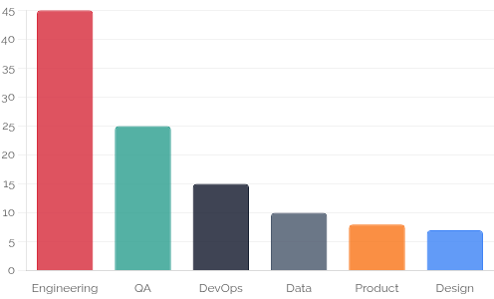
OUR PARTNERSHIP WITH SocGen — DELIVERY OVERVIEW
Our existing J2W relationship — people, skills & engagement
101
6
31
Existing client
Consultants deployed
Functions delivered
Distinct skills
Engagement type
FUNCTION BREAKDOWN
FUNCTION DISTRIBUTION
▸ Software Engineering: 45 ▸ Other / Specialist: 35 ▸ Data & Analytics: 11 ▸ Business & Operations: 7 ▸ Infrastructure & Networking: 2 ▸ Quality Engineering & Testing: 1

Slide 6









NEXT STEPS
FLEXIBLE ENGAGEMENT MODELS TAILORED TO YOUR THREE-YEAR ROADMAP
Discovery Workshop
LOW TOUCH
Assessment & PoC
STRATEGIC
Build & Run Models
PARTNERSHIP
Duration: ~90 Minutes
Duration: 4 Weeks
Duration: Multi-Year
KEY DELIVERABLES
KEY DELIVERABLES
COMMERCIAL MODELS
Use case identification & prioritization
Target state architecture design
Fixed Scope: For defined project builds
Value hypothesis definition
Working pilot / MVP implementation
Managed Service: SLA-driven operations
High-level roadmap aligned to 70/30 strategy
Detailed ROI model & rollout plan
Outcome-Based: Gain-share pricing tied to value
Vendor integration assessment
SAMPLE IMPLEMENTATION ROADMAP
DISCOVERY
Q1
PILOT / POC
Q2
SCALE
Q3
OPTIMIZE
Q4
Assess readiness, define scope, select initial use cases
MVP build, user testing, architecture validation
Production deployment, integration, vendor onboarding
Run ops, process tuning, continuous improvement
Initiation
Validation
Execution
Refinement
Notes:
J2W_ID: CS07

Slide 7




"Let's win together"
Notes:
J2W_ID: CS08

