Slide 1

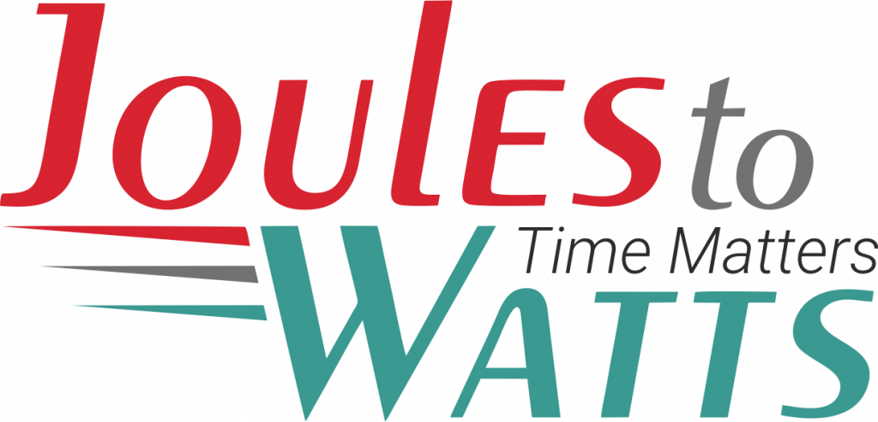



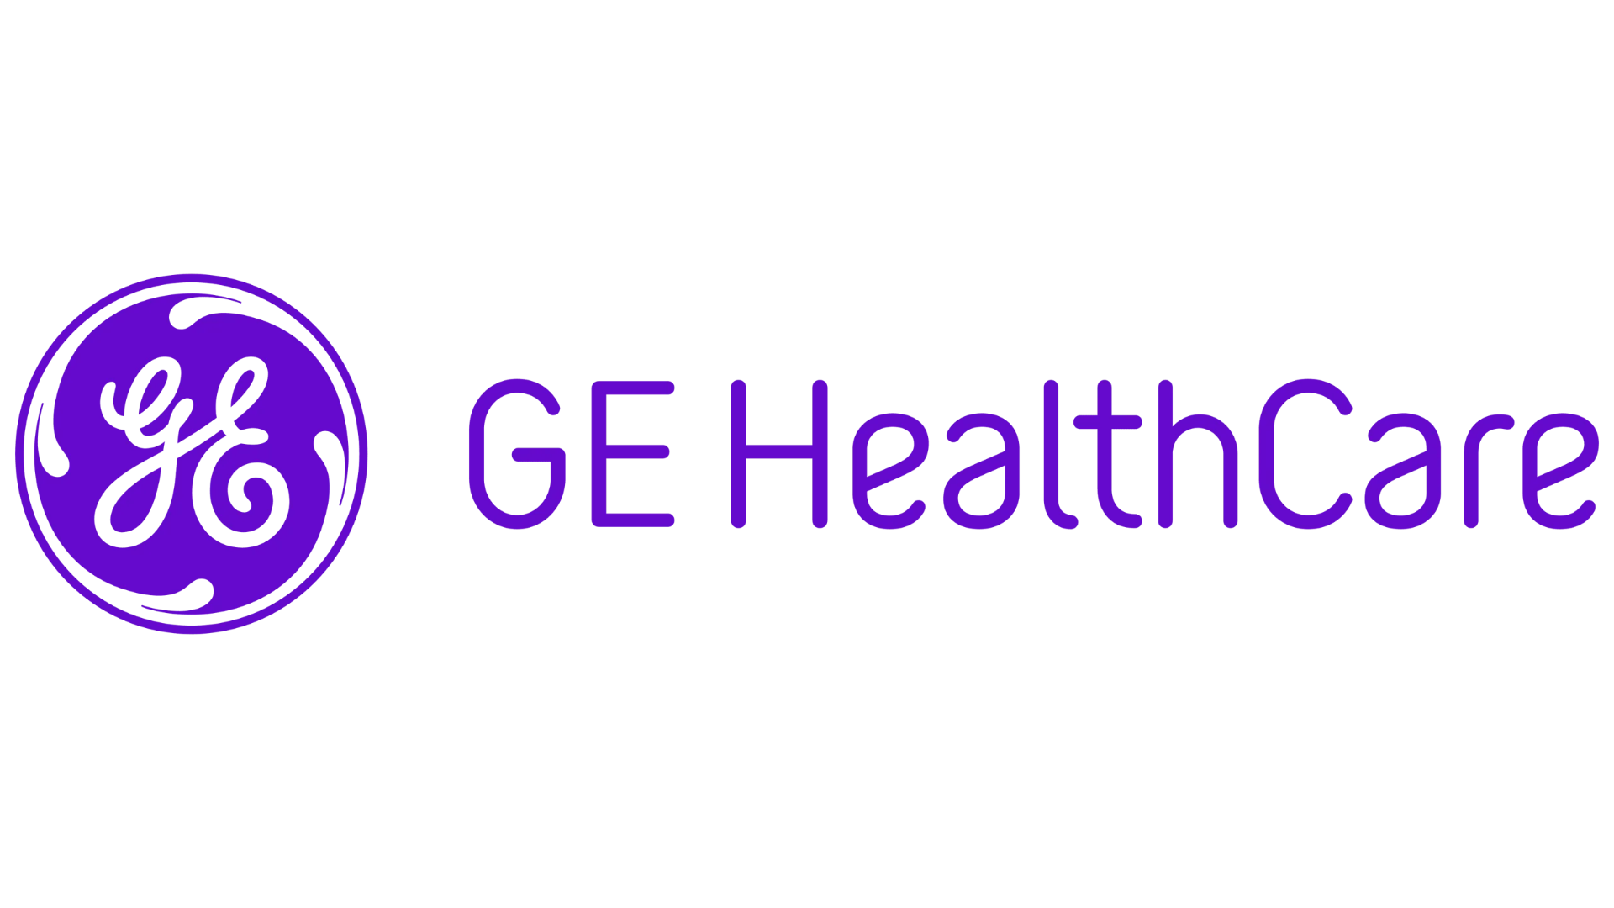
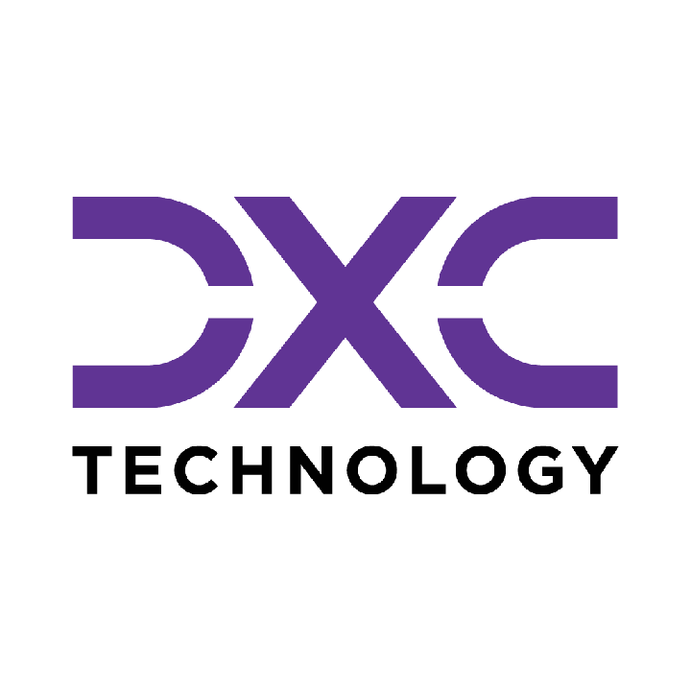









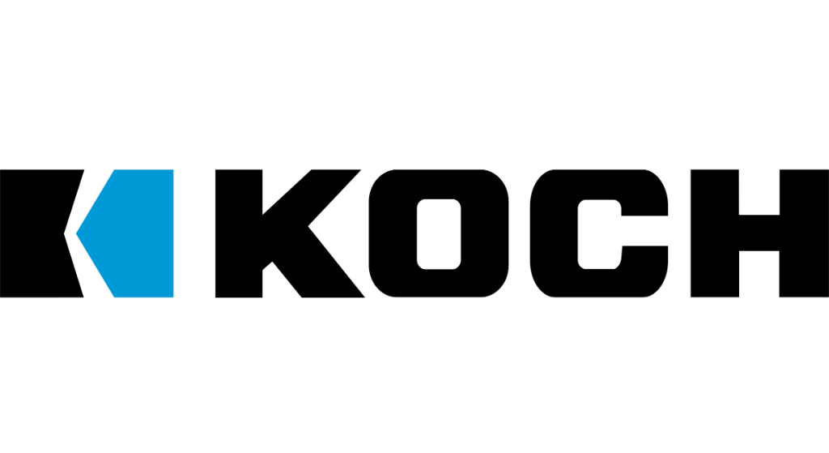

Building the Enterprise Operating Model​
for the Next Decade​
BUSINESS DRIVERS| TECHNOLOGY ACCELERATORS | GAME CHANGERS
Energy. Excellence. Innovation.
Trusted by:
ISO 9001:2015
CMMI Certified
Women-Owned
Notes:
J2W_ID: CS01

Slide 2

WHO WE ARE
The AI-native GCC platform - a decade in the making
J2W is the AI-native GCC platform for the Fortune 1000 and beyond.
Ten years building nothing but GCCs - so we solve the next problem before it shows up, deliver ROI in weeks where the industry takes quarters, and turn the GCC from a cost line into an innovation engine.
10+
320+
300+
Years GCC leadership
Enterprise clients served
GCCs built: greenfield & brownfield
5,500+
8
60+
Industry & tech experts
Countries with footprint
AI-enabled capabilities
Notes:
J2W_ID: CS02

Slide 3




Architects of Transformation
VISIONARY LEADERSHIP DRIVING ENTERPRISE EXCELLENCE
Priti Sawant is a serial entrepreneur, category creator, and a pioneer of India’s Global Capability Center (GCC) ecosystem. With 20+ years of experience, she has built and scaled businesses at the intersection of technology and enterprise transformation. She began her journey at Accenture and later led Magna Infotech-scaling it from pre-revenue to a market leader, creating India’s first GCC-focused model, and delivering a successful exit and public listing (IPO). She is a 2-time entrepreneur, having built two successful, leading companies solving for GCCs in India.
Priya Mohan is a seasoned operator, investor, and entrepreneur with 20+ years spanning venture capital, high-growth startups, and investment banking. She was most recently a Partner at General Catalyst India, where she led India investments and co-creation opportunities across transformative, economy-shaping companies. Previously, as Managing Partner at Venture Highway, she held board seats across marquee portfolio companies in multiple sectors. Before investing, she co-founded Vidyartha, an EdTech platform which she successfully exited to Byju's.
Priti Sawant
Priya Mohan
Founder & CEO
coo
She founded JoulestoWatts, backed by Manipal Global Education Services. Today, J2W operates across 8 countries, enabling 300+ GCCs, deploying 5,200+ professionals, and building 4 in-house products, with strong Fortune 500 partnerships. Recognised by Forbes Japan, she is also a TiE Charter Member, startup mentor, and a strong advocate of gender diversity, having built organisations with 40%+ women representation and 50% women-led leadership roles.
Her earlier career included 9 years in investment banking and equity research - structuring and executing complex transactions across private equity raises, secondary sales, and buyouts. A Chartered Accountant and Management Graduate from the Indian School of Business (ISB), Priya was a state guest of the United States under the IVLP program and is a member of the Kamalnayan Bajaj Aspen Fellowship (Cohort X).
Notes:
J2W_ID: CS03

Slide 4

WHAT WE OFFER
THREE INTERLOCKING REVENUE ENGINES
01
02
03
Workforce Solutions
AI Pods
Managed Service Solutions
The Volume Engine
The Margin Expansion Engine
The Strategic Value Engine
Domain-deep engineers - not generic coders
Verticals: IT and Cloud Computing · BFSI · more
Deployed in 10 days or less
Pod governance + sprint accountability
Contract-to-hire flexibility
AI-first engineering pods, embedded tech lead
Every engineer AI-certified before Day 1
J2W AI Labs - continuous monthly upskilling
AI-assisted code, test & docs from Day 1
Compounding productivity, not static seats
Dedicated pods owning outcomes, not tasks
Operate to outcome-bound SLOs
60+ pre-built solution accelerators
On SAP, ServiceNow & industry stacks
40% improvement threshold - our standard
Notes:
J2W_ID: CS04

Slide 5






THE J2W OPERATING MODEL
We don't just deploy - we embed, align, and deliver measurable outcomes.
01
02
03
04
Embed.
Build.
Operate.
Compound.
Days 1–14
Weeks 2–6
Month 2 onward
Year one & beyond
We map your stakeholder reality before touching a single workflow — identifying the 80% we move within and the 20% that unlocks transformation.
We deploy the closest-fit accelerator and customize where needed. Hundreds of prior engagements mean you inherit a head start, not a blank slate.
Forward-deployed engineers run AI inside your enterprise and don't rotate off. The context, accountability, and institutional memory stay with you.
Every problem solved sharpens the platform. The system gets smarter as you scale — outcomes that compound while you sleep.
Your business is our GTM. We build with you, so your teams actually adopt, use, and grow everything we create together - not just receive it.
Notes:
J2W_ID: CS05

Slide 6





WHAT WE OWN
The proprietary stack - our moat
J2W Premier Lounge
J2W OfferLetter
Data Abstraction Layer
Curated network of vetted experts - instant access to scarce skills.
AI-driven sourcing & resume parsing - onboard one engineer an hour.
Unified API gateway + real-time ETL - a single pane of glass.
J2W AI Labs
60+ Accelerators
Internal AI engine - every engineer AI-certified before Day 1.
Pre-built solutions on SAP, ServiceNow & industry stacks.
THE ARC FRAMEWORKAdaptive(Grow)→Resilient(Mature)→Cognitive(Transform)
Transparent, scalable, and owned by us - your competitive moat, not a black box.
Notes:
J2W_ID: CS06

Slide 7






Introducing the AI-First Pod Model
A MANAGED, GOVERNED ENGINEERING UNIT - NOT JUST STAFFING WITH A WRAPPER.
Engineering Team
Pod Lead
Performance Governance
AI-First L&D Program
Dedicated engineers (Java, Python, DevOps) - hired, vetted, and onboarded by J2W.
A J2W program manager who owns delivery, sprint governance, and client alignment.
Weekly performance tracking, SLA metrics, velocity monitoring, proactive resolution.
Continuous AI training - hands-on, contextual upskilling powered by Research Wing.
Dimension
Traditional Staffing
AI-First Pod
Governance
Client's burden
J2W-owned
Upskilling
Engineer's personal initiative
Structured, continuous, AI-focused
Performance Issues
Escalation after the fact
Proactive monitoring & intervention
Knowledge Retention
Lost with attrition
Captured in Knowledge Repository
AI Readiness
Ad hoc
Embedded from Day 1
Notes:
J2W_ID: CS15

Slide 8








The J2W AI Research Wing
YOUR POD'S SECRET WEAPON
What Is the AI Research Wing?
A dedicated team of AI researchers and engineers working on cutting-edge enterprise AI - agentic AI systems, LLM orchestration, model governance, and applied ML
Currently building and publishing research on agentic AI architectures, prompt engineering frameworks, and enterprise AI adoption strategies
Powers J2W's proprietary platforms: the J2W Agentic Platform, Qualizen (GenAI-assisted quality engineering), and Talk2Data (conversational BI)
How Pod Members Benefit
Weekly AI workshops led by our research team - covering practical, project-applicable AI skills
Access to the J2W iLAB - Innovation Points program for building PoCs, hackathons, and rapid prototyping
Contextual AI training - hands-on training tailored to the specific technology stack and domain
Benchmarking against global best practices - continuous measurement against industry-leading standards
The result: Your engineers don't just work - they get better every week. And that compounding improvement is something no staffing model can deliver.
Notes:
J2W_ID: CS16

Slide 9
AI-FIRST POD DELIVERY
CLIENT: Leading Healthcare Technology Enterprise | DOMAIN: Healthcare Technology
The Challenge
The Solution
A leading healthcare technology company operated across 20 or more vendors across 6 engineering teams with no unified governance layer. Distributed ownership, uneven quality, inconsistent productivity benchmarks, slower release cycles than global benchmarks, and no AI capability embedded in any delivery team were the result of a fragmented vendor model that had grown without a governance architecture.
J2W became the anchor vendor, embedding 121 engineers across Imaging, Patient Care, DevOps/Cloud, AI and Data, and Quality teams. AI-first pod governance was introduced alongside hackathon-led innovation culture and phased vendor consolidation. CD automation, SPCR AI coding, parallel test execution, and the Qualizen AI Test Platform were deployed across the engineering estate.
Key Capabilities Developed
CD Automation via Axone
SPCR AI Coding System
Parallel Test Execution
Release cycle compressed from 6 weeks to under 4 weeks, testing efficiency improved by 30%, and tag detection time reduced by 98%.
LLaMA2 with LoRA deployed to auto-classify field incident reports, eliminating manual SPCR coding entirely.
Under 33-hour end-to-end test cycle with 316 scenarios automated across Kubernetes infrastructure.
Qualizen AI Test Platform
AVS Cloud DevOps
AI-First Pod Governance
65% faster testing cycles and 50% fewer defects - built by J2W and awarded client-internal hackathon prize.
Jenkins to GitOps migration and Docker Swarm to EKS roadmap reducing deployment overhead.
Unified weekly sprint reviews and scorecards maintaining 10-day onboarding, over 85% sprint completion, and under 0.5 defect density.
33%
30%
3
release cycle improvement
testing efficiency uplift
out of 3 client-internal AI hackathon prizes won by J2W engineers

Slide 10
CAAS GLOBAL MEDTECH ENGINEERING
CLIENT: Leading Healthcare Technology Enterprise | DOMAIN: Healthcare Technology
The Challenge
The Solution
A global MedTech engineering program combining AI-enabled quality, regulatory automation, test acceleration, and secure release execution in regulated product environments required capabilities-as-a-service across multiple engineering disciplines. Delivery needed embedded DevSecOps, quality engineering, and regulatory-aware automation practices aligned to MedTech compliance standards.
Capabilities were delivered through governed AI pods with embedded DevSecOps, quality engineering, and regulatory-aware automation practices. SPCR AI coding, SOUP and SBOM regulatory automation, parallel test execution via Qualizen, CD automation via Axone, and DevSecOps and cybersecurity were deployed across the MedTech program.
Key Capabilities Developed
SPCR AI Coding
SOUP and SBOM Regulatory Automation
Parallel Test Execution via Qualizen
Automated classification of software problem change reports eliminating manual coding effort.
Software of Unknown Provenance and Software Bill of Materials automation ensuring regulatory traceability.
Simultaneous test execution across environments compressing regression cycles significantly.
CD Automation via Axone
DevSecOps and Cybersecurity
AI Pod Governance
Continuous delivery automation reducing release cycle time to under 4 weeks.
Security integrated into every stage of the development and release pipeline.
Structured sprint reviews, defect density tracking, and onboarding standards maintained across the program.
65%
4
2
faster testing cycles
Under -week release cycle
minute tag detection time

Slide 11
DEVSECOPS PIPELINE FOR OPEN BANKING DIGITAL TRANSFORMATION
CLIENT: Leading Banking Institution | DOMAIN: Banking
The Challenge
The Solution
A global bank's Open Banking initiative required a fully automated, security-compliant DevSecOps pipeline across multiple microservices and source control repositories while adhering to strict global banking regulations and managing complex multi-service release cycles without disrupting existing operations.
A comprehensive AWS-powered DevSecOps pipeline was implemented integrating GitHub Actions, HashiCorp Vault, Veracode SAST/SCA, JFrog, ARGO CD, and Lacework across Dev, Staging, and Production environments with formal approval gates. Near 100% test automation was achieved through a streamlined release train model.
Key Capabilities Developed
Stakeholder-Balanced Pipeline Design
Multi-Repository Microservice Integration
Near 100% Test Automation
Architecture balancing technical requirements and business stakeholder needs across all environments.
Seamless integration across multiple source control repositories and microservice boundaries.
Automated QE and security testing across every release candidate without manual regression.
Streamlined Release Train Model
Security-First Pipeline Architecture
Banking Regulatory Compliance
Multi-service coordinated release model cutting deployment times significantly.
SAST, SCA, dependency validation, and Lacework monitoring embedded throughout the pipeline.
Architecture ensuring adherence to global banking regulatory standards at every release gate.
100%
Reduced deployment
Full QE
Near test automation across microservice deployments
cycle time
security automation with accelerated time-to-market

Slide 12









NEXT STEPS
FLEXIBLE ENGAGEMENT MODELS TAILORED TO YOUR THREE-YEAR ROADMAP
Discovery Workshop
LOW TOUCH
Assessment & PoC
STRATEGIC
Build & Run Models
PARTNERSHIP
Duration: ~90 Minutes
Duration: 4 Weeks
Duration: Multi-Year
KEY DELIVERABLES
KEY DELIVERABLES
COMMERCIAL MODELS
Use case identification & prioritization
Target state architecture design
Fixed Scope: For defined project builds
Value hypothesis definition
Working pilot / MVP implementation
Managed Service: SLA-driven operations
High-level roadmap aligned to 70/30 strategy
Detailed ROI model & rollout plan
Outcome-Based: Gain-share pricing tied to value
Vendor integration assessment
SAMPLE IMPLEMENTATION ROADMAP
DISCOVERY
Q1
PILOT / POC
Q2
SCALE
Q3
OPTIMIZE
Q4
Assess readiness, define scope, select initial use cases
MVP build, user testing, architecture validation
Production deployment, integration, vendor onboarding
Run ops, process tuning, continuous improvement
Initiation
Validation
Execution
Refinement
Notes:
J2W_ID: CS07

Slide 13


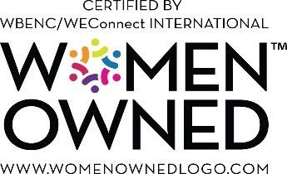

"Let's win together"
Notes:
J2W_ID: CS08

