Slide 1

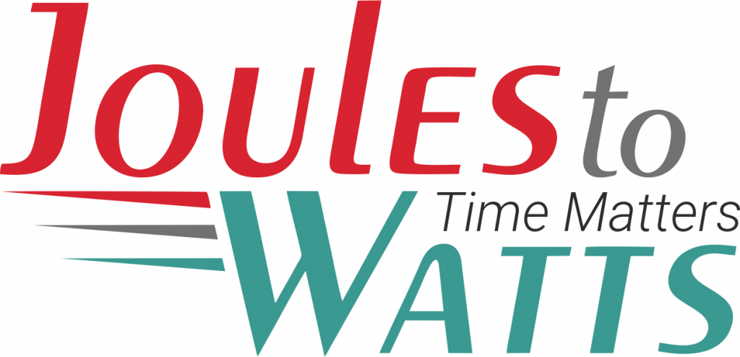




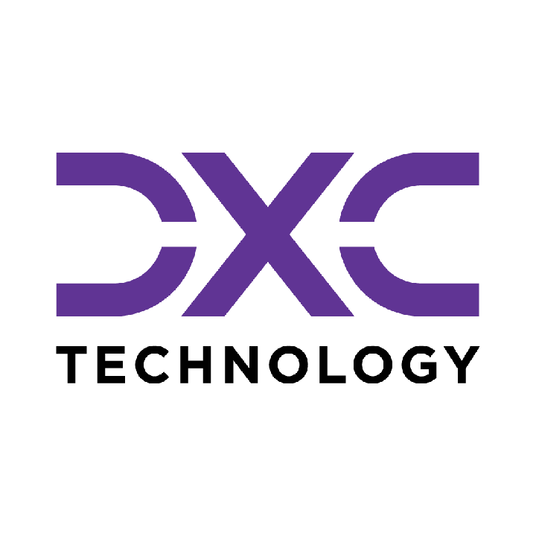









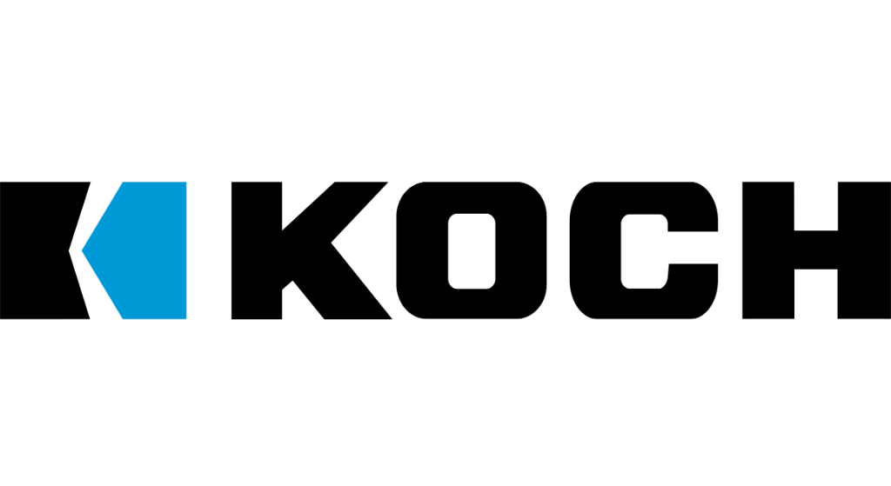

Building the Enterprise Operating Model​
for the Next Decade​
BUSINESS DRIVERS| TECHNOLOGY ACCELERATORS | GAME CHANGERS
Energy. Excellence. Innovation.
Trusted by:
ISO 9001:2015
CMMI Certified
Women-Owned
Notes:
J2W_ID: CS01

Slide 2

WHO WE ARE
The AI-native GCC platform - a decade in the making
J2W is the AI-native GCC platform for the Fortune 1000 and beyond.
Ten years building nothing but GCCs - so we solve the next problem before it shows up, deliver ROI in weeks where the industry takes quarters, and turn the GCC from a cost line into an innovation engine.
10+
320+
300+
Years GCC leadership
Enterprise clients served
GCCs built: greenfield & brownfield
5,500+
8
60+
Industry & tech experts
Countries with footprint
AI-enabled capabilities
Notes:
J2W_ID: CS02

Slide 3




Architects of Transformation
VISIONARY LEADERSHIP DRIVING ENTERPRISE EXCELLENCE
Priti Sawant is a serial entrepreneur, category creator, and a pioneer of India’s Global Capability Center (GCC) ecosystem. With 20+ years of experience, she has built and scaled businesses at the intersection of technology and enterprise transformation. She began her journey at Accenture and later led Magna Infotech-scaling it from pre-revenue to a market leader, creating India’s first GCC-focused model, and delivering a successful exit and public listing (IPO). She is a 2-time entrepreneur, having built two successful, leading companies solving for GCCs in India.
Priya Mohan is a seasoned operator, investor, and entrepreneur with 20+ years spanning venture capital, high-growth startups, and investment banking. She was most recently a Partner at General Catalyst India, where she led India investments and co-creation opportunities across transformative, economy-shaping companies. Previously, as Managing Partner at Venture Highway, she held board seats across marquee portfolio companies in multiple sectors. Before investing, she co-founded Vidyartha, an EdTech platform which she successfully exited to Byju's.
Priti Sawant
Priya Mohan
Founder & CEO
coo
She founded JoulestoWatts, backed by Manipal Global Education Services. Today, J2W operates across 8 countries, enabling 300+ GCCs, deploying 5,200+ professionals, and building 4 in-house products, with strong Fortune 500 partnerships. Recognised by Forbes Japan, she is also a TiE Charter Member, startup mentor, and a strong advocate of gender diversity, having built organisations with 40%+ women representation and 50% women-led leadership roles.
Her earlier career included 9 years in investment banking and equity research - structuring and executing complex transactions across private equity raises, secondary sales, and buyouts. A Chartered Accountant and Management Graduate from the Indian School of Business (ISB), Priya was a state guest of the United States under the IVLP program and is a member of the Kamalnayan Bajaj Aspen Fellowship (Cohort X).
Notes:
J2W_ID: CS03

Slide 4

WHAT WE OFFER
THREE INTERLOCKING REVENUE ENGINES
01
02
03
Workforce Solutions
AI Pods
Managed Service Solutions
The Volume Engine
The Margin Expansion Engine
The Strategic Value Engine
Domain-deep engineers - not generic coders
Verticals: IT and Cloud Computing · BFSI · more
Deployed in 10 days or less
Pod governance + sprint accountability
Contract-to-hire flexibility
AI-first engineering pods, embedded tech lead
Every engineer AI-certified before Day 1
J2W AI Labs - continuous monthly upskilling
AI-assisted code, test & docs from Day 1
Compounding productivity, not static seats
Dedicated pods owning outcomes, not tasks
Operate to outcome-bound SLOs
60+ pre-built solution accelerators
On SAP, ServiceNow & industry stacks
40% improvement threshold - our standard
Notes:
J2W_ID: CS04

Slide 5






THE J2W OPERATING MODEL
We don't just deploy - we embed, align, and deliver measurable outcomes.
01
02
03
04
Embed.
Build.
Operate.
Compound.
Days 1–14
Weeks 2–6
Month 2 onward
Year one & beyond
We map your stakeholder reality before touching a single workflow — identifying the 80% we move within and the 20% that unlocks transformation.
We deploy the closest-fit accelerator and customize where needed. Hundreds of prior engagements mean you inherit a head start, not a blank slate.
Forward-deployed engineers run AI inside your enterprise and don't rotate off. The context, accountability, and institutional memory stay with you.
Every problem solved sharpens the platform. The system gets smarter as you scale — outcomes that compound while you sleep.
Your business is our GTM. We build with you, so your teams actually adopt, use, and grow everything we create together - not just receive it.
Notes:
J2W_ID: CS05

Slide 6





WHAT WE OWN
The proprietary stack - our moat
J2W Premier Lounge
J2W OfferLetter
Data Abstraction Layer
Curated network of vetted experts - instant access to scarce skills.
AI-driven sourcing & resume parsing - onboard one engineer an hour.
Unified API gateway + real-time ETL - a single pane of glass.
J2W AI Labs
60+ Accelerators
Internal AI engine - every engineer AI-certified before Day 1.
Pre-built solutions on SAP, ServiceNow & industry stacks.
THE ARC FRAMEWORKAdaptive(Grow)→Resilient(Mature)→Cognitive(Transform)
Transparent, scalable, and owned by us - your competitive moat, not a black box.
Notes:
J2W_ID: CS06

Slide 7





Workforce & Talent Solutions
A MANAGED, AI-DRIVEN WORKFORCE UNIT - NOT JUST STAFFING WITH A WRAPPER.
Sourcing Engine
Human + AI Teams
Fully Managed
AI-First L&D
AI-driven talent matching across 8,500+ active consultants and 1,250+ skills - niche to mainstream.
Blended delivery with AI productivity tools embedded from Day 1. Capability stacks over role pyramids.
J2W owns payroll, compliance, onboarding and HR. Zero admin burden on the client side.
Continuous upskilling via J2W CoE - contextual, hands-on AI training powered by Research Wing.
Dimension
Traditional Staffing
J2W Workforce
Speed to Deploy
Weeks to months
1 engineer onboarded per hour
Team Composition
Single-role profile deployments
Human + AI blended capability stacks
Governance
Client's burden
J2W-owned - HRBP implant at every site
Performance Issues
Escalation after the fact
Proactive monitoring & intervention
Knowledge Retention
Lost with attrition
Captured in J2W Knowledge Repository
AI Readiness
Ad hoc
Embedded from Day 1
5,500+
1,250+
320+
0%
1/hr
Active Consultants
Skills Covered
Enterprise Clients
Attrition (6-Mo Pilot)
Engineers Onboarded
Notes:
J2W_ID: CS10

Slide 8



WORKFORCE SOLUTIONS - HOW WE DELIVER
From sourcing to sprint governance - a structured operating model, not a staffing drop.
01
Scope & Source
02
AI-Assess
03
Deploy in 10 Days
Role definition + domain-specific talent pool activation. TalentAI matching + voice-agent pre-screen. Shortlist in 72 hrs.
Live coding + domain scenario assessment via TalentSphere. Technical bar validated by J2W before client interview.
Offer → onboarding → Day-1 productivity. J2W payroll, compliance, IT provisioning - fully managed.
04
Govern & Upskill
05
POFU - 90-Day Funnel
06
Scale or Convert
Sprint accountability via Pod Manager. Monthly AI upskilling in J2W Labs. Weekly performance telemetry.
Post-Offer Follow-Up: milestone touchpoints, counter-offer inoculation, manager connects. Dropout rate → single digits.
C2H → permanent conversion on Day 91. Scale the pod up or down. Quarterly Business Review with ROI data.
Notes:
J2W_ID: CS11

Slide 9






STRUCTURAL DIFFERENTIATION
WORKFORCE SOLUTIONS
Five structural differences that change the engagement from transactional to transformational.
No Subcontracting
300+ in-house recruiters. 7,200+ professionals on J2W payroll. Zero subcontracting layer diluting quality, speed, or accountability.
GCC-Native Intelligence
Forged through 300+ active GCC deployments. We see the next problem before it shows up because we have already solved it somewhere else.
AI at Every Step
TalentAI + TalentSphere: AI-ranked pools, voice-agent screening, skill graphs, predictive placement. Every tool passed our 40% improvement gate internally.
Pod Governance Built In
A dedicated Pod Manager - not billed to client - owns sprint governance, performance tracking, and L&D coordination. This is a pod, not a staffing drop.
Validated Playbooks
Every tool, process, and accelerator has passed our internal 40% improvement gate. Clients benefit from completed learning - not our experimentation.
Notes:
J2W_ID: CS12

Slide 10


WHY J2W - NOT THE BIG 4 OR LARGE SIs
THE SMARTER CHOICE FOR AI & DIGITAL TRANSFORMATION AT SCALE
JoulesToWatts + J2W
Big 4 / Top IT SIs
Staffing Agencies
Outcome-driven from Day 1 - aligned to your milestones, CXO ROI expectations & project KPIs
Heavy retainers + longer payback cycles. High technical debt risk on failed transformations
Headcount model only. Zero delivery ownership or outcome accountability
ROI & Outcome Model
Production-ready Gen & Agentic AI PoCs in weeks via 50+ accelerators across SAP, Oracle, ServiceNow & more
Lengthy consulting cycles with SI-driven models - higher costs & slower results
Time-To-Value
Not offered
Pre-built guardrails. Mission-critical delivery in regulated industries (Fortune 500 MedTech). Data stays in your environment
Claims excellence, but multiple public incidents (e.g. Deloitte AU govt penalties) undermine credibility
AI / Data Governance
Not offered
30-40% reduction in AI OPEX via Query Routing, Semantic Caching, Precision RAG & in-house SLMs
SI incentivised to maximise licences & tokens - not to optimise your cost
AI OPEX Optimisation
Not offered
7,200+ in-house consultants · 300+ recruiters · 2 proprietary hiring platforms · No subcontracting
Frequently subcontract. No proprietary hiring platforms
Lacks SME depth & governance. Outcome ownership absent
Talent & Managed Services
KEY METRICS
5,500
60+
30-40%
Weeks
0
In-house Consultants
AI Accelerators
AI OPEX Reduction
PoC to Production
Subcontracting
Notes:
J2W_ID: CS13

Slide 11






Introducing the AI-First Pod Model
A MANAGED, GOVERNED ENGINEERING UNIT - NOT JUST STAFFING WITH A WRAPPER.
Engineering Team
Pod Lead
Performance Governance
AI-First L&D Program
Dedicated engineers (Java, Python, DevOps) - hired, vetted, and onboarded by J2W.
A J2W program manager who owns delivery, sprint governance, and client alignment.
Weekly performance tracking, SLA metrics, velocity monitoring, proactive resolution.
Continuous AI training - hands-on, contextual upskilling powered by Research Wing.
Dimension
Traditional Staffing
AI-First Pod
Governance
Client's burden
J2W-owned
Upskilling
Engineer's personal initiative
Structured, continuous, AI-focused
Performance Issues
Escalation after the fact
Proactive monitoring & intervention
Knowledge Retention
Lost with attrition
Captured in Knowledge Repository
AI Readiness
Ad hoc
Embedded from Day 1
Notes:
J2W_ID: CS15

Slide 12








The J2W AI Research Wing
YOUR POD'S SECRET WEAPON
What Is the AI Research Wing?
A dedicated team of AI researchers and engineers working on cutting-edge enterprise AI - agentic AI systems, LLM orchestration, model governance, and applied ML
Currently building and publishing research on agentic AI architectures, prompt engineering frameworks, and enterprise AI adoption strategies
Powers J2W's proprietary platforms: the J2W Agentic Platform, Qualizen (GenAI-assisted quality engineering), and Talk2Data (conversational BI)
How Pod Members Benefit
Weekly AI workshops led by our research team - covering practical, project-applicable AI skills
Access to the J2W iLAB - Innovation Points program for building PoCs, hackathons, and rapid prototyping
Contextual AI training - hands-on training tailored to the specific technology stack and domain
Benchmarking against global best practices - continuous measurement against industry-leading standards
The result: Your engineers don't just work - they get better every week. And that compounding improvement is something no staffing model can deliver.
Notes:
J2W_ID: CS16

Slide 13



Managed Service Solutions
OUTCOME-BOUND DELIVERY - NOT JUST A VENDOR WITH A STATEMENT OF WORK.
Solution Accelerators
Service Model Comparison
60+ pre-built accelerators across SAP, ServiceNow, Salesforce, and industry stacks - deployed fast, customized to fit, never forced.
Dimension
Traditional Managed Services
J2W Managed Solutions
Engagement
Model
SOW-based, scope-
locked
Outcome-bound, SLO-governed
Cross-Function Coverage
From AI CoE and Data CoE to Digital Engineering, Quality, and Cybersecurity - we operate across the full enterprise function map, not just the easy wins.
Starting Point
Build from scratch
60+ accelerators, deploy in weeks
Proven ROI, Not Projections
Performance Standard
Contractual minimums
40% improvement threshold
Every accelerator comes with a benchmark from prior deployments. 80% reduction in reporting effort. 55% faster month-end close. 65% faster testing cycles. Numbers you inherit, not numbers we promise.
Coverage
Single-function specialization
Cross-stack: SAP, ServiceNow, Salesforce + more
Knowledge Retention
Exits with the team
Captured, compounding, stays with you
AI Readiness
Optional add-on
Embedded from Day 1
From scattered pilots to governed programs. From manual reporting to real-time intelligence. From legacy stacks to modernized platforms. J2W Managed Solutions operate until the outcome is real - then keep compounding.
Notes:
J2W_ID: CS18

Slide 14










Strategic Managed Services Offerings
COMPREHENSIVE CAPABILITIES DRIVING DIGITAL TRANSFORMATION
AI Solutions (AI CoE)
Quality Engineering
GenAI strategies, agents, LLM workflows, predictive models, knowledge bots, and enterprise-grade AI governance & value realization frameworks.
Intelligent QA and Test Automation at scale - covering functional, performance, security, CI/CD pipelines, and TaaS delivery pods.
01
06
Data Migration & Infra Support
Call Centre Optimization
Seamless migration across on-prem & cloud, with data quality, cleansing, secure pipelines, infra ops, and cloud governance across AWS/Azure/GCP.
Transforming contact centers through operational assessment, workforce analytics, real-time dashboards, agent assist AI, and IVA-based automation.
02
07
Cybersecurity
SAP Services
Full-spectrum security including assessment, red-team, cloud security, managed SOC/MDR, compliance (ISO, PCI, RBI), incident response & digital forensics.
End-to-end SAP modernization - from S/4HANA migrations to BTP, Fiori, SuccessFactors, and enterprise-wide rollout with managed SAP support.
03
08
Digital Engineering & Automation
Salesforce Services
Spanning full-stack & UI/UX development, intelligent automation, AI-augmented RPA, and end-to-end process orchestration.
Complete Salesforce transformation across Sales, Service, Marketing, Financial Services Cloud, and MuleSoft - backed by org audits and managed support.
04
09
Data Analytics & Dashboarding
ServiceNow
Interactive dashboards across Power BI, Tableau, and Qlik - enabling real-time operational, financial, and leadership insights.
End-to-end ServiceNow enablement across ITSM, ITOM, CSM, CMDB, automation workflows, and CoE setup for scalable, multi-instance operations.
05
10
Notes:
J2W_ID: CS19

Slide 15
PARTNER INTEGRATION TESTING FOR TELECOM MVNO ECOSYSTEM
CLIENT: Leading Telecom Operator | DOMAIN: Telecom
The Challenge
The Solution
Rolling out new features across a complex MVNO, MVNE, and MNA partner ecosystem risked disrupting 80 or more partners with unique tariff plans, pricing models, and customer data systems, where even minor disruptions to shared MNO services could trigger widespread outages or partner dissatisfaction.
A risk-based regression testing approach was deployed with independent validation cycles across 500 or more business flows covering 80 or more client APIs. The production push was coordinated with precise feedback loops and validation gates ensuring zero business-as-usual impact across the entire partner ecosystem.
Key Capabilities Developed
Risk-Based Regression Testing
Independent Validation Cycles
Zero BAU Impact Coordination
Structured framework validating all feature enhancements ensuring critical partner functions remain unaffected.
500 or more business flows across 80 or more client APIs independently validated for isolated issue detection.
Production push coordinated with precise validation gates protecting partner business-as-usual operations.
Multi-Partner Coverage
Regression Acceleration
Flawless Production Push
Testing adapted to each partner's unique systems, tariff plans, and customer data models.
100% risk mitigation achieved before UAT through optimized testing cycle design.
Zero complaints or tickets post-release confirming robust pre-deployment validation quality.
500
Zero partner
100%
or more business flows validated
complaints post-release
risk mitigation with zero downtime

Slide 16
MANAGED TESTING FOR OTT PLATFORM LAUNCH
CLIENT: Leading Telecom Operator | DOMAIN: Telecom
The Challenge
The Solution
A major US telecom company launching its OTT platform needed end-to-end managed quality engineering to reduce go-to-market time, covering test automation, functional and non-functional testing, device compatibility, and API testing while significantly cutting manual effort.
A multi-layer testing strategy was implemented using OTT UTAF for E2E automation, cross-browser and cross-device testing across Android and iOS, content and subscription validation, and comprehensive non-functional testing including load, performance, QoE, ad-validation, analytics, and security.
Key Capabilities Developed
E2E User Journey Automation
Content and Subscription Validation
Cross-Device and Cross-Browser Testing
Automated user flows using OTT Unified Test Automation Framework accelerating deployment cycles.
Rigorous testing across playback, subscription management, and content management systems.
Multi-browser and smartphone testing including seamless OTT application integration validation.
Non-Functional Testing Suite
Continuous Automation Framework
Managed Test House
In-depth load, performance, quality of experience, ad-validation, analytics, and security testing.
Systematically reducing manual testing effort while ensuring consistent quality and stability.
Comprehensive, integrated QA oversight across the entire OTT platform ecosystem.
50%
11
60%
or more reduction in release timeframe
.4 million user base grown post-launch
reduction in manual testing effort

Slide 17
NETWORK PROVISIONING ENGINE MIGRATION TESTING
CLIENT: Leading Telecom Operator | DOMAIN: Telecom
The Challenge
The Solution
Migrating from a legacy Switch Control to a modernized Network Provisioning Engine supporting 500,000 or more partners required safeguarding data integrity, validating complex API orchestration upgrades, and baselining all revenue-critical user flows while ensuring zero downtime and no revenue leakage during the transition.
A 2-pronged manual and automated testing approach was deployed. Revenue-critical flows were prioritized, complex edge-case journeys validated, automated pre- and post-migration baseline comparisons with screenshot capture executed for every critical interaction, and a swift seamless production push enabled with zero partner disruption.
Key Capabilities Developed
Revenue-Critical Flow Prioritization
Baseline Integrity Validation
Edge-Case Journey Validation
Critical business journeys tested comprehensively first to safeguard revenue-generating operations.
Pre- and post-migration comparison ensuring no financial discrepancies or data corruption.
Manual and automated testing for complex, high-risk, and infeasible scenario edge cases.
Automated Baseline Comparison
Zero-Downtime Migration Execution
100% Future Regression Automation
Screenshot-based automation enabling rapid discrepancy detection across all critical interfaces.
All 500,000 or more partners and third-party systems remained fully functional throughout.
Full automation established for all future regression testing requirements post-migration.
Zero revenue
Zero partner
100%
leakage during migration
downtime
future regression automated

Slide 18
CAAS GLOBAL AUTOMOTIVE OEM ENGINEERING
CLIENT: Leading Automotive Engineering Enterprise | DOMAIN: Automotive Engineering
The Challenge
The Solution
A global automotive OEM engineering engagement delivered through an engineering services partner required capabilities-as-a-service across cloud modernization, analytics, enterprise migration, and AI-enabled domain workflows. Domain-certified engineering teams were needed with flexible billing and long-horizon engagement continuity across multiple concurrent workstreams.
Domain-certified engineering teams were delivered through governed AI pod structures with flexible billing and long-horizon engagement continuity. ADAS video streaming analytics, Truck BOM Connect cloud migration, a Warranty Fault AI NLP engine, S/4HANA migration, and AI pod governance were deployed across the engagement.
Key Capabilities Developed
ADAS Video Streaming Analytics
Truck BOM Connect Cloud Migration
Warranty Fault AI NLP Engine
AI-enabled video analytics for advanced driver assistance system processing and real-time data streaming.
Cloud migration of truck bill-of-materials connectivity systems to scalable cloud infrastructure.
Natural language processing engine automatically classifying and routing warranty fault reports without manual coding.
S/4HANA Migration
Domain-Certified Engineering Teams
AI Pod Governance
Enterprise SAP S/4HANA migration delivered within governed pod structures with domain-certified engineers.
Engineers vetted on automotive-specific standards, systems, and software engineering requirements.
Unified sprint reviews, scorecards, and cadences maintaining delivery accountability across all workstreams.
60%
9
3
memory optimization achieved
billing models deployed across the engagement
or more year active partnership sustained

Slide 19
PLANFORGE AI - AGENTIC PRODUCTION PLANNING
CLIENT: Leading Manufacturing Enterprise | DOMAIN: Manufacturing
The Challenge
The Solution
A manufacturer's planners spent 6 to 10 hours per disruption event stitching ERP, MRP, supplier, and material data into spreadsheets just to assess the situation. A 2 to 4 day gap separated a real-world signal from a revised plan, meaning cascades were discovered days late through email and spreadsheet chains. Compound disruption scenarios were rarely modelled before the plan changed, so recovery choices were made on instinct and revenue at risk only became visible after orders ran late.
An agentic production planning engine was deployed connecting order books, factory capacity, supplier reliability, and material readiness in a unified model. The system simulates disruption scenarios before the plan changes and compares recovery options side by side, replacing instinct with evidence-based choices. Every plan change is logged with the reasoning behind it, giving planners a complete decision trail and giving management full audit of what was known and when.
Key Capabilities Developed
Unified Planning View
Scenario Simulation
Disruption Response and Audit
Brings order books, capacity, supplier reliability, and material readiness into one model so a cascade is visible as it starts.
Models compound disruptions before the plan changes and compares recovery options side by side, replacing instinct with evidence-based decisions.
Surfaces revenue at risk within the response window, enables cross-plant rebalancing on signal, and logs why each plan changed.
Signal-to-Plan Automation
Cross-Plant Rebalancing
Revenue-at-Risk Quantification
Connects real-world signals directly to plan updates, reducing the lag between disruption and revised schedule.
Evaluates rebalancing options across plants simultaneously when a disruption hits, rather than sequentially per plant.
Calculates the financial exposure of each disruption scenario so planners prioritize by commercial impact, not just operational urgency.
6
2
100%
10 hours of planner time freed per disruption event through automated data stitching
4 day signal-to-plan lag reduced toward real time
decision trail with every plan change logged

Slide 20
AGENTIC AI GOVERNANCE IMPLEMENTATION
CLIENT: Leading Software Enterprise | DOMAIN: Software
The Challenge
The Solution
An enterprise deploying autonomous AI agents had no standardized approval policies, human-in-the-loop controls, or audit mechanisms governing agent behavior. Agent decisions had no visible trail, and cost accountability across agentic use cases was entirely absent, leaving compliance and finance teams with no way to verify what agents had done or what it had cost.
A governance layer was deployed to operationalize autonomous agent oversight, designing approval policies, building behavior monitoring dashboards, and establishing token-level cost tracking and ROI measurement per use case across existing cloud infrastructure. Every agent action now carries a visible decision trail and a cost attribution back to its specific use case.
Key Capabilities Developed
Approval Policy Design
Human-in-the-Loop Controls
Behavior Monitoring Dashboards
Establishes standardized approval workflows for autonomous agent actions.
Embeds review gates for sensitive or high-impact agent decisions.
Tracks agent behavior continuously across all deployed use cases.
Token-Level Cost Tracking
ROI Measurement
Audit Trail Generation
Attributes AI spend down to the token level per use case.
Measures return on investment per agentic use case against defined business outcomes.
Maintains full decision trail visibility across every autonomous workflow for compliance review.
3x
100%
30%
faster agent audit and compliance reviews
decision trail visibility across every autonomous workflow
Approximately reduction in ungoverned agent spend through token-level cost tracking

Slide 21
LLMOPS AND GENAI OBSERVABILITY
CLIENT: Leading Software Enterprise | DOMAIN: Software
The Challenge
The Solution
An enterprise running GenAI applications in production had no meaningful observability into how those applications actually behaved. Prompt traces were lost, RAG retrieval quality went unmeasured, and cost attribution per use case remained unclear. Standard APM tooling captured infrastructure metrics but missed AI-specific operational signals entirely, leaving teams blind to the behavior that actually mattered.
A purpose-built observability layer was deployed to deliver prompt-level tracing, retrieval quality scoring, semantic drift detection, and cost attribution. The system correlates user intent through agent action to business outcome, giving end-to-end production traceability that standard infrastructure monitoring could not provide. Teams moved from reacting to incidents after the fact to continuous, telemetry-driven model performance management.
Key Capabilities Developed
Prompt-Level Tracing
Retrieval Quality Scoring
Semantic Drift Detection
Captures and traces every prompt through the full GenAI pipeline.
Measures RAG retrieval quality continuously rather than assuming correctness.
Detects when model outputs drift semantically from expected behavior.
Cost Attribution per Use Case
Intent-to-Outcome Correlation
Continuous Performance Telemetry
Tracks GenAI spend by specific use case rather than aggregated infrastructure cost.
Correlates user intent through agent action to business outcome for full traceability.
Provides ongoing, telemetry-driven visibility instead of reactive incident response.
50
40
Shift from
70% improvement in GenAI operational visibility
55% faster root cause identification for model performance issues
reactive incident response to continuous, telemetry-driven performance management

Slide 22
AI-DRIVEN PRODUCTION SCHEDULING ACROSS 60+ PLANTS
CLIENT: Leading Manufacturing Enterprise | DOMAIN: Manufacturing
The Challenge
The Solution
A manufacturer running more than 60 plants faced a problem that worsened with every unit of scale added: when a supply disruption hit, calculating downstream impact required planners to manually trace dependencies across work orders, material flows, and plant capacity, a process that took hours, sometimes days. By the time a response plan was ready, the window to act without cost had already closed. The disruptions were manageable; the lag between disruption and decision was not.
An ERP-connected production planning system was deployed to compress the time from disruption to decision. It builds and maintains a live dependency graph across all plants, mapping materials, work orders, supplier schedules, and capacity constraints in real time. When a disruption occurs, the system calculates cascading effects instantly, ranks affected plants by delivery exposure, and surfaces 2 to 3 response options with projected cost and impact. The planner approves; the system writes the decision back into ERP as updated work orders.
Key Capabilities Developed
Live Dependency Mapping
Disruption Cascade Analysis
AI Response Recommendations
Maintains a real-time graph of work orders, material flows, and plant capacity across the network, so disruption impact is calculable instantly.
Calculates downstream effects across all plants, ranked by delivery commitment exposure and production priority.
Generates 2 to 3 options per disruption, deprioritize, transfer, or expedite, with projected cost and impact, so planners choose rather than calculate.
ERP Write-Back
Multi-Plant Scale Architecture
Confidence Scoring
Pushes approved decisions directly into ERP as updated work orders, eliminating manual re-entry.
Replicates the planning model across 60+ plants with localized parameters, scale adds coverage without adding headcount.
Attaches confidence levels to each recommendation so planners know where the system is certain and where human judgment should lead.
25
15
60
40% reduction in time from disruption to action
25% reduction in production stoppages
80 plants scalable with no headcount increase

Slide 23
INTELLIGENT ENTERPRISE ORCHESTRATION
CLIENT: Leading Software Enterprise | DOMAIN: Software
The Challenge
The Solution
A global enterprise's AI deployments were fragmented across monolithic systems that were rigid to change, complex to integrate, and disconnected from each other. A typical enterprise AI rollout took 6 to 9 months and cost over $300,000, with no unified intelligence or shared context between systems like ServiceNow, Workday, and Concur. Each new automation effort effectively started from zero.
A modular agent-as-a-tool orchestration layer was deployed, connecting systems like ServiceNow, Workday, and Concur through a central orchestrator. Each agent operates independently while sharing context with the others, enabling incremental deployment, cross-system intelligence, and secure automation governed by role-based access control. New automation use cases now deploy in weeks instead of months, without vendor lock-in to any single platform.
Key Capabilities Developed
Agent-as-a-Tool Orchestration
Cross-System Context Sharing
Incremental Deployment Model
Connects enterprise systems through a central orchestrator while each agent operates independently.
Shares context between agents across connected systems for coordinated decisioning.
Enables new use cases to be added without rebuilding the underlying integration layer.
RBAC-Governed Automation
Vendor-Agnostic Architecture
Rapid Use-Case Onboarding
Secures every automated action with role-based access control.
Avoids lock-in to any single platform vendor as the system scales.
Reduces the time to stand up a new automation use case from months to weeks.
85%
85%
40
faster deployment (6-9 months to approximately 5 weeks)
cost reduction ($300K-$400K to approximately $50K)
50% faster resolution via cross-system orchestration

Slide 24
DEMAND-DRIVEN MATERIAL PLANNING
CLIENT: Leading Manufacturing Enterprise | DOMAIN: Manufacturing
The Challenge
The Solution
A manufacturer running hundreds of SKUs across multiple grades and regions had outgrown human demand planning. Forecasts built from experience and spreadsheets were good enough in stable periods, wrong in ways that compounded fast. Excess inventory locked up capital; stockouts halted lines while procurement scrambled. No human planner could hold the full picture across SKUs, geographies, and shifting market conditions simultaneously. Planning was always a step behind.
An ML-based demand forecasting engine was deployed alongside an automated MRP system, both running from the same data and the same dashboard. The forecasting layer ingests historical sales, seasonal patterns, and external market signals to produce SKU-level predictions, and flags anomalies before they distort the plan. Those forecasts feed directly into an MRP engine that translates production schedules into precise material needs, calculates reorder points dynamically, and generates procurement recommendations. Planners set the parameters; the system does the arithmetic and raises the exceptions.
Key Capabilities Developed
ML-Based Demand Forecasting
Anomaly Detection
Dynamic Reorder and Safety Stock Calculation
Analyzes sales history, seasonal variation, and market signals to produce SKU-level predictions at a scale no human planner can match.
Identifies demand anomalies in real time and flags them before they distort procurement or production plans.
Computes optimal reorder points and safety stock levels per SKU continuously, replacing static rules with live parameters.
Automated MRP Generation
Procurement Guidance
End-to-End Planning Visibility
Converts production schedules directly into material requirements, eliminating the lag between plan and procurement trigger.
Recommends what to buy, in what quantity, and by when, based on live forecasts and current inventory positions.
Single dashboard spanning demand signal, inventory position, and purchase order status across the full chain.
Zero stockouts
Optimized
End-to-end
through predictive planning
storage costs with just-in-time arrival
visibility from demand signal to procurement

Slide 25
AI/ML AND INTELLIGENT AUTOMATION FOR FINANCIAL INSTITUTIONS
CLIENT: Leading Banking Institution | DOMAIN: Banking
The Challenge
The Solution
A financial institution needed to operationalize GenAI and machine learning across credit research, deal processing, and portfolio surveillance, but lacked an enterprise framework for governance, security, and auditability strict enough for regulated use. Analyst time went into manual credit research summarization, deal memo drafting, and document checklist work across deals, with no systematic way to monitor portfolio risk or covenant compliance at scale across the institution's full book.
An enterprise-grade GenAI and machine learning platform was deployed covering AI assistants for credit research and deal memo drafting, intelligent document processing for deal checklists, and predictive surveillance for portfolio monitoring and covenant tracking. Delivery follows a structured framework: use-case discovery, data preparation through vectorization and knowledge graphs, RAG and LLM engineering with enterprise guardrails, and MLOps governance with model monitoring and audit-trail integration. Analysts now work from AI-assisted drafts and flagged portfolio signals instead of building both from raw source documents.
Key Capabilities Developed
AI Credit Research Summarization
Deal Memo Drafting Assistant
Intelligent Document Processing
Assembles and summarizes credit research from source documents and filings automatically.
Drafts deal memos and advisor engagement materials for analyst review.
Automates document extraction, data verification, and checklist workflows for deals.
ML-Driven Portfolio Monitoring
Covenant Tracking Alerts
MLOps and Audit Governance
Tracks portfolio performance and surfaces risk signals continuously.
Flags covenant breaches and market trend deviations automatically.
Provides model monitoring, drift detection, and audit-trail integration for regulatory compliance.
40%
90%
60%
Approximately increase in analyst productivity
Over precision and recall
reduction in cycle time

Slide 26
INDUSTRY 4.0 INTELLIGENCE
CLIENT: Leading Process Manufacturing Enterprise | DOMAIN: Process Manufacturing
The Challenge
The Solution
A specialty chemicals manufacturer running continuous-process plants had spent 2 years evaluating industrial AI without a single deployment reaching the floor. Every vendor solution required displacing the existing DCS and historian, infrastructure the plant had spent a decade calibrating, and moving operational data outside the OT environment, which security would not clear. A catalyst reactor ran outside optimal temperature bands for 6 hours, causing a batch loss of £340,000. The cause was visible in the historian after the fact; the capability to catch it in real time existed on the market, but no deployment path existed inside the plant's security constraints.
A suite of modular industrial AI capabilities was deployed directly against the plant's existing DCS, historian, and MES, connected via OPC UA and MQTT, no new platform license, no data leaving the environment. Each module runs as a containerized microservice alongside existing infrastructure, validated on real plant data within 2 to 4 weeks. The manufacturer started with energy optimization and predictive maintenance on the reactor line and extended module by module as each proved value on the floor.
Key Capabilities Developed
Plant Energy Intelligence
Predictive Maintenance
AI Vision Quality Gates
GenAI-driven recommendations targeting peak demand costs, deployed against existing metering with no new hardware.
ML models on existing telemetry predict failure windows before they become unplanned downtime.
Inline inspection compares live output to golden references with no line speed impact.
Production Digital Twin
Operator GenAI Copilot
Modular Deployment Architecture
Real-time simulation of temperature, pressure, and feed-rate scenarios without touching live production.
Conversational assistant drawing on live tags, manuals, and SOPs, runs on edge, on the floor.
Each module deploys independently, so the plant starts where risk is highest and expands without a platform migration.
2
Zero new
4
4 weeks POC per module on real plant data
platform licenses required
Accelerates Industry .0 maturity roadmap

Slide 27









NEXT STEPS
FLEXIBLE ENGAGEMENT MODELS TAILORED TO YOUR THREE-YEAR ROADMAP
Discovery Workshop
LOW TOUCH
Assessment & PoC
STRATEGIC
Build & Run Models
PARTNERSHIP
Duration: ~90 Minutes
Duration: 4 Weeks
Duration: Multi-Year
KEY DELIVERABLES
KEY DELIVERABLES
COMMERCIAL MODELS
Use case identification & prioritization
Target state architecture design
Fixed Scope: For defined project builds
Value hypothesis definition
Working pilot / MVP implementation
Managed Service: SLA-driven operations
High-level roadmap aligned to 70/30 strategy
Detailed ROI model & rollout plan
Outcome-Based: Gain-share pricing tied to value
Vendor integration assessment
SAMPLE IMPLEMENTATION ROADMAP
DISCOVERY
Q1
PILOT / POC
Q2
SCALE
Q3
OPTIMIZE
Q4
Assess readiness, define scope, select initial use cases
MVP build, user testing, architecture validation
Production deployment, integration, vendor onboarding
Run ops, process tuning, continuous improvement
Initiation
Validation
Execution
Refinement
Notes:
J2W_ID: CS07

Slide 28




"Let's win together"
Notes:
J2W_ID: CS08

