Slide 1

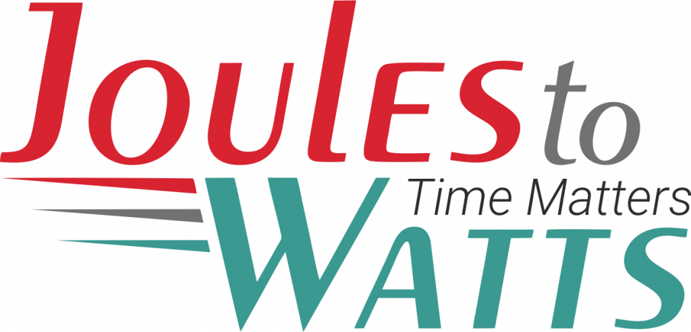



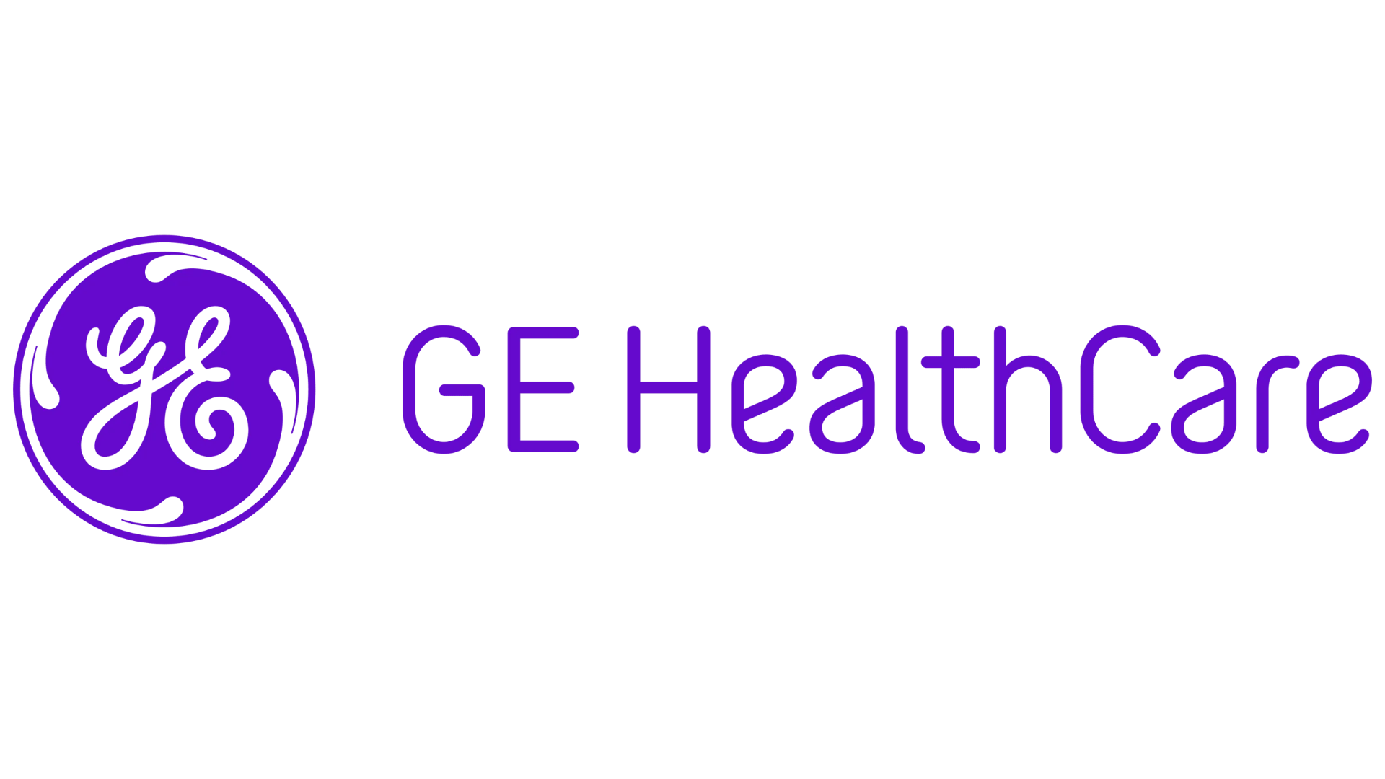
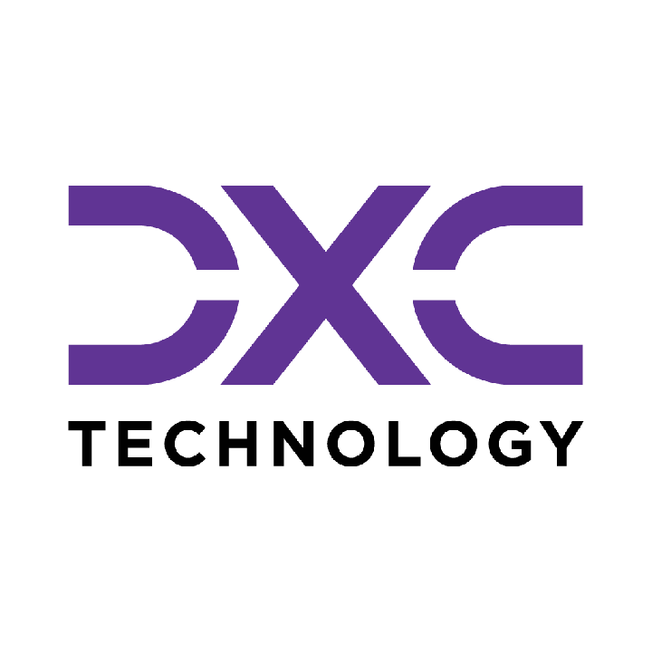






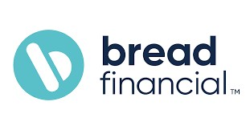


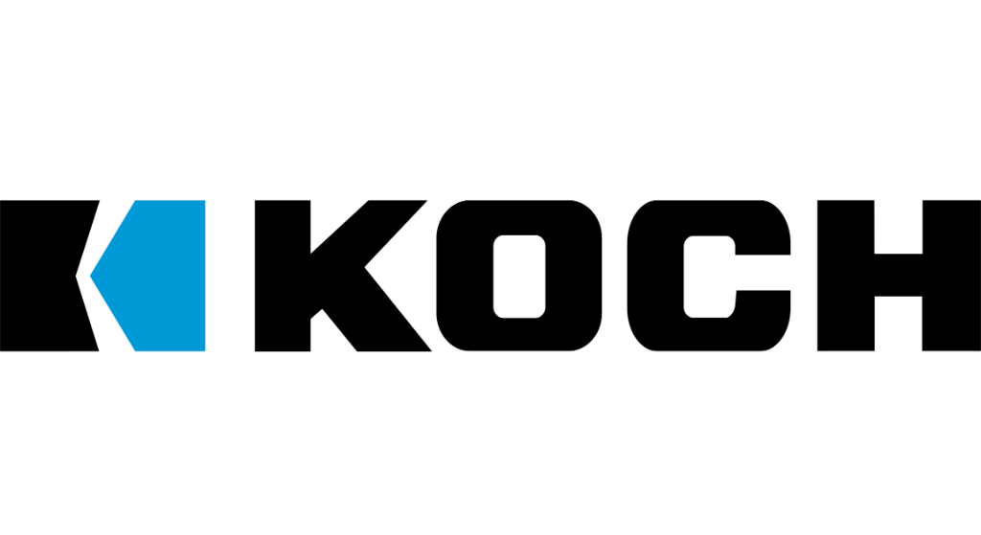

Building the Enterprise Operating Model​
for the Next Decade​
BUSINESS DRIVERS| TECHNOLOGY ACCELERATORS | GAME CHANGERS
Energy. Excellence. Innovation.
Trusted by:
ISO 9001:2015
CMMI Certified
Women-Owned
Notes:
J2W_ID: CS01

Slide 2

WHO WE ARE
The AI-native GCC platform - a decade in the making
J2W is the AI-native GCC platform for the Fortune 1000 and beyond.
Ten years building nothing but GCCs - so we solve the next problem before it shows up, deliver ROI in weeks where the industry takes quarters, and turn the GCC from a cost line into an innovation engine.
10+
320+
300+
Years GCC leadership
Enterprise clients served
GCCs built: greenfield & brownfield
5,500+
8
60+
Industry & tech experts
Countries with footprint
AI-enabled capabilities
Notes:
J2W_ID: CS02

Slide 3

WHAT WE OFFER
THREE INTERLOCKING REVENUE ENGINES
01
02
03
Workforce Solutions
AI Pods
Managed Service Solutions
The Volume Engine
The Margin Expansion Engine
The Strategic Value Engine
Domain-deep engineers - not generic coders
Verticals: IT and Cloud Computing · BFSI · more
Deployed in 10 days or less
Pod governance + sprint accountability
Contract-to-hire flexibility
AI-first engineering pods, embedded tech lead
Every engineer AI-certified before Day 1
J2W AI Labs - continuous monthly upskilling
AI-assisted code, test & docs from Day 1
Compounding productivity, not static seats
Dedicated pods owning outcomes, not tasks
Operate to outcome-bound SLOs
60+ pre-built solution accelerators
On SAP, ServiceNow & industry stacks
40% improvement threshold - our standard
Notes:
J2W_ID: CS04

Slide 4






THE J2W OPERATING MODEL
We don't just deploy - we embed, align, and deliver measurable outcomes.
01
02
03
04
Embed.
Build.
Operate.
Compound.
Days 1–14
Weeks 2–6
Month 2 onward
Year one & beyond
We map your stakeholder reality before touching a single workflow — identifying the 80% we move within and the 20% that unlocks transformation.
We deploy the closest-fit accelerator and customize where needed. Hundreds of prior engagements mean you inherit a head start, not a blank slate.
Forward-deployed engineers run AI inside your enterprise and don't rotate off. The context, accountability, and institutional memory stay with you.
Every problem solved sharpens the platform. The system gets smarter as you scale — outcomes that compound while you sleep.
Your business is our GTM. We build with you, so your teams actually adopt, use, and grow everything we create together - not just receive it.
Notes:
J2W_ID: CS05

Slide 5





WHAT WE OWN
The proprietary stack - our moat
J2W Premier Lounge
J2W OfferLetter
Data Abstraction Layer
Curated network of vetted experts - instant access to scarce skills.
AI-driven sourcing & resume parsing - onboard one engineer an hour.
Unified API gateway + real-time ETL - a single pane of glass.
J2W AI Labs
60+ Accelerators
Internal AI engine - every engineer AI-certified before Day 1.
Pre-built solutions on SAP, ServiceNow & industry stacks.
THE ARC FRAMEWORKAdaptive(Grow)→Resilient(Mature)→Cognitive(Transform)
Transparent, scalable, and owned by us - your competitive moat, not a black box.
Notes:
J2W_ID: CS06

Slide 6





Workforce & Talent Solutions
A MANAGED, AI-DRIVEN WORKFORCE UNIT - NOT JUST STAFFING WITH A WRAPPER.
Sourcing Engine
Human + AI Teams
Fully Managed
AI-First L&D
AI-driven talent matching across 8,500+ active consultants and 1,250+ skills - niche to mainstream.
Blended delivery with AI productivity tools embedded from Day 1. Capability stacks over role pyramids.
J2W owns payroll, compliance, onboarding and HR. Zero admin burden on the client side.
Continuous upskilling via J2W CoE - contextual, hands-on AI training powered by Research Wing.
Dimension
Traditional Staffing
J2W Workforce
Speed to Deploy
Weeks to months
1 engineer onboarded per hour
Team Composition
Single-role profile deployments
Human + AI blended capability stacks
Governance
Client's burden
J2W-owned - HRBP implant at every site
Performance Issues
Escalation after the fact
Proactive monitoring & intervention
Knowledge Retention
Lost with attrition
Captured in J2W Knowledge Repository
AI Readiness
Ad hoc
Embedded from Day 1
5,500+
1,250+
320+
0%
1/hr
Active Consultants
Skills Covered
Enterprise Clients
Attrition (6-Mo Pilot)
Engineers Onboarded
Notes:
J2W_ID: CS10

Slide 7



WORKFORCE SOLUTIONS - HOW WE DELIVER
From sourcing to sprint governance - a structured operating model, not a staffing drop.
01
Scope & Source
02
AI-Assess
03
Deploy in 10 Days
Role definition + domain-specific talent pool activation. TalentAI matching + voice-agent pre-screen. Shortlist in 72 hrs.
Live coding + domain scenario assessment via TalentSphere. Technical bar validated by J2W before client interview.
Offer → onboarding → Day-1 productivity. J2W payroll, compliance, IT provisioning - fully managed.
04
Govern & Upskill
05
POFU - 90-Day Funnel
06
Scale or Convert
Sprint accountability via Pod Manager. Monthly AI upskilling in J2W Labs. Weekly performance telemetry.
Post-Offer Follow-Up: milestone touchpoints, counter-offer inoculation, manager connects. Dropout rate → single digits.
C2H → permanent conversion on Day 91. Scale the pod up or down. Quarterly Business Review with ROI data.
Notes:
J2W_ID: CS11

Slide 8






STRUCTURAL DIFFERENTIATION
WORKFORCE SOLUTIONS
Five structural differences that change the engagement from transactional to transformational.
No Subcontracting
300+ in-house recruiters. 7,200+ professionals on J2W payroll. Zero subcontracting layer diluting quality, speed, or accountability.
GCC-Native Intelligence
Forged through 300+ active GCC deployments. We see the next problem before it shows up because we have already solved it somewhere else.
AI at Every Step
TalentAI + TalentSphere: AI-ranked pools, voice-agent screening, skill graphs, predictive placement. Every tool passed our 40% improvement gate internally.
Pod Governance Built In
A dedicated Pod Manager - not billed to client - owns sprint governance, performance tracking, and L&D coordination. This is a pod, not a staffing drop.
Validated Playbooks
Every tool, process, and accelerator has passed our internal 40% improvement gate. Clients benefit from completed learning - not our experimentation.
Notes:
J2W_ID: CS12

Slide 9



Managed Service Solutions
OUTCOME-BOUND DELIVERY - NOT JUST A VENDOR WITH A STATEMENT OF WORK.
Solution Accelerators
Service Model Comparison
60+ pre-built accelerators across SAP, ServiceNow, Salesforce, and industry stacks - deployed fast, customized to fit, never forced.
Dimension
Traditional Managed Services
J2W Managed Solutions
Engagement
Model
SOW-based, scope-
locked
Outcome-bound, SLO-governed
Cross-Function Coverage
From AI CoE and Data CoE to Digital Engineering, Quality, and Cybersecurity - we operate across the full enterprise function map, not just the easy wins.
Starting Point
Build from scratch
60+ accelerators, deploy in weeks
Proven ROI, Not Projections
Performance Standard
Contractual minimums
40% improvement threshold
Every accelerator comes with a benchmark from prior deployments. 80% reduction in reporting effort. 55% faster month-end close. 65% faster testing cycles. Numbers you inherit, not numbers we promise.
Coverage
Single-function specialization
Cross-stack: SAP, ServiceNow, Salesforce + more
Knowledge Retention
Exits with the team
Captured, compounding, stays with you
AI Readiness
Optional add-on
Embedded from Day 1
From scattered pilots to governed programs. From manual reporting to real-time intelligence. From legacy stacks to modernized platforms. J2W Managed Solutions operate until the outcome is real - then keep compounding.
Notes:
J2W_ID: CS18

Slide 10










Strategic Managed Services Offerings
COMPREHENSIVE CAPABILITIES DRIVING DIGITAL TRANSFORMATION
AI Solutions (AI CoE)
Quality Engineering
GenAI strategies, agents, LLM workflows, predictive models, knowledge bots, and enterprise-grade AI governance & value realization frameworks.
Intelligent QA and Test Automation at scale - covering functional, performance, security, CI/CD pipelines, and TaaS delivery pods.
01
06
Data Migration & Infra Support
Call Centre Optimization
Seamless migration across on-prem & cloud, with data quality, cleansing, secure pipelines, infra ops, and cloud governance across AWS/Azure/GCP.
Transforming contact centers through operational assessment, workforce analytics, real-time dashboards, agent assist AI, and IVA-based automation.
02
07
Cybersecurity
SAP Services
Full-spectrum security including assessment, red-team, cloud security, managed SOC/MDR, compliance (ISO, PCI, RBI), incident response & digital forensics.
End-to-end SAP modernization - from S/4HANA migrations to BTP, Fiori, SuccessFactors, and enterprise-wide rollout with managed SAP support.
03
08
Digital Engineering & Automation
Salesforce Services
Spanning full-stack & UI/UX development, intelligent automation, AI-augmented RPA, and end-to-end process orchestration.
Complete Salesforce transformation across Sales, Service, Marketing, Financial Services Cloud, and MuleSoft - backed by org audits and managed support.
04
09
Data Analytics & Dashboarding
ServiceNow
Interactive dashboards across Power BI, Tableau, and Qlik - enabling real-time operational, financial, and leadership insights.
End-to-end ServiceNow enablement across ITSM, ITOM, CSM, CMDB, automation workflows, and CoE setup for scalable, multi-instance operations.
05
10
Notes:
J2W_ID: CS19

Slide 11
A leading Japanese multinational GCC STRATEGY AND DISCOVERY FRAMEWORK
CLIENT: Leading Professional Services Enterprise | DOMAIN: Professional Services
The Challenge
The Solution
A leading Japanese multinational needed a structured, question-driven GCC strategy to align corporate goals with India's GCC landscape across 5 critical dimensions: Strategic Objectives, Functional Scope, Financial Model, Operating Model, and Growth and Talent. The challenge was moving from intent to a precisely tailored roadmap covering location selection, investment planning, and governance grounded in real outcomes from Japanese multinational GCC examples.
A Discovery Framework using targeted questionnaires and Japanese multinational case studies was deployed to define the client's optimal GCC archetype. Location strategy matched function mix to city archetypes including Innovation Hubs, Balanced Centers, and Tier-2 cities. A financial blueprint for investment scale, ROI timelines, and incentives was developed alongside a scalable talent and technology roadmap.
Key Capabilities Developed
GCC Discovery Framework
Location Strategy Matching
Financial Blueprint
5-dimension structured questionnaire covering objectives, scope, financial model, operating model, and growth strategy.
City archetype matching aligning Innovation, Balanced, or Transactional center selection to cost and talent goals.
Investment scale options, ROI and break-even timelines, automation targets, and tax incentive utilization roadmap.
Operating Model Design
AI and ML Integration Roadmap
Scalability and Talent Roadmap
Centralized and hybrid service center designs with governance and cultural integration frameworks.
Proprietary predictive models and ML dashboards targeting up to 40% process time reduction.
Expansion planning, upskilling pipelines, campus partnerships, and ESG alignment built into the plan.
330
40%
42%
or more GCCs enabled globally through the J2W playbook
reduction in process times through AI and ML integration
automation targets achieved across deployed programs

Slide 12
PRE & POST CONTRACT INTELLIGENCE
CLIENT: Leading Construction Enterprise | DOMAIN: Construction
The Challenge
The Solution
A large EPC contractor managing multi-year infrastructure contracts had no integrated system connecting bid preparation to post-award execution. Proposals were drafted manually across separate teams for scope, milestones, commercials, and compliance, with no benchmark against past contract performance. Contractor selection relied on relationships rather than delivery data. Scope deviations during execution went undetected until cost overruns and schedule slippage were already visible in the numbers.
An AI-embedded contract intelligence layer was deployed across the full contract lifecycle, from pre-bid proposal generation through post-award execution governance. Multi-agent frameworks handle scope, milestones, commercials, and compliance in parallel, referencing historical contracts and pricing benchmarks to calibrate every bid. Once a contract is awarded, the system extracts project structure directly from contract documents and continuously monitors execution against it, auto-regenerating delivery plans when scope shifts occur.
Key Capabilities Developed
Multi-Agent Proposal Generation
Historical Intelligence and Benchmarking
Capability-Based Contractor Selection
Dedicated agents assemble scope, milestones, commercials, and compliance documentation in parallel with risk-weighted inputs.
References past contracts, clause libraries, and pricing benchmarks to calibrate proposal accuracy.
Evaluates contractors on historical performance and deviation trends rather than relationship-based judgment.
Contract Intelligence Reader
Agent-Based Recalibration
Anomaly Detection and Risk Governance
Extracts project structure, including buildings, materials, resources, and timelines, from released contracts into execution-ready data.
Auto-generates SOWs and delivery plans when scope shifts occur, keeping milestones aligned to real-time constraints.
Flags deviations and compliance gaps across active contracts before they compound into overruns.
15
15
30
25% reduction in bid preparation time
25% reduction in commercial leakage
40% faster contract-to-execution conversion

Slide 13
PROCUREMENT CYCLE COMPRESSION
CLIENT: Leading Manufacturing Enterprise | DOMAIN: Manufacturing
The Challenge
The Solution
A manufacturing company in active scale-up was running its entire procurement operation on calls, emails, and spreadsheets maintained by individual buyers. Vendor quotes arrived in different formats, approval chains had no single owner, and PO status existed only in people's heads. Fragmentation was invisible until production timelines started slipping, not because of supply failures, but because internal procurement had become the bottleneck. A missed approval or untracked PO became a line stoppage.
A fully digitized procure-to-pay system replaced the manual chain from indent to payment. Vendors receive structured RFQs through WhatsApp and respond in a format the system reads directly. Approval routing executes against the client's actual hierarchy without chasing. Every PO moves through a tracked lifecycle with real-time visibility at each stage. The procurement team now operates from one platform instead of a scatter of inboxes and files.
Key Capabilities Developed
End-to-End Procurement Execution
Vendor Quote Collection via WhatsApp
Automated Approval Routing
Covers the full cycle from requisition to final payment on one platform, eliminating handoff gaps between steps.
Sends structured RFQs to suppliers and captures responses in a standard format, removing manual collation.
Configurable chains trigger and escalate automatically by value, category, and department, with no follow-up required.
Purchase Order Lifecycle Tracking
Vendor Performance Scoring
Spend and Savings Analytics
Real-time visibility from PO creation to goods receipt, so delays surface before they hit the line.
Tracks delivery reliability, quality, and pricing trends per supplier to inform future sourcing decisions.
Aggregates procurement data into spend analysis and vendor comparisons, making cost patterns visible for the first time.
70%
Automated
Single platform
reduction in procurement cycle time
approval workflows with zero manual chasing
indent-to-payment visibility

Slide 14









NEXT STEPS
FLEXIBLE ENGAGEMENT MODELS TAILORED TO YOUR THREE-YEAR ROADMAP
Discovery Workshop
LOW TOUCH
Assessment & PoC
STRATEGIC
Build & Run Models
PARTNERSHIP
Duration: ~90 Minutes
Duration: 4 Weeks
Duration: Multi-Year
KEY DELIVERABLES
KEY DELIVERABLES
COMMERCIAL MODELS
Use case identification & prioritization
Target state architecture design
Fixed Scope: For defined project builds
Value hypothesis definition
Working pilot / MVP implementation
Managed Service: SLA-driven operations
High-level roadmap aligned to 70/30 strategy
Detailed ROI model & rollout plan
Outcome-Based: Gain-share pricing tied to value
Vendor integration assessment
SAMPLE IMPLEMENTATION ROADMAP
DISCOVERY
Q1
PILOT / POC
Q2
SCALE
Q3
OPTIMIZE
Q4
Assess readiness, define scope, select initial use cases
MVP build, user testing, architecture validation
Production deployment, integration, vendor onboarding
Run ops, process tuning, continuous improvement
Initiation
Validation
Execution
Refinement
Notes:
J2W_ID: CS07

Slide 15


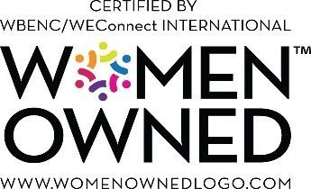

"Let's win together"
Notes:
J2W_ID: CS08

Slide 16
HYBRID BOT-CAAS R&D HUB FOR GLOBAL MEDTECH LEADER
CLIENT: Leading Healthcare Technology Enterprise | DOMAIN: Healthcare Technology
The Challenge
The Solution
A global MedTech leader needed a regulated R&D hub that could move fast without cutting corners - accelerating device development across 25 countries, maintaining 100% compliance, and facilitating FDA approvals all under a flexible, zero-CapEx structure designed for safety-critical R&D work.
A hybrid BOT-CaaS model was deployed, combining Build-Operate-Transfer flexibility with CaaS zero-CapEx advantages. Domain-deep engineering talent was embedded across multiple cities, compressing device development by 40%. Compliance was built into every workflow from the start, enabling 20 or more FDA approvals without a single compliance breach.
Key Capabilities Developed
Hybrid BOT-CaaS Model
Device Development Acceleration
Regulatory Compliance at Scale
Purpose-built structure combining BOT flexibility and CaaS zero-CapEx advantages designed for safety-critical R&D.
40% faster device development through deeply embedded domain engineering and optimized R&D workflows.
100% regulatory compliance maintained across 25 countries with compliance built into every workflow.
FDA Approval Facilitation
Multi-City Talent Architecture
Zero-CapEx Structure
Structured compliance and documentation practices facilitating 20 or more FDA approvals from the hub.
300 or more professionals sourced, onboarded, and operationalized across multiple cities under unified governance.
Full R&D hub established and operated without client capital expenditure commitment.
300
40%
100%
or more professionals across a multi-city hub
faster device development
regulatory compliance across 25 countries and 20 or more FDA approvals facilitated

