Slide 1

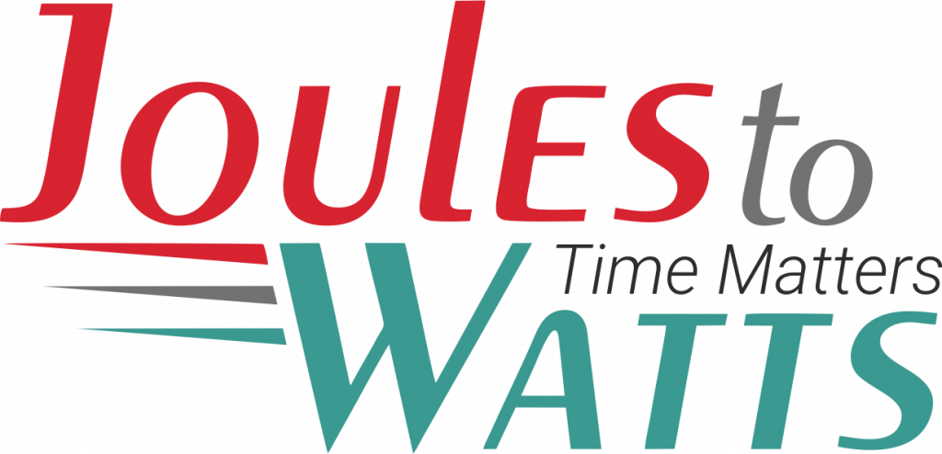




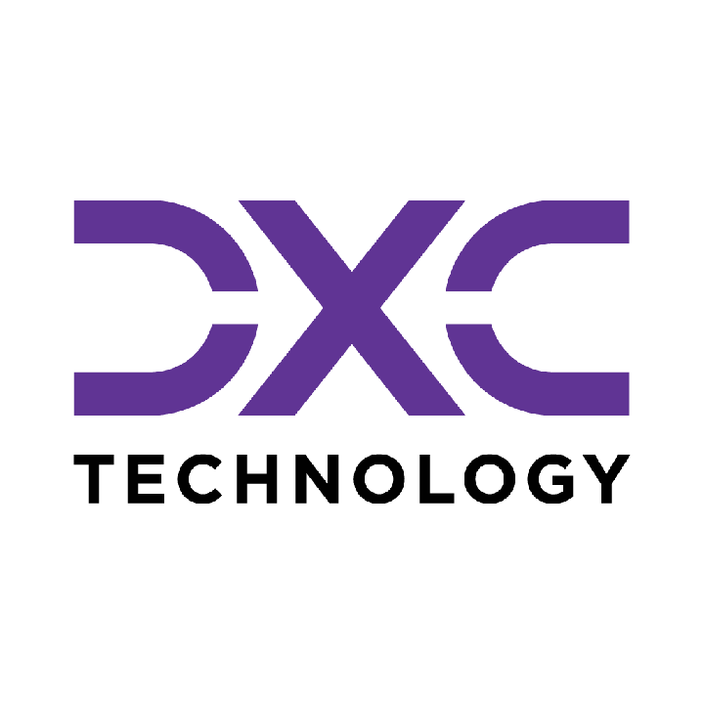









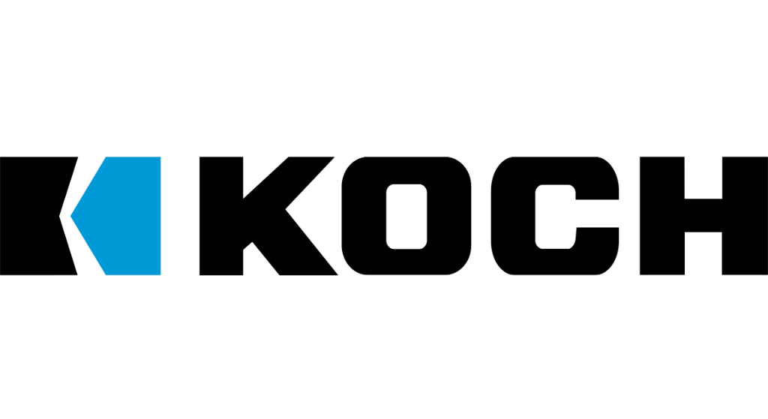

Building the Enterprise Operating Model​
for the Next Decade​
BUSINESS DRIVERS| TECHNOLOGY ACCELERATORS | GAME CHANGERS
Energy. Excellence. Innovation.
Trusted by:
ISO 9001:2015
CMMI Certified
Women-Owned
Notes:
J2W_ID: CS01

Slide 2

WHO WE ARE
The AI-native GCC platform - a decade in the making
J2W is the AI-native GCC platform for the Fortune 1000 and beyond.
Ten years building nothing but GCCs - so we solve the next problem before it shows up, deliver ROI in weeks where the industry takes quarters, and turn the GCC from a cost line into an innovation engine.
10+
320+
300+
Years GCC leadership
Enterprise clients served
GCCs built: greenfield & brownfield
5,500+
8
60+
Industry & tech experts
Countries with footprint
AI-enabled capabilities
Notes:
J2W_ID: CS02

Slide 3
AGENTIC SDLC TRANSFORMATION
CLIENT: Leading Software Enterprise | DOMAIN: Software
The Challenge
The Solution
A 3,000-engineer organization delivering across multiple regions operated with no AI-assisted continuity between planning, development, testing, and deployment. Requirements were translated into test cases manually. Full regression suites ran for every code change regardless of what actually changed, and defects were routinely discovered late in the cycle. Automation scripts broke with every system update and required manual repair, and no feedback loop connected delivery outcomes back into the pipeline to improve the next cycle.
An end-to-end agentic SDLC framework was deployed, embedding AI across every stage of the software lifecycle. AI agents autonomously generate test cases from requirements, perform impact-aware test selection on every commit, and self-heal broken automation scripts without manual intervention. Engineering shifted from reactive execution, where every change triggered a full manual cycle, to insight-driven delivery where the pipeline adapts to what actually changed.
Key Capabilities Developed
AI Test Generation
Self-Healing Automation
Intelligent Test Selection
Automatically generates test cases from requirements with 95% coverage accuracy.
Repairs broken test scripts automatically, reducing maintenance overhead.
Impact-aware selection targets only affected modules per commit instead of running full regression.
Defect Prediction Engine
Agentic CI/CD Orchestration
Release Risk Analytics
Predicts defects before they occur using ML pattern recognition.
AI-driven pipeline orchestration for optimized deployment flow.
Provides real-time risk assessment to support release go/no-go decisions.
40
50
35%
60% reduction in automation maintenance
80% faster regression cycles
Approximately earlier defect detection

Slide 4
MANAGED TESTING FOR OTT PLATFORM LAUNCH
CLIENT: Leading Telecom Operator | DOMAIN: Telecom
The Challenge
The Solution
A major US telecom company launching its OTT platform needed end-to-end managed quality engineering to reduce go-to-market time, covering test automation, functional and non-functional testing, device compatibility, and API testing while significantly cutting manual effort.
A multi-layer testing strategy was implemented using OTT UTAF for E2E automation, cross-browser and cross-device testing across Android and iOS, content and subscription validation, and comprehensive non-functional testing including load, performance, QoE, ad-validation, analytics, and security.
Key Capabilities Developed
E2E User Journey Automation
Content and Subscription Validation
Cross-Device and Cross-Browser Testing
Automated user flows using OTT Unified Test Automation Framework accelerating deployment cycles.
Rigorous testing across playback, subscription management, and content management systems.
Multi-browser and smartphone testing including seamless OTT application integration validation.
Non-Functional Testing Suite
Continuous Automation Framework
Managed Test House
In-depth load, performance, quality of experience, ad-validation, analytics, and security testing.
Systematically reducing manual testing effort while ensuring consistent quality and stability.
Comprehensive, integrated QA oversight across the entire OTT platform ecosystem.
50%
11
60%
or more reduction in release timeframe
.4 million user base grown post-launch
reduction in manual testing effort

Slide 5
INDUSTRY 4.0 INTELLIGENCE
CLIENT: Leading Process Manufacturing Enterprise | DOMAIN: Process Manufacturing
The Challenge
The Solution
A specialty chemicals manufacturer running continuous-process plants had spent 2 years evaluating industrial AI without a single deployment reaching the floor. Every vendor solution required displacing the existing DCS and historian, infrastructure the plant had spent a decade calibrating, and moving operational data outside the OT environment, which security would not clear. A catalyst reactor ran outside optimal temperature bands for 6 hours, causing a batch loss of £340,000. The cause was visible in the historian after the fact; the capability to catch it in real time existed on the market, but no deployment path existed inside the plant's security constraints.
A suite of modular industrial AI capabilities was deployed directly against the plant's existing DCS, historian, and MES, connected via OPC UA and MQTT, no new platform license, no data leaving the environment. Each module runs as a containerized microservice alongside existing infrastructure, validated on real plant data within 2 to 4 weeks. The manufacturer started with energy optimization and predictive maintenance on the reactor line and extended module by module as each proved value on the floor.
Key Capabilities Developed
Plant Energy Intelligence
Predictive Maintenance
AI Vision Quality Gates
GenAI-driven recommendations targeting peak demand costs, deployed against existing metering with no new hardware.
ML models on existing telemetry predict failure windows before they become unplanned downtime.
Inline inspection compares live output to golden references with no line speed impact.
Production Digital Twin
Operator GenAI Copilot
Modular Deployment Architecture
Real-time simulation of temperature, pressure, and feed-rate scenarios without touching live production.
Conversational assistant drawing on live tags, manuals, and SOPs, runs on edge, on the floor.
Each module deploys independently, so the plant starts where risk is highest and expands without a platform migration.
2
Zero new
4
4 weeks POC per module on real plant data
platform licenses required
Accelerates Industry .0 maturity roadmap

Slide 6
WELD VISION AND JOINT INTEGRITY ANALYTICS
CLIENT: Leading Manufacturing Enterprise | DOMAIN: Manufacturing
The Challenge
The Solution
A heavy equipment OEM verified weld joint integrity through sampled inspection, leaving subsurface defects, porosity, and incomplete fusion undetected until they surfaced as rework, structural failures, or audit escapes. At production line speeds, manual 100% inspection was not feasible. Quality teams were structurally positioned to manage defects after the fact rather than catch them at the joint.
An AI vision layer was deployed at the weld station to capture and analyze every joint in real time, classifying geometry, detecting surface anomalies, and correlating findings with process parameters to isolate root cause at the joint level. Full traceability is generated automatically across every weld, operator, and production run without disrupting line speed. Inspection moved from a sample to 100% coverage at no cost to throughput.
Key Capabilities Developed
100% Inline Weld Vision Inspection
Porosity and Fusion Defect Detection
Process Parameter Correlation
AI cameras capture every joint at line speed, classifying weld geometry and surface condition without sampling or line interruption.
Detects porosity, incomplete fusion, undercut, and spattering, flagging defects before parts advance to downstream assembly.
Correlates visual defects with welding parameters to isolate root cause across wire feed, voltage, and travel speed.
Joint Traceability and Run Logging
Defect Trend and Heatmap Analytics
Closed-Loop Quality Feedback
Links every weld to operator, shift, and material batch, generating audit-ready traceability records.
Maps defect frequency across stations and shifts, surfacing systemic quality patterns before batch escapes occur.
Routes verified defect data back to process engineering, turning every detected issue into a parameter adjustment rather than a one-off fix.
40
30
Audit-ready
60% reduction in weld defect escapes to downstream assembly
45% improvement in root cause identification speed
full joint-level traceability across production

Slide 7
OPERATIONAL DIGITAL TWIN
CLIENT: Leading Energy Utility | DOMAIN: Energy
The Challenge
The Solution
An offshore oil and gas operator running aging platforms across the North Sea managed asset health through scheduled inspections, manual technician readings, and calendar-based maintenance. A compressor on one platform showed irregular vibration signatures for 11 days before a bearing failure took it offline, a £2.1 million unplanned shutdown requiring weather-dependent crew mobilization and 14 days off-production. The data that would have predicted it was being collected; nobody was watching it, and no engineer held a view across the full platform fleet at any given moment.
An AI-embedded operational digital twin was deployed across the platform fleet, ingesting live sensor, PLC, and SCADA streams into a continuously maintained digital replica of every critical asset. Operational health scoring runs continuously against equipment performance and system interdependencies, surfacing degradation before it reaches the production threshold. Engineers now work from a unified dashboard across all platforms, seeing asset condition, trend, and warranted intervention, without leaving the control room.
Key Capabilities Developed
Live Asset Mirroring
Operational Health Scoring
Predictive Maintenance
Real-time sensor, PLC, and SCADA streams maintain a continuously updated digital replica across platforms and asset classes.
Flags degradation trajectories and failure probability before output is affected, across interdependent systems.
Anticipates failures and optimal intervention windows from telemetry and load history, replacing calendar-based scheduling.
Anomaly Detection and Root Cause Isolation
Scenario Simulation
Unified Operations Dashboard
Triggers corrective workflows before cascading failures develop.
Tests load changes and equipment swaps against the live twin without touching real systems.
Consolidates asset health, performance, and risk scores with drill-down visibility across platforms.
30
20
25
40% reduction in unplanned downtime
30% improvement in asset utilisation
35% faster fault detection and resolution

Slide 8









NEXT STEPS
FLEXIBLE ENGAGEMENT MODELS TAILORED TO YOUR THREE-YEAR ROADMAP
Discovery Workshop
LOW TOUCH
Assessment & PoC
STRATEGIC
Build & Run Models
PARTNERSHIP
Duration: ~90 Minutes
Duration: 4 Weeks
Duration: Multi-Year
KEY DELIVERABLES
KEY DELIVERABLES
COMMERCIAL MODELS
Use case identification & prioritization
Target state architecture design
Fixed Scope: For defined project builds
Value hypothesis definition
Working pilot / MVP implementation
Managed Service: SLA-driven operations
High-level roadmap aligned to 70/30 strategy
Detailed ROI model & rollout plan
Outcome-Based: Gain-share pricing tied to value
Vendor integration assessment
SAMPLE IMPLEMENTATION ROADMAP
DISCOVERY
Q1
PILOT / POC
Q2
SCALE
Q3
OPTIMIZE
Q4
Assess readiness, define scope, select initial use cases
MVP build, user testing, architecture validation
Production deployment, integration, vendor onboarding
Run ops, process tuning, continuous improvement
Initiation
Validation
Execution
Refinement
Notes:
J2W_ID: CS07

Slide 9




"Let's win together"
Notes:
J2W_ID: CS08

