Slide 1

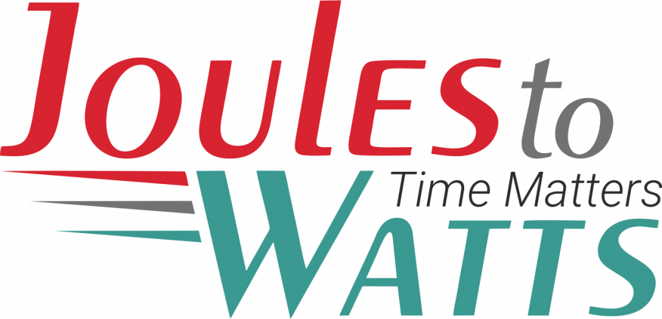



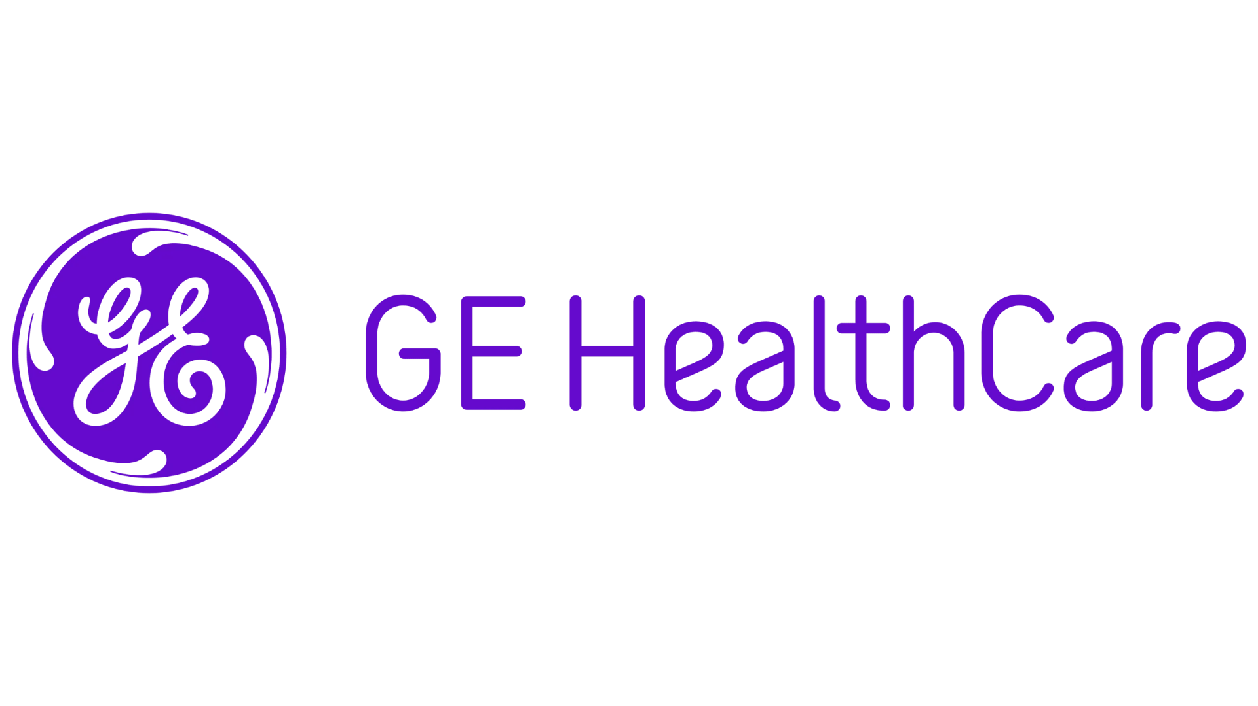
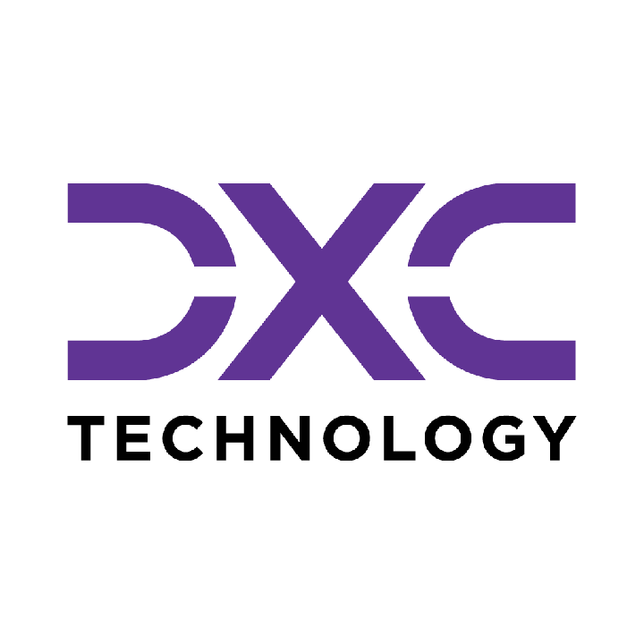









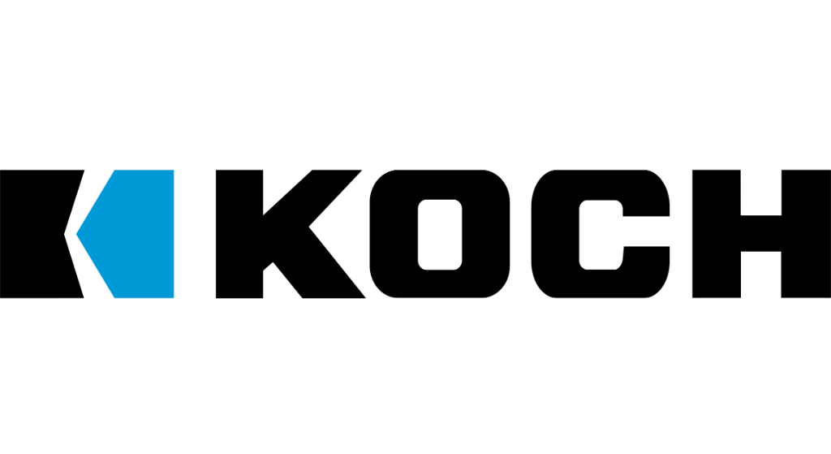

Building the Enterprise Operating Model​
for the Next Decade​
BUSINESS DRIVERS| TECHNOLOGY ACCELERATORS | GAME CHANGERS
Energy. Excellence. Innovation.
Trusted by:
ISO 9001:2015
CMMI Certified
Women-Owned
Notes:
J2W_ID: CS01

Slide 2

WHO WE ARE
The AI-native GCC platform - a decade in the making
J2W is the AI-native GCC platform for the Fortune 1000 and beyond.
Ten years building nothing but GCCs - so we solve the next problem before it shows up, deliver ROI in weeks where the industry takes quarters, and turn the GCC from a cost line into an innovation engine.
10+
320+
300+
Years GCC leadership
Enterprise clients served
GCCs built: greenfield & brownfield
5,500+
8
60+
Industry & tech experts
Countries with footprint
AI-enabled capabilities
Notes:
J2W_ID: CS02

Slide 3




Architects of Transformation
VISIONARY LEADERSHIP DRIVING ENTERPRISE EXCELLENCE
Priti Sawant is a serial entrepreneur, category creator, and a pioneer of India’s Global Capability Center (GCC) ecosystem. With 20+ years of experience, she has built and scaled businesses at the intersection of technology and enterprise transformation. She began her journey at Accenture and later led Magna Infotech-scaling it from pre-revenue to a market leader, creating India’s first GCC-focused model, and delivering a successful exit and public listing (IPO). She is a 2-time entrepreneur, having built two successful, leading companies solving for GCCs in India.
Priya Mohan is a seasoned operator, investor, and entrepreneur with 20+ years spanning venture capital, high-growth startups, and investment banking. She was most recently a Partner at General Catalyst India, where she led India investments and co-creation opportunities across transformative, economy-shaping companies. Previously, as Managing Partner at Venture Highway, she held board seats across marquee portfolio companies in multiple sectors. Before investing, she co-founded Vidyartha, an EdTech platform which she successfully exited to Byju's.
Priti Sawant
Priya Mohan
Founder & CEO
coo
She founded JoulestoWatts, backed by Manipal Global Education Services. Today, J2W operates across 8 countries, enabling 300+ GCCs, deploying 5,200+ professionals, and building 4 in-house products, with strong Fortune 500 partnerships. Recognised by Forbes Japan, she is also a TiE Charter Member, startup mentor, and a strong advocate of gender diversity, having built organisations with 40%+ women representation and 50% women-led leadership roles.
Her earlier career included 9 years in investment banking and equity research - structuring and executing complex transactions across private equity raises, secondary sales, and buyouts. A Chartered Accountant and Management Graduate from the Indian School of Business (ISB), Priya was a state guest of the United States under the IVLP program and is a member of the Kamalnayan Bajaj Aspen Fellowship (Cohort X).
Notes:
J2W_ID: CS03

Slide 4

WHAT WE OFFER
THREE INTERLOCKING REVENUE ENGINES
01
02
03
Workforce Solutions
AI Pods
Managed Service Solutions
The Volume Engine
The Margin Expansion Engine
The Strategic Value Engine
Domain-deep engineers - not generic coders
Verticals: IT and Cloud Computing · BFSI · more
Deployed in 10 days or less
Pod governance + sprint accountability
Contract-to-hire flexibility
AI-first engineering pods, embedded tech lead
Every engineer AI-certified before Day 1
J2W AI Labs - continuous monthly upskilling
AI-assisted code, test & docs from Day 1
Compounding productivity, not static seats
Dedicated pods owning outcomes, not tasks
Operate to outcome-bound SLOs
60+ pre-built solution accelerators
On SAP, ServiceNow & industry stacks
40% improvement threshold - our standard
Notes:
J2W_ID: CS04

Slide 5






THE J2W OPERATING MODEL
We don't just deploy - we embed, align, and deliver measurable outcomes.
01
02
03
04
Embed.
Build.
Operate.
Compound.
Days 1–14
Weeks 2–6
Month 2 onward
Year one & beyond
We map your stakeholder reality before touching a single workflow — identifying the 80% we move within and the 20% that unlocks transformation.
We deploy the closest-fit accelerator and customize where needed. Hundreds of prior engagements mean you inherit a head start, not a blank slate.
Forward-deployed engineers run AI inside your enterprise and don't rotate off. The context, accountability, and institutional memory stay with you.
Every problem solved sharpens the platform. The system gets smarter as you scale — outcomes that compound while you sleep.
Your business is our GTM. We build with you, so your teams actually adopt, use, and grow everything we create together - not just receive it.
Notes:
J2W_ID: CS05

Slide 6





WHAT WE OWN
The proprietary stack - our moat
J2W Premier Lounge
J2W OfferLetter
Data Abstraction Layer
Curated network of vetted experts - instant access to scarce skills.
AI-driven sourcing & resume parsing - onboard one engineer an hour.
Unified API gateway + real-time ETL - a single pane of glass.
J2W AI Labs
60+ Accelerators
Internal AI engine - every engineer AI-certified before Day 1.
Pre-built solutions on SAP, ServiceNow & industry stacks.
THE ARC FRAMEWORKAdaptive(Grow)→Resilient(Mature)→Cognitive(Transform)
Transparent, scalable, and owned by us - your competitive moat, not a black box.
Notes:
J2W_ID: CS06

Slide 7





Workforce & Talent Solutions
A MANAGED, AI-DRIVEN WORKFORCE UNIT - NOT JUST STAFFING WITH A WRAPPER.
Sourcing Engine
Human + AI Teams
Fully Managed
AI-First L&D
AI-driven talent matching across 8,500+ active consultants and 1,250+ skills - niche to mainstream.
Blended delivery with AI productivity tools embedded from Day 1. Capability stacks over role pyramids.
J2W owns payroll, compliance, onboarding and HR. Zero admin burden on the client side.
Continuous upskilling via J2W CoE - contextual, hands-on AI training powered by Research Wing.
Dimension
Traditional Staffing
J2W Workforce
Speed to Deploy
Weeks to months
1 engineer onboarded per hour
Team Composition
Single-role profile deployments
Human + AI blended capability stacks
Governance
Client's burden
J2W-owned - HRBP implant at every site
Performance Issues
Escalation after the fact
Proactive monitoring & intervention
Knowledge Retention
Lost with attrition
Captured in J2W Knowledge Repository
AI Readiness
Ad hoc
Embedded from Day 1
5,500+
1,250+
320+
0%
1/hr
Active Consultants
Skills Covered
Enterprise Clients
Attrition (6-Mo Pilot)
Engineers Onboarded
Notes:
J2W_ID: CS10

Slide 8



WORKFORCE SOLUTIONS - HOW WE DELIVER
From sourcing to sprint governance - a structured operating model, not a staffing drop.
01
Scope & Source
02
AI-Assess
03
Deploy in 10 Days
Role definition + domain-specific talent pool activation. TalentAI matching + voice-agent pre-screen. Shortlist in 72 hrs.
Live coding + domain scenario assessment via TalentSphere. Technical bar validated by J2W before client interview.
Offer → onboarding → Day-1 productivity. J2W payroll, compliance, IT provisioning - fully managed.
04
Govern & Upskill
05
POFU - 90-Day Funnel
06
Scale or Convert
Sprint accountability via Pod Manager. Monthly AI upskilling in J2W Labs. Weekly performance telemetry.
Post-Offer Follow-Up: milestone touchpoints, counter-offer inoculation, manager connects. Dropout rate → single digits.
C2H → permanent conversion on Day 91. Scale the pod up or down. Quarterly Business Review with ROI data.
Notes:
J2W_ID: CS11

Slide 9






STRUCTURAL DIFFERENTIATION
WORKFORCE SOLUTIONS
Five structural differences that change the engagement from transactional to transformational.
No Subcontracting
300+ in-house recruiters. 7,200+ professionals on J2W payroll. Zero subcontracting layer diluting quality, speed, or accountability.
GCC-Native Intelligence
Forged through 300+ active GCC deployments. We see the next problem before it shows up because we have already solved it somewhere else.
AI at Every Step
TalentAI + TalentSphere: AI-ranked pools, voice-agent screening, skill graphs, predictive placement. Every tool passed our 40% improvement gate internally.
Pod Governance Built In
A dedicated Pod Manager - not billed to client - owns sprint governance, performance tracking, and L&D coordination. This is a pod, not a staffing drop.
Validated Playbooks
Every tool, process, and accelerator has passed our internal 40% improvement gate. Clients benefit from completed learning - not our experimentation.
Notes:
J2W_ID: CS12

Slide 10


WHY J2W - NOT THE BIG 4 OR LARGE SIs
THE SMARTER CHOICE FOR AI & DIGITAL TRANSFORMATION AT SCALE
JoulesToWatts + J2W
Big 4 / Top IT SIs
Staffing Agencies
Outcome-driven from Day 1 - aligned to your milestones, CXO ROI expectations & project KPIs
Heavy retainers + longer payback cycles. High technical debt risk on failed transformations
Headcount model only. Zero delivery ownership or outcome accountability
ROI & Outcome Model
Production-ready Gen & Agentic AI PoCs in weeks via 50+ accelerators across SAP, Oracle, ServiceNow & more
Lengthy consulting cycles with SI-driven models - higher costs & slower results
Time-To-Value
Not offered
Pre-built guardrails. Mission-critical delivery in regulated industries (Fortune 500 MedTech). Data stays in your environment
Claims excellence, but multiple public incidents (e.g. Deloitte AU govt penalties) undermine credibility
AI / Data Governance
Not offered
30-40% reduction in AI OPEX via Query Routing, Semantic Caching, Precision RAG & in-house SLMs
SI incentivised to maximise licences & tokens - not to optimise your cost
AI OPEX Optimisation
Not offered
7,200+ in-house consultants · 300+ recruiters · 2 proprietary hiring platforms · No subcontracting
Frequently subcontract. No proprietary hiring platforms
Lacks SME depth & governance. Outcome ownership absent
Talent & Managed Services
KEY METRICS
5,500
60+
30-40%
Weeks
0
In-house Consultants
AI Accelerators
AI OPEX Reduction
PoC to Production
Subcontracting
Notes:
J2W_ID: CS13

Slide 11






Introducing the AI-First Pod Model
A MANAGED, GOVERNED ENGINEERING UNIT - NOT JUST STAFFING WITH A WRAPPER.
Engineering Team
Pod Lead
Performance Governance
AI-First L&D Program
Dedicated engineers (Java, Python, DevOps) - hired, vetted, and onboarded by J2W.
A J2W program manager who owns delivery, sprint governance, and client alignment.
Weekly performance tracking, SLA metrics, velocity monitoring, proactive resolution.
Continuous AI training - hands-on, contextual upskilling powered by Research Wing.
Dimension
Traditional Staffing
AI-First Pod
Governance
Client's burden
J2W-owned
Upskilling
Engineer's personal initiative
Structured, continuous, AI-focused
Performance Issues
Escalation after the fact
Proactive monitoring & intervention
Knowledge Retention
Lost with attrition
Captured in Knowledge Repository
AI Readiness
Ad hoc
Embedded from Day 1
Notes:
J2W_ID: CS15

Slide 12








The J2W AI Research Wing
YOUR POD'S SECRET WEAPON
What Is the AI Research Wing?
A dedicated team of AI researchers and engineers working on cutting-edge enterprise AI - agentic AI systems, LLM orchestration, model governance, and applied ML
Currently building and publishing research on agentic AI architectures, prompt engineering frameworks, and enterprise AI adoption strategies
Powers J2W's proprietary platforms: the J2W Agentic Platform, Qualizen (GenAI-assisted quality engineering), and Talk2Data (conversational BI)
How Pod Members Benefit
Weekly AI workshops led by our research team - covering practical, project-applicable AI skills
Access to the J2W iLAB - Innovation Points program for building PoCs, hackathons, and rapid prototyping
Contextual AI training - hands-on training tailored to the specific technology stack and domain
Benchmarking against global best practices - continuous measurement against industry-leading standards
The result: Your engineers don't just work - they get better every week. And that compounding improvement is something no staffing model can deliver.
Notes:
J2W_ID: CS16

Slide 13



Managed Service Solutions
OUTCOME-BOUND DELIVERY - NOT JUST A VENDOR WITH A STATEMENT OF WORK.
Solution Accelerators
Service Model Comparison
60+ pre-built accelerators across SAP, ServiceNow, Salesforce, and industry stacks - deployed fast, customized to fit, never forced.
Dimension
Traditional Managed Services
J2W Managed Solutions
Engagement
Model
SOW-based, scope-
locked
Outcome-bound, SLO-governed
Cross-Function Coverage
From AI CoE and Data CoE to Digital Engineering, Quality, and Cybersecurity - we operate across the full enterprise function map, not just the easy wins.
Starting Point
Build from scratch
60+ accelerators, deploy in weeks
Proven ROI, Not Projections
Performance Standard
Contractual minimums
40% improvement threshold
Every accelerator comes with a benchmark from prior deployments. 80% reduction in reporting effort. 55% faster month-end close. 65% faster testing cycles. Numbers you inherit, not numbers we promise.
Coverage
Single-function specialization
Cross-stack: SAP, ServiceNow, Salesforce + more
Knowledge Retention
Exits with the team
Captured, compounding, stays with you
AI Readiness
Optional add-on
Embedded from Day 1
From scattered pilots to governed programs. From manual reporting to real-time intelligence. From legacy stacks to modernized platforms. J2W Managed Solutions operate until the outcome is real - then keep compounding.
Notes:
J2W_ID: CS18

Slide 14










Strategic Managed Services Offerings
COMPREHENSIVE CAPABILITIES DRIVING DIGITAL TRANSFORMATION
AI Solutions (AI CoE)
Quality Engineering
GenAI strategies, agents, LLM workflows, predictive models, knowledge bots, and enterprise-grade AI governance & value realization frameworks.
Intelligent QA and Test Automation at scale - covering functional, performance, security, CI/CD pipelines, and TaaS delivery pods.
01
06
Data Migration & Infra Support
Call Centre Optimization
Seamless migration across on-prem & cloud, with data quality, cleansing, secure pipelines, infra ops, and cloud governance across AWS/Azure/GCP.
Transforming contact centers through operational assessment, workforce analytics, real-time dashboards, agent assist AI, and IVA-based automation.
02
07
Cybersecurity
SAP Services
Full-spectrum security including assessment, red-team, cloud security, managed SOC/MDR, compliance (ISO, PCI, RBI), incident response & digital forensics.
End-to-end SAP modernization - from S/4HANA migrations to BTP, Fiori, SuccessFactors, and enterprise-wide rollout with managed SAP support.
03
08
Digital Engineering & Automation
Salesforce Services
Spanning full-stack & UI/UX development, intelligent automation, AI-augmented RPA, and end-to-end process orchestration.
Complete Salesforce transformation across Sales, Service, Marketing, Financial Services Cloud, and MuleSoft - backed by org audits and managed support.
04
09
Data Analytics & Dashboarding
ServiceNow
Interactive dashboards across Power BI, Tableau, and Qlik - enabling real-time operational, financial, and leadership insights.
End-to-end ServiceNow enablement across ITSM, ITOM, CSM, CMDB, automation workflows, and CoE setup for scalable, multi-instance operations.
05
10
Notes:
J2W_ID: CS19

Slide 15
HYBRID TEST AUTOMATION FOR CLINICAL VALIDATION
CLIENT: Leading Healthcare Technology Enterprise | DOMAIN: Healthcare Technology
The Challenge
The Solution
A leading enterprise healthcare client operated a safety-critical patient monitoring ecosystem requiring extensive manual validation before every release. Engineers configured simulators, observed monitors, cross-checked data, and wrote execution evidence by hand, stretching a single regression cycle to several days. Critical interface components, including GPU-rendered waveforms and embedded clinical displays, were unreachable through conventional automation tools, leaving significant validation gaps with every release.
A unified hybrid automation platform was deployed to continuously orchestrate test execution across native, rendered, and embedded clinical interfaces from a single framework. AI-powered vision detection, self-healing test execution, and automated evidence collection run across the full validation lifecycle. Clinical regression shifted from days of manual effort to autonomous, audit-ready execution timed to every release cycle.
Key Capabilities Developed
Hybrid Automation Orchestrator
AI-Powered Visual Validation
Self-Healing Test Execution
Routes test execution across multiple UI technologies from a single engine, eliminating framework switching and manual handoffs.
Computer vision models interact with rendered and embedded interfaces that expose no accessibility metadata to conventional tools.
Adjusts test paths dynamically when UI layouts shift between releases, reducing brittleness and maintenance overhead.
Collaborative Test Authoring
Cross-System Data Validator
Fully Automated Evidence Capture
Lets QA, engineering, and product teams author and validate test cases in plain language without developer involvement.
Automatically cross-checks patient vitals across all system layers with timestamped, traceable evidence at each step.
Captures screenshots, failure traces, and structured reports at every step, delivering audit-ready documentation.
70%
60%
40%
reduction in regression cycle duration through end-to-end automated orchestration
reduction in manual validation effort as repetitive clinical workflows are automated
increase in test coverage by reaching previously inaccessible interfaces through AI-powered visual automation

Slide 16
WELD VISION AND JOINT INTEGRITY ANALYTICS
CLIENT: Leading Manufacturing Enterprise | DOMAIN: Manufacturing
The Challenge
The Solution
A heavy equipment OEM verified weld joint integrity through sampled inspection, leaving subsurface defects, porosity, and incomplete fusion undetected until they surfaced as rework, structural failures, or audit escapes. At production line speeds, manual 100% inspection was not feasible. Quality teams were structurally positioned to manage defects after the fact rather than catch them at the joint.
An AI vision layer was deployed at the weld station to capture and analyze every joint in real time, classifying geometry, detecting surface anomalies, and correlating findings with process parameters to isolate root cause at the joint level. Full traceability is generated automatically across every weld, operator, and production run without disrupting line speed. Inspection moved from a sample to 100% coverage at no cost to throughput.
Key Capabilities Developed
100% Inline Weld Vision Inspection
Porosity and Fusion Defect Detection
Process Parameter Correlation
AI cameras capture every joint at line speed, classifying weld geometry and surface condition without sampling or line interruption.
Detects porosity, incomplete fusion, undercut, and spattering, flagging defects before parts advance to downstream assembly.
Correlates visual defects with welding parameters to isolate root cause across wire feed, voltage, and travel speed.
Joint Traceability and Run Logging
Defect Trend and Heatmap Analytics
Closed-Loop Quality Feedback
Links every weld to operator, shift, and material batch, generating audit-ready traceability records.
Maps defect frequency across stations and shifts, surfacing systemic quality patterns before batch escapes occur.
Routes verified defect data back to process engineering, turning every detected issue into a parameter adjustment rather than a one-off fix.
40
30
Audit-ready
60% reduction in weld defect escapes to downstream assembly
45% improvement in root cause identification speed
full joint-level traceability across production

Slide 17
OPERATIONAL DIGITAL TWIN
CLIENT: Leading Energy Utility | DOMAIN: Energy
The Challenge
The Solution
An offshore oil and gas operator running aging platforms across the North Sea managed asset health through scheduled inspections, manual technician readings, and calendar-based maintenance. A compressor on one platform showed irregular vibration signatures for 11 days before a bearing failure took it offline, a £2.1 million unplanned shutdown requiring weather-dependent crew mobilization and 14 days off-production. The data that would have predicted it was being collected; nobody was watching it, and no engineer held a view across the full platform fleet at any given moment.
An AI-embedded operational digital twin was deployed across the platform fleet, ingesting live sensor, PLC, and SCADA streams into a continuously maintained digital replica of every critical asset. Operational health scoring runs continuously against equipment performance and system interdependencies, surfacing degradation before it reaches the production threshold. Engineers now work from a unified dashboard across all platforms, seeing asset condition, trend, and warranted intervention, without leaving the control room.
Key Capabilities Developed
Live Asset Mirroring
Operational Health Scoring
Predictive Maintenance
Real-time sensor, PLC, and SCADA streams maintain a continuously updated digital replica across platforms and asset classes.
Flags degradation trajectories and failure probability before output is affected, across interdependent systems.
Anticipates failures and optimal intervention windows from telemetry and load history, replacing calendar-based scheduling.
Anomaly Detection and Root Cause Isolation
Scenario Simulation
Unified Operations Dashboard
Triggers corrective workflows before cascading failures develop.
Tests load changes and equipment swaps against the live twin without touching real systems.
Consolidates asset health, performance, and risk scores with drill-down visibility across platforms.
30
20
25
40% reduction in unplanned downtime
30% improvement in asset utilisation
35% faster fault detection and resolution

Slide 18
CYBERSECURITY TESTING FOR FINANCIAL SERVICES FIRM
CLIENT: Leading Banking Institution | DOMAIN: Banking
The Challenge
The Solution
A leading money management platform required robust functional and automation testing for a new suite of business applications. The testing team needed deep domain expertise in digital finance, highly efficient regression cycles to meet aggressive delivery timelines, and comprehensive coverage across both functional aspects and complex API integrations.
A specialized managed testing team with significant digital finance domain experience was deployed. An end-to-end automated regression test suite covering all functional and API validations was implemented, and rigorous service delivery governance practices were established to ensure consistent quality and timely delivery.
Key Capabilities Developed
Domain-Specialist Testing Team
Comprehensive Automated Regression Suite
Service Delivery Governance
Specialists with deep digital finance expertise overseeing and executing all critical testing activities.
End-to-end regression covering all functional and complex API validations.
Strict governance practices with fully aligned KPIs ensuring consistent, high-quality, on-time delivery.
API Integration Validation
Delivery Timeline Management
KPI-Aligned Quality Reporting
Thorough API testing ensuring all integration points function correctly under load and at boundary conditions.
Testing velocity maintained to meet aggressive delivery timelines without coverage compromise.
Quality metrics reported against defined KPIs providing transparent delivery accountability.
70%
KPI-aligned
Governance-driven
reduction in regression turnaround time
quality improvement through structured delivery
consistency across all testing outcomes

Slide 19
REGRESSION TESTING ACCELERATION FOR INSTANT CREDIT PLATFORM
CLIENT: Leading Banking Institution | DOMAIN: Banking
The Challenge
The Solution
A leading instant credit platform needed to dramatically reduce regression testing turnaround time. Existing manual processes were too slow to support rapid expansion goals, and both functional and complex API integrations required thorough, consistent validation to prevent downstream quality issues and system downtime.
The Unified Test Automation Framework was implemented through high-velocity automation sprints. An extensive Proof of Concept validated feasibility, followed by a simplified strategic approach of automating simpler test cases first. This approach achieved rapid early ROI before progressing to more complex scenarios.
Key Capabilities Developed
Unified Test Automation Framework
PoC Validation Before Scale
High-Velocity Automation Sprints
Advanced UTAF platform automating regression testing, eliminating manual bottlenecks and enabling faster release cycles.
Extensive Proof of Concept validating automation feasibility across key workflows before full-scale deployment.
Structured delivery in agile sprints prioritizing simpler automation first to demonstrate early business returns.
Functional and API Validation Scripts
Incremental Complexity Approach
ROI-First Delivery Model
Comprehensive test scripts validating core functional components and third-party API integrations.
Automation complexity scaled progressively from simple to complex as framework matured.
Early automation wins documented and measured to validate investment before progressing to complex scenarios.
75%
Immediate
Zero schedule
reduction in regression turnaround time
ROI from high-velocity automation releases
variance with on-time and on-budget delivery

Slide 20
ENGINEERING ANALYST AUGMENTATION
CLIENT: Leading Manufacturing Enterprise | DOMAIN: Manufacturing
The Challenge
The Solution
A global automotive OEM's 2,500-strong engineering team spent a significant share of their time retrieving information from legacy documents, manuals, and past project repositories, generating standard reports and design summaries by hand, and navigating complex PLM and simulation tools to find data that already existed somewhere in the organization. None of this work required new headcount to fix, only faster access to what engineers already had.
A Gen AI engineering productivity layer was deployed across the PLM and engineering environment, providing a RAG-based knowledge assistant, automated standard reporting, a natural language interface to Teamcenter, and a cross-team knowledge graph. Engineers now query Teamcenter and past project data in plain language and receive cited answers instead of searching documentation manually. The layer integrates with Siemens Teamcenter PLM, SIMULIA/ANSYS environments, SharePoint/Confluence, and CAD repositories.
Key Capabilities Developed
Engineering Knowledge Assistant
Simulation and Report Automation
PLM Integration Copilot
RAG-based assistant trained on documentation, standards, and past projects, delivering cited answers from authoritative sources.
Converts simulation outputs into structured engineering reports and summaries automatically.
Natural language interface to Teamcenter for querying data, comparisons, and change history.
Change Impact Intelligence
Cross-Team Knowledge Graph
Multi-System Integration
Identifies downstream dependencies, affected simulation runs, and validation requirements instantly.
Maps relationships across components, engineers, projects, and solutions to prevent duplicate effort.
Connects Teamcenter PLM, SIMULIA/ANSYS, SharePoint/Confluence, and CAD repositories into a single query layer.
30
20
2,500
40% reduction in search and synthesis time
30% faster change impact assessments
engineers augmented globally

Slide 21
PREDICTIVE MAINTENANCE INTELLIGENCE
CLIENT: Leading Manufacturing Enterprise | DOMAIN: Manufacturing
The Challenge
The Solution
A heavy equipment manufacturer was discovering equipment failures at the line, not in the control room. Maintenance teams worked off fixed schedules and manual inspections, missing early degradation signals already present in vibration, temperature, and runtime data. Unplanned stoppages idled shifts, compressed delivery windows, and steadily eroded MTBF benchmarks, with no predictive layer in place to intervene before failure occurred.
An AI-embedded predictive maintenance layer was deployed to continuously ingest sensor, SCADA, and MES data and detect early failure signatures across critical assets. Anomaly detection, remaining useful life forecasting, and automated work order generation shifted maintenance from calendar-based routines to condition-driven intervention aligned with actual equipment health. The system connects to existing PLC and MES infrastructure without requiring replacement.
Key Capabilities Developed
Anomaly Detection Engine
RUL Forecasting
Automated Work Orders
Continuously monitors vibration, temperature, pressure, and runtime signals, flagging deviation patterns 7 to 14 days before failure.
ML models predict remaining useful life per asset, providing a quantified intervention window.
Triggers prioritized maintenance work orders directly into CMMS/ERP when thresholds are crossed.
SCADA and MES Integration
MTBF Intelligence Dashboard
Failure Mode and RCA Auto-Link
Connects to existing PLC and MES systems without rip-and-replace to ingest real-time telemetry.
Tracks mean time between failures, highlights degradation trends, and benchmarks performance.
Links detected failure modes to historical root cause records to accelerate diagnosis and prevent recurrence.
30
20
15
45% reduction in unplanned downtime
35% improvement in MTBF
25% reduction in maintenance cost

Slide 22









NEXT STEPS
FLEXIBLE ENGAGEMENT MODELS TAILORED TO YOUR THREE-YEAR ROADMAP
Discovery Workshop
LOW TOUCH
Assessment & PoC
STRATEGIC
Build & Run Models
PARTNERSHIP
Duration: ~90 Minutes
Duration: 4 Weeks
Duration: Multi-Year
KEY DELIVERABLES
KEY DELIVERABLES
COMMERCIAL MODELS
Use case identification & prioritization
Target state architecture design
Fixed Scope: For defined project builds
Value hypothesis definition
Working pilot / MVP implementation
Managed Service: SLA-driven operations
High-level roadmap aligned to 70/30 strategy
Detailed ROI model & rollout plan
Outcome-Based: Gain-share pricing tied to value
Vendor integration assessment
SAMPLE IMPLEMENTATION ROADMAP
DISCOVERY
Q1
PILOT / POC
Q2
SCALE
Q3
OPTIMIZE
Q4
Assess readiness, define scope, select initial use cases
MVP build, user testing, architecture validation
Production deployment, integration, vendor onboarding
Run ops, process tuning, continuous improvement
Initiation
Validation
Execution
Refinement
Notes:
J2W_ID: CS07

Slide 23




"Let's win together"
Notes:
J2W_ID: CS08

