Slide 1
A Hyper-Local Campus Freelance & Skill Exchange Marketplace
SKILLSPHERE
Group 12
Abhishek A P, Athul S L,
Dev Narayanan S Nair, Jayaraj S
UNDER THE GUIDANCE OF
Smt. Athira Prakash J S

Slide 2
INTRODUCTION
Students often possess marketable skills (coding, design, photography) but lack a platform to monetize them
within the campus.
Current systems for finding help are fragmented (WhatsApp, word-of-mouth), leading to inefficiency and lack
of trust.
This project aims to build a verified, exclusive campus marketplace that:
- Connects student freelancers with peers who need services.
Verifies users via college credentials to ensure safety.
- Facilitates secure communication and service tracking.

Slide 3
PROBLEM STATEMENT
Students have marketable skills but lack a centralized, hyper-local platform to monetize them, making talent discovery chaotic and inefficient. Global platforms create trust issues for beginners, while local methods lack verification and feedback systems. This leaves students without a secure, reliable marketplace for peer services.

Slide 4
OBJECTIVES
- Financial Constraints: Students need pocket money but often cannot commit to full-time off-campus jobs.
- Invisibility of Talent: Talented students have no central platform to showcase their portfolios to the campus
community.
- Trust Deficit: Global platforms (Fiverr/Upwork) are anonymous and highly competitive, making them
unsuitable for beginners.
- Inefficient Discovery: Finding a specific service (e.g., "Need a poster designer for tomorrow") relies on
chaotic group chats.
- Lack of Feedback: There is no verified rating system to judge the quality of a peer's work before hiring them.

Slide 5
GAP IDENTIFIED
Existing platforms (LinkedIn, Fiverr, WhatsApp Groups) lack:
- Hyper-Localization: No platform limits access to ONLY verified students of our specific college.
- Micro-Transaction Support: Global platforms aren't built for small tasks like “Design a poster for 50 Rs".
- Verified Trust: No guarantee that the freelancer is actually a student on the same campus.
- Unified Workflow: Current methods lack a structured flow (Booking -> In Progress -> Completed -> Rated).

Slide 6
LITERATURE SURVEY REPORT
SI NO. | Author(s) | Title/Year | Methodology | Results | Limitation / Gap
1 | Amritesh Kumar Sukhbir Kunal Sharma Sohail | Skillify: Peer-To-Peer Barter-Based Exchange (IRJMETS, 2026) | Node.js and Socket.io platform for trading skills (e.g. Coding for Design) | Democratized knowledge sharing without financial barriers. | Barter-Only Model: Fails when needs aren’t mutual. Does not help students earn money.
2 | Abdul Rahman Al-Zekri Ayman Jammaa Coco Ajbna Moammad Al-Sharif Mustafa Esmail Dr. Niemah Izzeldin Mohamed Osman | Career Craft: A Student Training and Freelancing Platform (Academic Journal of Research and Scientific Publishing 2024) | A web-based platform offering task-based IT training and freelancing with team projects and a ranking system. | Improved students’ practical skills and employability through real-world project exposure. | Limited to IT domain, lacks AI-based matching, and has minimal real-world user evaluation.
3 | Prof. Surbhi Khare Mr. Ankit Shende Mr. Harsh Gupta Mr. Nitesh Tiwari Mr. Kartik Zade Mr. Dnyaneshwar Kharabe | CampLink: A Smart Platform for Collaborative Networking and Local Freelance Exchange (IJERT, 2026) | A campus-focused freelance and networking platform using React, Node.js, and a skill-based recommendation system. | Increased peer collaboration and localized freelance opportunities among students. | Limited scalability analysis, basic recommendation logic, and mostly qualitative evaluation.
4 | Dr. Naresh Thoutam Atharva Kambale Gaurav Bachhav Pratik Kande Kanishka Wagh | Connect Sphere: Student Marketplace (IJFMR, 2025) | Uses university emain verification for a closed marketplace. | Solved the trust deficit prevalent in open platforms. | Engagement Gap: Lacks Gamification (Coins/Badges) crucial for student retention.

Slide 7
PROPOSED SOLUTION
SkillSphere is an AI-Assisted Campus Marketplace that:
- Verifies identities using College Email domains/Roll Numbers.
- Categorizes gigs into Tech, Design, Academic Help, and Lifestyle.
- Utilizes a FastAPI backend for high-performance searching and matching.
- Provides a React-based dashboard for managing Gigs and Orders.
Key Innovation: A closed-loop, verified economy that combines the professional features of Fiverr with the
trust of a college community.

Slide 8
MODULE DESCRIPTION
1. User Management Module:
- Handles Sign Up/Login with JWT Authentication.
- Profile management (Bio, Skills, Portfolio).
2. Gig Marketplace Module:
- Allows Sellers to Post, Edit, and Delete Gigs.
- Displays Gigs in a responsive grid layout.
3. Search & Match Module:
- FastAPI-powered search engine to filter by tags.
- Sorts results by Rating and Price.
4. Order & Transaction Module:
- Manages the lifecycle of a request (Pending -> Accepted -> Delivered).
- Handles the credit transfer logic.

Slide 9
FUNCTIONAL REQUIREMENTS
User Registration:
- Must validate college email domains.
- Users can select skills from a pre-defined list.
Gig Management:
- Users can upload cover images for their gigs.
- Gigs must have a "Delivery Time" specified.
Order System:
- Buyers cannot order their own gigs.
- Sellers can "Accept" or "Reject" an incoming order request.
Review System:
- Only Buyers who have *completed* an order can leave a review.
- Ratings are calculated as a weighted average.

Slide 10
NON-FUNCTIONAL REQUIREMENTS
1. Security & Authentication
-Identity Verification: The system must restrict access exclusively to users with valid college email domains to ensure a closed-loop campus economy.
-Data Protection: User passwords must be stored using secure hashing (password_hash), and sessions must be managed via JWT (JSON Web Token) authentication.
2. Performance & Efficiency
-Response Time: The FastAPI backend must ensure high-performance searching and matching to prevent delays during service discovery.
-Hardware Compatibility: The application should run smoothly on standard student hardware, requiring at least an Intel i5/Ryzen 5 processor and 8 GB of RAM.

Slide 11
NON-FUNCTIONAL REQUIREMENTS
3. Reliability & Availability
-Data Consistency: The PostgreSQL database must maintain the integrity of the "Unified Workflow," ensuring the status of orders is accurately tracked from "Pending" to "Completed".
-Connectivity: The system must maintain a stable connection to the Cloud Database to allow real- time updates for gig listings and order requests.
4. Usability & Interface
-Responsive Design: The React-based frontend must use Tailwind CSS to provide a responsive grid layout that works across various screen sizes.
-Intuitive Discovery: The interface must categorize gigs (Tech, Design, Academic) to solve the "inefficient discovery" problem found in chaotic group chats.

Slide 12
NON-FUNCTIONAL REQUIREMENTS
5. Scalability & Maintainability
-Modular Architecture: The system must be built using a modular approach (User, Gig, Search, Order modules) to allow for easy updates and feature additions like gamification.
-Standardized APIs: The use of FastAPI’s Swagger UI is required to ensure that APIs are well- documented for future integration and testing.

Slide 13
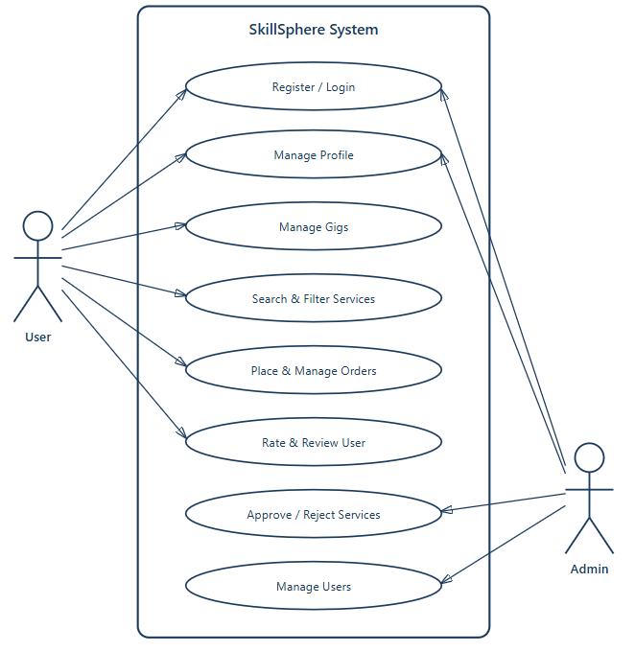
USE CASE DIAGRAM

Slide 14
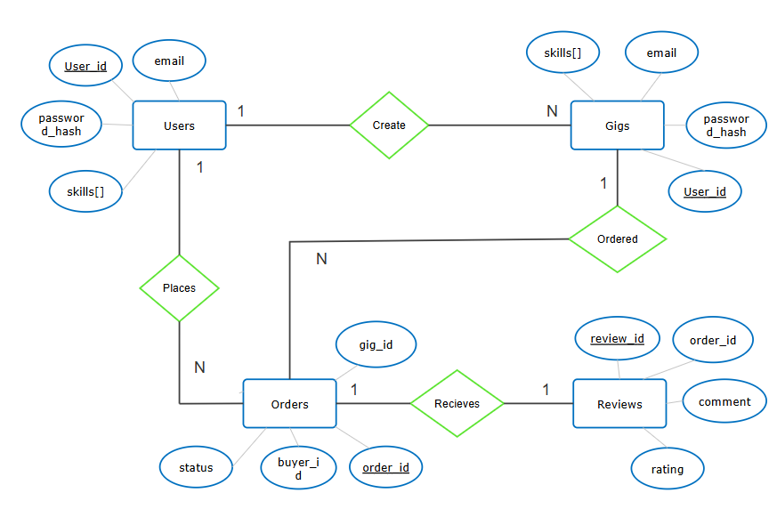
ER DIRAGRAM

Slide 15
SOFTWARE & HARDWARE REQUIREMENTS
SOFTWARE REQUIREMENTS:
- Frontend: React.js (Vite) + Tailwind CSS
- Backend: FastAPI (Python 3.10+)
- Database: PostgreSQL
- API Testing: Swagger UI (FastAPI)
HARDWARE REQUIREMENTS:
- Processor: Intel i5 / Ryzen 5 or higher
- RAM: Minimum 8 GB
- Storage: 10 GB free disk space
- Internet: Required for Cloud Database connectivity

Slide 16
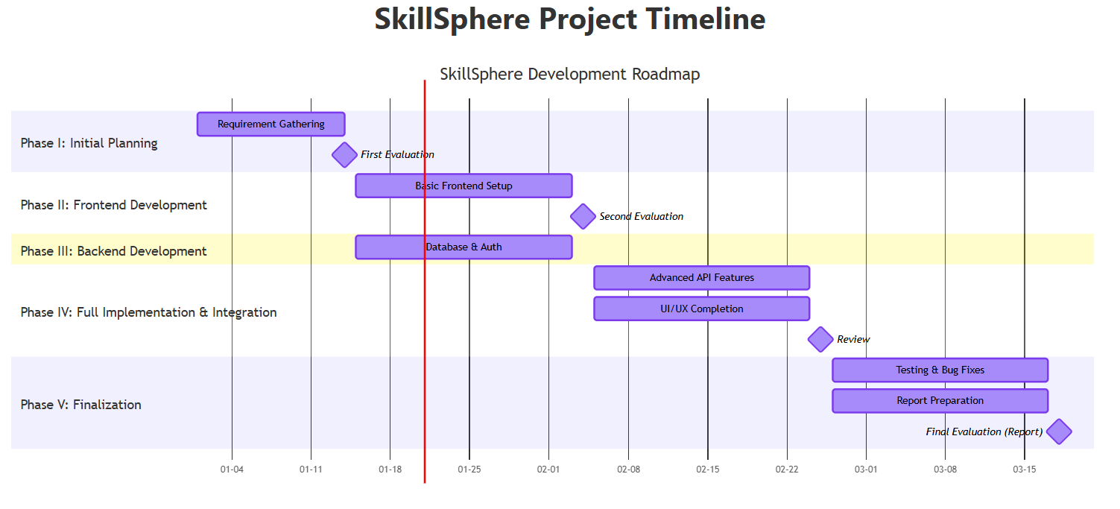
GANTT CHART

Slide 17
CONCLUSION
- SkillSphere successfully creates a micro-economy within the campus.
- It empowers students to earn financial independence using their skills.
- The system uses modern tech (FastAPI + React) to ensure speed and scalability.
- It solves the "Trust" and "Discovery" problems prevalent in current manual methods.

Slide 18
REFERENCES
IRJMETS(2026) Skillify: Peer-To-Peer Barter-Based Skill Exchange
Link: https://www.irjmets.com/upload_newfiles/irjmets80100027351/paper_file/irjmets80100027351.pdf?hl=en-US
(Academic Journal of Research and Scientific Publishing 2024) Career Craft: A Student Training and Freelancing Platform
Link: https://www.researchgate.net/publication/378146344_Career_Craft_A_Student_Training_and_Freelancing_Platform
IJERT(2026). Student Exchange Emporium: Promoting Sustainability
Link: https://www.ijert.org/camplink-a-smart-platform-for-collaborative-networking-and-local-freelance-exchange- among-college-students
IJFMR(2025). Connect Sphere: A Peer-To-Peer Student Marketplace
Link: https://www.ijfmr.com/papers/2025/5/58019.pdf

