Slide 1
git-cherry-pick ‘sha1 of that commit’
Git merge
Git reset –hard head^
Git merge –abort
Git merge –Xours branch1 (takes the code from current branch)
Git merge –Xtheirs branch1 (takes the code from branch which is merging)
Rerere - reuse recorded resolution
git config --global rerere.enabled true

Slide 2
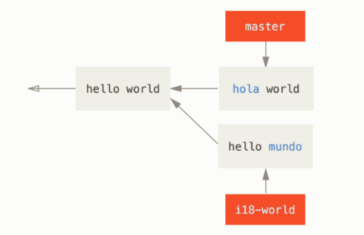

Slide 3
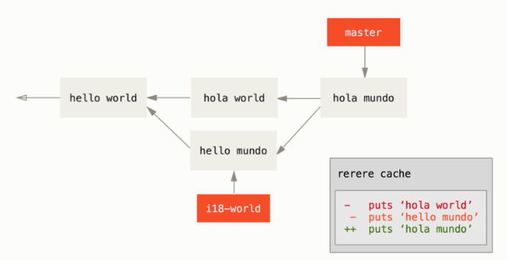
After merging

Slide 4
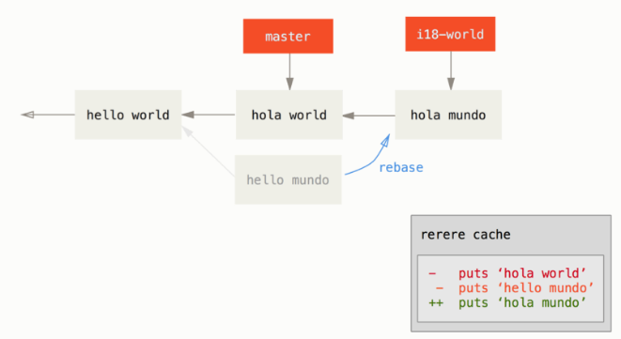
Git reset –hard HEAD^ from master
Git check out branch
Git rebase master

Slide 5
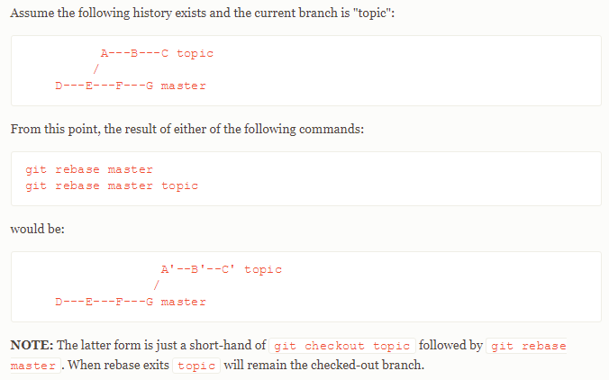
Git rebase

Slide 6
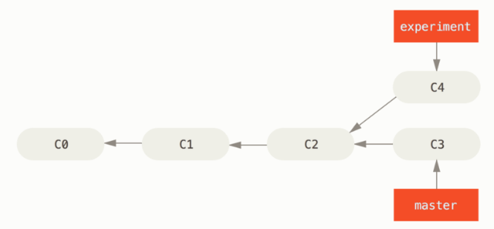

Slide 7
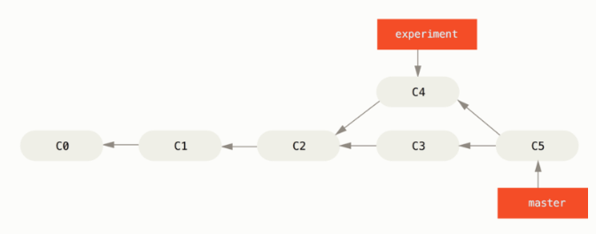
After merging

Slide 8

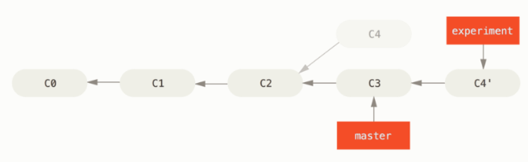

Slide 9

